Slide 1
An introduction to mariadb
Huichao Zhao

Slide 2

INTRODUCTION
Who am I ?
Current:
Sr. Software Engineer in FutureWei@IntelliProGroup
Previous:
Big Data Engineer in MetiStream (2015)
Software Engineer in QuantGroup (2014-2015)
Algorithms R&D Engineer in Tokyo Keiso CO., LTD. ( 2010 – 2014)
PhD in Control Science and Engineering Tsinghua University(2010-2015)
Ping ME
zhaohc10@gmail.com

Slide 3
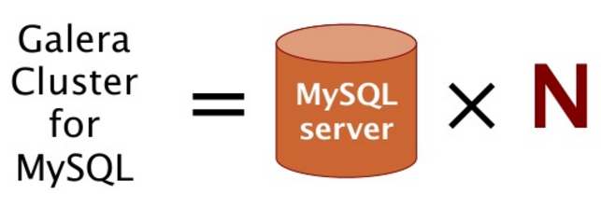

Slide 4
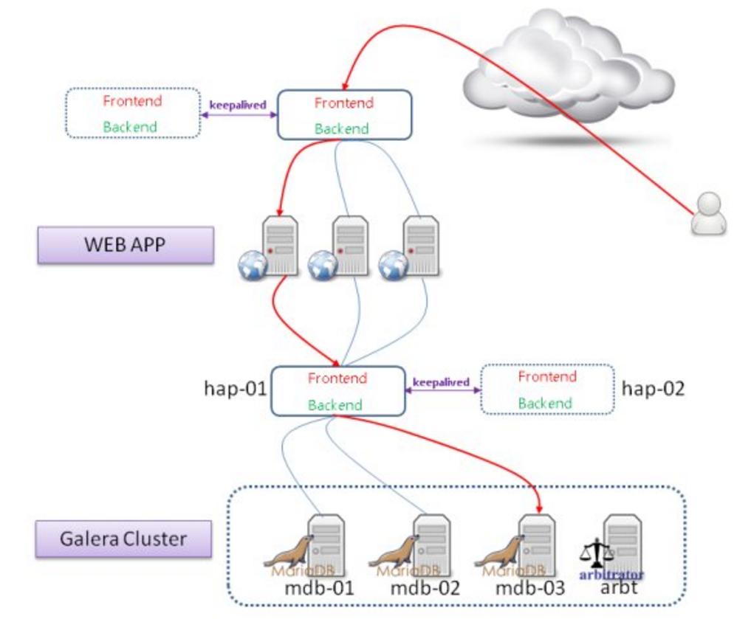

Slide 5
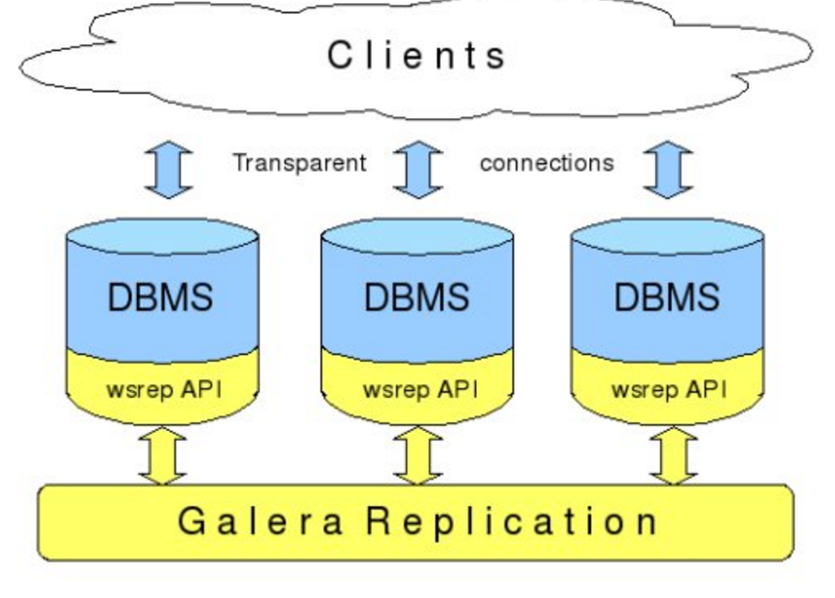
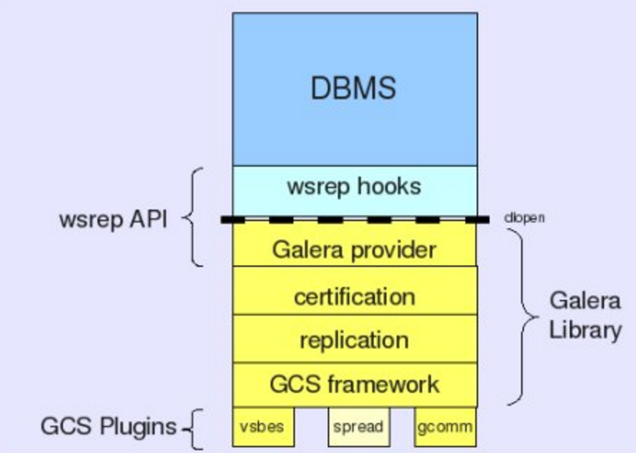
客户端通过Galera Load Balancer访问数据库，提交的每个事务都会通过wsrep API 在所有服务器中执行，要不所有服务器都执行成功，要不就所有都回滚，保证所有服务的数据一致性，而且所有服务器同步实时更新。
http://www.open-open.com/lib/view/open1390482866007.html

Slide 6
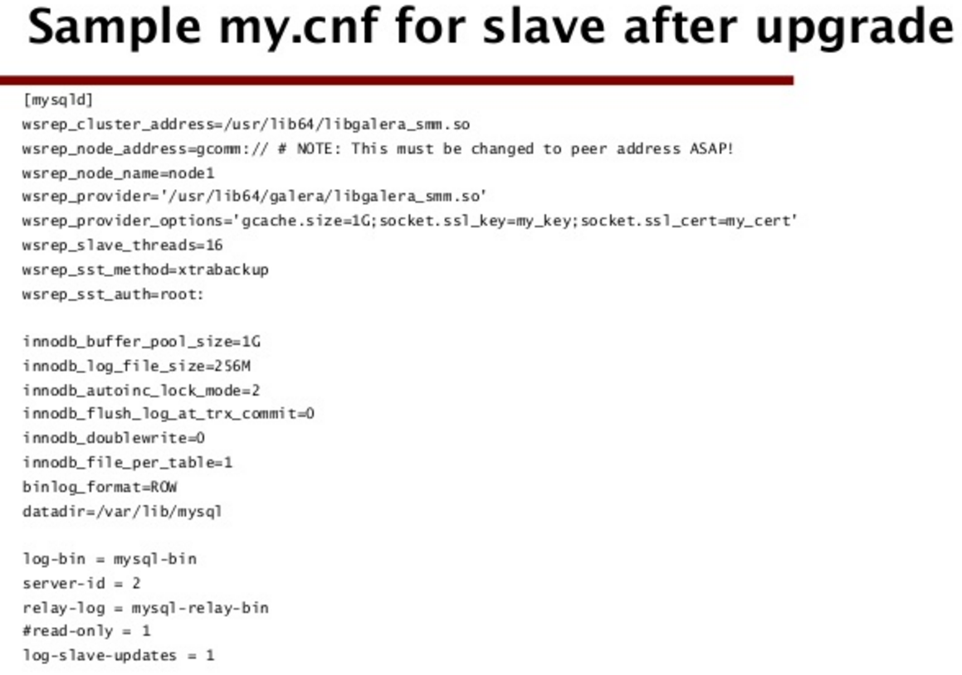

Slide 7
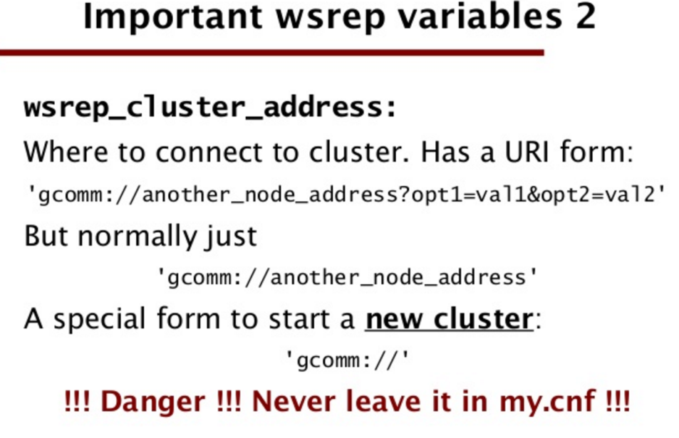

Slide 8
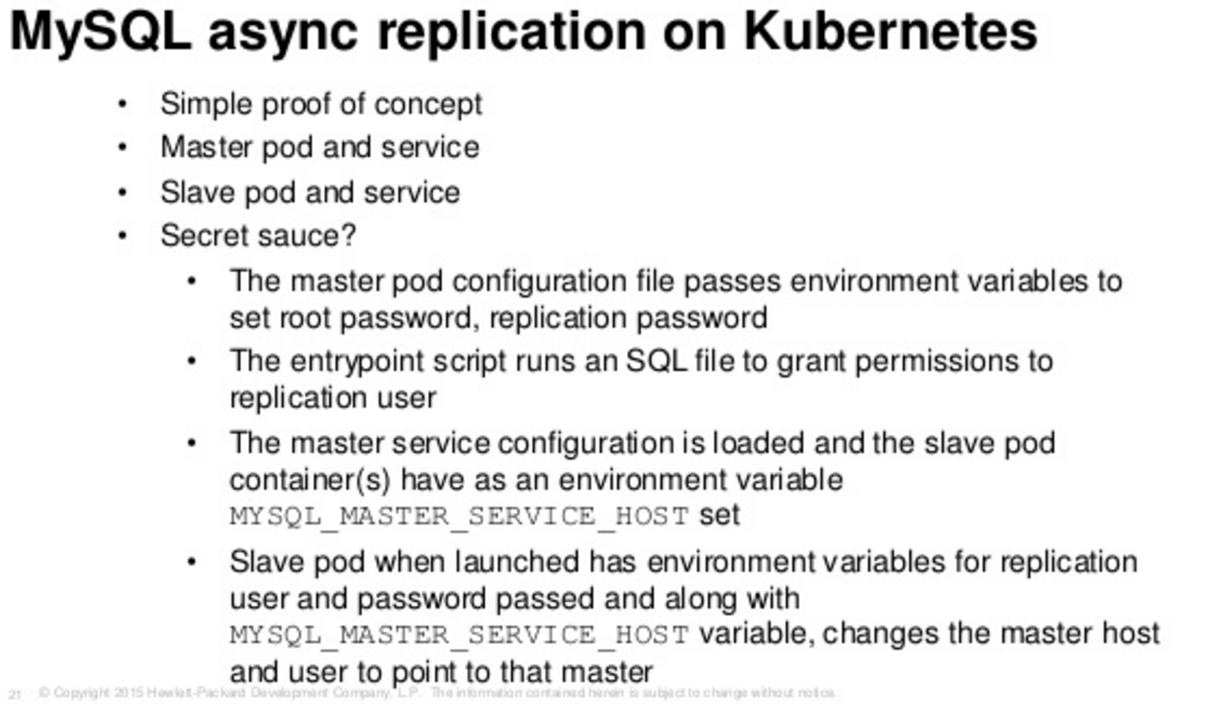
http://www.slideshare.net/PatrickGalbraith/galera-on-kubernetesnovideo

Slide 9
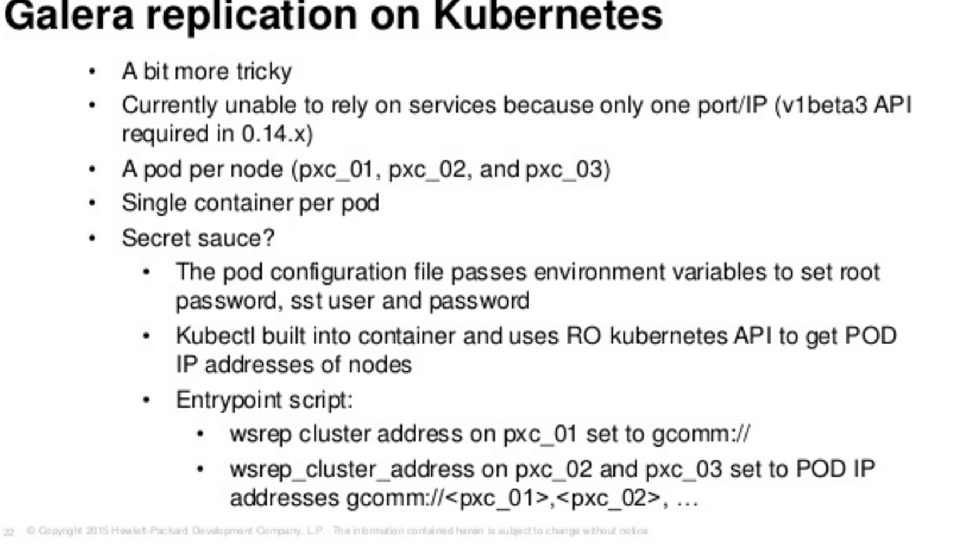
http://www.slideshare.net/PatrickGalbraith/galera-on-kubernetesnovideo

Slide 10
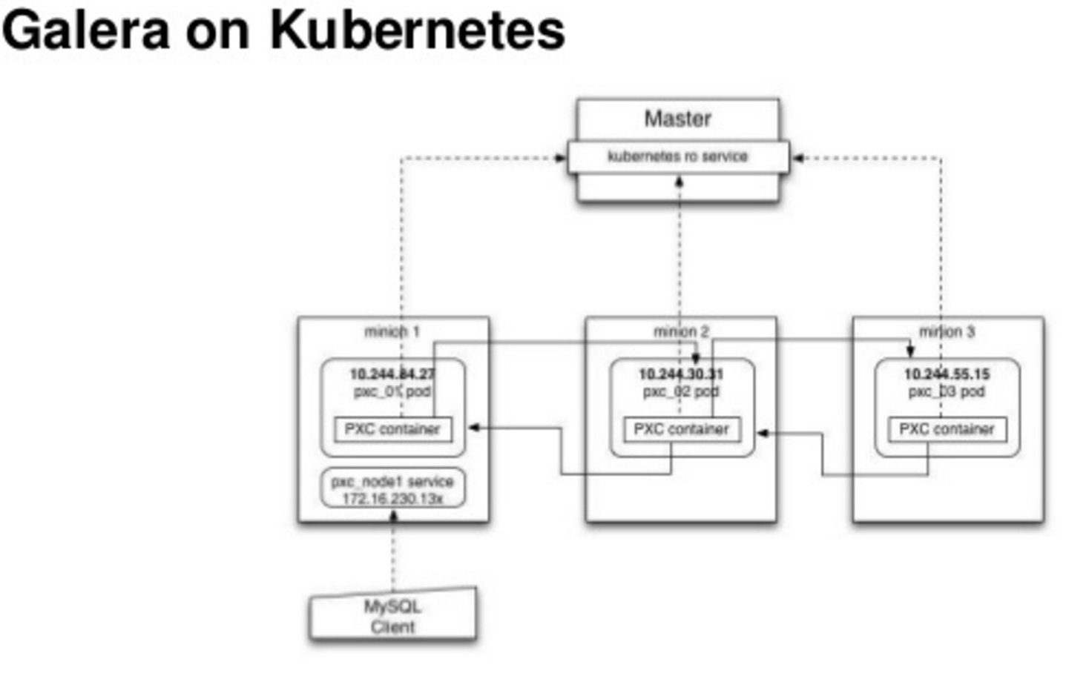
http://www.slideshare.net/PatrickGalbraith/galera-on-kubernetesnovideo

Slide 11
When using the containers (compare below) manually or via the Mesos Marathon galera.json app definition, the seed must be started first. When it is up and healthy, the nodes are started and join theseed node. Then the seed node must be stopped. The other nodes keep running. The reason for this is that the seed node will start a new cluster again when restarted (e.g. by Marathon), even though the other nodes still form a valid cluster. This is probably not what one wants.
http://sttts.github.io/galera/mesos/2015/03/04/galera-on-mesos.html

Slide 12
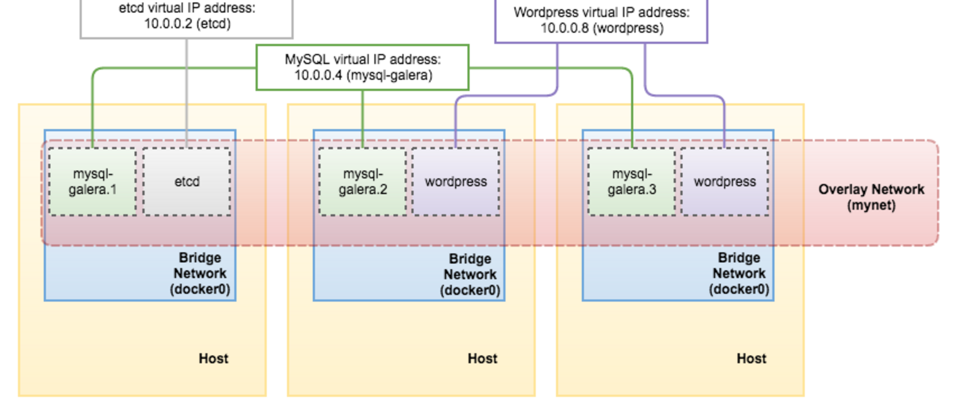
http://severalnines.com/blog/mysql-docker-introduction-docker-swarm-mode-and-multi-host-networking

