Slide 1
An introduction to Golang
Huichao Zhao

Slide 2

INTRODUCTION
Who am I ?
Current:
Sr. Software Engineer in FutureWei@IntelliProGroup
Previous:
Big Data Engineer in MetiStream (2015)
Software Engineer in QuantGroup (2014-2015)
Algorithms R&D Engineer in Tokyo Keiso CO., LTD. ( 2010 – 2014)
PhD in Control Science and Engineering Tsinghua University(2010-2015)
Ping ME
zhaohc10@gmail.com

Slide 3
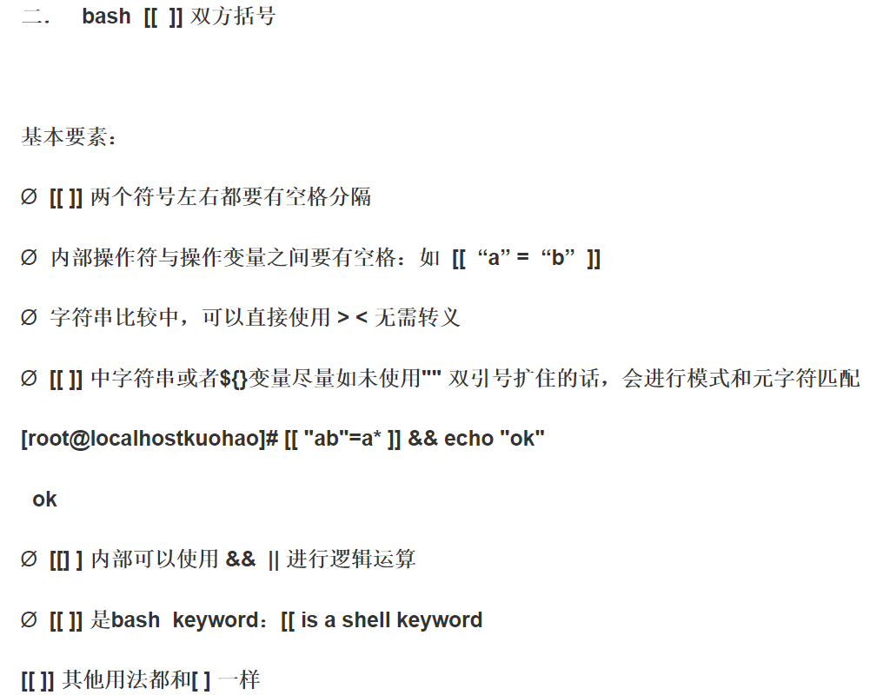
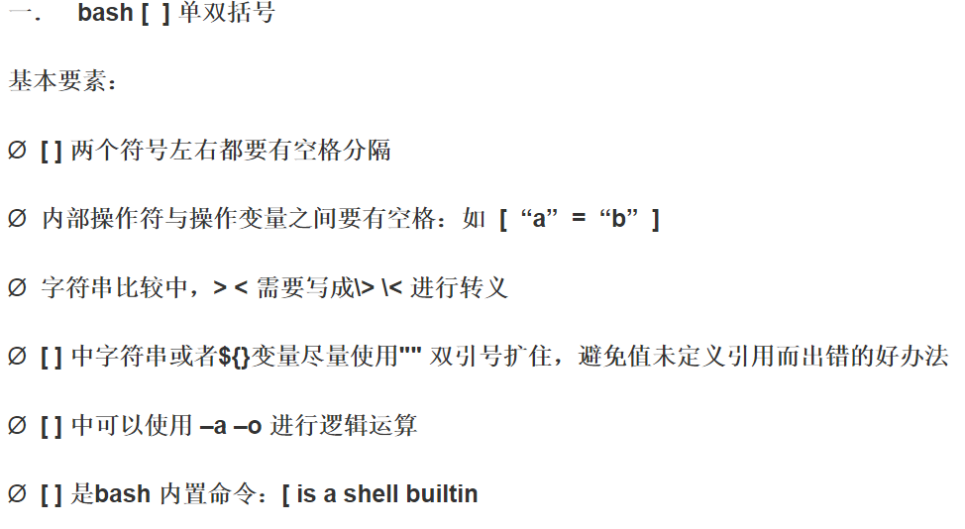
route添加路由 ： 添加到某网段的路由：route add -net desIP rouIP dev eth0 添加到某ip的路由： route add -host desIP rouIP dev eth0

