Slide 1
Overview
Formal Methods Foundation
Baojian Hua
bjhua@ustc.edu.cn

Slide 2
This course is about math…
Lots of different math
Relationship with CS?
A different viewpoint in this course

Slide 3
What’s the math in this course?
Mathematics about programs, language, and systems
  logic, type theory, and semantics
Purpose:
  to have a basic understanding of CS math
  learn how to reason about systems
  learn how to think abstractly
Theory but also practice

Slide 4
History and perspective
Most well-developed:
  From Plato 2000 years ago to Godel now
  Wide applications
Most fruitful
  13 Turing awards (44 totals)
    7 theory and algorithm
    4 AI
    3 database

Slide 5
History and perspective, cont’
Top US CS departments:
  M.I.T, CMU, Berkeley, Princeton, Harvard, Upenn, …
  this course’s material is based (roughly) the same content there!
Top mainland CS departments
  ios, USTC, Tsinghua, Pku, …

Slide 6
How This Course Works

Slide 7
Structure of this course
Practice first
  assigned one week before, submit one week later
Lectures
  On blackboard lecture, few slides
Exercises & test

Slide 8
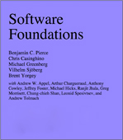
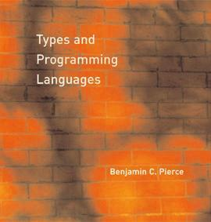
Textbooks & Reference
A book draft:

Slide 9
Grading
40% for homework exercise
20% for middle test I
20% for middle test II
20% for final test

Slide 10
Summary
This is a practice-oriented theory course
Stay engaged, and it is addictive

Slide 11
Last Thing
Install the software
Read the online book
And do assignment #1

