Slide 1
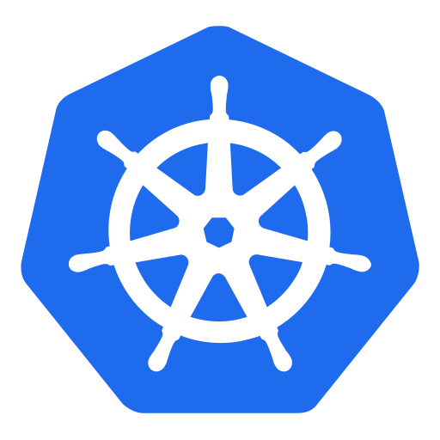

HELM
Application deployment management for Kubernetes

Slide 2

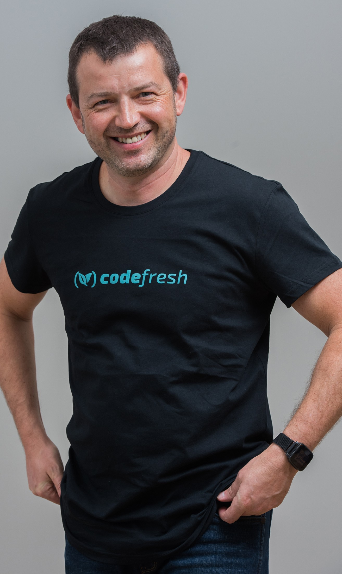
About me…
Chief of Research @codefresh.io
github.com/alexei-led/pumba
github.com/codefresh-io/microci
#docker #k8s #golang #aws
medium.com/@alexeiled
@alexeiled

Slide 3
Kubernetes recap

Slide 4
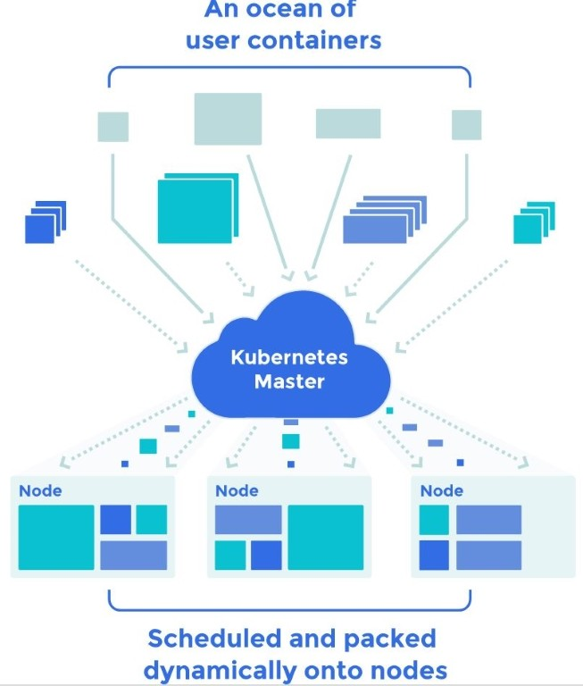
What is Kubernetes?
Kubernetes is container orchestration. It’s how to run containers at scale.
It’s a very active open-source platform with lots of contributors
Originally developed by Google and donated to Cloud Native Computing Foundation (Linux Foundation)

Slide 5
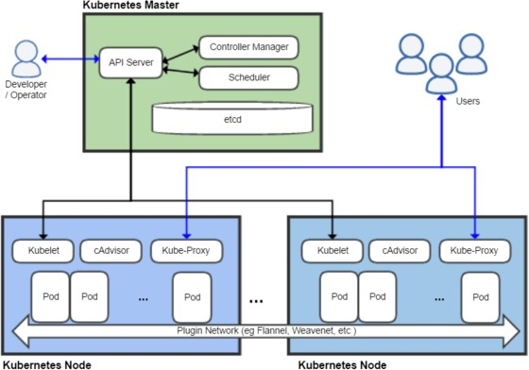
K8s Architecture

Slide 6
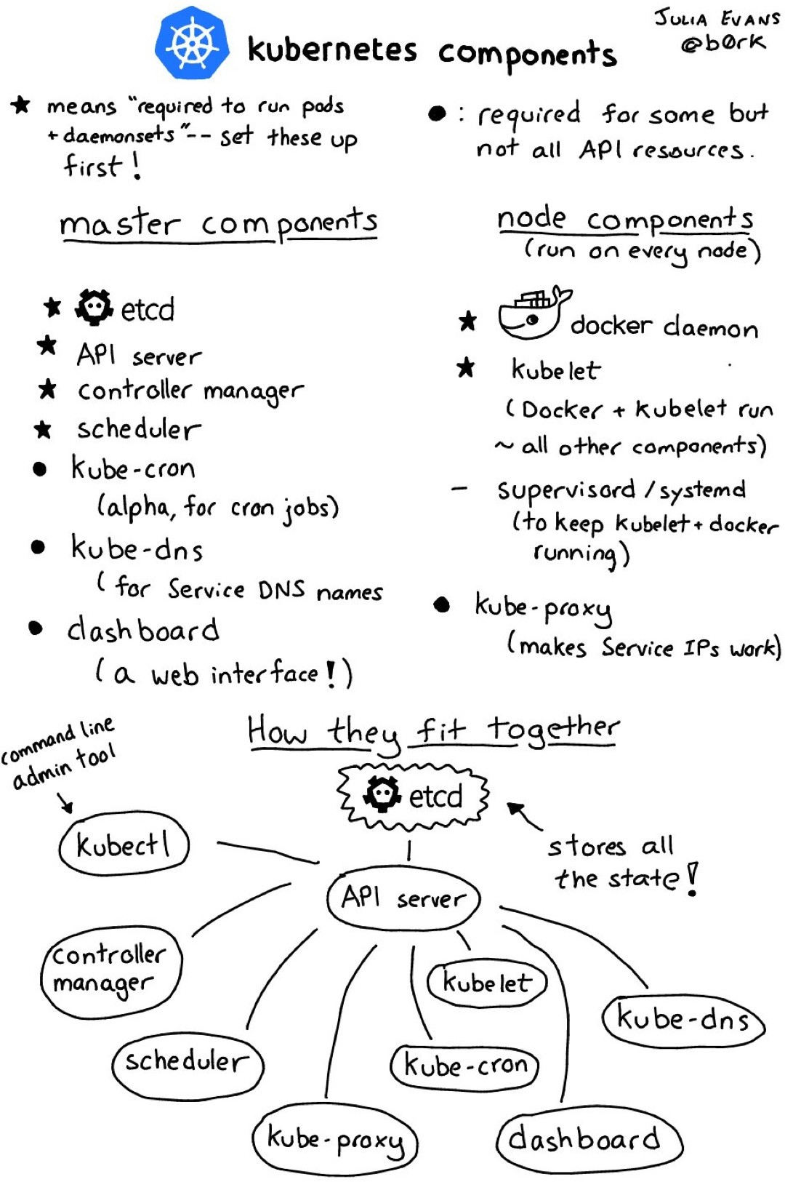

Slide 7
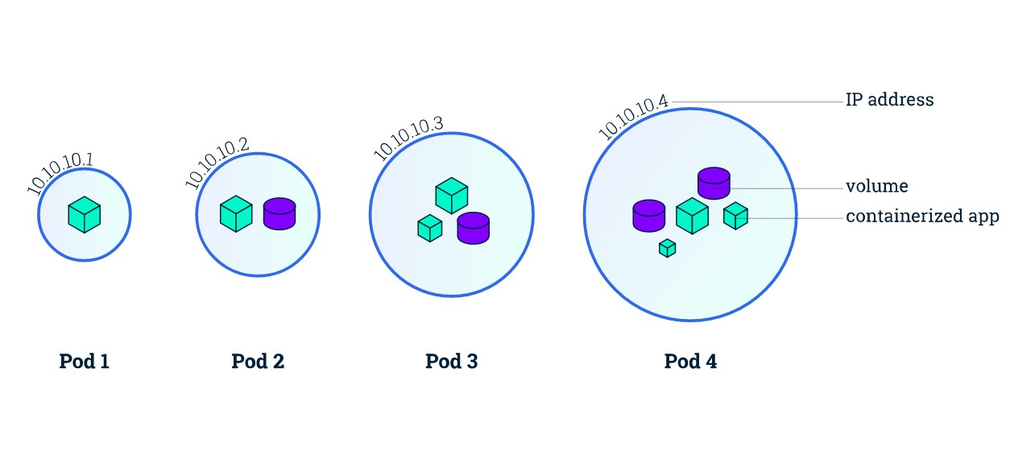
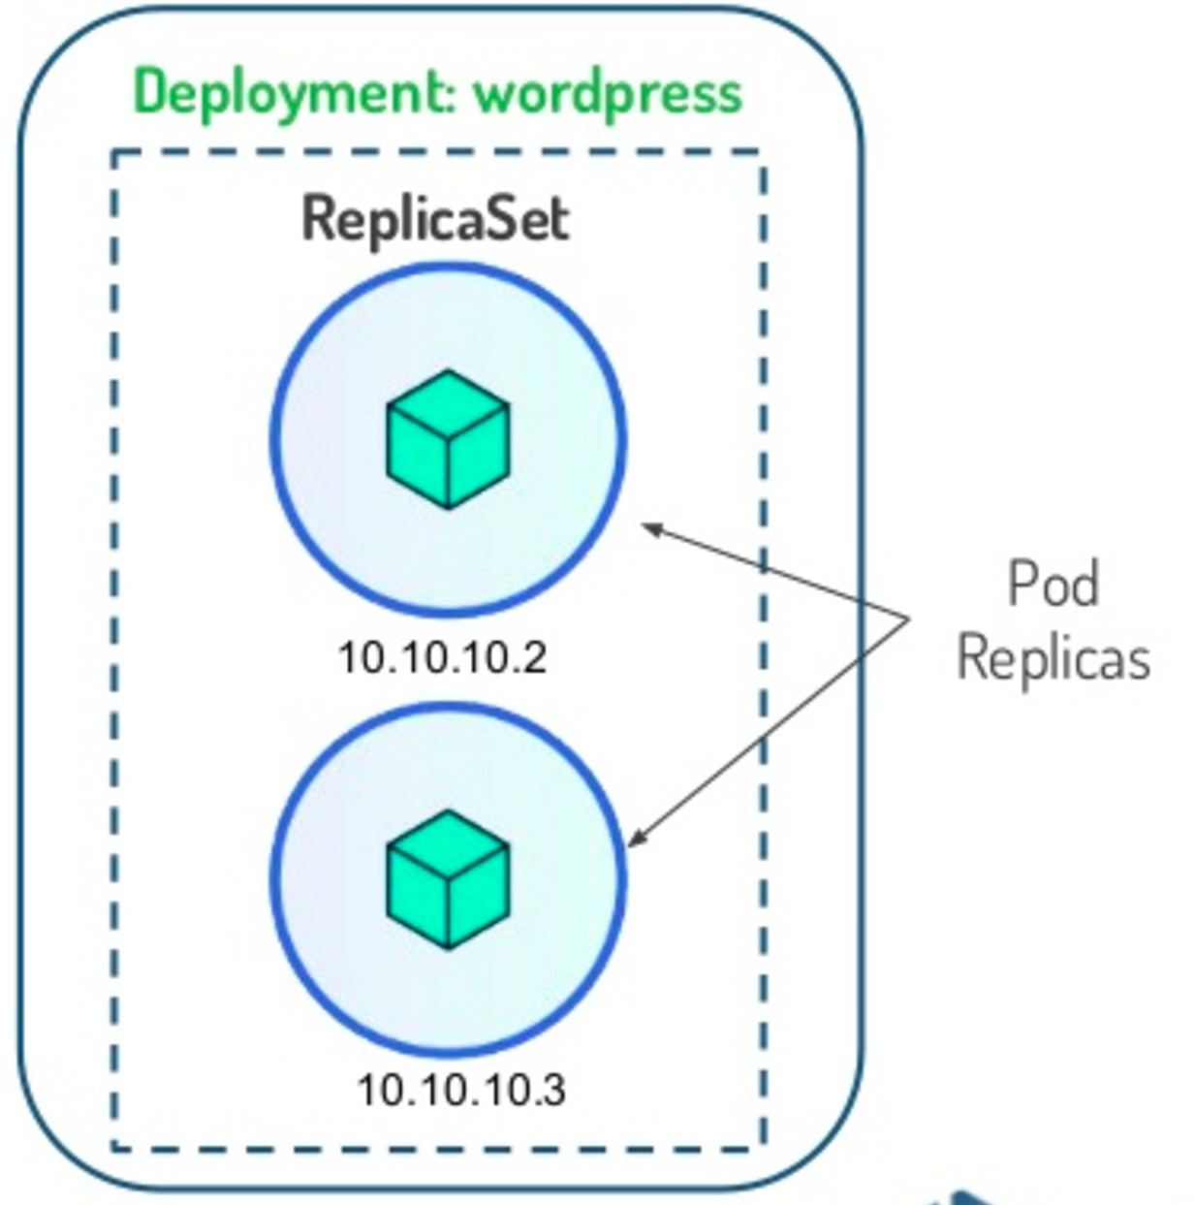
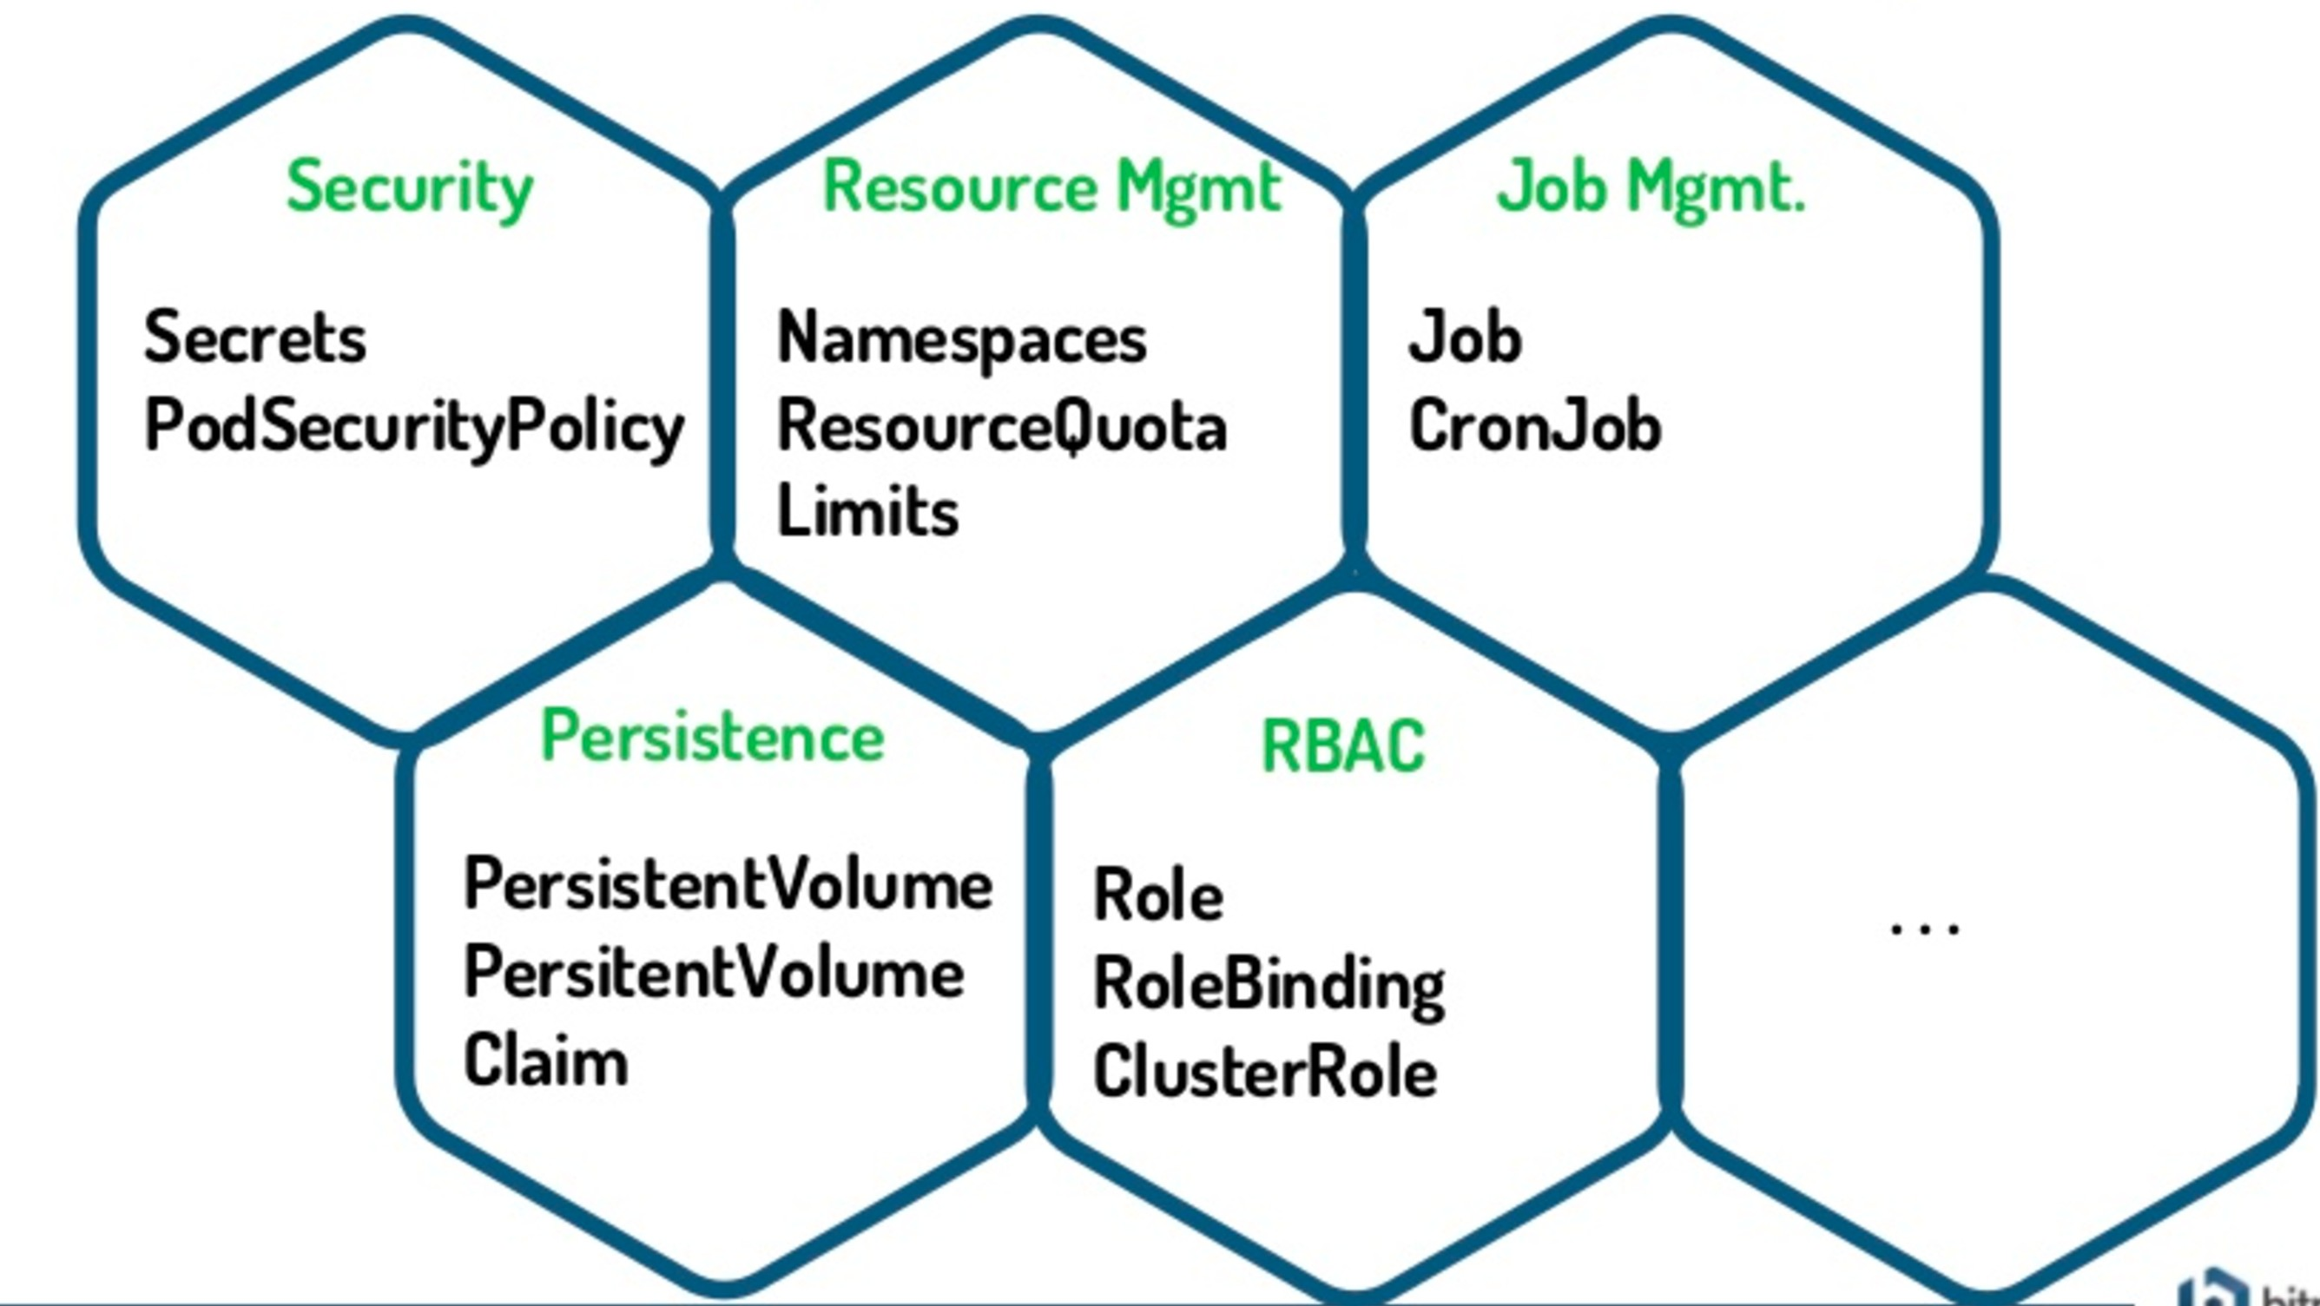

Kubernetes Objects
wordpress service
210.14.128.31

Slide 8
K8s Deployment Challenges
Move to microservice architecture
application consists from multiple components
each component has its own resources and can be scaled individually
It’s hard to …
… manage, edit and update multiple K8s configurations
… deploy multiple K8s configuration as a SINGLE application
… share and reuse K8s configurations and applications
… parametrize and support multiple environments
… manage application releases: rollout, rollback, diﬀ, history
… define deployment lifecycle (control operations to be run in diﬀerent phases)
… validate release state after deployment

Slide 9
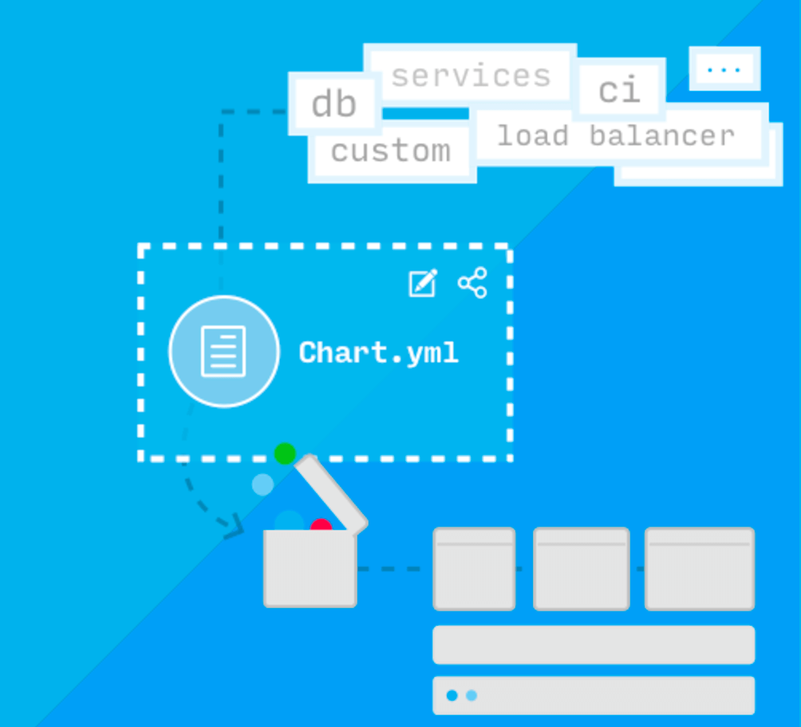
Helm makes it easy to start using
Kubernetes with real applications

Slide 10
What is Helm?
Helm is a Package Manager for Kubernetes
package multiple K8s resources into a single logical deployment unit: Chart
… but it’s not just a Package Manager
Helm is a Deployment Management for Kubernetes
do a repeatable deployment
management dependencies: reuse and share
manage multiple configurations
update, rollback and test application deployments (Releases)

Slide 11
Helm Dictionary
Chart - a package; bundle of Kubernetes resources
Release - a chart instance is loaded into Kubernetes
same chart can be installed several times into the same cluster; each will have it’s own Release
Repository - a repository of published Charts
Template - a K8s configuration file mixed with Go/Sprig template

Slide 12
kubernetes/helm
Helm was jointly started by Google and Deis
Helm is a Kubernetes project now (managed by CNCF)
Active community: Google, Microsoft, Bitnami, …
kubeapps.io - curated list (repository) of Helm Charts
Works with any K8s cluster: K8s, Minikube, GKE, ACS, …

Slide 13
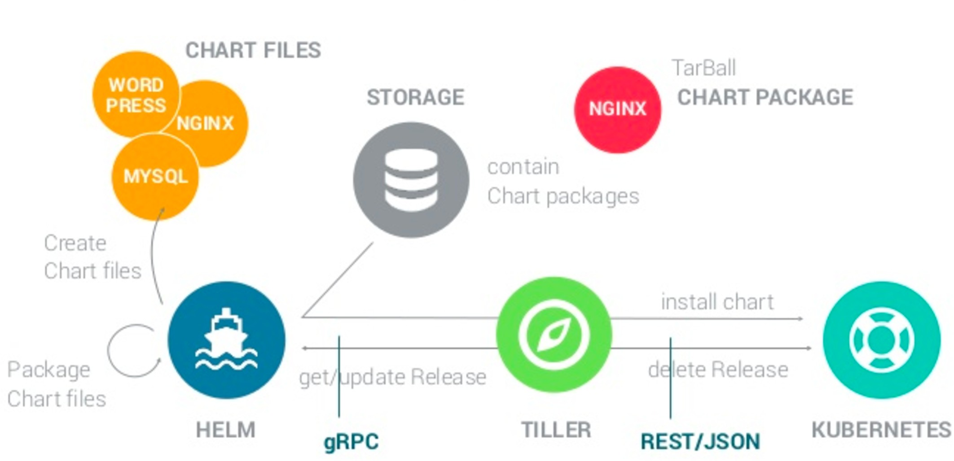
Helm Architecture
$ helm init

Slide 14
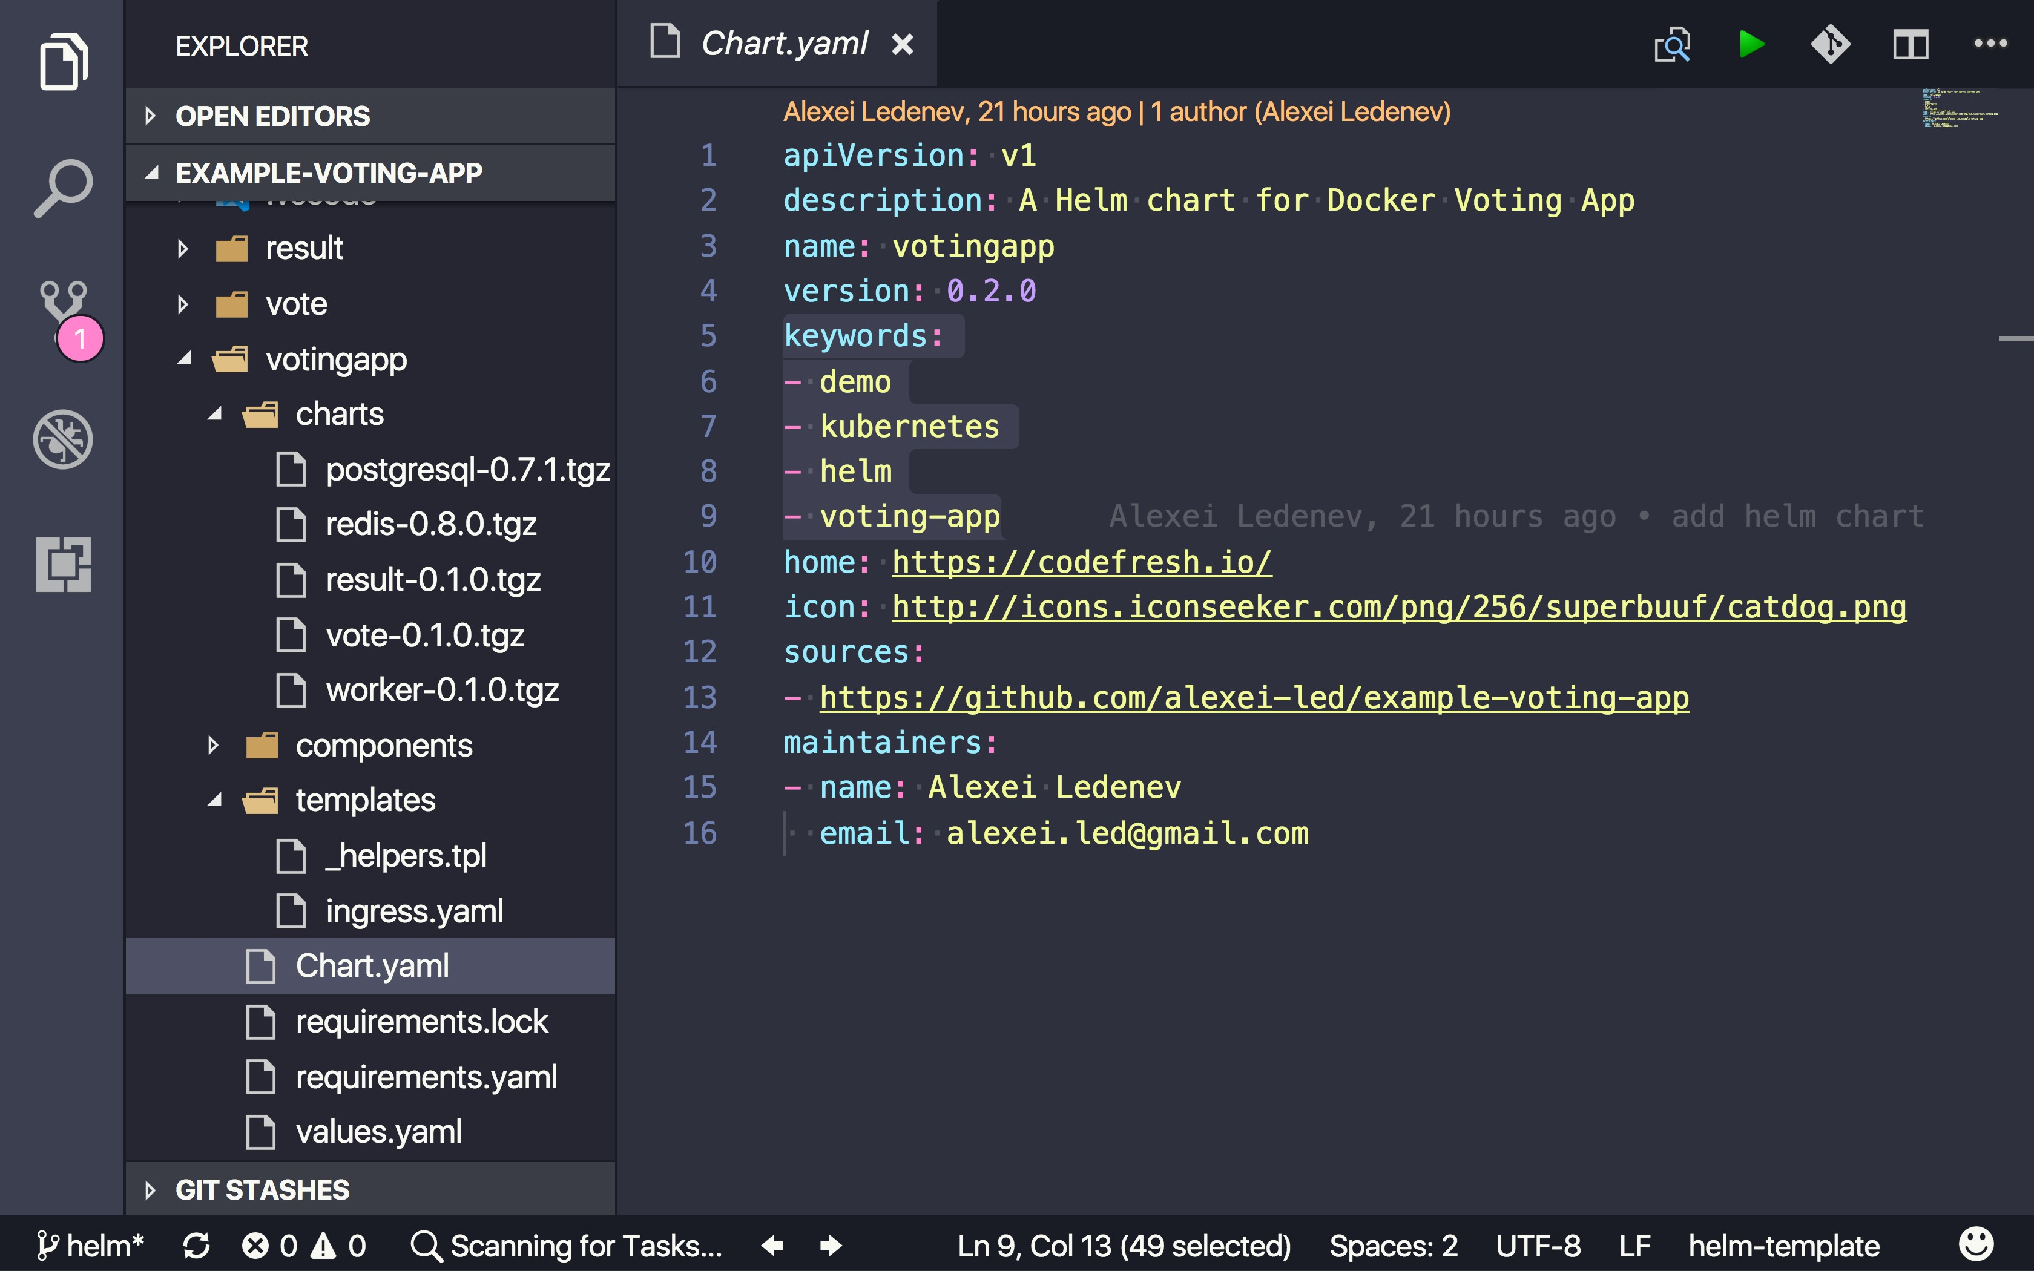
Chart Project Structure

Slide 15
Using Helm
# install helm client
brew install kubernetes-helm
# install helm server
helm init
# show help
helm --help
# show helm version
helm version
# install shell autocompletion; add it to .bashrc
source <(helm completion bash)
# create new chart
helm create mydemo
# deploy new release
helm install --name myrelease mydemo --namespace demo
# list all releases
helm list --all

Slide 16
Dependency Management
Helm subcharts
requirements.yaml
helm dependency --help

Slide 17
Templates
The Go Template language: {{.foo | quote}}
Variables, simple control structures (looping, conditionals, nesting)
Pipelines - chain together templates functions
50+ functions from Go/Sprig Template libraries
date, string, conversions, encoding, reflection, data structures (list, dict), math, crypto, semver

Slide 18
Values
Specify values that should be injected into templates
Simple YAML with “namespaces”
Each subchart can have its own values.yaml file
Can use multiple Values files
Can override individual value for install/update

Slide 19
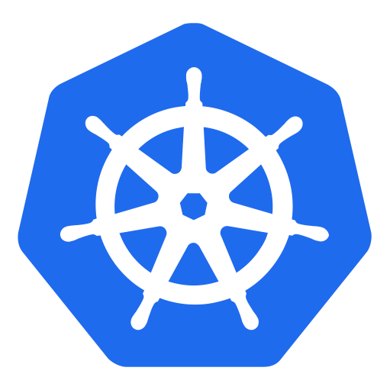
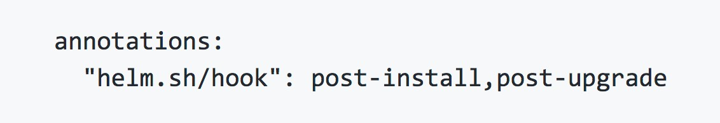
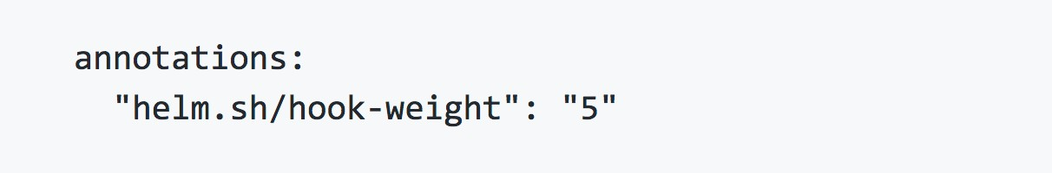
Helm Hooks
Perform "operation" at specific point of release lifecycle
"Operation" can be any K8s resource: job, config-map, secret, pod, ...
pre/post-install pre/post-delete
The resources that a hook creates are not tracked or managed as part of the release
pre/post-upgrade pre/post-rollback
...

Slide 20
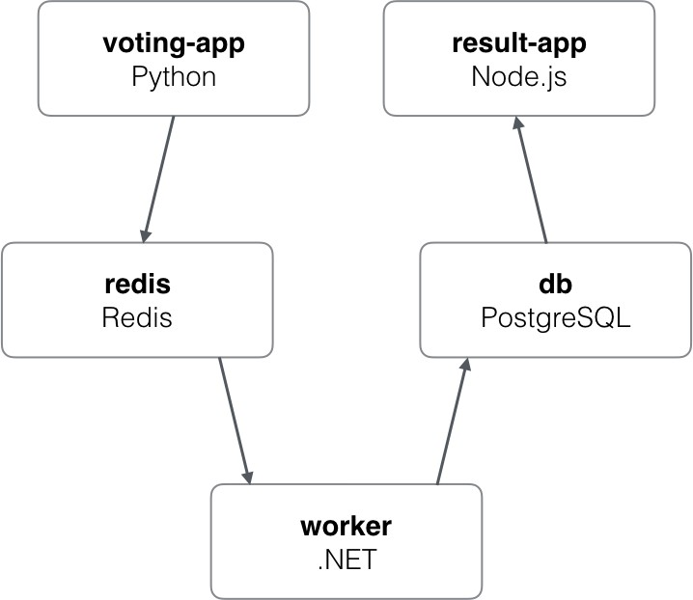

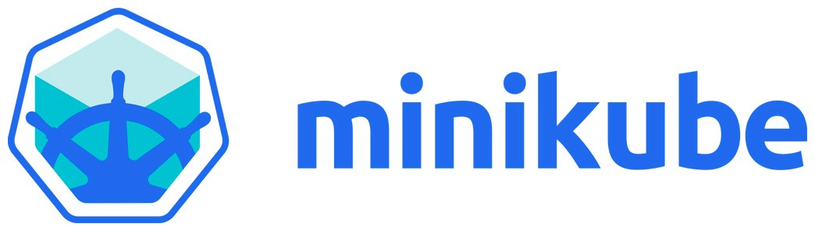
Demo: Voting App
https://github.com/alexei-led/example-voting-app/tree/helm

Slide 21
Helm Tips
Create Chart for each (micro)service; keep it in same Git repository
Learn and practice Go Template language (and Sprig template library) 3.Use Helm hooks to control release flow
Use helm test to validate releases
Host your own Helm repository for private charts; just serve index.html and packaged charts (can be hosted on AWS S3, Google Storage, GH pages, or other web server)
Manage environments with multiple Values files
7.(!) Do not commit secrets into GitHub; or encrypt secrets with sops or similar tool
Follow community Helm best practices and conventions: take a look at docs and kubernetes/ charts examples
Use helm template plugin to debug Helm Charts; or use --dry-run flag

Slide 22
Helm Weaknesses
Project relative immaturity - it's a young project
No built-in environment support
Non informative logs on failures (it's also a K8s issue)
Weak linter: too many errors skip linter checks
Open Issues:
subcharts are ignored when there is a requirements.yaml
the --recreate-pods tag is does not recreate pods of statefulsets

Slide 23

