Slide 1
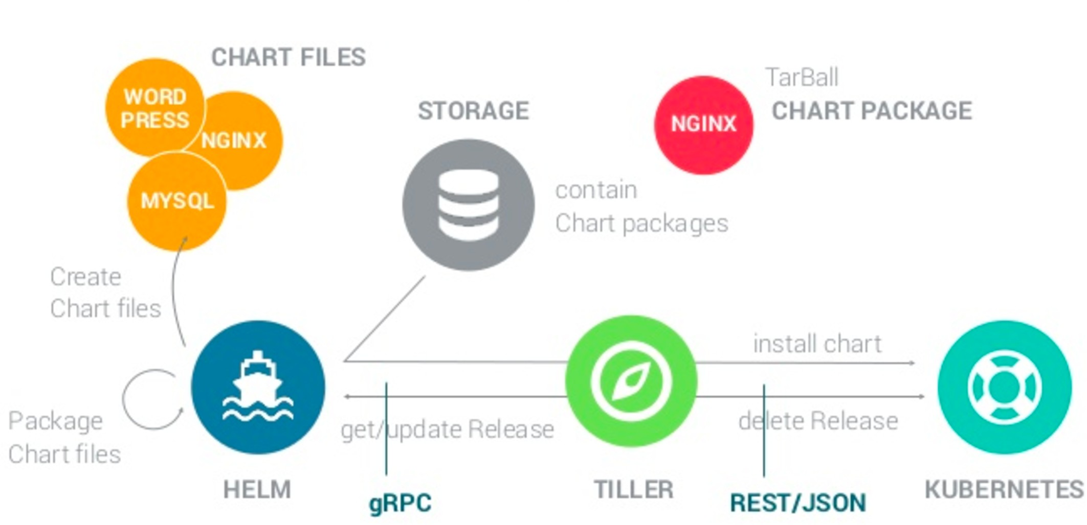
Package
REPOSITORY

