Slide 1
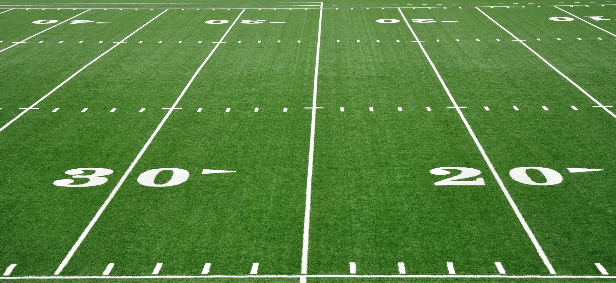
NFL Play Predictions
Will Burton, NCSU Industrial Engineering 2015
Michael Dickey, NCSU Statistics 2015

Slide 2
Motivation
Method
If an offensive play call can be predicted, then the defense can adjust their formation to potentially shut down the offense
Research classification methods
Gather and clean NFL play by play data
Exploratory analysis and significance testing
4) Model building
5) Implement models in R Shiny
Application
Notes:
Only used Pass and Run plays, Excluded all other play types. ex. Punt, Field goal, extra pt, etc
Gather and clean NFL Play By Play data from ArmChair Analysis
Research Logistic Regression and Random Forest
Perform variable selection
Formulate optimal models
Create Interactive Shiny Web app

Slide 3
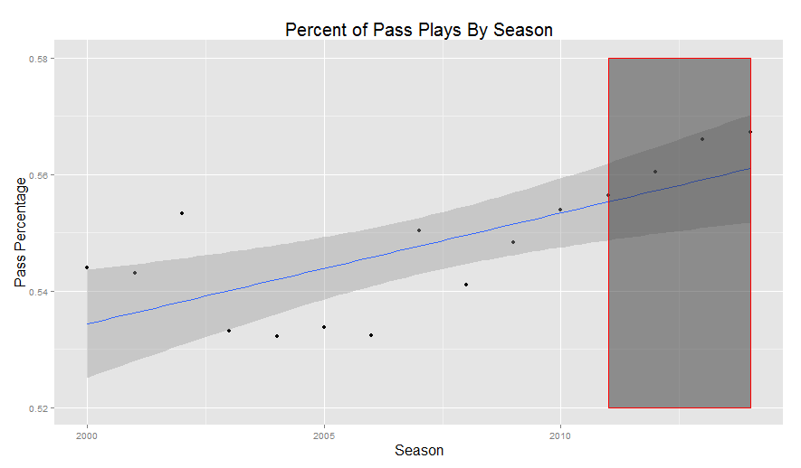
Data Characteristics
Final Variables Used For Modeling
Source: ArmchairAnalysis.com
NFL plays from 2000 – 2014 seasons
132,220 observations (trained using only 2011-2014 seasons)
Down
Field Position
Yards to Go
Cumulative Number Interceptions
Cumulative Number Fumbles
Cumulative number of sacks
Down * Yards To Go
Number Offensive Points
Number Defensive Points
Point Differential
Offensive Timeouts Remaining
Defensive Timeouts Remaining
Minutes Remaining in Quarter
Previous play call
Quarter

Slide 4
Logistic Regression
Additional Steps to Final Model:
Adjust for non-linearity
Perform forward selection
Reduce overfitting with Lasso Penalty
Cross-Validation
Final Model Created For:
1st Quarter 4th Quarter Winning
2nd Quarter 4th Quarter Losing
3rd Quarter 4th Quarter Tied
Notes:
found relevant examples: http://analytics.ncsu.edu/sesug/2009/SD016.Sampath.pdf
ex. cumulative number fumbles, interceptions and sacks, down*yards to go, two minute warning, 3rd and One, etc.
2) Perform significance testing: use chi square for discrete and individual modeling for continuous
3) Here's what the boosting interaction function found. It does a Friedman's H-Statistic test where a value closer to 1 indicates a significant interaction while a value close to 0 is very insignificant:
4) Looked at probabilities at different values of the continuous independent variables
5) Used forward selection
6) Used lasso and cross validation to pick optimal lambda R package glmnet
4) Variable selection
5) Find optimal model parameters

Slide 5
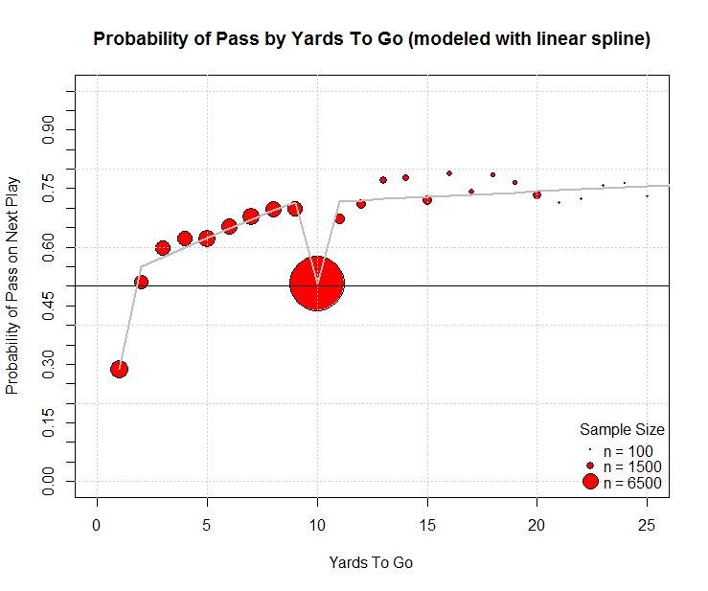
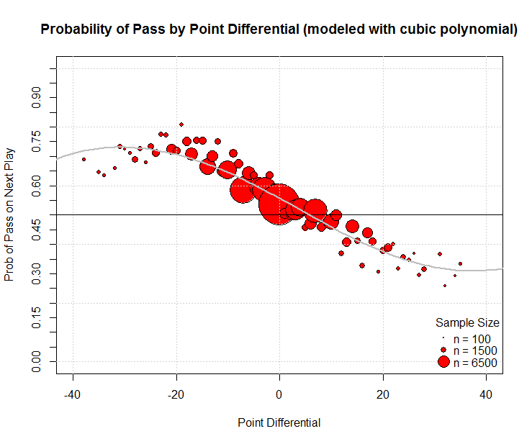
Non-Linearity of Odds

Slide 6
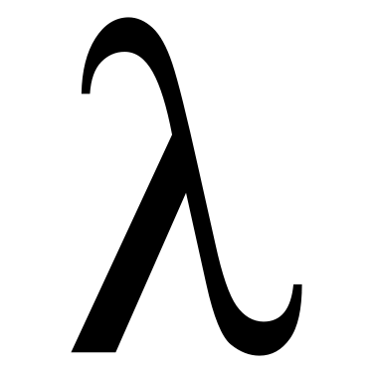
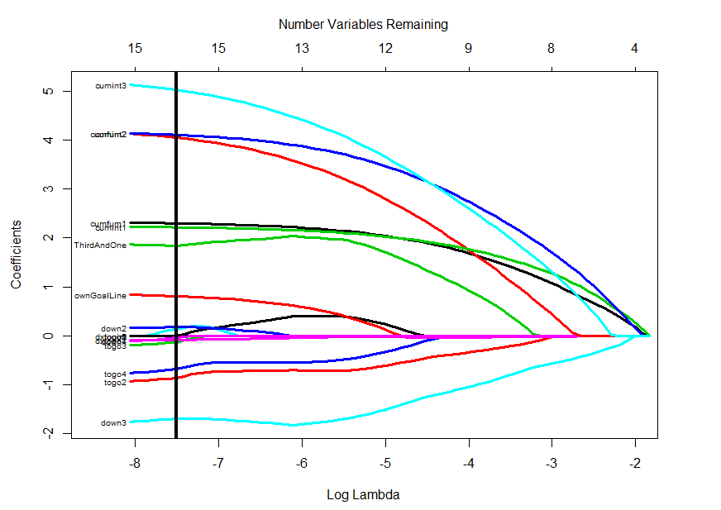
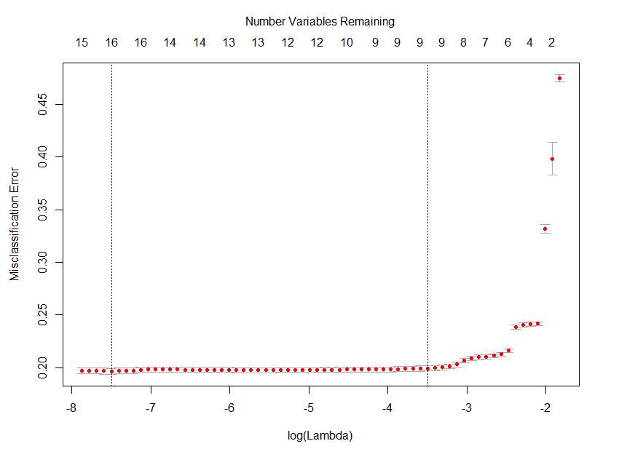
Lasso and Cross-Validation
1st Quarter model
Lasso
C-V for

Slide 7
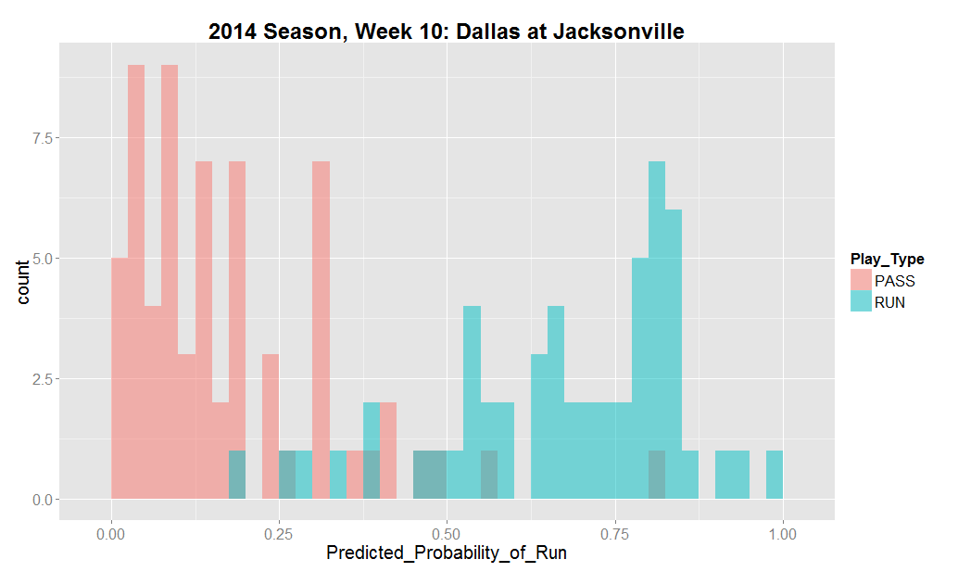
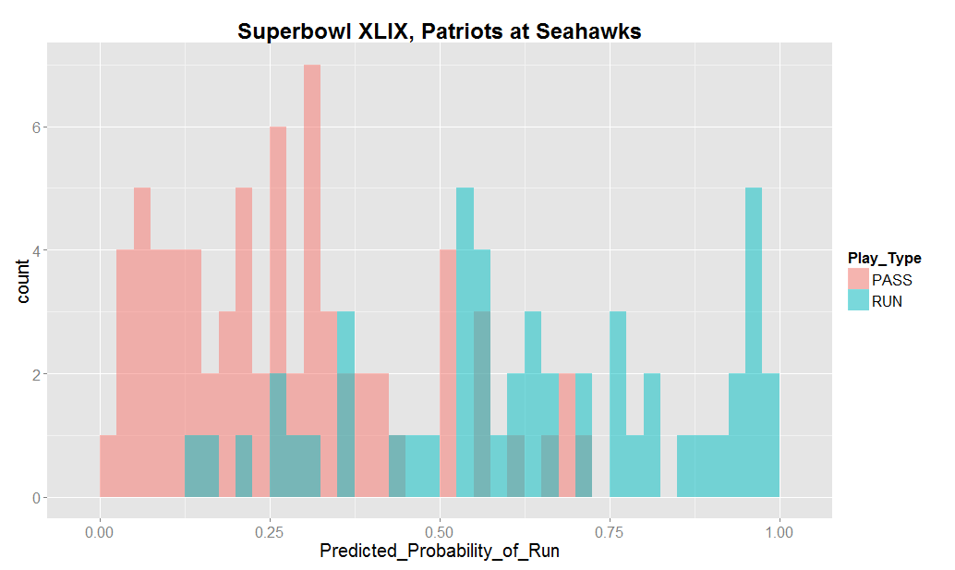
Results
Tested on 20 randomly selected games between 2011- 2014:
Mean Accuracy Rate: 75.4% Correct
Highest Accuracy Rate: 91.4% Correct
 | Actual Pass | Actual Run
Pred Pass | 59 | 13
Pred Run | 12 | 37
 | Actual Pass | Actual Run
Pred Pass | 63 | 8
Pred Run | 2 | 46
79.3% Correct
91.4% Correct

Slide 8
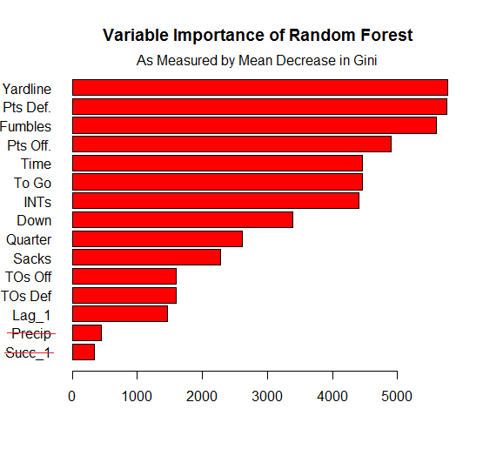
Random Forest
Tuning Parameters:
Number of candidate splitting variables
Maximum number of nodes
Cutoff threshold
Variable Selection
Assess importance of variables with Gini Index
Informal process of trial and error
Variable importance expressed as the mean decrease in Gini index

Slide 9
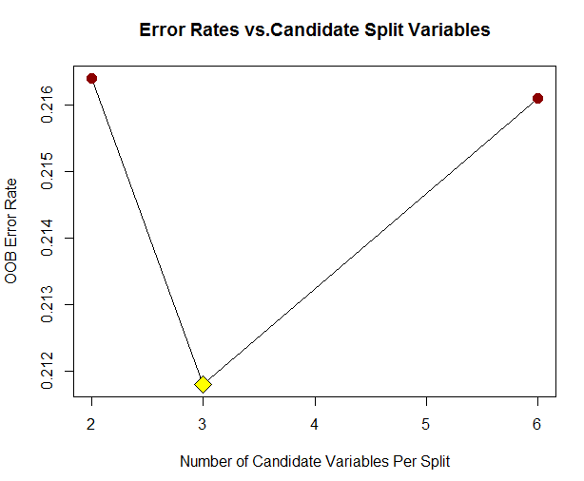
Tuning Parameters
Candidate Splitting Variables:
Compare OOB error rates
Maximum Nodes:
Trees grown to maximum depth
Determined via experimentation
Cutoff Threshold:
Use Youden index to maximize (Specificity + Sensitivity)
tuneRF: {randomForest}

Slide 10
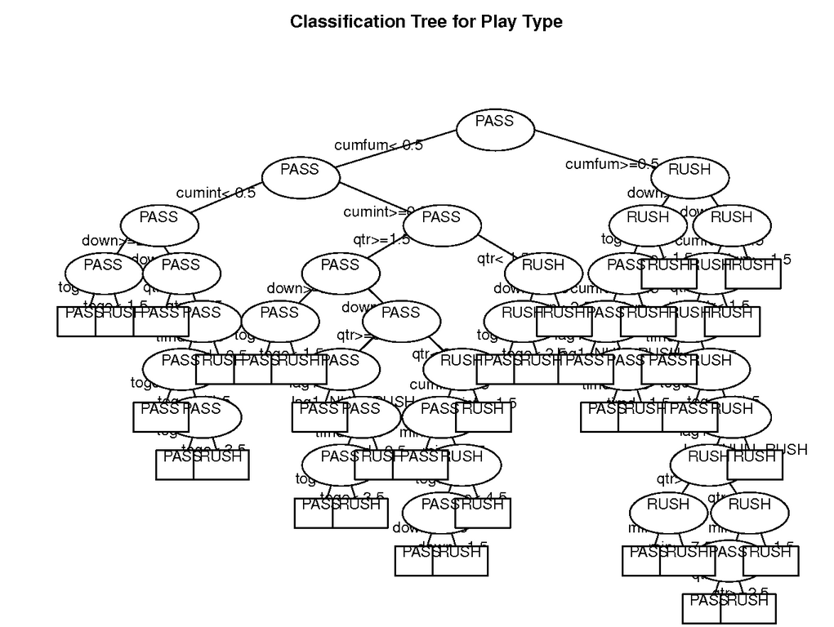
Tuning Parameters
Candidate Splitting Variables:
tuneRF: {randomForest}
Maximum Nodes:
Trees grown to maximum depth
Determined via experimentation
Cutoff Threshold:
Use Youden index to maximize (Specificity + Sensitivity)
Trees are overgrown to promote variability!

Slide 11
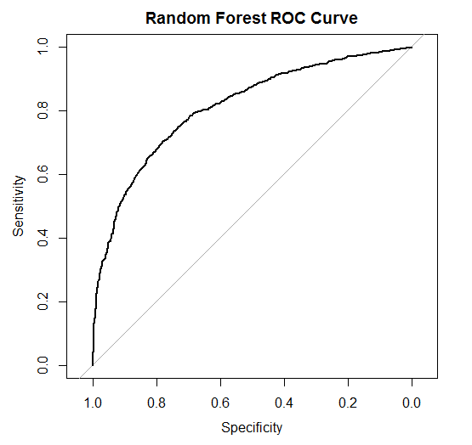
Tuning Parameters
Candidate Splitting Variables:
tuneRF: {randomForest}
Maximum Nodes:
Trees grown to maximum depth
Determined via experimentation
Cutoff Threshold:
Use Youden index to maximize (Specificity + Sensitivity)
coords: {pROC}

Slide 12
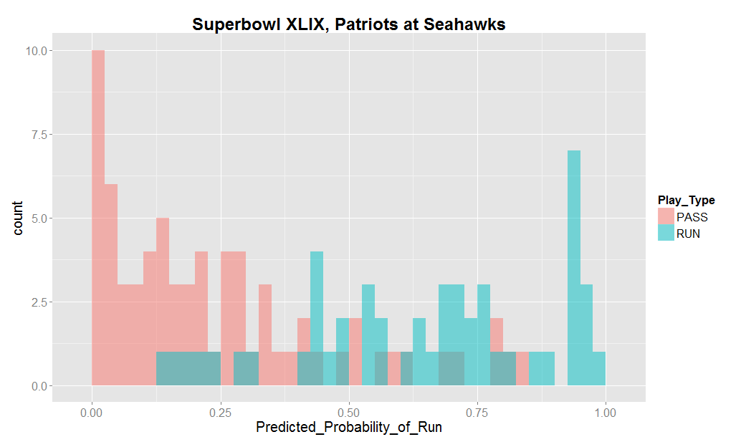
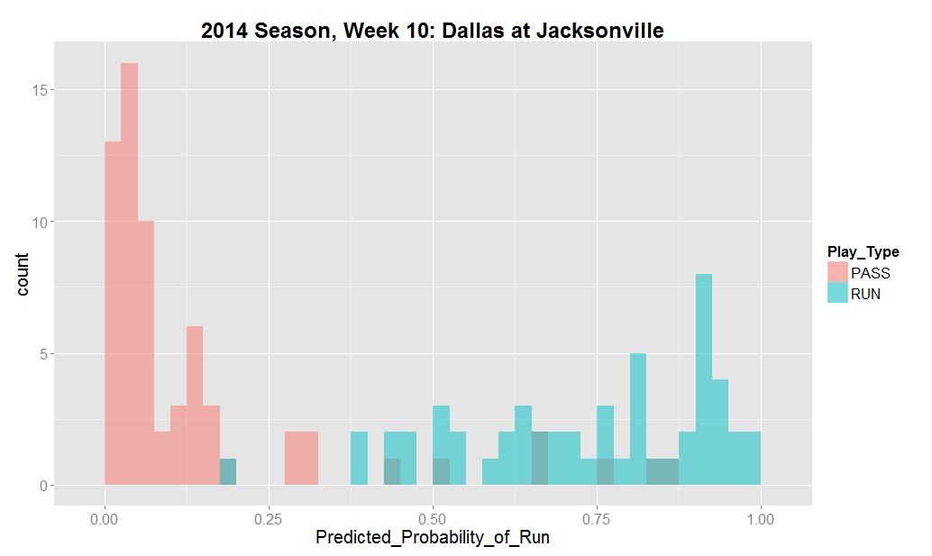
Results
Tested on 20 randomly selected games between 2011- 2014:
Mean Accuracy Rate: 74.5% Correct
Highest Accuracy Rate: 89.1% Correct
 | Actual Pass | Actual Run
Pred Pass | 59 | 7
Pred Run | 6 | 47
 | Actual Pass | Actual Run
Pred Pass | 60 | 15
Pred Run | 11 | 35
89.1% Correct
78.5% Correct

Slide 13
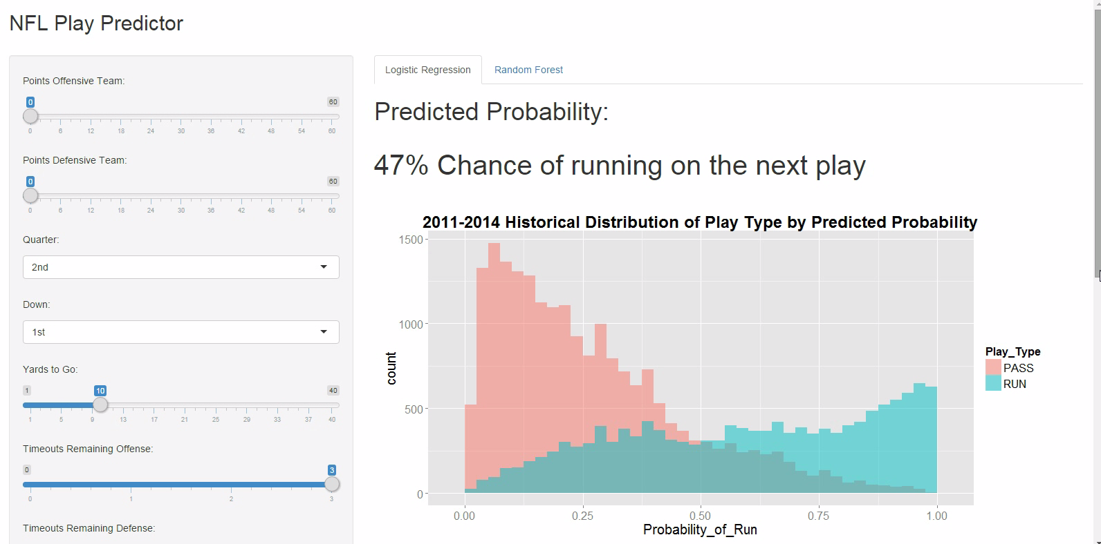
Visualizing Predictions
R Shiny visualization demo
Plotting the predictions within one new game (try for Super Bowl 2015)

Slide 14
Results and Conclusions
You can predict NFL plays with high accuracy using simple variables!
Model building processes are much different but achieve similar accuracy rates
Further Research
Compare with more complex machine learning techniques (i.e. neural networks)
Develop a loss function to account for difference in consequences for each misclassification

