Slide 1

Statistics: Worlds of Opportunities
Justin Post

Slide 2
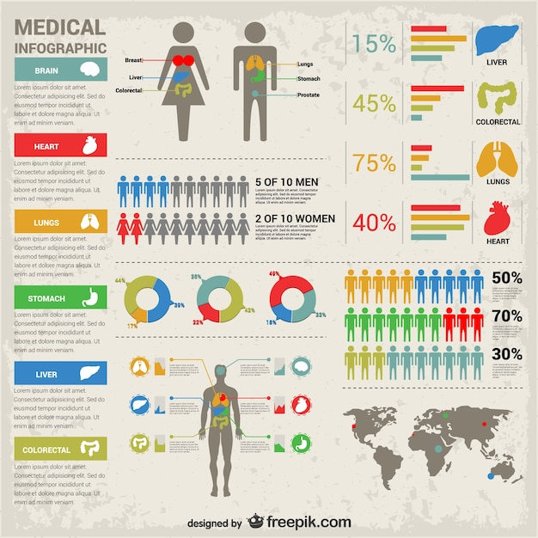
Statisticians
What does a statistician do?
Deal with data!
“The best thing about being a statistician is that you get to play in everyone's backyard.”
- John Tukey

Slide 3
Data is Everywhere!
Josh Katz – NY Times Upshot, Data Visualization Expert
James Gilmon – Philadelphia Eagles, Director of Analytics
Matt Avery – Institute for Defense Analyses, Researcher
Ben Wells – Environmental Protection Agency, Air Quality Research
Brad Turnbull – Air bnb, Data Scientist
Craig Lazarski & Kristi Ramey – Cary Academy, Educators
What do you call a sweetened, carbonated beverage?

Slide 4
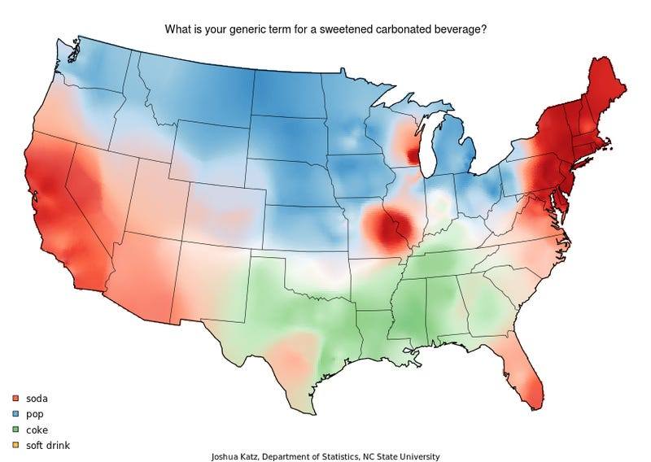
Data Visualization – Josh Katz (NYT Upshot)
How do you address a group of two or more people?

Slide 5
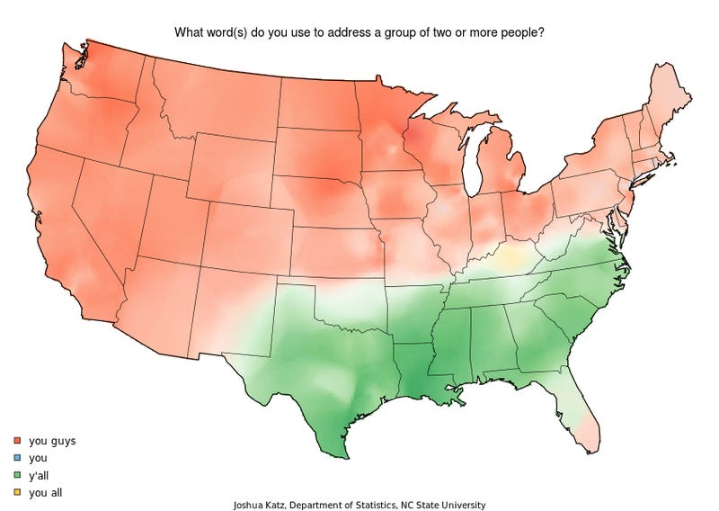
Data Visualization – Josh Katz (NYT Upshot)
What do you call the thing from which you might drink water from in school?

Slide 6
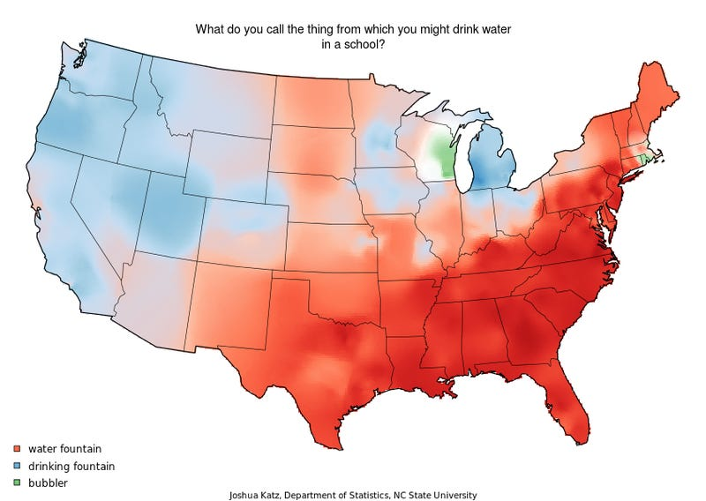
Data Visualization – Josh Katz (NYT Upshot)
How do you say crayon?

Slide 7
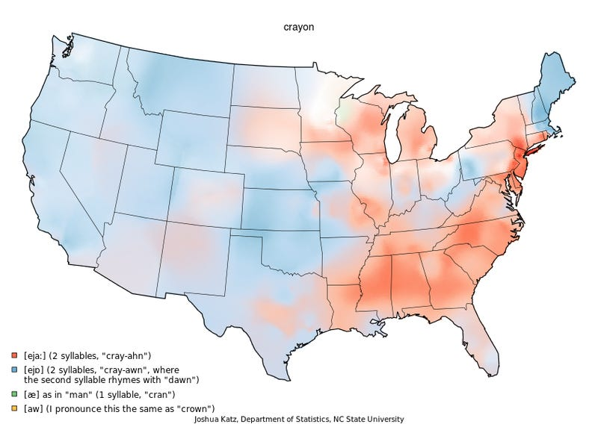
Data Visualization – Josh Katz (NYT Upshot)
How do you say pecan?

Slide 8
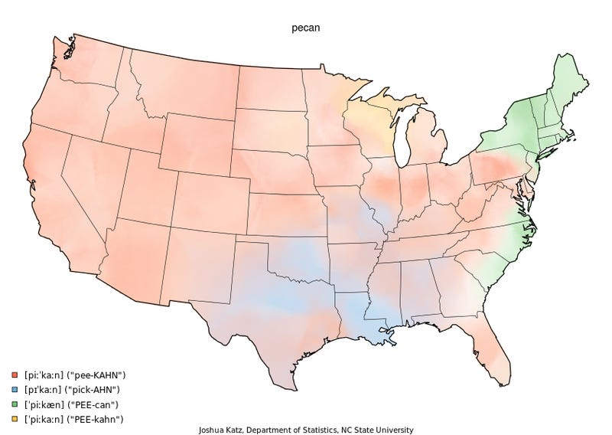
Data Visualization – Josh Katz (NYT Upshot)

Slide 9




Sports Statistics
Graduates from our department work at:
Have you noticed statistics being used in baseball?

Slide 10
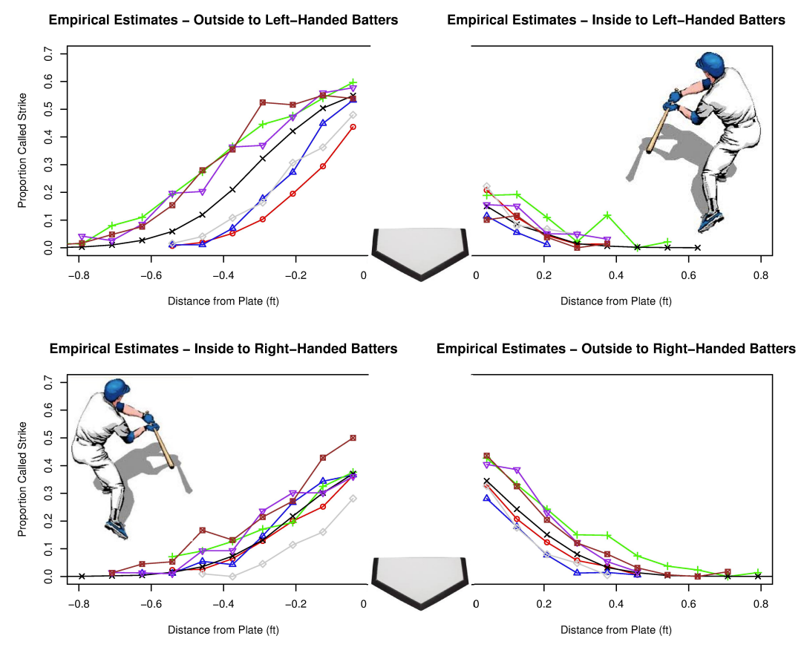
Osborne & Post – MLB Umpires
Have you noticed statistics being used in the NFL?

Slide 11
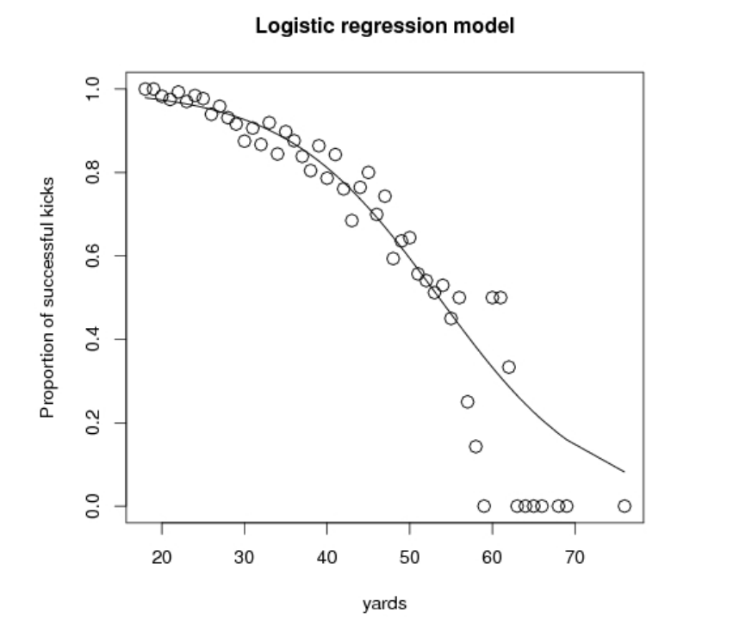
Jason Osborne – NFL Field Goals

Slide 12
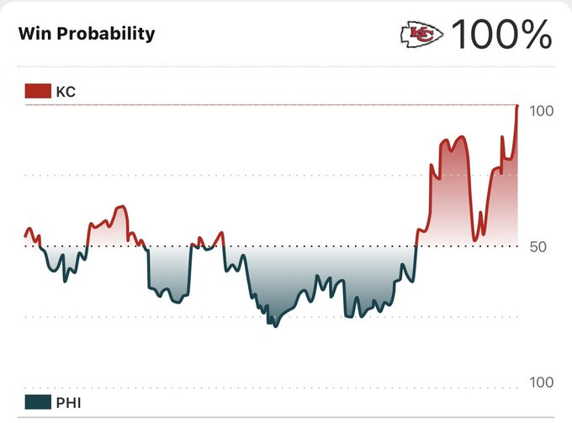
Win Probability Changes Drive Decision Making!
Have you noticed statistics being used in the NBA?

Slide 13
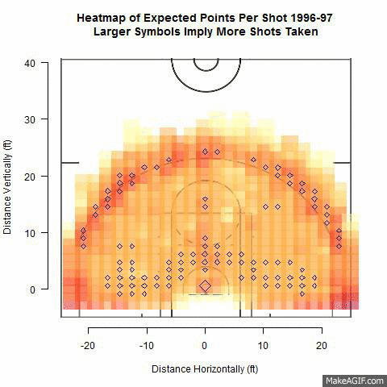
Michael Dickey – Visualizing Changes in Shooting

Slide 14

Designing Experiments

Slide 15
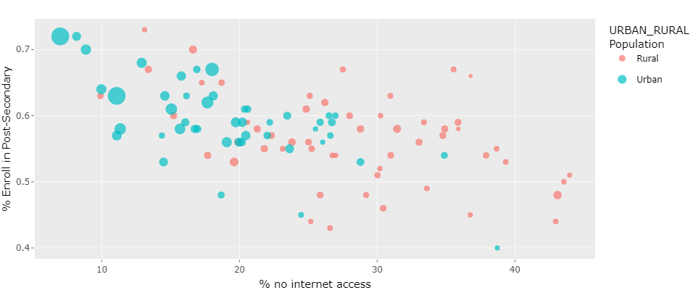
Understanding How Broadband Access Relates to College Success
Winning project at NC Education Datathon last year!

Slide 16
Probability
Probability is the foundation for statistical methods and models!
Let’s make a deal

