Slide 1
Grammatical Evolution Neural Networks for Genetic Epidemiology
Alison Motsinger-Reif, PhD
Bioinformatics Research Center
Department of Statistics
North Carolina State University

Slide 2
Overview
Epistasis and its implications for genetic analysis
GENN Method
  Optimization and dissection of the evolutionary process
  Comparison to other NN applications
  Comparison the other methods used in genetic epidemiology
  Power studies
  Application to an HIV Immunogenetics dataset
Future directions

Slide 3
Genetics of Human Disease
Single Gene Single Disease
Multiple Genes Complex Disease

Slide 4
Epistasis
p(D) | Genotype
 | BB | Bb | bb
AA | 0.0 | 0.0 | 1.0
Aa | 0.0 | 0.5 | 0.0
aa | 1.0 | 0.0 | 0.0
gene-gene or gene-environment interactions;
two or more genes interacting in a non-additive manner to confer a phenotype
1.0
BB
Disease risk
.50
Bb
0.0
bb
AA
Aa
aa
Notes:
Definition?

Slide 5
Epistasis
Biologists believe bio-molecular interactions are common
Single locus studies do not replicate
Identifying “the gene” associated with common disease has not been successful like it has for Mendelian disease
Mendelian single-gene disorders are now being considered complex traits with gene-gene interactions (modifier genes)

Slide 6
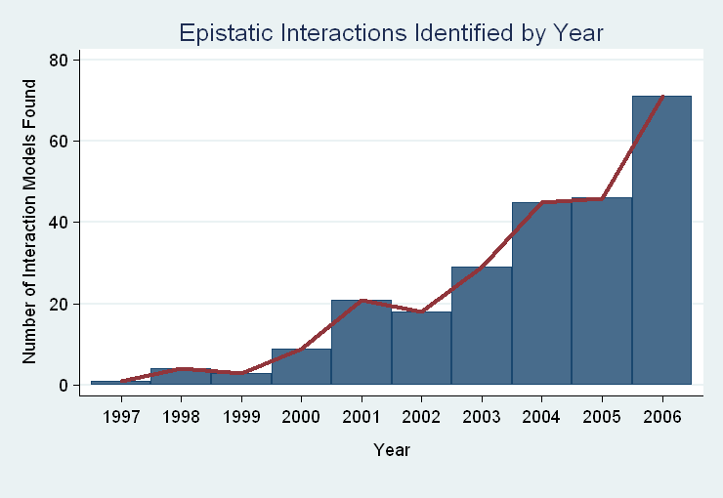
“gene-gene interactions are commonly found when properly investigated”
[Moore (2003)]

Slide 7
Traditional Statistical Approaches
Typically one marker or SNP at a time to detect loci exhibiting main effects
Follow-up with an analysis to detect interactions between the main effect loci
Some studies attempt to detect pair-wise interactions even without main effects
Higher dimensions are usually not possible with traditional methods

Slide 8
Traditional Statistical Approaches
Logistic Regression
  Small sample size can result in biased estimates of regression coefficients and can result in spurious associations (Concato et al. 1993)
  Need at least 10 cases or controls per independent variable to have enough statistical power (Peduzzi et al 1996)
  Curse of dimensionality is the problem (Bellman 1961)

Slide 9
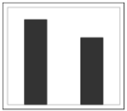
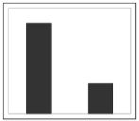
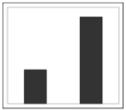
Curse of Dimensionality
N = 100
50 Cases, 50 Controls
SNP 1
AA
Aa
aa

Slide 10
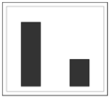
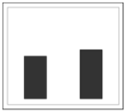
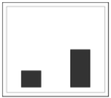
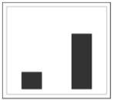
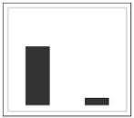
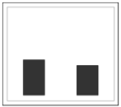
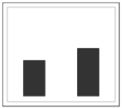
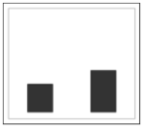
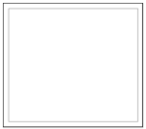
Curse of Dimensionality
N = 100
50 Cases, 50 Controls
SNP 1
AA
Aa
aa
BB
SNP 2
Bb
bb

Slide 11







Curse of Dimensionality
SNP 3
CC
Cc
cc
N = 100
SNP 1
SNP 1
SNP 1
AA
Aa
aa
AA
Aa
aa
AA
Aa
aa
BB
50 Cases, 50 Controls
Bb
SNP 2
DD
bb
BB
SNP 4
Bb
SNP 2
Dd
bb
BB
Bb
SNP 2
dd
bb

Slide 12
Traditional Statistical Approaches
Advantages
  Easily computed
  Easily interpreted
  Well documented and accepted
Disadvantages
  Susceptibility loci must have significant main effect
  Difficult to detect purely interactive effects
  Need a very large sample size to explore interactions between more than two variables

Slide 13
Objectives for Novel Methods
Variable Selection
  Choose a subset of variables from an effectively infinite number of combinations
Statistical Modeling
Generate Testable Hypotheses

Slide 14
Objectives for Novel Methods
Variable Selection
  Choose a subset of variables from an effectively infinite number of combinations
Statistical Modeling
Generate Testable Hypotheses
GOAL : Detect genetic/environmental factors associated with disease risk in the presence or absence of main effects from a large pool of potential factors

Slide 15
Methods to Detect Epistasis
Multifactor Dimensionality Reduction (MDR)
Random ForestsTM
Restricted Partition Method (RPM)
Classification and Regression Trees (CART)
Symbolic Discriminant Analysis (SDA)
Focused Interaction Testing Framework (FITF)
Set Association
Combinatorial Partitioning Method (CPM)
Patterning and Recursive Partitioning (PRP)
…………
Notes:
Find tiny picture of solution representation for each method.

Slide 16
Methods to Detect Epistasis
Multifactor Dimensionality Reduction (MDR)
Random ForestsTM
Restricted Partition Method (RPM)
Classification and Regression Trees (CART)
Symbolic Discriminant Analysis (SDA)
Focused Interaction Testing Framework (FITF)
Set Association
Combinatorial Partitioning Method (CPM)
Patterning and Recursive Partitioning (PRP)
…………
There are theoretical and/or practical concerns with each!
Notes:
Find tiny picture of solution representation for each method.

Slide 17
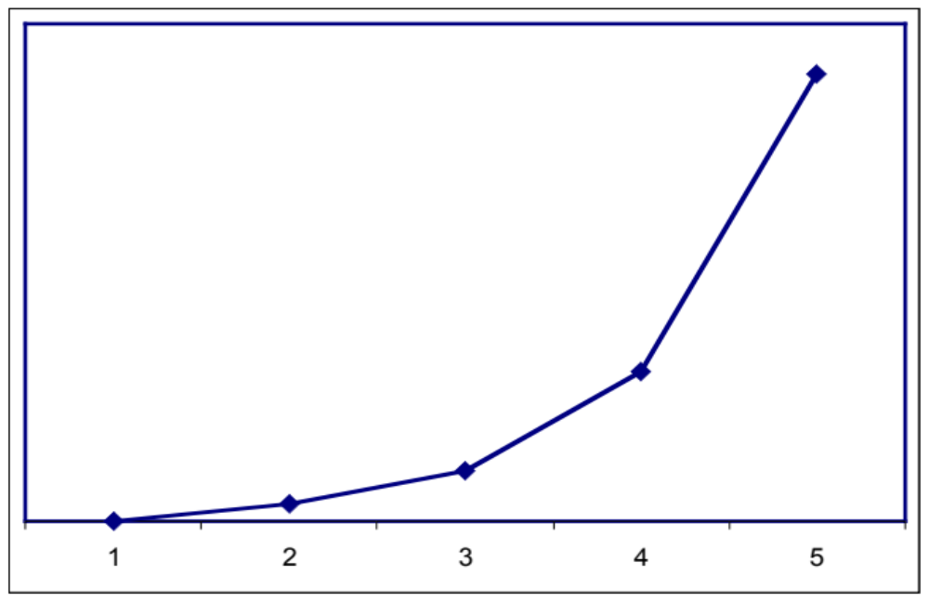
How Many Combinations are There?
Genome-wide association studies
~500,000 SNPs to span the genome
2 x 10²⁶
Number of Possible Combinations
3 x 10²¹
2 x 10¹⁶
1 x 10¹¹
5 x 10⁵
SNPs in each subset

Slide 18
How Many Combinations are There?
Genome-wide association studies
~500,000 SNPs to span the genome
2 x 10²⁶
2 x 10²⁶ combinations
* 1 combination per second
* 86400 seconds per day
---------
3.0 x 10²¹ days to complete
(8.2 x 10¹⁸ years)
Number of Possible Combinations
3 x 10²¹
2 x 10¹⁶
1 x 10¹¹
5 x 10⁵
SNPs in each subset

Slide 19
How Many Combinations are There?
Genome-wide association studies
~500,000 SNPs to span the genome
2 x 10²⁶
2 x 10²⁶ combinations
* 1 combination per second
* 86400 seconds per day
---------
3.0 x 10²¹ days to complete
(8.2 x 10¹⁸ years)
We need methods to detect epistatic interactions without examining all possible combinations!!!
Number of Possible Combinations
3 x 10²¹
2 x 10¹⁶
1 x 10¹¹
5 x 10⁵
SNPs in each subset

Slide 20
Novel Approaches
Pattern Recognition
  Considers full dimensionality of the data
  Aims to classify data based on information extracted from the patterns
    Neural Networks (NN)
    Clustering Algorithms
    Self-Organizing Maps (SOM)
    Cellular Automata (CA)
Cases
Controls
G1
G2
G3
G4
E1
E2
G1
G2
G3
G4
E1
E2
Subject 1
Subject 1
Subject 2
Subject 2
1
0

Slide 21
Neural Networks
Input
X₁
a₁
Σ
Output
a₅
X₂
a₂
y
Σ
X₃
a₃
Σ
a₆
X₄
a₄
Developed 60 years ago
Originally developed to model/mimic the human brain
More recently, uses theory of neurons to do computation
Applications
  Association, classification, categorization

Slide 22
Neural Networks
Input
X₁
a₁
Σ
Output
a₅
X₂
a₂
y
Σ
X₃
a₃
Σ
a₆
X₄
a₄
NNs multiply each input node (i.e. variable, genotype, etc.) by a weight (a), the result of which is processed by a function (Σ), and then compared to a threshold to yield an output (0 or 1).
Weights are applied to each connection and optimized to minimize the error in the data.

Slide 23
Neural Networks
Advantages
  Can handle large quantities of data
  Universal function approximators
  Model-free
Limitations
  Must fix architecture prior to analysis
  Only the weights are optimized
  Weights are optimized using hill-climbing algorithms

Slide 24
Neural Networks
Advantages
  Can handle large quantities of data
  Universal function approximators
  Model-free
Limitations
  Must fix architecture prior to analysis
  Only the weights are optimized
  Weights are optimized using hill-climbing algorithms
Solution: Evolutionary computation algorithms can be used for the optimization of the inputs, architecture, and weights of a NN to improve the power to identify gene-gene interactions.

Slide 25
Grammatical Evolution
Evolutionary computation algorithm inspired by the biological process of transcription and translation.
Uses linear genomes and a grammar (set of rules) to generate computer programs.
GE separates the genotype from the phenotype in the evolutionary process and allows greater genetic diversity within the population than other evolutionary algorithms.

Slide 26
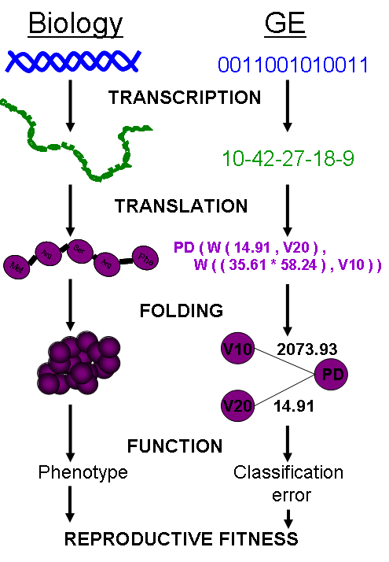
DNA: The heritable material in GE is the binary string chromosome. The GE chromosome is divided into codons, undergoes crossover and mutation, and can contain non-coding sequence just as biological DNA.
RNA: In GE, the binary chromosome string in transcribed into an integer string. This integer string is a linear copy message of the original heritable material that can then be processed further.
Polypeptide String: The integer string is translated using the grammar provided into the code for a functional NN.
Protein Folding: The grammar encoding is then interpreted as a multi-dimensional NN. This NN produces a classification error, just as a protein produces a phenotype within an organism.
Function: In GE a lower classification error indicates higher fitness. Natural selection will work at the level of reproductive fitness, forcing changes in the heritable material of both biological organisms or GE individuals.

Slide 27
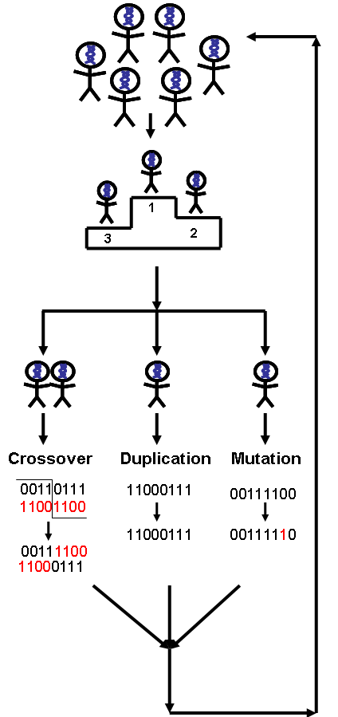
Step 1: A population of individuals is randomly generated, where each individual is a binary string chromosome (genetic material). The number of individuals is user-specified.
Step 2: Individuals are randomly chosen for tournaments – where they compete with other individuals for the highest fitness, and the tournament winners get to pass on their genetic material.
Step 3: Of the winners, user-specified proportions participate in crossover, mutation, or duplication of their genomes to produce offspring.
Step 4: When pooled together, these offspring will become the initial population for the next generation of evolution.
Steps 1-4 are repeated for a user-specified number of generations, to produce offspring with the highest possible fitness.

Slide 28
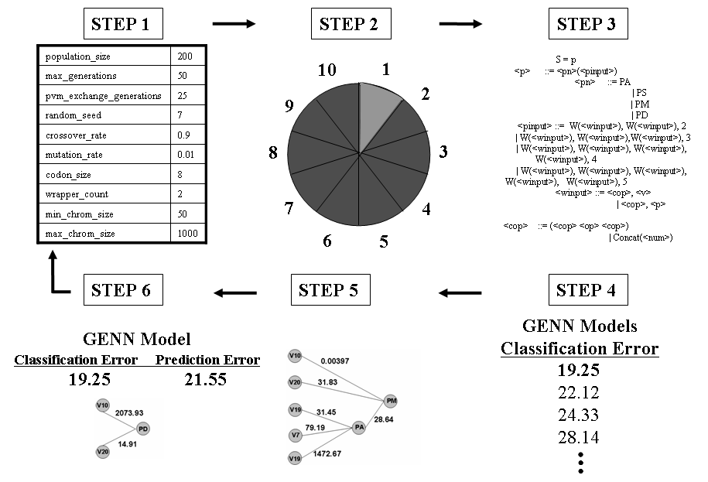
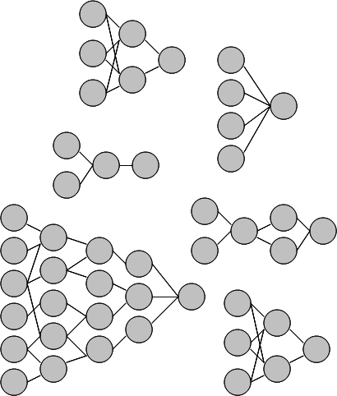
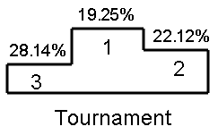
GE Neural Networks

Slide 29
Example Results
CV | Factors in Model |  |  |  |  | CE | PE
1 | SNP_1 | SNP_200 |  |  |  | 0.26 | 0.15
2 | SNP_1 | SNP_200 | SNP_630 | SNP_755 |  | 0.38 | 0.22
3 | SNP_1 | SNP_200 | SNP_512 |  |  | 0.32 | 0.29
4 | SNP_1 | SNP_200 | SNP_333 | SNP_467 | SNP_987 | 0.19 | 0.35
5 | SNP_1 | SNP_200 | SNP_814 | SNP_900 |  | 0.12 | 0.32
6 | SNP_1 | SNP_200 | SNP_665 |  |  | 0.20 | 0.19
7 | SNP_1 | SNP_200 | SNP_742 | SNP_801 |  | 0.21 | 0.22
8 | SNP_1 | SNP_200 | SNP_245 | SNP_294 |  | 0.19 | 0.28
9 | SNP_1 | SNP_200 | SNP_410 | SNP_502 | SNP_873 | 0.18 | 0.28
10 | SNP_1 | SNP_200 | SNP_311 |  |  | 0.26 | 0.18
Notes:
CV pie diagram above “CV” column as a tiny reminder.
Change “CA/PA” to error (subtract from 1).

Slide 30
Example Results
CV | Factors in Model |  |  |  |  | CE | PE
1 | SNP_1 | SNP_200 |  |  |  | 0.26 | 0.15
2 | SNP_1 | SNP_200 | SNP_630 | SNP_755 |  | 0.38 | 0.22
3 | SNP_1 | SNP_200 | SNP_512 |  |  | 0.32 | 0.29
4 | SNP_1 | SNP_200 | SNP_333 | SNP_467 | SNP_987 | 0.19 | 0.35
5 | SNP_1 | SNP_200 | SNP_814 | SNP_900 |  | 0.12 | 0.32
6 | SNP_1 | SNP_200 | SNP_665 |  |  | 0.20 | 0.19
7 | SNP_1 | SNP_200 | SNP_742 | SNP_801 |  | 0.21 | 0.22
8 | SNP_1 | SNP_200 | SNP_245 | SNP_294 |  | 0.19 | 0.28
9 | SNP_1 | SNP_200 | SNP_410 | SNP_502 | SNP_873 | 0.18 | 0.28
10 | SNP_1 | SNP_200 | SNP_311 |  |  | 0.26 | 0.18
Notes:
CV pie diagram above “CV” column as a tiny reminder.
Change “CA/PA” to error (subtract from 1).

Slide 31
Significance Testing
Final Model is forced
Average PE is calculated
Permutation testing is used to ascribe statistical significance to the model
SNP_200
12.58
÷
-2.38
SNP_1
Prediction Error: 15.4%
p<0.01
Notes:
Transition to GenomeSIM slide by saying why you need realistic simulation methods

Slide 32
Successes of GENN
High power to detect a wide range of main effect and interactive models
  Motsinger-Reif AA, Dudek SM, Hahn LW, and Ritchie MD. Comparison of approaches for machine-learning optimization of neural networks for detecting gene-gene interactions in genetic epidemiology. Genetic Epidemiology 2008 Feb 8 [Epub ahead of print]
Robust to changes in the evolutionary process
  Motsinger AA, Hahn LW, Dudek SM, Ryckman KK, Ritchie MD. Alternative cross-over strategies and selection techniques for Grammatical Evolution Optimized Neural Networks. In: Maarten Keijzer et al, eds. Proceeding of Genetic and Evolutionary Computation Conference 2006 Association for Computing Machinery Press, New York, pp. 947-949.
Higher power than traditional BPNN, GPNN, or random search NN
  Motsinger AA, Dudek SM, Hahn LW, and Ritchie MD. Comparison of neural network optimization approaches for studies of human genetics. Lecture Notes in Computer Science, 3907: 103-114 (2006).
  Motsinger-Reif AA, Dudek SM, Hahn LW, and Ritchie MD. Comparison of approaches for machine-learning optimization of neural networks for detecting gene-gene interactions in genetic epidemiology. Genetic Epidemiology 2008 Feb 8 [Epub ahead of print]

Slide 33
Successes of GENN
Robust to class imbalance
  Hardison NE, Fanelli TJ, Dudek SM, Ritchie MD, Reif DM, Motsinger-Reif AA. Balanced accuracy as a fitness function in Grammatical Evolution Neural Networks is robust to imbalanced data. Genetic and Evolutionary Algorithm Conference. In Press.
Scales linearly in regards to computation with the number of variables
  Motsinger AA, Reif DM, Dudek SM, and Ritchie MD. Dissecting the evolutionary process of Grammatical Evolution Optimized Neural Networks. Proceedings of the IEEE Symposium on Computational Intelligence in Bioinformatics and Computational Biology 2006 pp. 1-8.
Robust to genotyping error, missing data, and phenocopies
  Motsinger AA, Fanelli TJ, Ritchie MD. Power of Grammatical Evolution Neural Networks to detect gene-gene interactions in the presence of error common to genetic epidemiological studies. BMC Research Notes In Press.

Slide 34
Successes of GENN
Has higher power in the presence of heterogeneity than MDR
  Motsinger AA, Fanelli TJ, Ritchie MD. Power of Grammatical Evolution Neural Networks to detect gene-gene interactions in the presence of error common to genetic epidemiological studies. BMC Research Notes In Press.
The presence of LD increases the power of GENN
  Motsinger AA, Reif DM, Fanelli TJ, Davis AC, Ritchie MD. Linkage disequilibrium in genetic association studies improves the power of Grammatical Evolution Neural Networks. Proceedings of the IEEE Symposium on Computational Intelligence in Bioinformatics and Computational Biology 2007 pp. 1-8.
Has been favorably compared to other methods in the field in a range of genetic models
  Random Forests, Focused Interaction Testing Framework, Multifactor Dimensionality Reduction, Logistic Regression
  Motsinger-Reif AA, Reif DM, Fanelli TJ, Ritchie MD. Comparison of computational approaches for genetic association studies. Genetic Epidemiology In Press.

Slide 35


Real Data Application:
HIV Immunogenetics
Applied GENN to the AIDS Clinical Trials Group #384 dataset to identify potential gene-gene interactions that predict EFV pharmacokinetics and long-term responses.
Notes:
GENN has been applied to real/epidemiological data as well, including AMD and HIV drug response. I am going to discuss the HIV study.
Add picture/figure/something interesting. Please.

Slide 36
Real Data Application:
HIV Immunogenetics
Participants from ACTG 384, a multicenter trial that enrolled from 1998-99.
Participants were randomized to 3- or 4-drug therapy with EFV, nelfinavir (NFV), or both EFV plus NFV, given with ddI+d4T or ZDV+3TC.
340 were randomized to receive EFV (± NFV) had genetic data available.
3 years follow up
Baseline characteristics:
  83% male
  50% white, 32% black, 17% Hispanic, 1% other race/ethnicity
  CD4 count 270 ± 220 cells/mm3
  baseline HIV-1 RNA 5.0 ± 0.9 log10 copies/ml

Slide 37
Real Data Application:
HIV Immunogenetics
Polymorphisms identified in the immune system and drug metabolism gene
Outcome of interest:
  CD4 increases in HIV patients undergoing potent antiretroviral therapy
  <200 CD4 cells/mm3 increase from baseline with 48 weeks of virologic control

Slide 38
Real Data Application:
HIV Immunogenetics
CV | Factors in GENN Model |  |  |  |  |  |  | CE | PE
1 | CD132_9823 | IL2RB_6844 |  |  |  |  |  | 0.4153 | 0.4000
2 | CD132_9823 | IL2RB_6844 | IL2RB_6844 | IL15RA_19029 | IL15RA_19411 |  |  | 0.4268 | 0.4091
3 | CD132_9823 | IL2RB_6844 |  |  |  |  |  | 0.4140 | 0.4227
4 | IL2_9352 | CD132_9823 | IL2RB_6844 | IL15RA_19371 | IL15_87710 |  |  | 0.4173 | 0.4368
5 | CD132_9823 | IL2RB_6395 | IL2RB_6844 | IL15RA_18856 |  |  |  | 0.4186 | 0.4253
6 | CD132_9823 | IL2RB_6844 | IL15RA_18856 | IL15_4526 |  |  |  | 0.4122 | 0.5862
7 | IL2_9511 | CD132_9276 | CD132_9823 | IL2RB_6443 | IL2RB_6844 | IL2RB_29015 | IL2RB_29015 | 0.4160 | 0.4483
8 | CD132_9823 | IL2RB_6844 | IL2RB_6844 | IL2RB_28628 | IL15RA_19029 |  |  | 0.4109 | 0.4828
9 | CD132_9276 | CD132_9823 | IL2RB_6844 | IL15_4526 | IL15_87191 |  |  | 0.4262 | 0.4828
10 | CD132_9823 | IL2RB_6844 | IL15RA_18856 | IL15_87435 |  |  |  | 0.4198 | 0.5402
Avg PE = 32.3%
P<0.02
Notes:
Cut CE and PE columns

Slide 39
Real Data Application:
HIV Immunogenetics
IL2 Receptor beta chain
(IL2RB:16491)
GG
CC
CG
IL2 Receptor common
gamma chain
(CD132: 9823)
IL2 Receptor common
gamma chain
(CD132: 9823)
CD4 change
>200 cells
CT
CC/TT
CC
CT/TT
CD4 change
>200 cells
CD4 change
<200 cells
CD4 change
>200 cells
CD4 change
<200 cells

Slide 40
Future Directions
Family data
Both continuous and discrete input and output variables
  Combine data types
Empirical studies to aid in NN interpretation
Improve computation time and evolutionary optimization

Slide 41
Acknowledgments
Vanderbilt University
  Center for Human Genetics Research
    Scott Dudek
    Lance Hahn, PhD
    Marylyn Ritchie, PhD
  CFAR
    David Haas, MD
    Todd Hulgan, MD MPH
    Jeff Canter, MD MPH
    Asha Kallianpur, MD
    Tim Sterling, MD
NCSU
  Nicholas Hardison
  Sandeep Oberoi
Penn State
  Theresa Fanelli

Slide 42
Questions?

