Slide 1
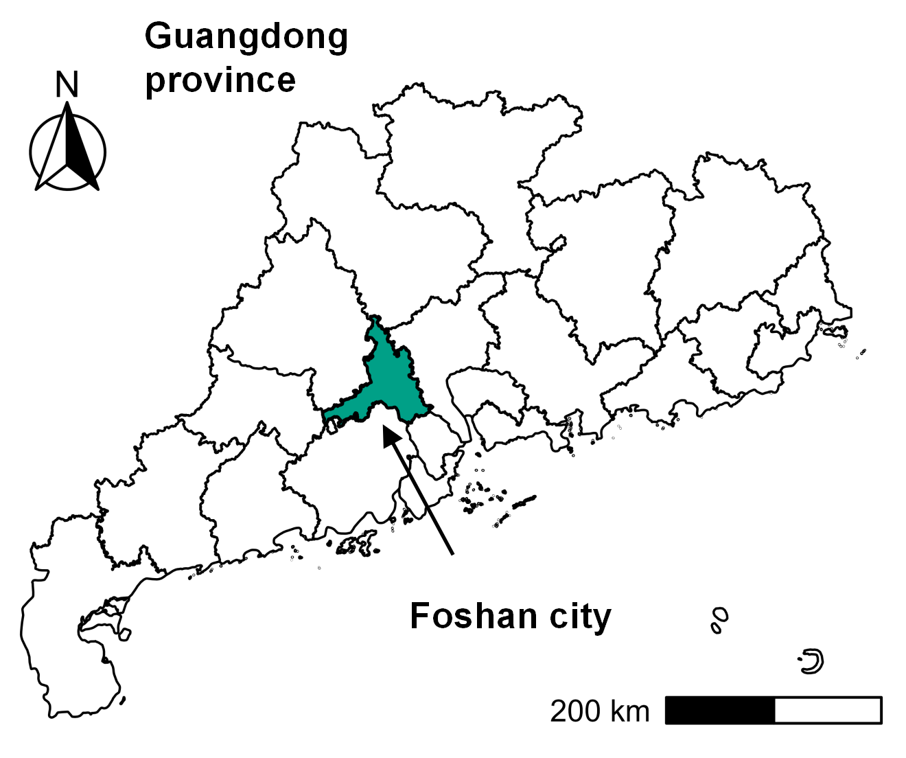




CHIKUNGUNYA TRANSMISSION MODEL DEVELOPMENT FRAMEWORK
STUDY SETTING & DATA COLLECTION
Foshan, Guangdong Province, China, site of largest CHIKF outbreak (as of 2025)
Epidemiological data Entomological data
MODEL DEVELOPMENT
CLOSED-SYSTEM & HOMOGENEOUS MIXING
POPULATION MOBILITY & SPATIAL HETEROGENEITY
City-level Chikungunya Transmission Model (CCTM)
v
Multi-district Chikungunya Transmission Model (MCTM)
Baseline model
Intervention model
Baseline model
Intervention model
Model Core: CCTM
Model framework
Initial values
Model Parameters
Model calibration
Baseline scenario
Model Core: MCTM
Model framework
Initial values
Model Parameters
Model calibration
Baseline scenario
Intervention
scenarios
Intervention
scenarios
Model results:
Estimation of CHIKF trend in different districts
Estimated transmission
Model results:
Effectiveness of single interventions (LC, AMC, BRR, and IPS)
Model results:
Effectiveness of single interventions (LC, AMC, BRR, and IPS)
Estimation of CHIKF trend
INTEGRATION LOGIC:
Consistent intervention effect between two models indicates limited impact of mobility and spatial heterogeneity; with post-outbreak city-scale interventions in Foshan, the results of CCTM were selected as the MAIN model results.
RESULTS
1
Effectiveness of single interventions at different intervention timings
4
Effectiveness of triple intervention combinations
2
Effectiveness of pairwise intervention combinations
5
Effectiveness of triple intervention combinations
at different intervention timings
3
Effectiveness of pairwise intervention combinations
at different intervention timings
6
Validation of model predictions under baseline and intervention scenarios

