Slide 1
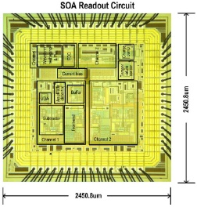
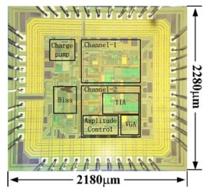
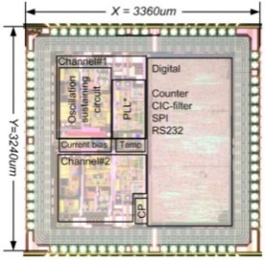
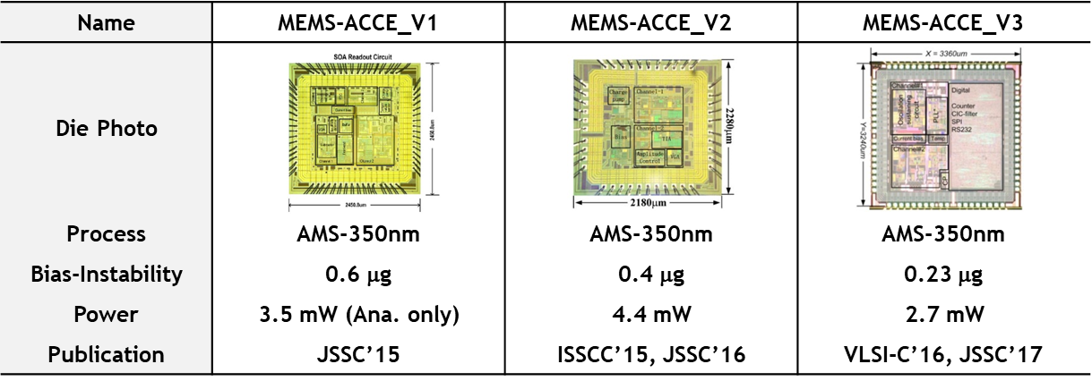
Name | MEMS-ACCE_V1 | MEMS-ACCE_V2 | MEMS-ACCE_V3
Die Photo
Process | AMS-350nm | AMS-350nm | AMS-350nm
Bias-Instability | 0.6 μg | 0.4 μg | 0.23 μg
Power | 3.5 mW (Ana. only) | 4.4 mW | 2.7 mW
Publication | JSSC’15 | ISSCC’15, JSSC’16 | VLSI-C’16, JSSC’17

Slide 2
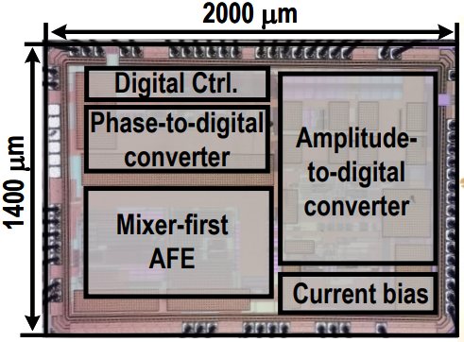
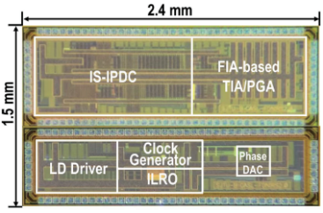
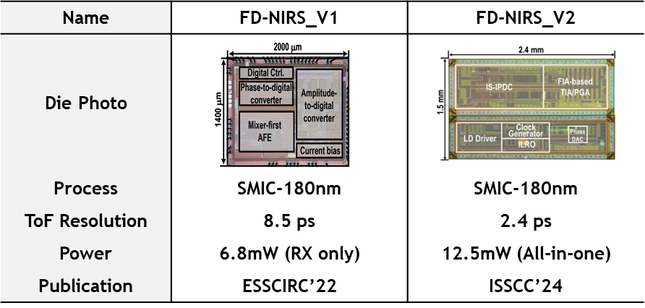
Name | FD-NIRS_V1 | FD-NIRS_V2
Die Photo
Process | SMIC-180nm | SMIC-180nm
ToF Resolution | 8.5 ps | 2.4 ps
Power | 6.8mW (RX only) | 12.5mW (All-in-one)
Publication | ESSCIRC’22 | ISSCC’24

Slide 3
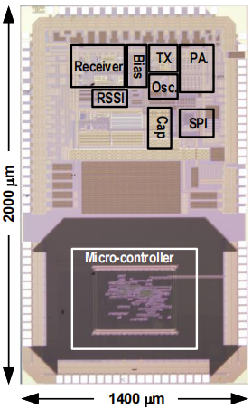
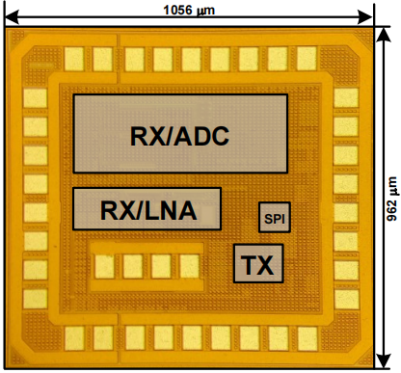
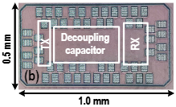
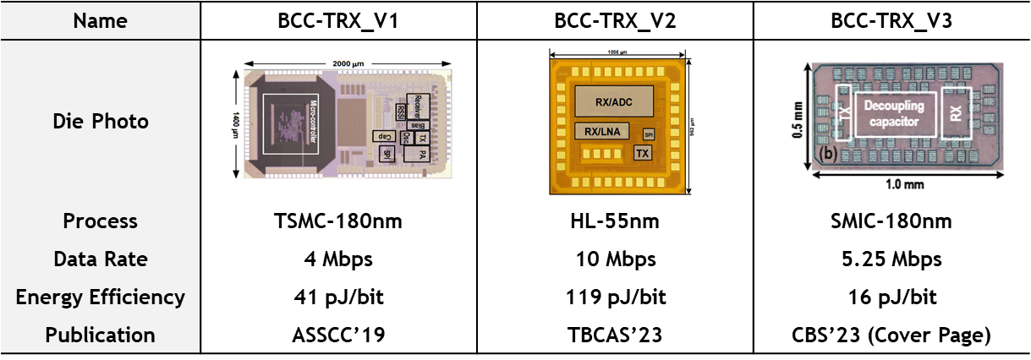
Name | BCC-TRX_V1 | BCC-TRX_V2 | BCC-TRX_V3
Die Photo
Process | TSMC-180nm | HL-55nm | SMIC-180nm
Data Rate | 4 Mbps | 10 Mbps | 5.25 Mbps
Energy Efficiency | 41 pJ/bit | 119 pJ/bit | 16 pJ/bit
Publication | ASSCC’19 | TBCAS’23 | CBS’23 (Cover Page)

Slide 4
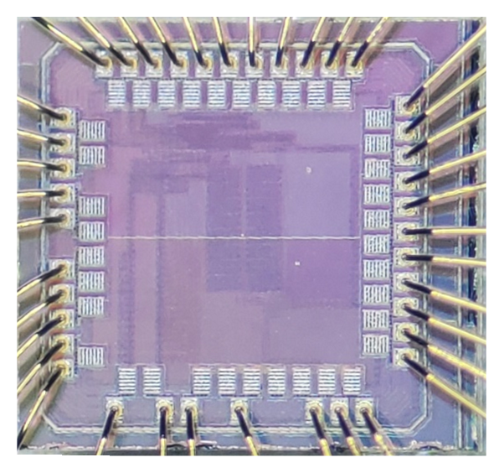
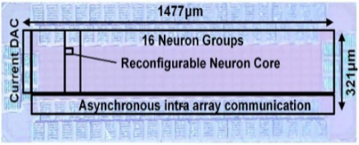
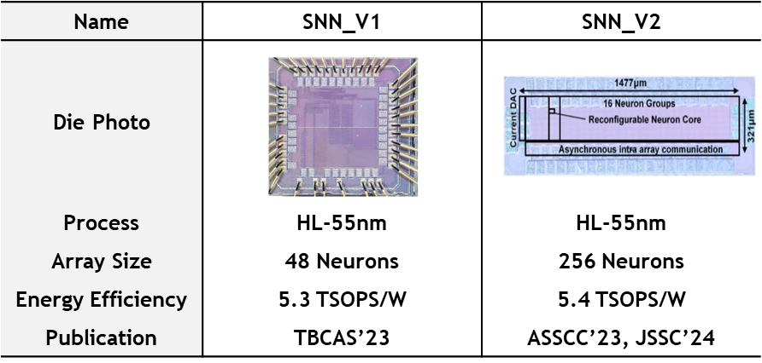
Name | SNN_V1 | SNN_V2
Die Photo
Process | HL-55nm | HL-55nm
Array Size | 48 Neurons | 256 Neurons
Energy Efficiency | 5.3 TSOPS/W | 5.4 TSOPS/W
Publication | TBCAS’23 | ASSCC’23, JSSC’24

Slide 5
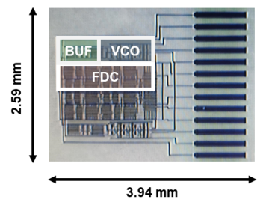
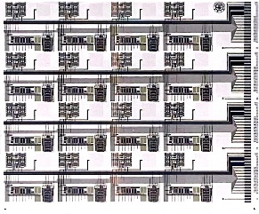
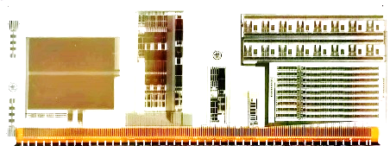
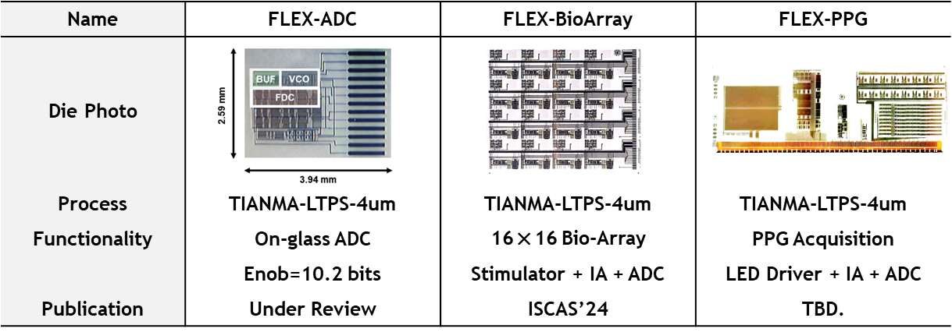
Name | FLEX-ADC | FLEX-BioArray | FLEX-PPG
Die Photo
Process | TIANMA-LTPS-4um | TIANMA-LTPS-4um | TIANMA-LTPS-4um
Functionality | On-glass ADC | 16×16 Bio-Array | PPG Acquisition
 | Enob=10.2 bits | Stimulator + IA + ADC | LED Driver + IA + ADC
Publication | Under Review | ISCAS’24 | TBD.

Slide 6

Name | FLEX-ADC | FLEX-BioArray | FLEX-PPG
Die Photo
Process | TIANMA-LTPS-4um | TIANMA-LTPS-4um | TIANMA-LTPS-4um
Functionality | On-glass ADC | 4×4 Bio-Array | PPG Acquisition
 | Enob=10.2 bits | Stimulator + IA + ADC | LED Driver + IA + ADC
Publication | TCAS-II’24 | ISCAS’24 | ASSCC’24

