Slide 1
Sprint 3:
RSNA-MICCAI Brain Tumor
Radiogenomic Classification
Team members:
Zhaowen Zhou
Rahaf Alharbey
Jiawei Zhao
Shuyi Fan

Slide 2
Contents
Data Preparation
Model 1: ResNet Model
Model 2: EfficientNet 3D
Next Step

Slide 3
Data Preparation

Slide 4
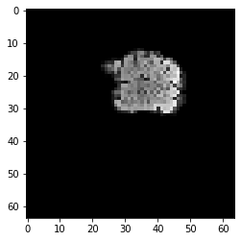
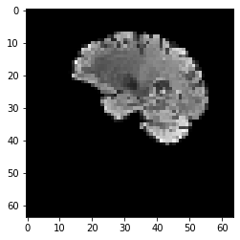
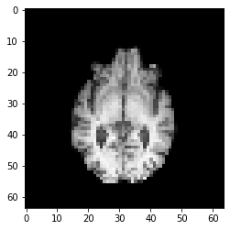
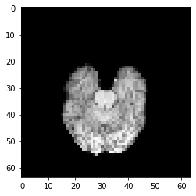
Input Data
FLAIR Picture
T1w Picture

Slide 5
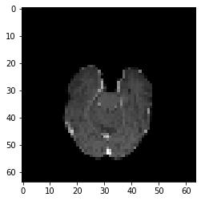
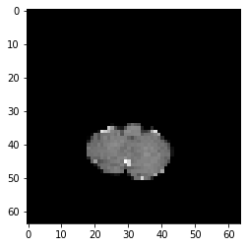
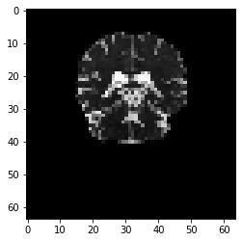
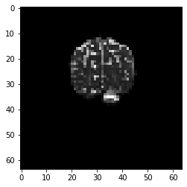
Input Data
T1wCE Picture
T2w Picture

Slide 6
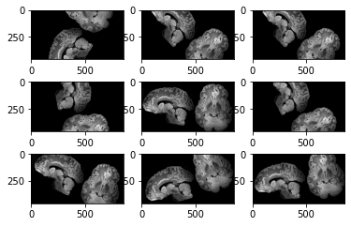
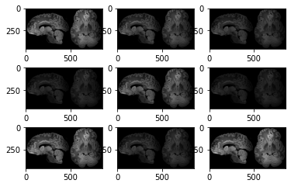
Data Augmentation
Rotation
Contrasting

Slide 7
Model 1: ResNet Model

Slide 8
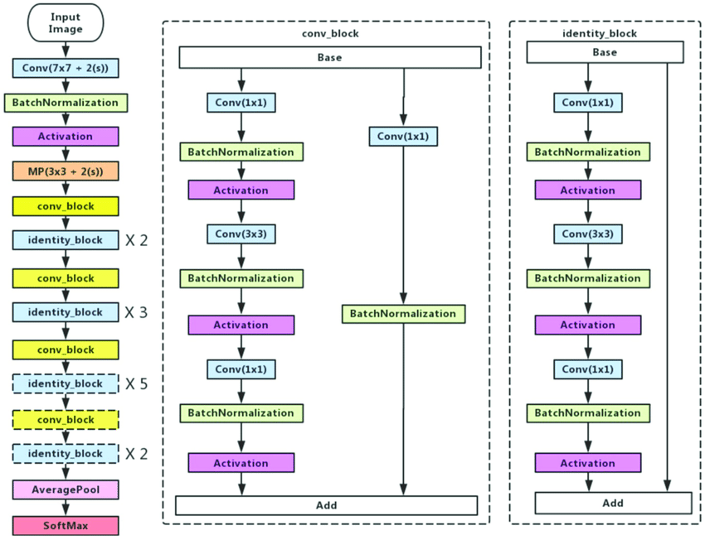
Resnet50

Slide 9
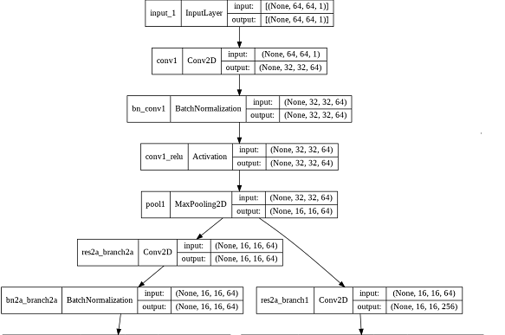
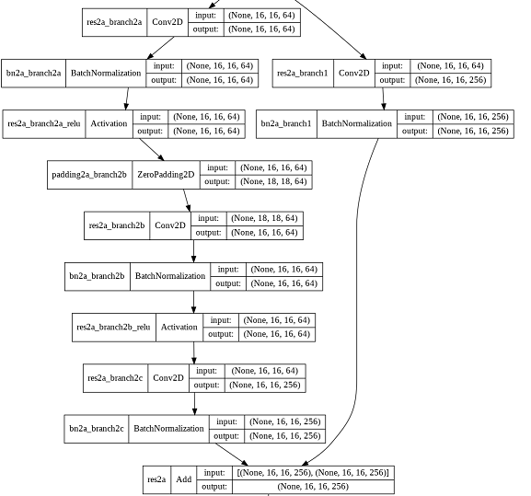
Our Model

Slide 10
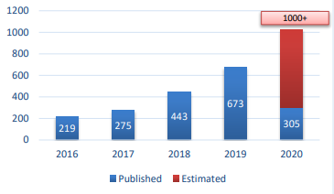
Resnet50
Number of CNN related publication in science direct
Resnet50 Features
Faster computational time.
Higher achieved accuracy.
Better flow of optimization loss.
Compatible with transfer learning.
Most useful CNN algorithms from 2015 for classification.

Slide 11
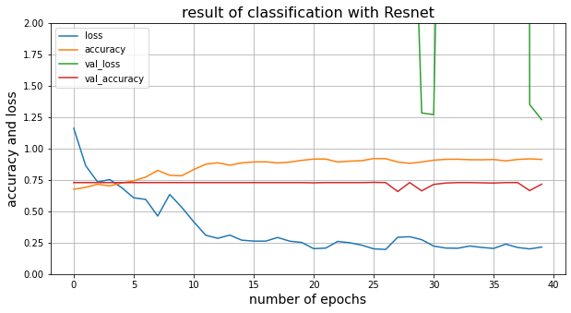
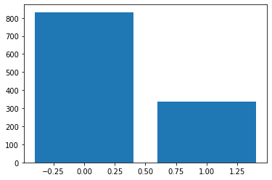
Result
Accuracy and Loss
Output prediction

Slide 12
Discussion
Based on the result on the training set and validation model got overfitted in the train set and needs more epochs for training.
The result of the work is better than other famous CNN algorithms like VGG16 and VGG32.
Achieved accuracy on test set is 74% which proves the needs for training the model with more procedure for regularization.
The last layer which had been added is a dense layer with 2 neurons for classification specification about number of neurons can get changed based on number of classes

Slide 13
Model 2: EfficientNet PytTorch 3D
GitHub open source:
https://github.com/tensorflow/tpu/tree/master/models/official/efficientnet
[1] Tan, M., & Le, Q.V. (2019). EfficientNet: Rethinking Model Scaling for Convolutional Neural Networks. ArXiv, abs/1905.11946.

Slide 14
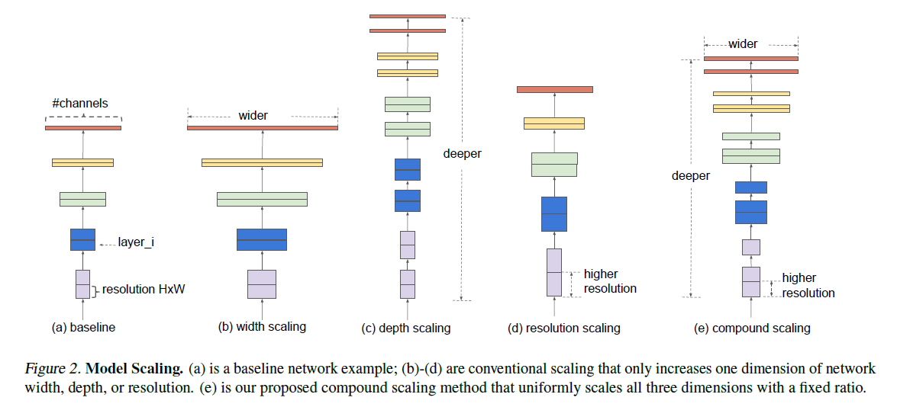
Model Scaling

Slide 15
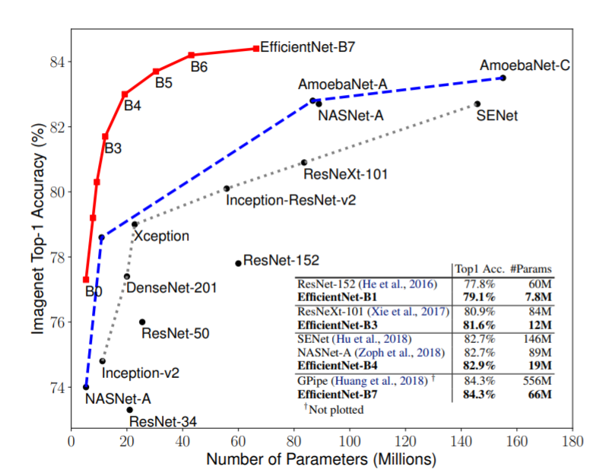
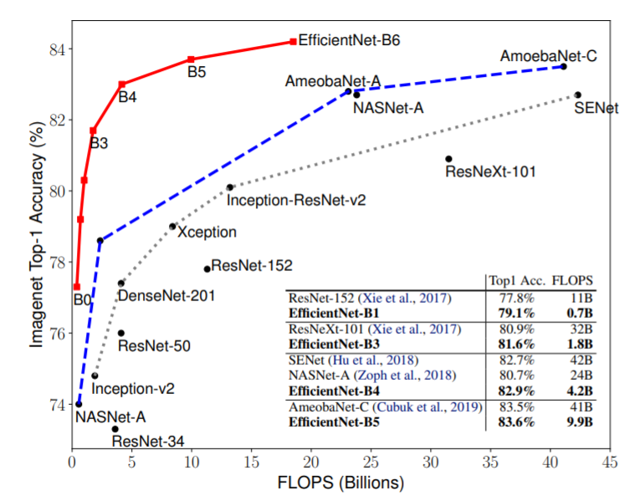
ImageNet Accuracy

Slide 16
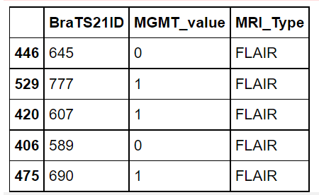
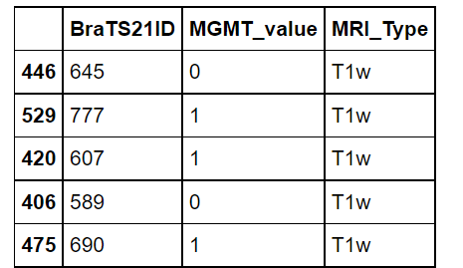
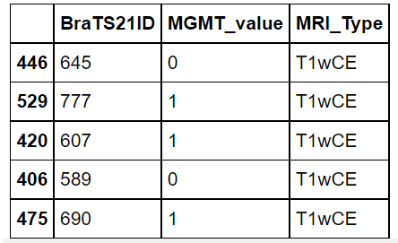
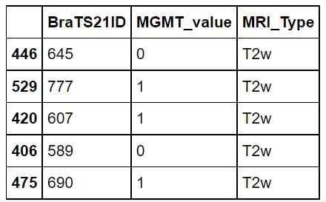
Train
Use models with only one MRI type, then ensemble the 4 models

Slide 17
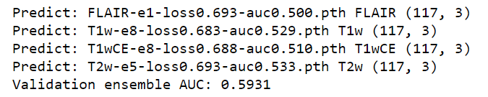
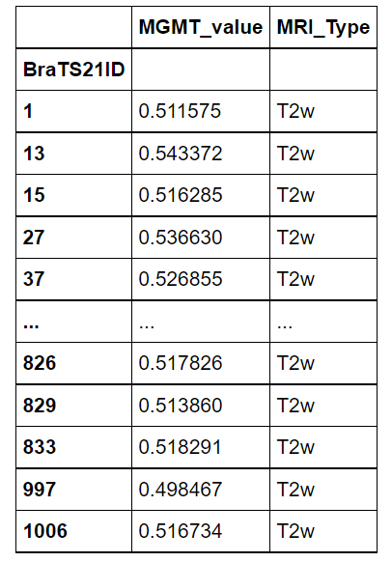
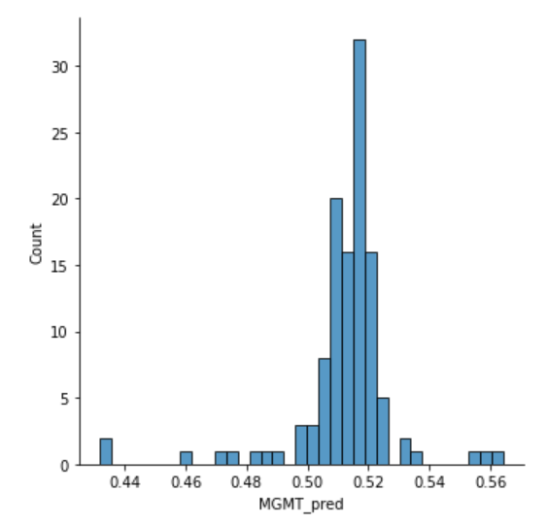
Models & Test

Slide 18
Next:
Compare and choose the best model;
Make products easier to applicate.

Slide 19
THANK YOU

