Slide 1
Navigation Objects Extraction for Better Content Structure Understanding
Kui Zhao, Bangpeng Li
Zilun Peng, Jiajun Bu, Can Wang

Slide 2
Outline
Motivation
Method
Hyperlink clustering
Hyperlink block classifying
Experiment
Summary

Slide 3
Motivation
The Dynamic Nature of Web 2.0
The structure is better captured by dynamic and personalized elements
Extracting navigation objects can capture both the static directory structures and the dynamic content structures in a web site
Applications
Depicting the web site structure
Adapting to different devices
Accessibility
Notes:
1. Web 2.0: such as social networks, e-commerce portals etc.
2. The structure is better captured by these dynamic and personalized elements, such top reading list, recommended items etc.
3. Extracting navigation ...
4. There are many applications.

Slide 4
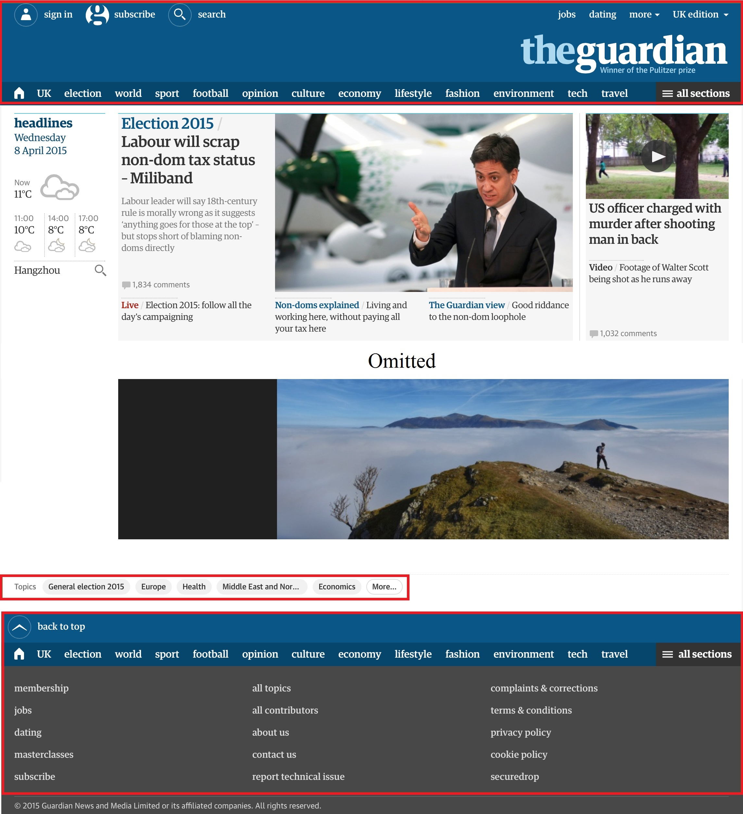
Motivation
Types of Hyperlinks
Navigation Menu: Hyperlinks provide site-level navigation
Navigation List: Hyperlinks provide page-dependent navigation
Content Hyperlink: Hyperlinks appear in the main content
Others: Hyperlinks include Ads, copyright information etc.
Objective
Extracting the navigation menus and lists as hyperlink blocks
Notes:
First of all, we divide hyperlinks into the following types:
Navigation Menu. Hyperlinks provide site-level navigation. They stay relatively invariant and can be directly mapped to the static directory structure in a website.
Navigation List. Hyperlinks provide page-dependent navigation and capture the dynamic and personalized content structures, such as recommended list etc.
Content Hyperlink: Hyperlinks appears in the main content
Others: Hyperlinks include Ads, copyright information etc.
We intend to extract the navigation menus and lists in the form of hyperlinks blocks.

Slide 5
Motivation
Challenge
Great diversities in webpage structures
Webpages come with various layouts, thus navigation objects in different webpages vary greatly in their presentation
Many navigation objects are generated dynamically, or customized for specific users

Slide 6
Method
Observations
The navigation objects are naturally grouped in different hyperlink blocks, in which few other contents other than these hyperlinks exist
The anchor text in these hyperlinks are usually short and well aligned
Framework
We first cluster hyperlinks in a webpage into multiple blocks
Then we classify hyperlink blocks into navigation objects or non-navigation objects using the SVM classifier
Notes:
Observations
...
Framework:
Cluster hyperlinks in a webpage into multiple blocks by exploiting features such as spatial locations of hyperlinks, the hierarchical structure of the DOM-tree and the hyperlink density etc.
Then we identify navigation objects using the SVM classifier

Slide 7
Method: hyperlink clustering
DOM-tree
It is a hierarchical structure
Parent node including children reflects their relation in webpage layout
Sibling nodes keep their relative displaying position in webpage layout
Hyperlinks in the same block should have the same parent node
Notes:
Before clustering hyperlinks in a webpage into blocks, we parse the webpage into a DOM-tree. Each webpage corresponds to a DOM-tree where detailed text, images and hyperlinks etc. are leaf nodes. An example of the DOM-tree is shown in the right figure. The DOM-tree at the bottom of figure is derived from the HTML code at the top right, whose webpage layout is at the top left.
DOM-tree has several interesting properties
It is a hierarchical structure
...
These properties are very useful when we cluster hyperlinks into blocks on the DOM-tree of a webpage.

Slide 8
Method: hyperlink clustering
DOM-tree Distance
We need to define a reasonable distance between hyperlinks conforming to our vision
Displaying distance is not a good choice, because it is slow and expensive and not always available
We proposal the DOM-tree distance to approximate the distance between two hyperlinks
Notes:
1. The central problem in clustering hyperlinks is to de ne a reasonable distance between them that well conforms to their visual presentation.
2. The most intuitive choice is the Euclid distance between their locations on the webpage as rendered by browsers. However, obtaining these locations requires expensive computation cost. Moreover, locations for many hyperlinks can not be obtained without user interactions, e.g., in multilevel menus, the displaying locations of hyperlinks in the second or third level menus are only available after clicking their parent menus.
We proposal the ...

Slide 9
Method: hyperlink clustering
DOM-tree Distance
We first traverse the DOM-tree in depth-first search order and index each node we encounter, starting from 1
Then we calculate the DOM-tree Distance (DD) between hyperlinks l₁ and l₂ as follow:
DD(l₁, l₂) = |index(l₁) − index(l₂)|
For two given hyperlink blocks B₁ and B₂, we define the gap between them as the minimum distance between hyperlinks in B₁ and B₂:
gap(B₁,B₂) = min_{ij} DD (l_{i}, l_{j})
Notes:
We first...
Then we calculate...
For two given ...
where index(l_{i}) means the index of hyperlink l_{i}

Slide 10

Method: hyperlink clustering
Hyperlink Density
We define the Hyperlink Density HD(S) for a given block S as follow, where #{text} means the number of words in the text:
HD(S) =$\frac{\#\{anchor text in S\}}{\#\{all text in S\}}$
Clustering on DOM-tree
In the beginning, each hyperlink block include one hyperlink
For hyperlink blocks B₁, B_{2,} if they have the same parent and are neighbors and the gap(B₁, B₂ ) < gt, merge B₁, B₂ into one block B
If HD(B) < hdt, accept this merging, otherwise reject that
We do that in the bottom-to-up and left-to-right way
Notes:
Another important observation is that a hyperlink block usually includes few text except the text in hyperlinks.
So we define the hyperlink density…
We cluster hyperlinks as follows:
In the beginning...

Slide 11

Method: hyperlink clustering
Gap Threshold(gt)
Let DL be the list containing all distances between neighbor hyperlinks with an additional 0, we proved that the proper gt can be chosen from DL
We choose the i-th value in DL as gt after sorting DL in decreasing order:
arg_{i} min($\frac{DLi}{DL1}$+β$\frac{i}{length(DL)}$)
β is a tradeoff parameter and we set β = 1 in all our experiments
not too large
not too small
Notes:
We use the gap threshold(denoted by gt) and the Hyperlink Density threshold(denoted by hdt) to control the results of clustering.
Due to the variety of webpages, gt and hdt vary greatly for different webpages. So we need an effective method to learn proper gt and hdt for each webpage.
Let DL be the list...
We choose the ...
The gt should not be too large to avoid clustering all hyperlinks into very few big blocks; The gt should not be too small to avoid clustering all hyperlinks into too many small blocks.
β is a tradeoff...

Slide 12
Method: hyperlink clustering
Hyperlink Density Threshold(hdt)
Let HD_{B} denote the Hyperlink Density of the whole webpage, then we define
hdt=γHD_{B}
It performs the lower bound of Hyperlink Density of hyperlink blocks. γ ≥ 0 is a tuning parameter and we set γ = 1 in our experiments
Notes:
A hyperlink block includes few text except the text in hyperlinks.
Let HD ...
It performs the ...
... and we set γ=1 in our experiments. It means that the Hyperlink Density of the navigation object should be greater than the average Hyperlink Density of the whole page.

Slide 13
Method: hyperlink block classifying
Features of Hyperlink Block
Number of hyperlinks
Length of text in hyperlinks
Variance of text length above
Smoothing
Gaussian smoothing
SVM classifier
RBF kernel
Notes:
As mentioned above, the anchor text for these hyperlinks are usually short and well aligned.
So we use these features of hyperlink block for classifying
Moreover, we use Gaussian smoothing.
Finally, we use SVM classifier with RBF kernel

Slide 14
Experiment
Date Set
CleanEval: various styles and structures
Myriad40: 40 sites of widely varying size and sophistication
Big5: Tribune, Freep, Ny Post, Suntimes and Techweb
Clustering Alternative
Agglomerative, DBSCAN, K-means, Spectral Clustering
K-Means and Spectral Clustering with best K
Ours
CHD is the version of clustering hyperlinks on DOM-tree without considering Hyperlink
CHD-HD is the version considering Hyperlink Density

Slide 15
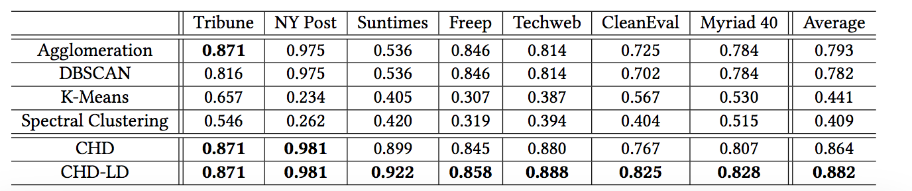
Experiment
Hyperlink Clustering: ARI

Slide 16
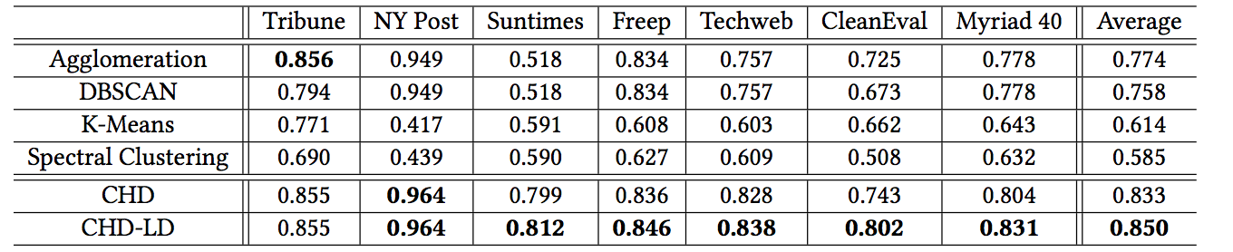
Experiment
Hyperlink Clustering: AMI
Notes:
Comparing the average ARI values and AMI values over all data sets, our methods (including both CHD and CHD-HD) outperform all comparison methods. Moreover, our method is more reliable than the comparison methods since our method has a stable performances while comparison methods may collapse on some particular data sets. It is because that our method makes good use of the hierarchical structure of the DOM-tree as well as the distance information on DOM-tree.
CHD-HD always performs better than CHD, especially on the dataset CleanEval, which has the greatest diversity and most dynamic and page-dependent navigation elements. at means besides the hierarchical structure of the DOM-tree, Hyperlink Density is also very helpful.

Slide 17
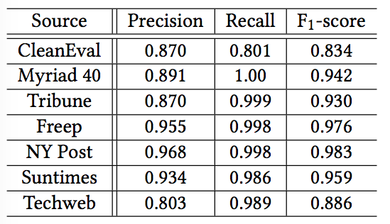
Experiment
Hyperlink Blocks Classifying
Notes:
It clearly shows that our method performs very well, not only on datasets with webpages from a single site (such as Tribune and Freep etc.) but also on datasets with webpages from various sites (such as CleanEval and Myriad 40).

Slide 18
Experiment
The Generalization
Notes:
1. We can observe that even using very few hyperlinks as the training data, 5% hyperlinks of whole training set for an example, the performance of our method is very impressive.
2. This means our method has a strong generalization ability because it needs very few training data to perform very well. at brings great practicability to our method.

Slide 19
Summary
Navigation Objects Extraction
Depicting both the static directory structures and the dynamic content structures in a web site
Adapting to devices and helpful for accessibility
Hyperlink clustering
DOM-tree distance, hyperlink density, clustering on DOM-tree
Hyperlink block classifying
Number of hyperlinks, anchor text length and its variance
Conclusions
The strength of our method include effectiveness, generalization and simplicity

Slide 20
Thanks
Q&A

