Slide 1
2019 Spring Innovative Experiment
Midterm Report
汇报人：赵力达 汪至圆 王凯
时间：2019.5.9

Slide 2
Contents
01.
Program structure introduction
CONTENTS
02.
Triangle model
Add a new model
03.
Noise reduction

Slide 3
PART 01
Program structure introduction

Slide 4
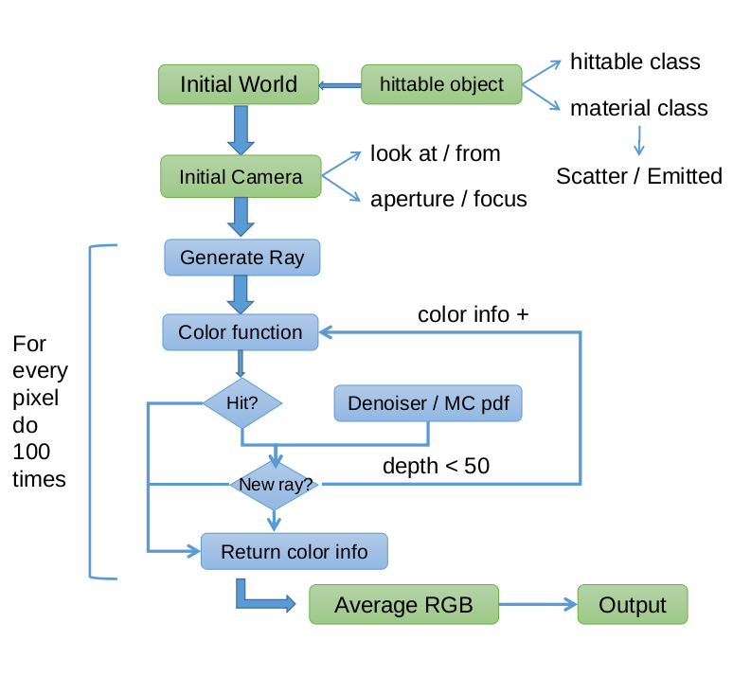
Program structure introduction

Slide 5
PART 02
Triangle model

Slide 6
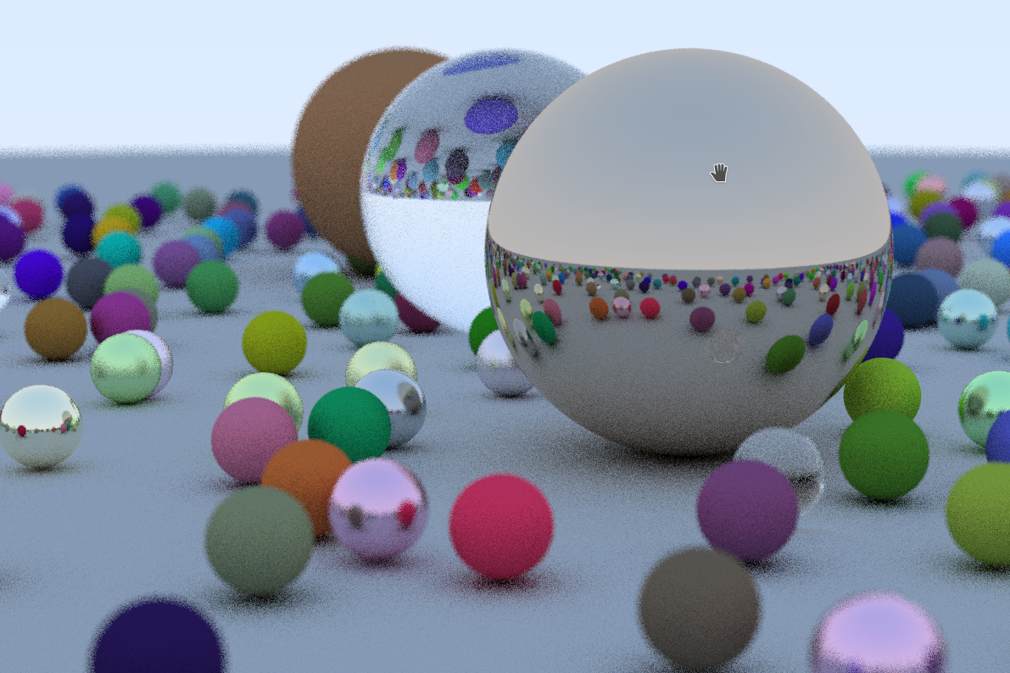
Triangle model
Why we need triangle?

Slide 7
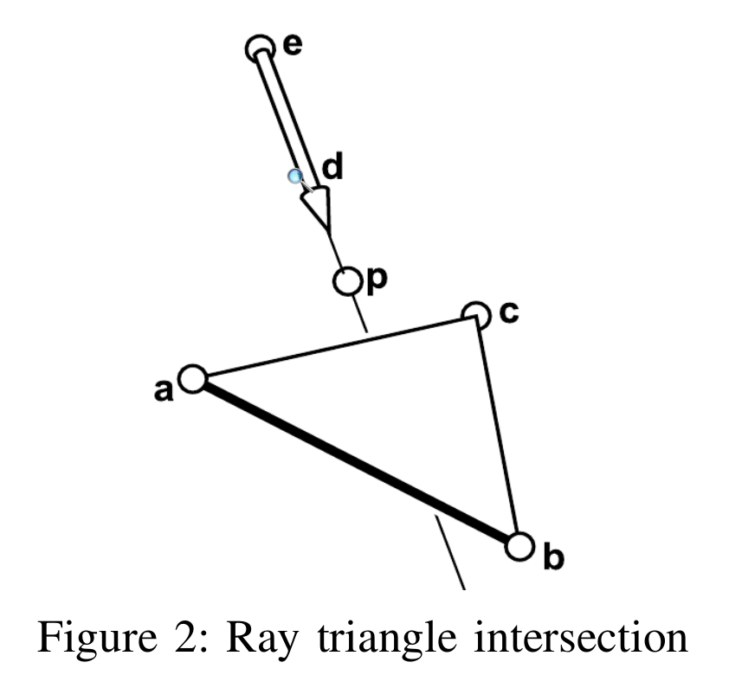
Triangle model
How to judge the intersection of ray and triangle?

Slide 8
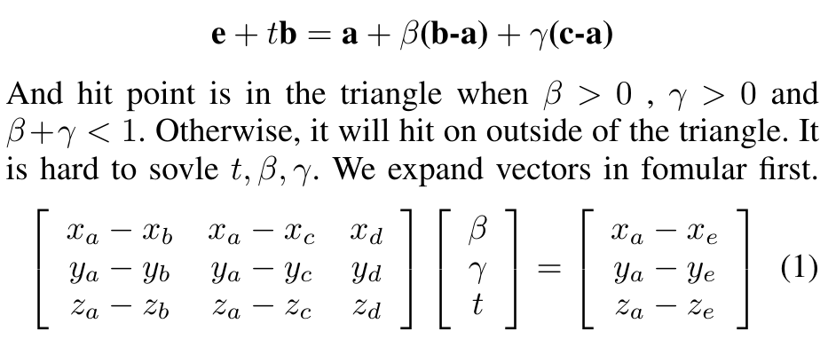
How to judge the intersection of ray and triangle?
Triangle model

Slide 9
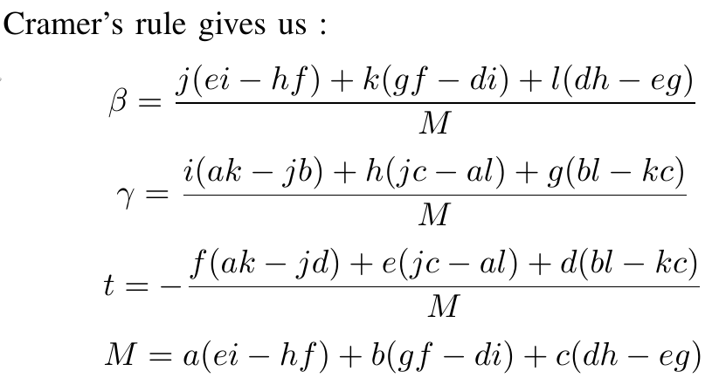
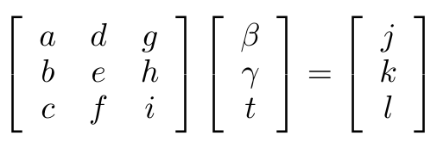
How to judge the intersection of ray and triangle?
Triangle model
Cramer's Rule:
https://en.wikipedia.org/wiki/Cramer%27s_rule

Slide 10
Triangle model
How to judge the front and back of a triangle?

Slide 11
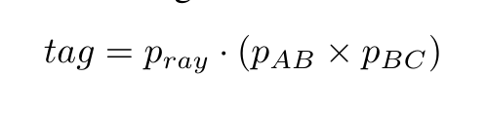
Triangle model
How to judge the front and back of a triangle?

Slide 12
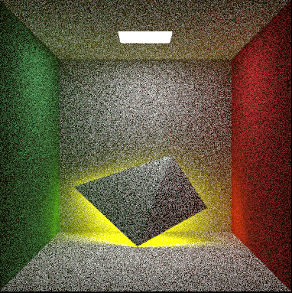
Triangle model

Slide 13
Reference
[1] P. Shirley, “Ray tracing in one weekend,” 2016.
[2] J. M. Snyder and A. H. Barr, Ray tracing complex models containing
surface tessellations. ACM, 1987, vol. 21, no. 4.

