Slide 1
Predict Type of Cuisine Using Logistic Regression
Lujin Zhao

Slide 2
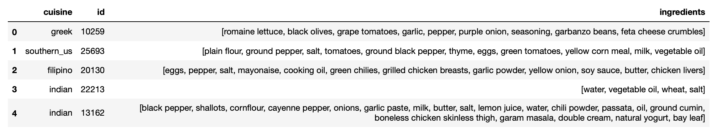
What I have:
In total, there are 20 cuisines, including Brazilian, British, French, Spanish and Thai, and over 6,000 ingredients.
39774 different dishes

Slide 3
What I want to do
Run a model to accurately predict the type of cuisine.
Using dummy variables cannot reflect the importance of some ingredients.

Slide 4
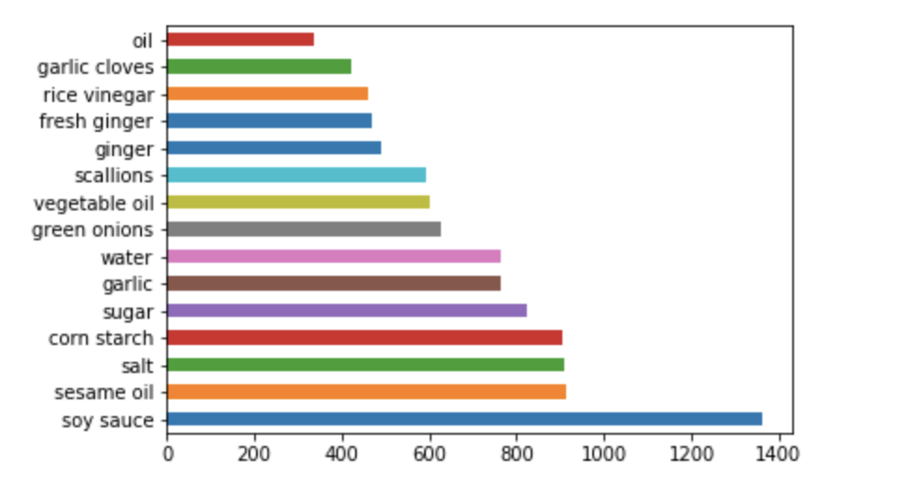
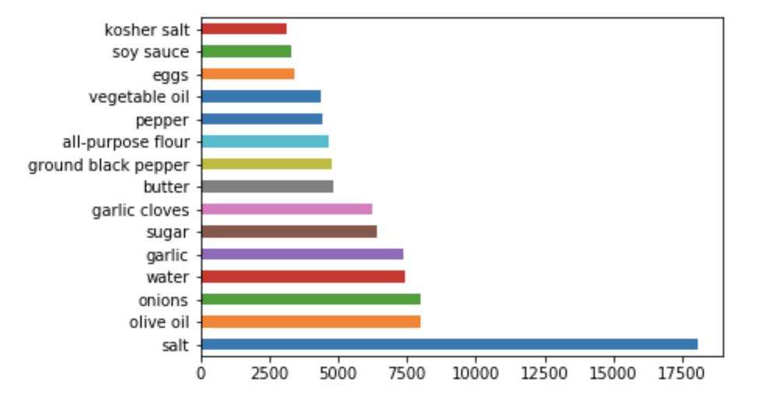
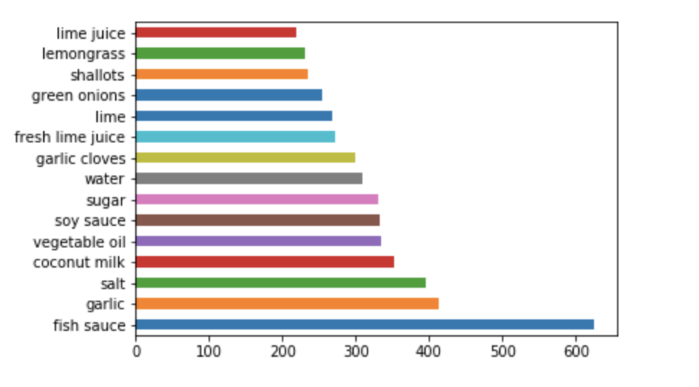
What I want to do
Run a logistic regression to accurately predict the type of cuisine.
Top 10 ingredients in Chinese cuisine
Top 10 ingredients in All cuisines
Top 10 ingredients in Thai cuisine

Slide 5
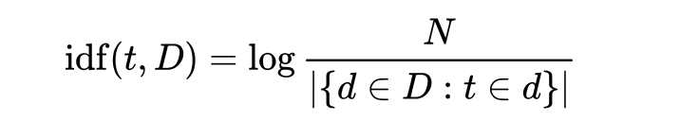
What I did
Since some ingredients cannot help us identify what cuisine it belongs to
I used TF-IDF to put weight on different ingredients.
it gives a higher value when the ingredient occurs rarely.

Slide 6
What I get
After vectorize the ingredients list, I got a 39774 x 2768 matrix
The reduction in size is mainly due to I controlled for tense and plural.
The logistic regression gives a score of 78.7%

