Slide 1
Identifying Optimal Location for Chinese Restaurant in Madrid, Spain
- Coursera IBM Capstone Final Project
August 19, 2019

Slide 2

Problem Statement
There are now more than 250,000 Chinese immigrants in Spain
Most Chinese immigrants resides in big cities like Madrid
Due to economic growth of Chinese immigrants, they have established themselves in Spanish market with big purchasing power
A new business targeting Chinese immigrants pose a good opportunity
This project attempted to find the optimal location with highest potential of success for a new Chinese restaurant in Madrid

Slide 3
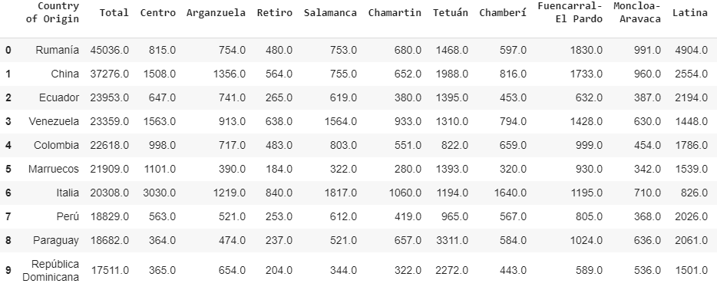
Data Acquisition
1
The original data was obtained from the Madrid City Hall website (www.madrid.es)
2
Data transformation to clean out unnecessary information
3
Foursquare API was used to acquire venue distribution information in the neighborhood of Madrid
4
The locational information (latitude and longitude) was also obtained from Geocoder

Slide 4
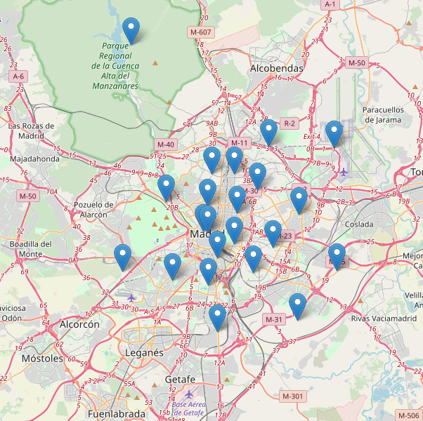
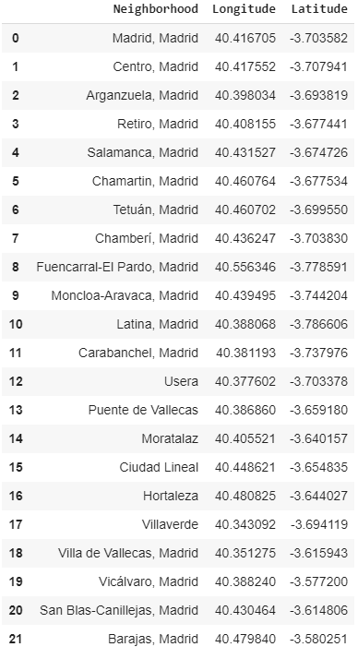
Data Acquisition
1
The original data was obtained from the Madrid City Hall website (www.madrid.es)
2
Data transformation to clean out unnecessary information
3
Foursquare API was used to acquire venue distribution information in the neighborhood of Madrid
4
The locational information (latitude and longitude) was also obtained from Geocoder

Slide 5
Data Acquisition
1
The original data was obtained from the Madrid City Hall website (www.madrid.es)
2
Data transformation to clean out unnecessary information
3
Foursquare API was used to acquire venue distribution information in the neighborhood of Madrid
4
The locational information (latitude and longitude) was also obtained from Geocoder

Slide 6
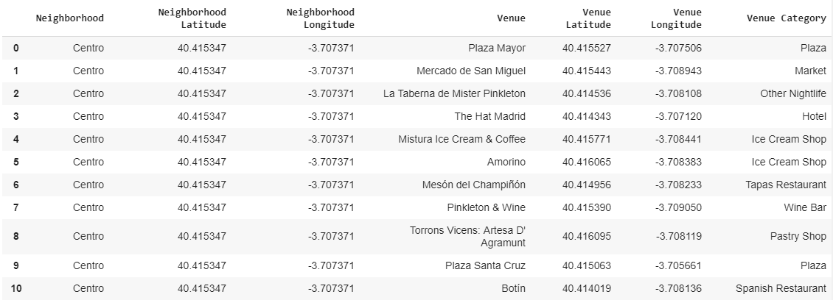
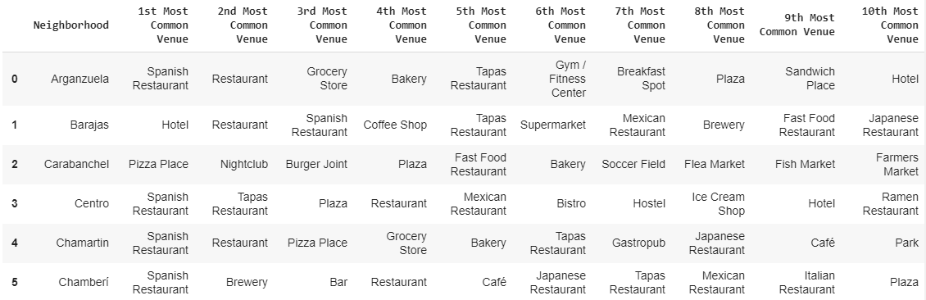
Data Presentation
1
The original data was obtained from the Madrid City Hall website (www.madrid.es)
2
Data transformation to clean out unnecessary information
3
Foursquare API was used to acquire venue distribution information in the neighborhood of Madrid
4
The locational information (latitude and longitude) was also obtained from Geocoder
5
Venues are categorized based on neighborhood location

Slide 7
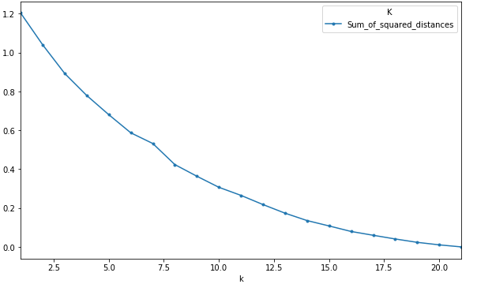
K-Nearest Neighbor Clustering
1
K-Nearest Neighbor requires the selection of the ideal K value
2
Elbow method was used to identify the ideal K value
3
Foursquare API was used to acquire venue distribution information in the neighborhood of Madrid
4
The locational information (latitude and longitude) was also obtained from Geocoder
5
Venues are categorized based on neighborhood location

Slide 8
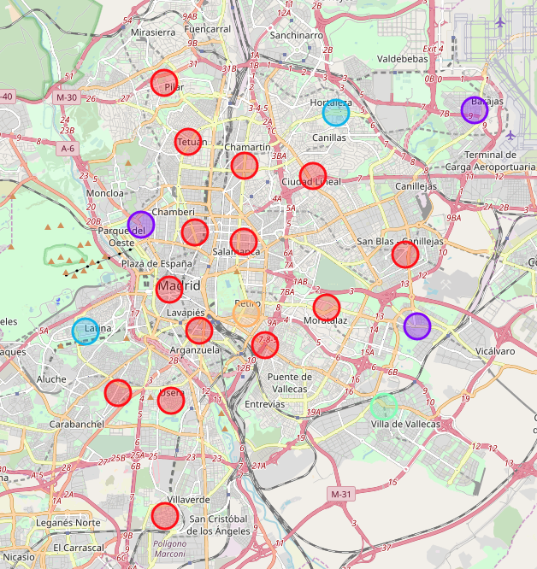
K-Nearest Neighbor Clustering
1
K-Nearest Neighbor requires the selection of the ideal K value
2
Elbow method was used to identify the ideal K value
3
Based on the selected K value of 5, the neighborhoods were divided into 5 clusters.
4
The locational information (latitude and longitude) was also obtained from Geocoder
5
Venues are categorized based on neighborhood location

Slide 9
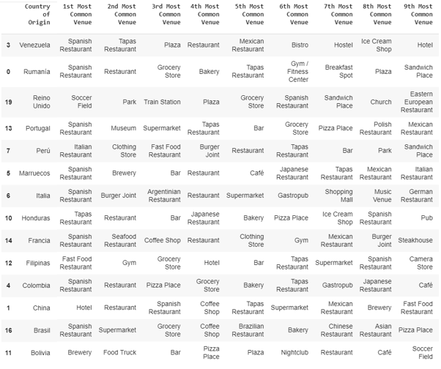
Results and Discussion
1
Cluster 1 included majority of the neighborhoods including Chinese immigrants
Most common venues include hotel, Spanish restaurants, and coffee shops
Chinese restaurants was only ranked 7th most common venue.
High competition for new business is anticipated.

Slide 10
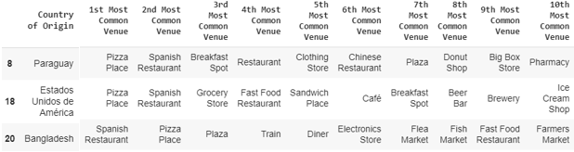
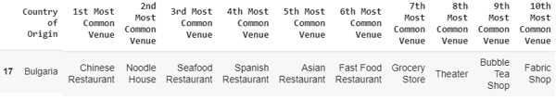
Results and Discussion
2
Cluster 2, 3, and 5 showed most venues from Pizza places and Spanish restaurants
It means very limited opportunity for Chinese-related business
4

Slide 11
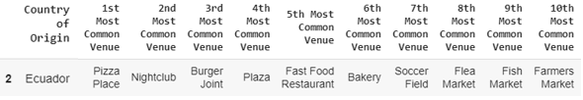
Results and Discussion
Cluster 4 covers the immigration population of Bulgaria
Most common venue was identified to be Chinese restaurant
Second, fifth, and ninth most common venues are also related to Chinese.
The residents show high interest in Chinese food and drinks
High potential for a new business
The Usera district shows significant growth of Chinse immigrants.
Ideal location for new Chinese restaurants or other related business
4

Slide 12
Conclusion
Cluster 1 shows large number of venues related to Chinese immigrants.
Large number of already-established business entities may lower the possibility of new business opportunities
Cluster 2, 3, and 5 showed very limited potential for Chinese-related business
Cluster 4, mainly the Usera district showed a significant growth in Chinese immigrant population with most common venue as Chinese restaurants
A new business targeting this neighborhood will have a high potential for success.

