Slide 1

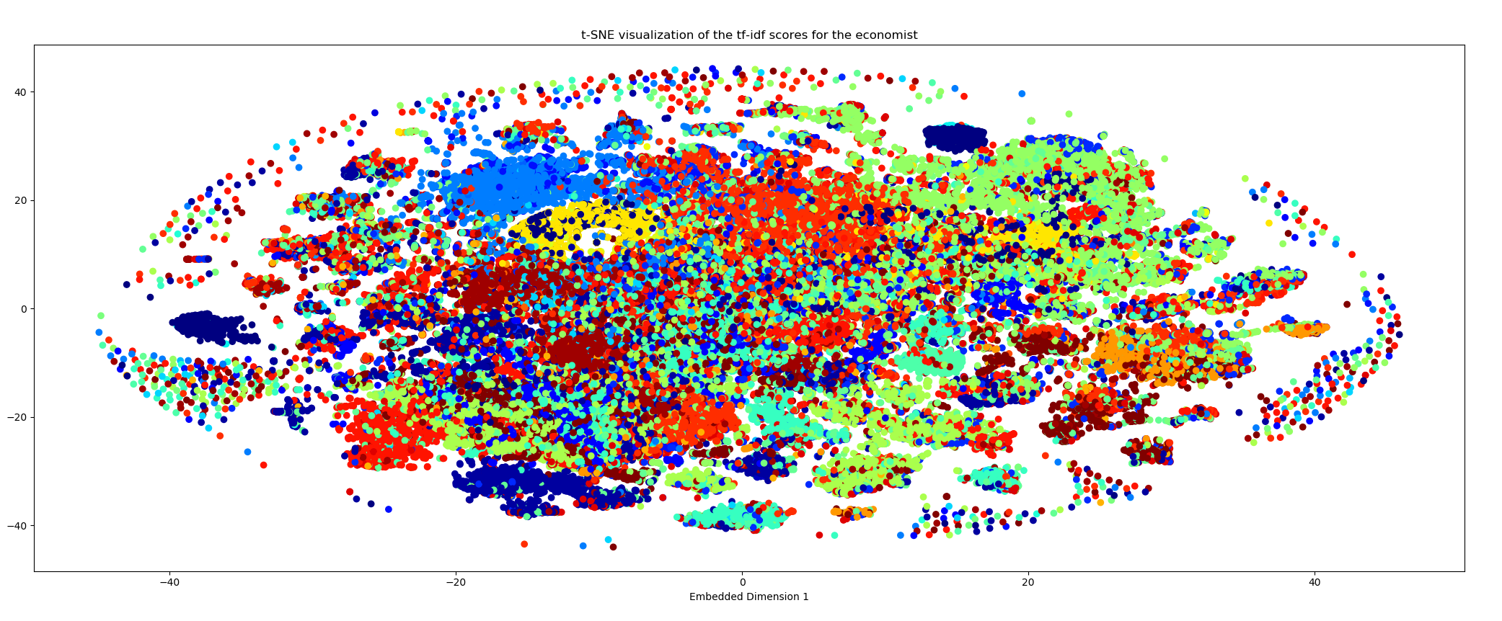
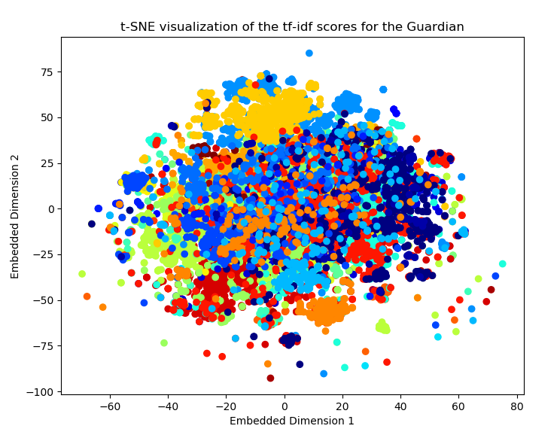
Topic Analysis of Digital Media with Deep Learning
Nathan Zhao, Jiahui Wang, Xianling Long
CS230 Winter 2018
Introduction
Models
Results
Data
References
t-SNE documentation: https://lvdmaaten.github.io/tsne/
sklearn documentatiln: http://scikit-learn.org/stable/
Keras documentation: https://keras.io

