Slide 1
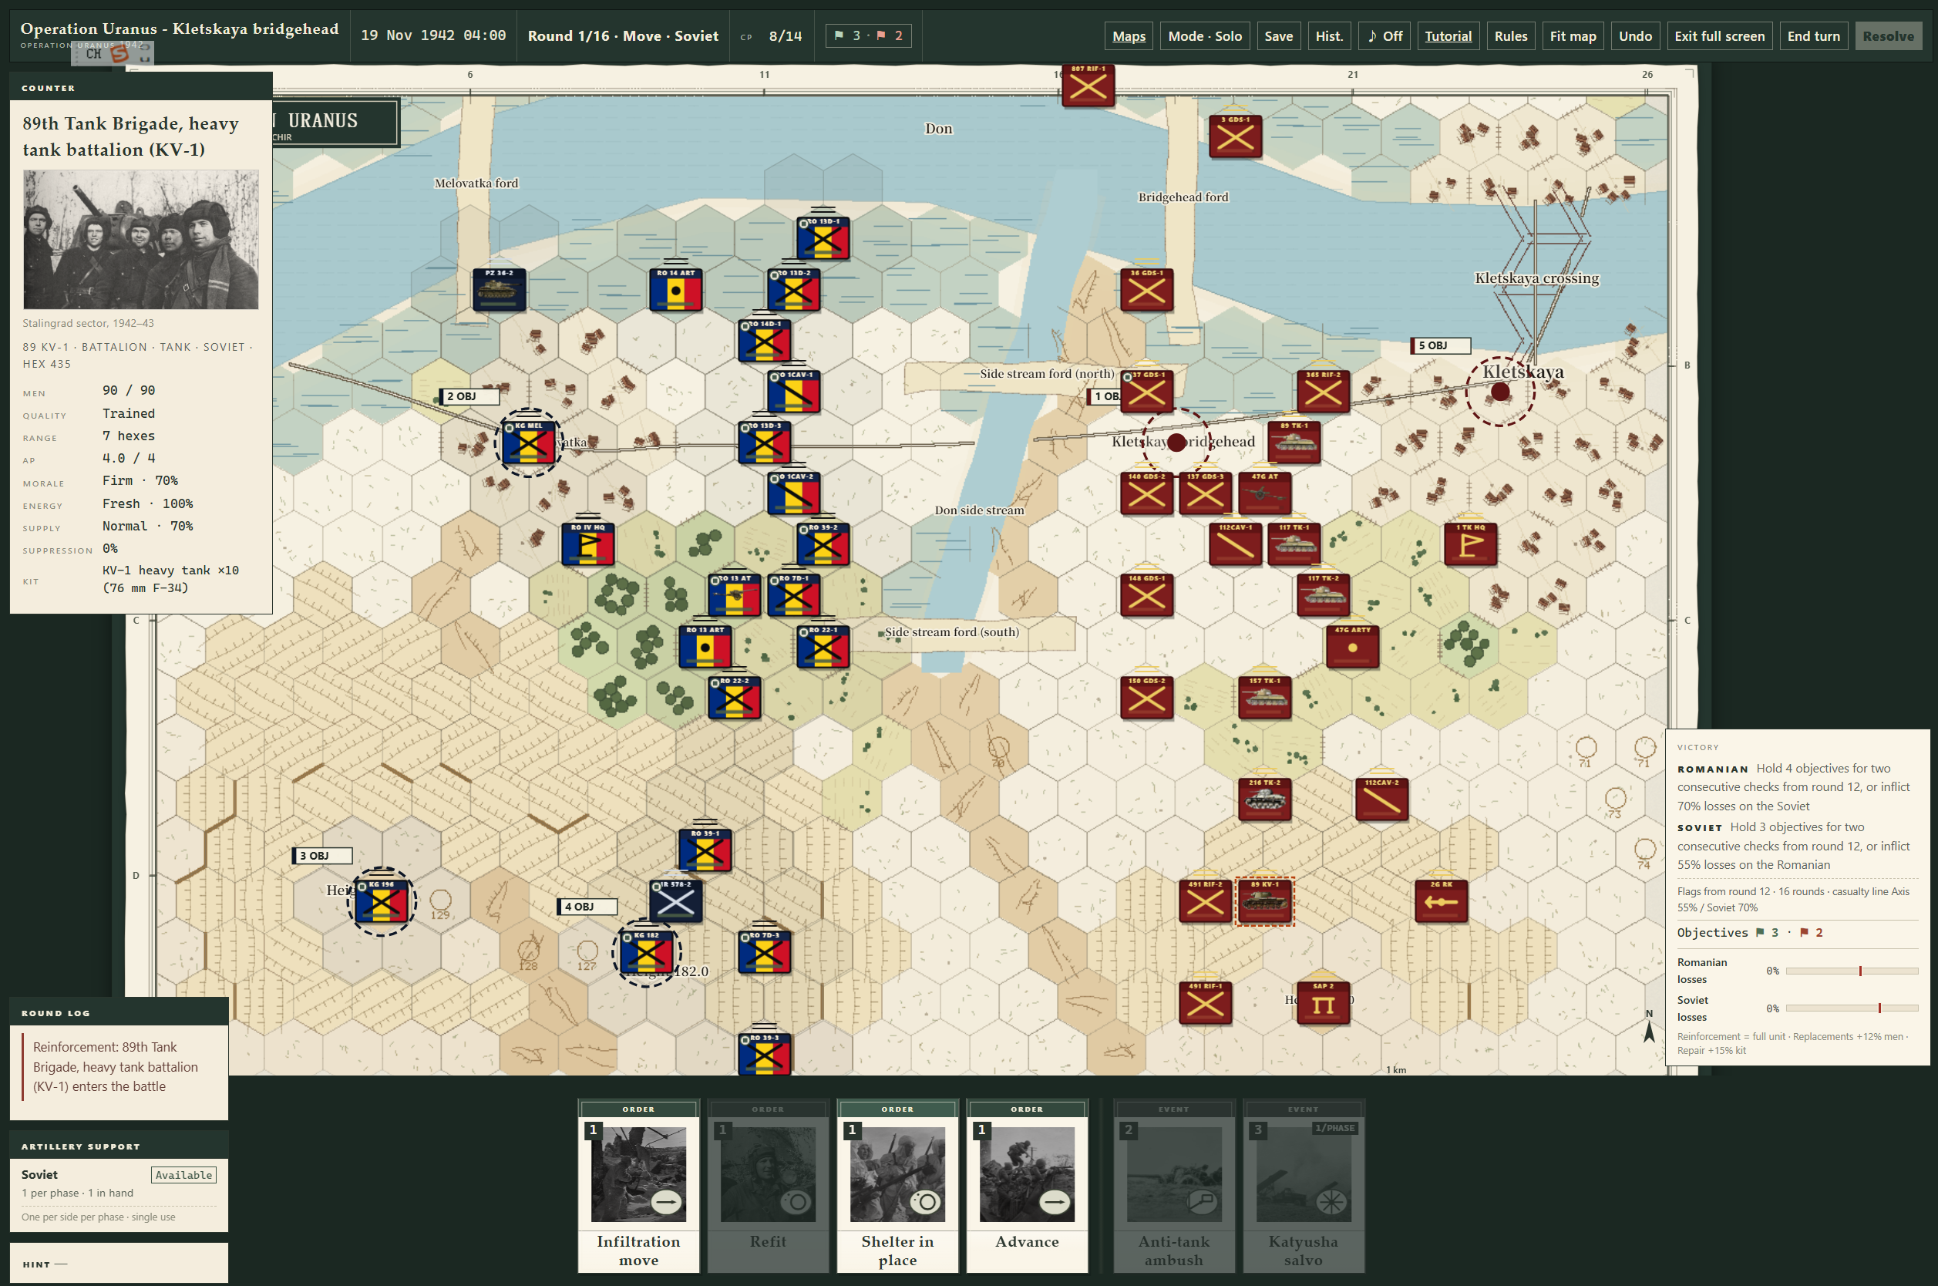
PUBLISHER / CO-DEVELOPMENT PROPOSAL
Order of the
General
STALINGRAD 1942
A card-driven hex-and-counter wargame of
Stalingrad and Operation Uranus.
Feature-complete Alpha · Windows 10/11 x64
Shihe Zhao (MrZhao) · szhao9906@gmail.com · November 2026
Order of the General · Publisher deck 1.2.0
01 / 12

Slide 2
THE GAP
Digital wargames force a bad choice
■ Deep rules, weak interface. Players fight the UI before the enemy.
■ Card games without a model. Orders are cards, but terrain, supply and ZOC are decoration.
■ Historical presentation, no decision layer. A diorama that plays the same way twice.
■ AI that cheats or does nothing. Neither teaches the rules nor rewards planning.
THE RESULT
Hard to learn.
Easy to solve.
Neither a wargame
nor a card game.
Order of the General starts from the opposite direction.
Order of the General · Publisher deck 1.2.0
02 / 12

Slide 3
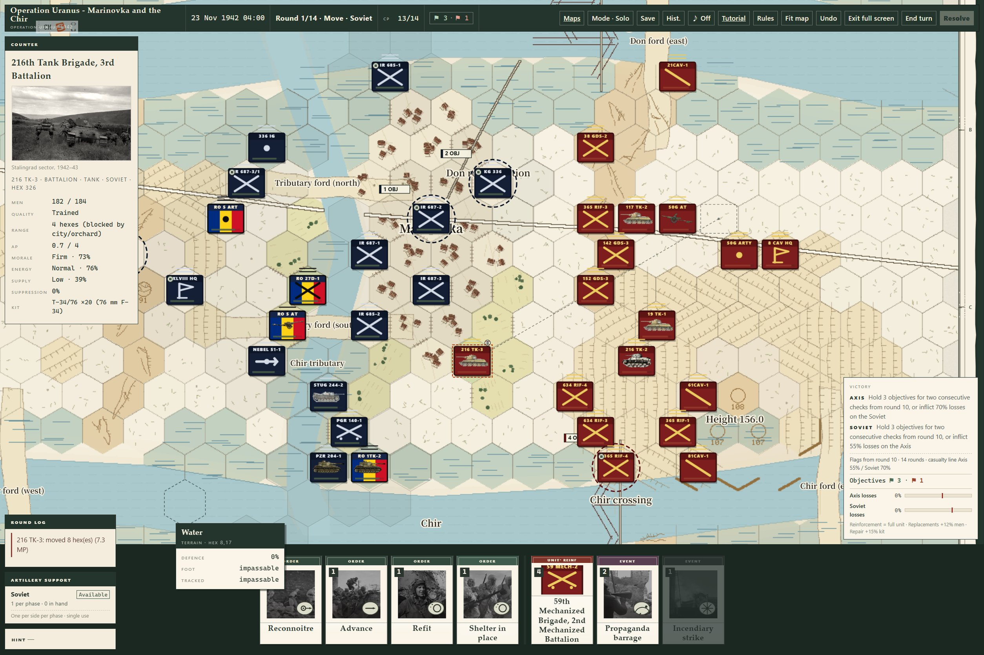
THE ANSWER
A wargame first. Card-driven second.
■ Hexes and counters. ZOC, LOS, stacking, supply, morale, fieldworks.
■ Orders are a hand. Movement, attack and special cards — not a menu.
■ Tempo is the design. You have the plan; you do not have the actions to do everything.
■ The AI plays the same game. Same decks, same rules, no hand-reading.
Marinovka and the Chir, 23 November 1942. Selected Soviet tank brigade; counter panel, hand, objectives, victory conditions.
Order of the General · Publisher deck 1.2.0
03 / 12

Slide 4
CORE LOOP
One phase, six decisions
01
02
03
Deal
Command
Act
4 normal + 3 special cards
Spend CP and action points
Move, fire, suppress, assault
04
05
06
Resolve
React
Judge
Morale, supply, fieldworks, casualties
End the phase; the AI acts
Objectives, losses, next round
Each phase deals a fresh hand; specials carry from movement into attack. The round ends on objectives, not on a kill count.
Order of the General · Publisher deck 1.2.0
04 / 12

Slide 5
THE MAP
Ground has memory
■ 216 m per hex; company/battalion scale
■ ZOC ends movement and blocks ZOC-to-ZOC steps
■ Line of fire, orchards, urban cover
■ Stacking by echelon
■ Supply traces and encirclement
■ Fieldworks and artillery sheaves
Terrain tooltip: water is impassable to foot and tracked; the river and ferries shape every plan.
Order of the General · Publisher deck 1.2.0
05 / 12

Slide 6
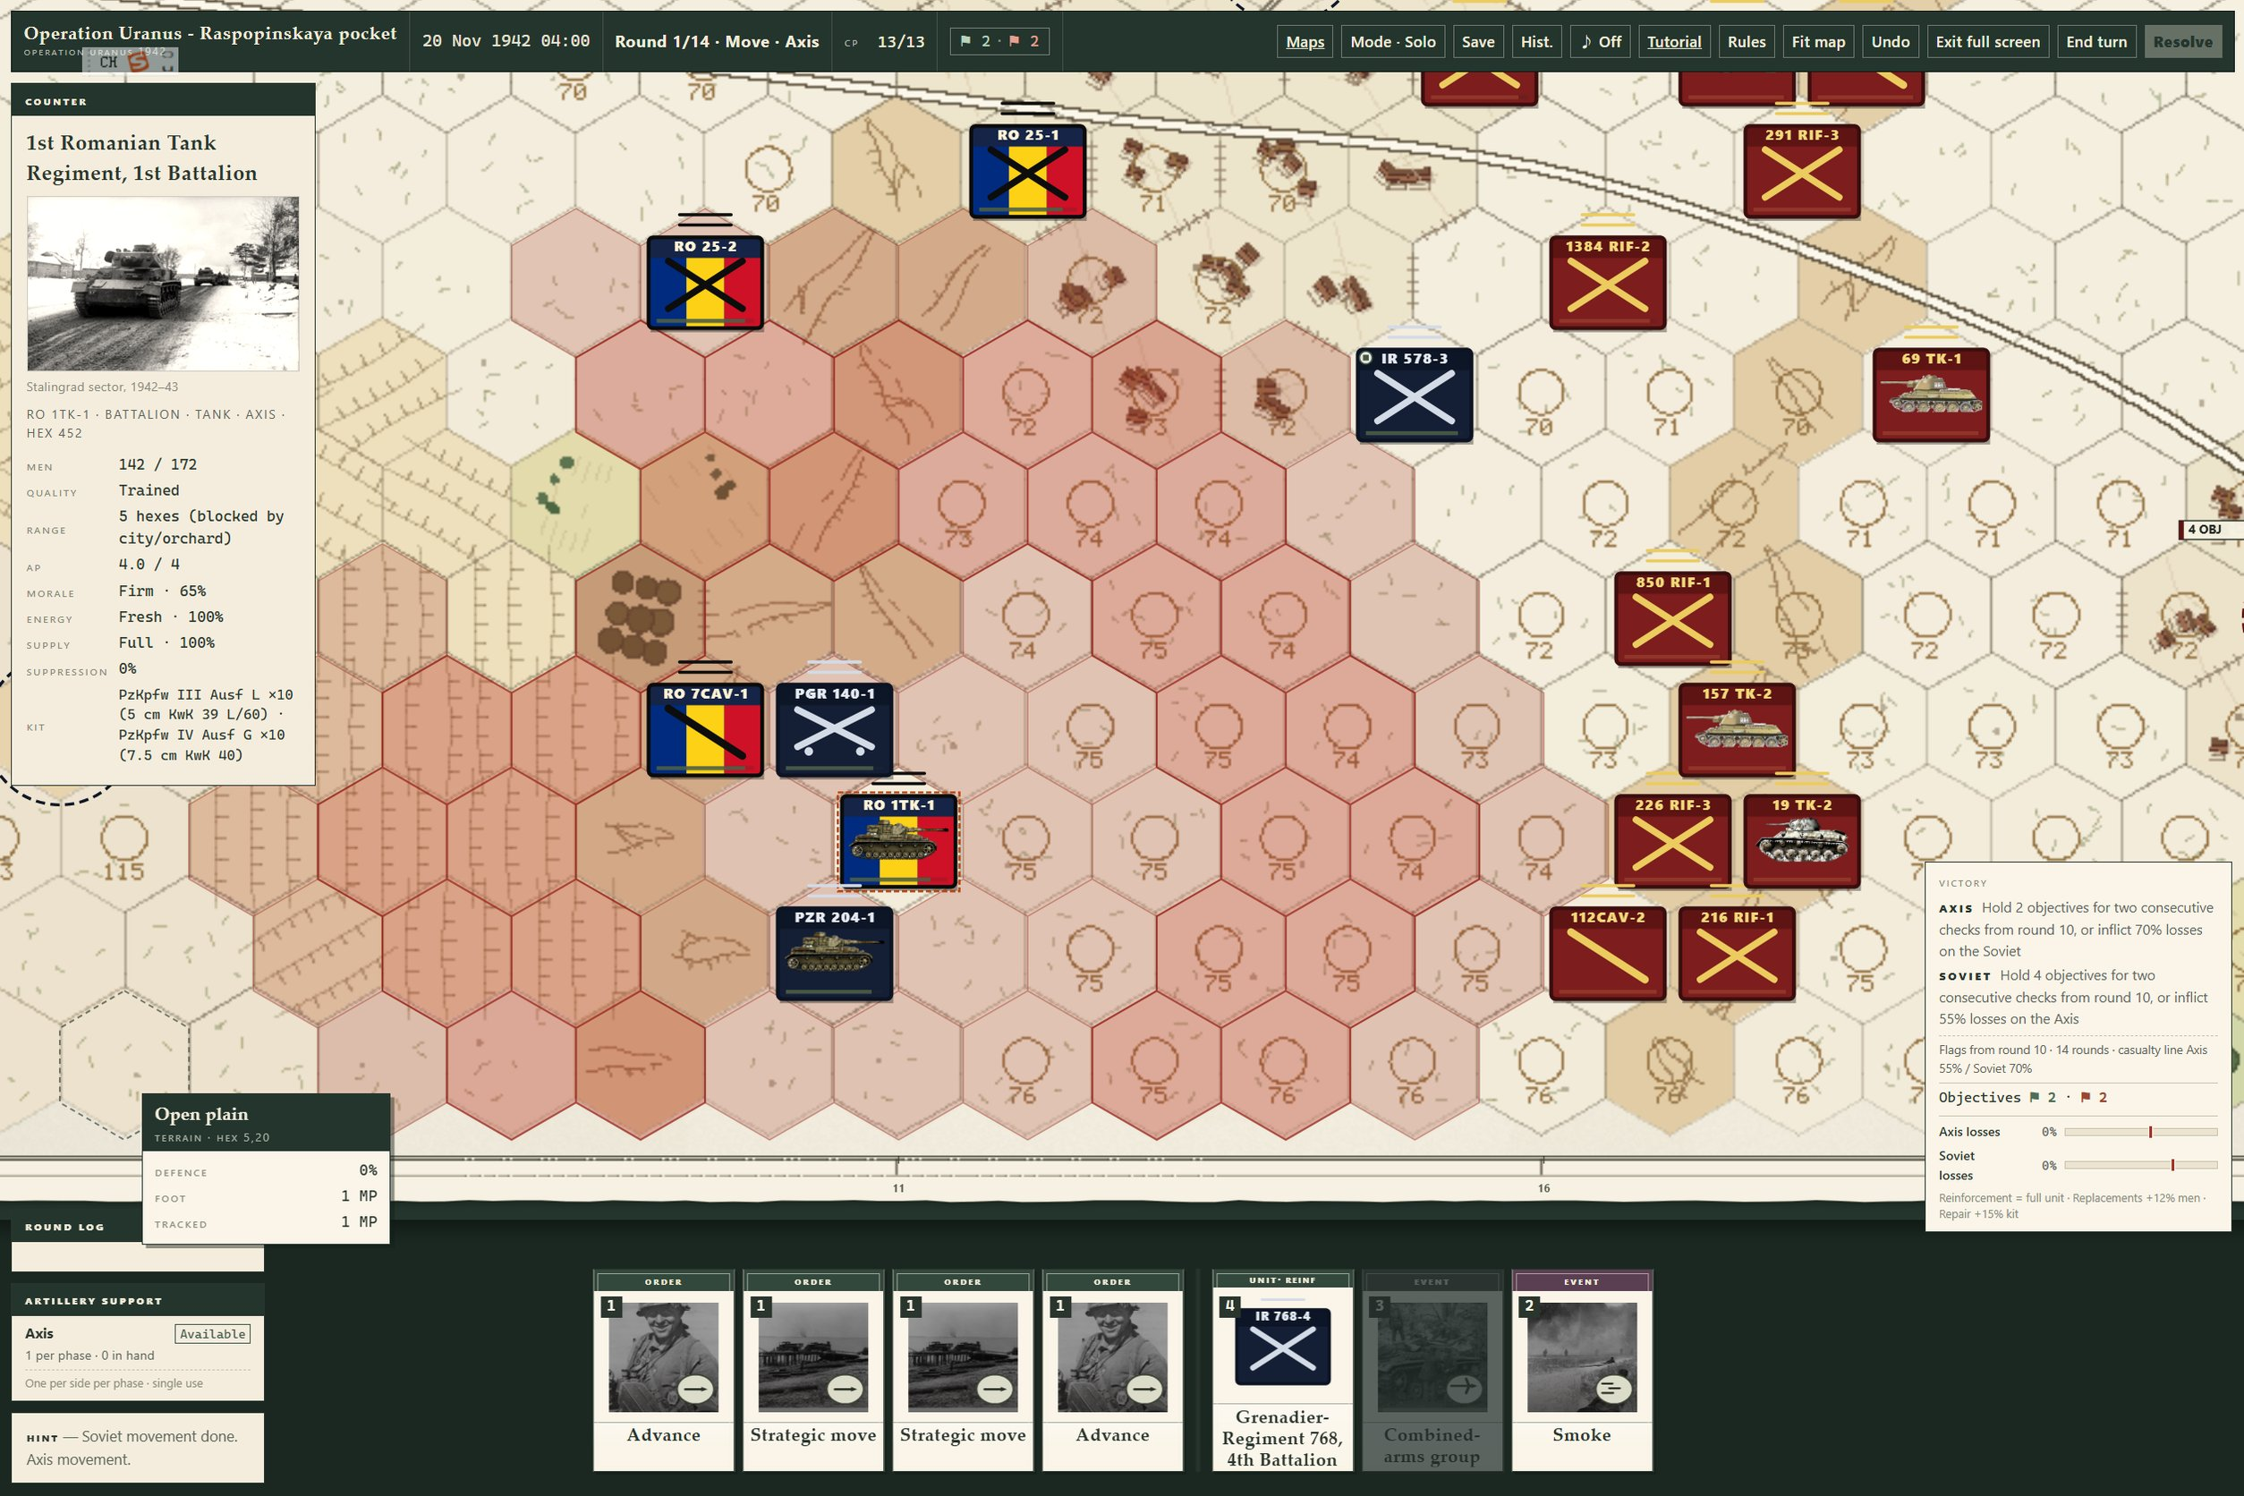
COMMAND
A hand, not a menu
■ Movement deck. Advance, Strategic Move, Infiltration, Recon, Resupply, Refit.
■ Attack deck. Attack, Assault, Fire, Direct Fire, Suppress, Defend, Entrench.
■ Special deck. Reinforcements, events, high command; carried across the round.
■ Prepared Manoeuvre. Attack-phase move at 0.8× MP; reach shown before commitment.
■ Infiltration. 0.75× MP, ignores ZOC; spend all remaining AP.
Axis hand, 26 November 1942: two Strategic Move cards, Advance, Refit; Romanian 1st Tank Regiment selected.
Order of the General · Publisher deck 1.2.0
06 / 12

Slide 7
OPPONENT
AI that plays the same game
■ Legal-action planner. Not scripted triggers; it scores what is actually legal.
■ Prep before assault. Artillery, suppression, combined arms, observed fire.
■ Armour behaves like armour. Keeps range against infantry; closes after suppression.
■ Anti-tank guns. Hold key ground and cover armour approaches.
■ Five levels. Easy, Normal, Hard, Extreme, Astra — same rules, different planning depth.
8
106
playable boards
unit templates
51
400
card definitions
self-play games
No hand-reading. No hidden-order reading.
Order of the General · Publisher deck 1.2.0
07 / 12

Slide 8
CONTENT
Eight boards, one ruleset
CITY
Mamayev Kurgan
Balka / factories
City centre
Lower town
URANUS
Kletskaya
Raspopinskaya
Kalach / Don
Marinovka / Chir
All eight share the same rules, decks, AI and UI. Content is authored — not a separate engine per battle.
Stalingrad city: four street-by-street boards. Operation Uranus: four encirclement boards.
Order of the General · Publisher deck 1.2.0
08 / 12

Slide 9
STATUS
Feature-complete alpha
PLAYABLE TODAY
PRODUCTION FINISH
■ Card / CP / action-point loop
■ Complete combat resolution
■ AI turns, five levels
■ Save / load, hot-seat, LAN
■ English UI
■ Eight boards
■ Guided tutorial slice
■ Audio / music / SFX
■ Animation / VFX
■ Historical-photo clearance
■ QA + localization QA
■ Steam integration
The engine and content are built. The remaining work is production finish, not another prototype.
Order of the General · Publisher deck 1.2.0
09 / 12

Slide 10
VERTICAL SLICE
The tutorial is the demo
■ 10–15 minute guided tutorial; one map
■ Select unit and card → ZOC → attack preview
■ Artillery minimum / maximum range
■ Suppression → assault → supply / refit
■ End turn → AI → objective check
■ Same build is the publisher demo
Kletskaya bridgehead: the opening situation a new player would meet in the guided tutorial.
Order of the General · Publisher deck 1.2.0
10 / 12

Slide 11
PRODUCTION
Six-to-eight months to a commercial beta
UI/UX + tutorial
Guided slice, onboarding, readability
THE ASK
Photo rights
Clearance ledger, licensed or replaced images
Development advance
or co-development
funding.
Open to publisher-
recommended partners
or our contracted team.
Audio
Music, ambience, UI and combat SFX
Animation / VFX
Movement, fire, suppression, artillery, cards
QA
Windows, saves, LAN, localization, regression
Localization
English LQA; additional languages optional
Steam
Steamworks, achievements, cloud saves, depot
Order of the General · Publisher deck 1.2.0
11 / 12

Slide 12
WHY THIS PROJECT
We are not asking for money
to build a prototype.
We are asking for a partner to finish a working wargame.
■ Rules engine and AI already built and tested
■ Eight boards already content-complete
■ Production gap scoped; photo rights audit underway
szhao9906@gmail.com · private build link supplied separately · November 2026
Order of the General · Publisher deck 1.2.0
12 / 12

