Slide 1
Interaction Design
chap5 : SOCIAL INTERACTION

Slide 2
Objectives
social interaction
social mechanisms
new technologies that facilitate collaboration
how social media changed our lives

Slide 3
Introduction&Being social
People are inherently social,A fundamental aspect of everyday life is being social
While face-to-face conversations remain central , the use of social media has dramatically increased
eg:adults have about 338 Facebook friends, have more than 1,000 connections in LinkedIn.
Key Q:how it has affected people’s ability to connect, work, and interact with others

Slide 4
Introduction&Being social
Immerse people in a virtual social world and have a negative impact on real-world social interactions.
Encourage people to put down their phones and engage in real-world communication
eg:Amazon's Echo devices:provide support for multiplayer games and activities, enabling multiple users to participate simultaneously and offering families the opportunity to play together

Slide 5
Activity1
Differences bet face-to-face communication&mobile communication
f-t-f:unpredictabe,spontaneous, much intimacy through eye contact,facial expressions
texting:Asynchronous,Pre-meditated
Emoticons
compensation for nonverbal communications
engaging&enjoyable|awkward&Embarrassing

Slide 6
Face-To-Face conversation
Talking:effortless but highly skilled
What makes up a conversation?
how conversations start, progress, and finish
how natural /comfortable to talk with digital agent
mechanisms in a conventional conversation

Slide 7
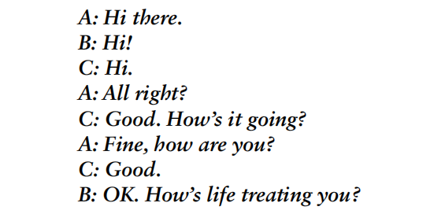
Face-To-Face conversation
Beginning/starting:
greeting like:
tech to improve chances of replying
open para with “hi/hello”
end with “thank u”

Slide 8
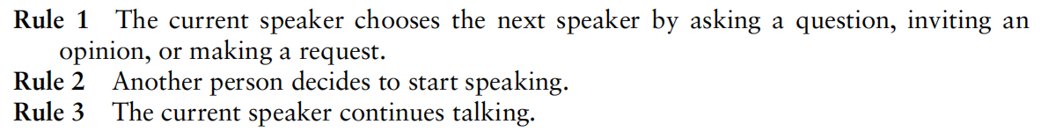
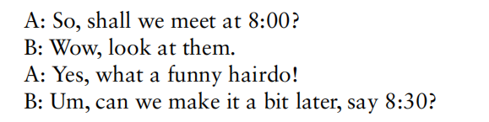
Face-To-Face conversation
Progressing:
three basic rules:
adjacency pairs
sometimes embedded in each other

Slide 9
Face-To-Face conversation
Finishing
signs indicating a desire to end a conversation:
implict:look at the watch
explict:“Well, I have to go now.|Oh dear, look at the time.”
Nonverbal communication also plays an important role in face-to-face conversation
the use of facial expressions, voice intonation, gesturing etc.

Slide 10
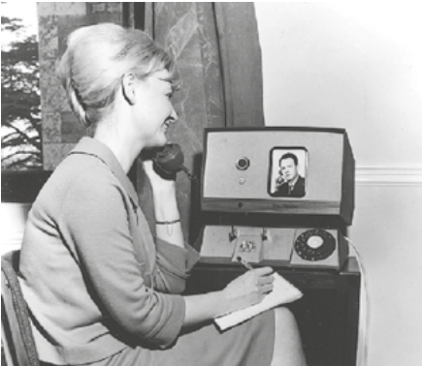
Remote conversation
Telephone&other techs are invented
Media space
eg.Media Windows

Slide 11
Remote conversation
Media space:videoconferencing
enlarging the person who’s talking
highlighting their portal
robotics
increasing physical&social self-efficacy and well-being
telepresence robots:

Slide 12
Remote conversation
telepresence robotics:
a regular feature at conferences,especially ACM CHI(2019)
5 feet-tall,have a display screen showing the remote’s peoples face at the top,wheels at the bottom
a microphone and two cameras
Strong immersion leads to a better experience
both to the conference attendees and the remote user
Some probs:
can’t see how he/she appears to others
can’t judge the volumn of his/her voice
can’t interat with physical peripheral environment
obstruct the attendee’s view

Slide 13
Box1:Facebook Spaces
How Natural Is It to Socialize in a 3D World
Goal:provide a magical feeling of presence
Probs:
a way to go before natural:
facial expression
skin tone
the two features appear to be cartoon-like
perennial problem of motion sickness

Slide 14
BOX2:Simulating Human Mirroring
During f-t-f conversations,mirroring is a common phenomenon
mimic facial expressions,gestures,body movements
induce empathy and closeness bet conversing
A new tech called FaceShare:
3D modeling including contours, eyes, nose, and mouth
raising the low eyelids,ends of mouth,cheeks
similar blendshapes matters in emotional communication

Slide 15
BOX3:Playing Together in the Same Place
Augmented reality sandboxes:
interact with a landscape,the sand is real but the landscape is virtual
shape the sand into diff-shaped contours
provide a creative space for both children and adult
The extensive applications of AR:in industry/education/medical
the experence of AR in industry
microsoft&meta

