Slide 1
DATA GATHERING

Slide 2
DATA GATHERING
Main goals about chap 8:
how to plan and run a successful data gathering program
how to run a interview
how to design a questionnaire
help you to plan and carry out an observation

Slide 3
DATA GATHERING:Introduction
Data can be anything that is useful for understanding a particular design
Data can be quantitative or qualitative.
Data gathering captures user reactions with a system
Three main techniques are introduced:
INTERVIEWS
QUESNTIONNAIRES
OBSERVATION

Slide 4
DATA GATHERING:Introduction
features about this techniques:
INTERVIEWS:
an interviewer,one more interviewees,synchronous,often f-t-f.
QUESNTIONNAIRES:
a series of questions to be answered asynchronously,paper-based or available online.
OBSERVATION
direct or indirect.
This three techs are used to collect quantitative or qualitative data

Slide 5
Five Key Issues
Five Key Issues:
goal setting
identifying participants
the relationship between the data collector and the data provider
triangulation
pilot studies

Slide 6
Five Key Issues:Setting Goals
main reason for gethering data:collect information about users,their behavior,their reaction to technology.
why setting goals matters:goals will influence the nature of data gathering sessions, the techniques to be used, and the analysis
In interaction design, it is more common to express goals for data gathering informally

Slide 7
Five Key Issues:Identifying Participants
population: people who fit the profile
sampling:
all members of the target population are accessible is called saturation sampling
only a portion of population involved in:
probability sampling:
simple random sampling or stratified sampling(简单随机抽样/分层抽样)
nonprobability sampling
convenience sampling , snowball sampling or volunteer panels

Slide 8
Five Key Issues:Identifying Participants
difference between probability and nonprobability methods：
probability methods:can apply statistical tests and generalize to the whole population
nonprobability methods:not robust

Slide 9
Five Key Issues:Relationship with Participants
make sure the relationship is clear and professional
different country ,different ways:
In the United States and United Kingdom,participants should sign an informed consent form intended to protect the interests of both the data gatherer and the data provider.
while in Scandinavia it’s not required.
a example：

Slide 10
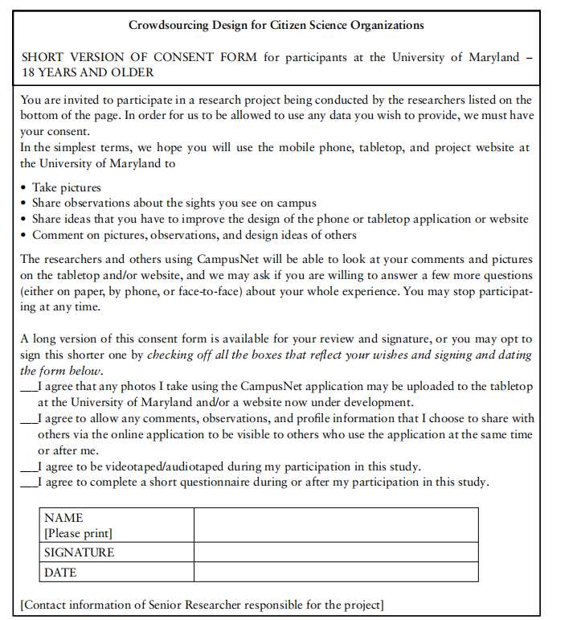
Five Key Issues:Relationship with Participants

Slide 11
Five Key Issues:Triangulation
what’s Triangulation: a term used to refer to the investigation of a phenomenon from two different perspectives or more.
Four types of triangulation:
Triangulation of data
data is drawn from different sources at different times, in different places
Investigator triangulation
different researchers
Triangulation of theories
the use of different theoretical frameworks
Methodological triangulation
employ different data gathering techniques

Slide 12
Five Key Issues:Pilot Studies
a small trial run of the main study, make sure that the proposed method is viable before embarking on the real study
asking colleagues or peers to participate can work as an alternative for a pilot study
anyone involved in a pilot study cannot be involved

Slide 13
Data Recording
Three common data recording approaches:
Notes Plus Photographs
using pen & paper
pos:more flexible,help reserchers think about what the data symbolized
neg:tiring to listen and write at the same time,easy to lose concentration,difficult to decipher
if possible, photograph(s) and short videos can supplyment notes
Audio Plus Photographs
for observer, focus on the activity rather than capture every word
for interviewer, pay more attention to the interviewee rather than take notes while listening
Audio recordings are often supplemented with photographs when performing interviews remotely
Video
when and where to record.

Slide 14
Activity 8-1
developing a new augmented reality garden planning tool, The goal is to find out how garden designers use an early prototype as they walk around their clients’ gardens sketching design ideas, taking notes, and asking the clients about what they like
What are the advantages and disadvantages of the three approaches (note-taking, audio recording with photographs, and video for data recording?

Slide 15
Interviews--conversation with a purpose
four main types of interviews:
open-ended/unstructured
structured
semi-structured
group interviews,also called focus group
how to choose a proper one?

Slide 16
Interviews--Unstructured Interviews
similar to conversations around a particular topic and no particular expectation about the format or content of answers.
both the interviewer and interviewee can steer the interview
despite being open,the interviewer needs a plan of main topics
benifit:
generate rich data
exploratory
produce rich insights

Slide 17
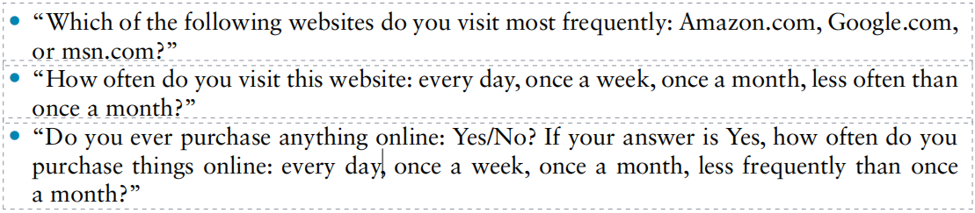
Interviews--Structured Interviews
asks predetermined questions similar to those in a questionnaire
work well if the range of possible answers is known
examples:

Slide 18
Interviews--Semi-structured Interviews
a basic script for guidance so that the same topics are covered with each interviewee
not to pre-empt an answer, the body language of the interviewer have a strong influence on whether the interviewee will agree with a question
Probes without introducing bias are a useful device

Slide 19
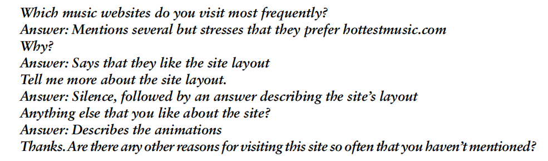
Interviews--Semi-structured Interviews
an example:

Slide 20
Interviews--Focus Groups
three to ten people involved in the group leaded by a trained facilitator
identify conflicts in expectations or terminology from different stakeholders(利益相关者)
benefits:
allows diverse or sensitive issues to be raised
convenient to guide and prompt discussion
encourage quiet people and stop verbose ones from dominating

Slide 21
Interviews--Planning and Conducting an Interview
Developing Interview questions
open-ended:unstructured interview
closed-ended:structured interview
combination of both types:semi-structured interview
some tips:
split a complicated Q into two separate questions.
explain jargons(黑话) in straightforward ways.
keep quastions neutral

Slide 22
Interviews--Running the Interview
listen more than to talk, response without bias
a common sequence:
An introduction
A warm-up session
Main session in a logical sequence
A cooling-off period
Closing

Slide 23
Questionnaires
more data can be collected
remotely or asynchronously
collaborated with other methods
diff bet Q and interview:
the motivation of the respondent to answer
the interviewer is not available to explain the Q of questionnaires

Slide 24
Questionnaires--Questionnaire Structure
start by basic demographc information(gender,age,place of birth)
details of relevant experience
a checklist:
the ordering of questions
clear instructions

Slide 25
Questionnaires--Question and Response Format
Some commonly used formats:
Check Boxes and Ranges
eg. age
Rating Scales:
Likert Scales
Semantic Differential Scales
eg:

Slide 26
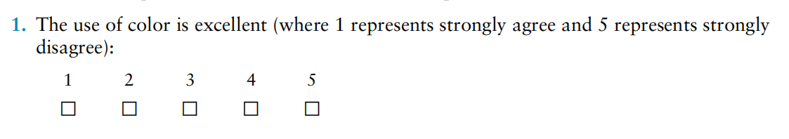
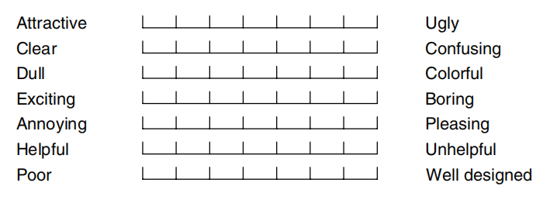
Questionnaires--Question and Response Format
Likert Scale
Semantic Differential Scales

Slide 27
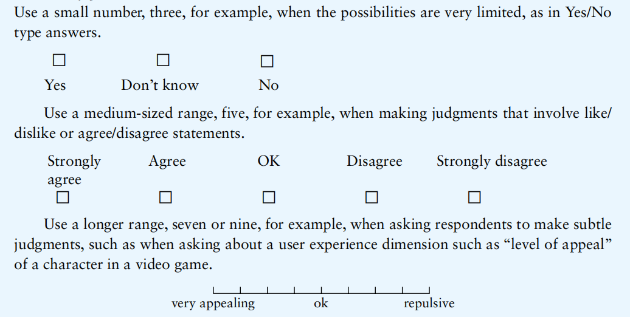
Questionnaires--Question and Response Format
Check Boxes&Likert Scale&Semantic Differential Scales

Slide 28
Observation
help fill in details
Direct observation in the field,Direct observation in a controlled environment,Indirect observation

Slide 29
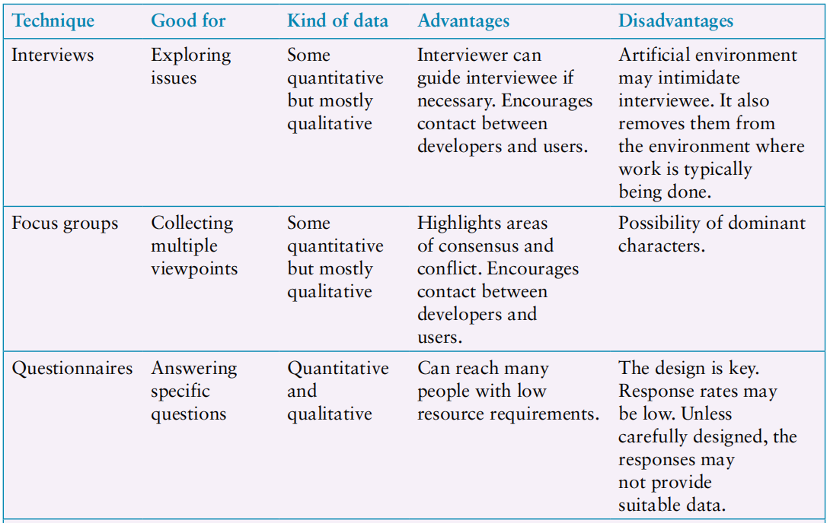
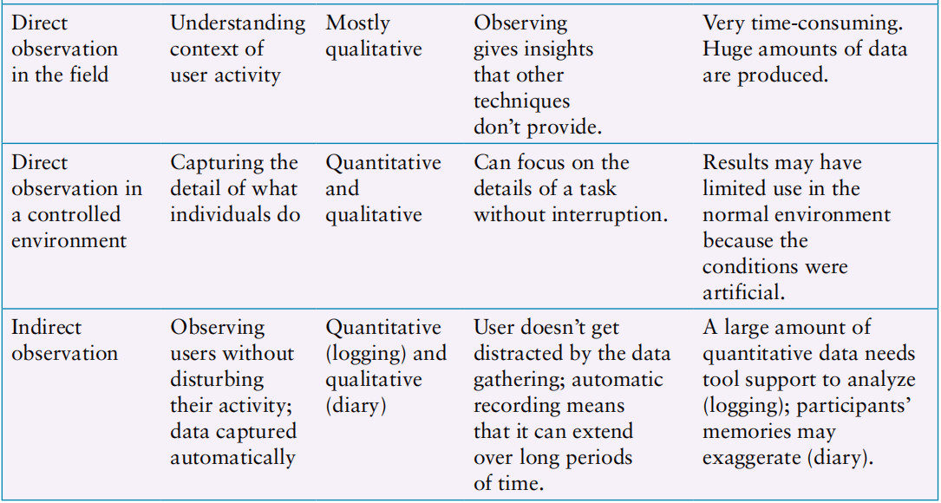
Choosing and Combining Techniques

Slide 30
Some ideas

Slide 31
DATA GATHERING:Introduction
Data can be quantitative or qualitative.
Three main techniques are introduced:
INTERVIEWS
QUESNTIONNAIRES
OBSERVATION
How to gather our data?
quantitative? -- interviews and questionnaires?
qualitative??

Slide 32
Five Key Issues:Identifying Participants
sampling:
all members of the target population are accessible is called saturation sampling
only a portion of population involved in:
probability sampling:
simple random sampling or stratified sampling(简单随机抽样/分层抽样)
nonprobability sampling
convenience sampling , snowball sampling or volunteer panels
robust or not? generalizing to the whole population ?

Slide 33
Interviews
open-ended/unstructured?
structured?
semi-structured?
group interviews,also called focus group?
semi-structured interview with open-ended and close-ended interview questions,group interviews.

Slide 34
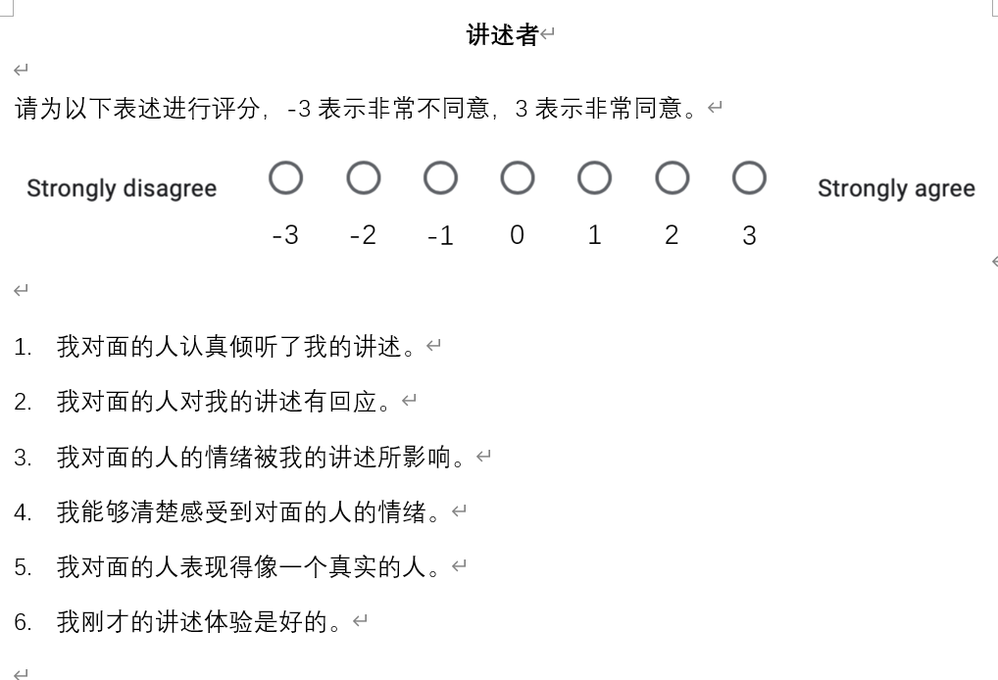
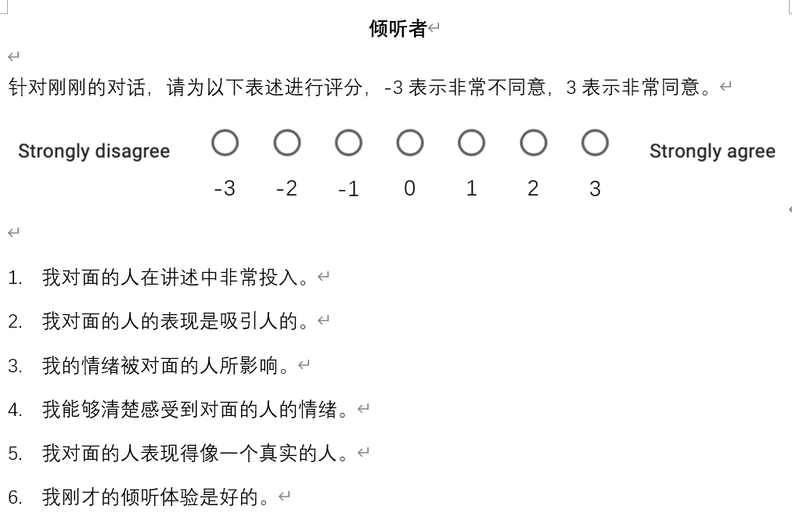
Questionnaires
how to collaborate with interview&observe?
details of relevant experience?
order?
clear instructions?
which format to choose?

