Slide 1
Capstone Project: Zillow’s Home Value Prediction
Shijie zhao
Mentor: Prof. Xiong

Slide 2
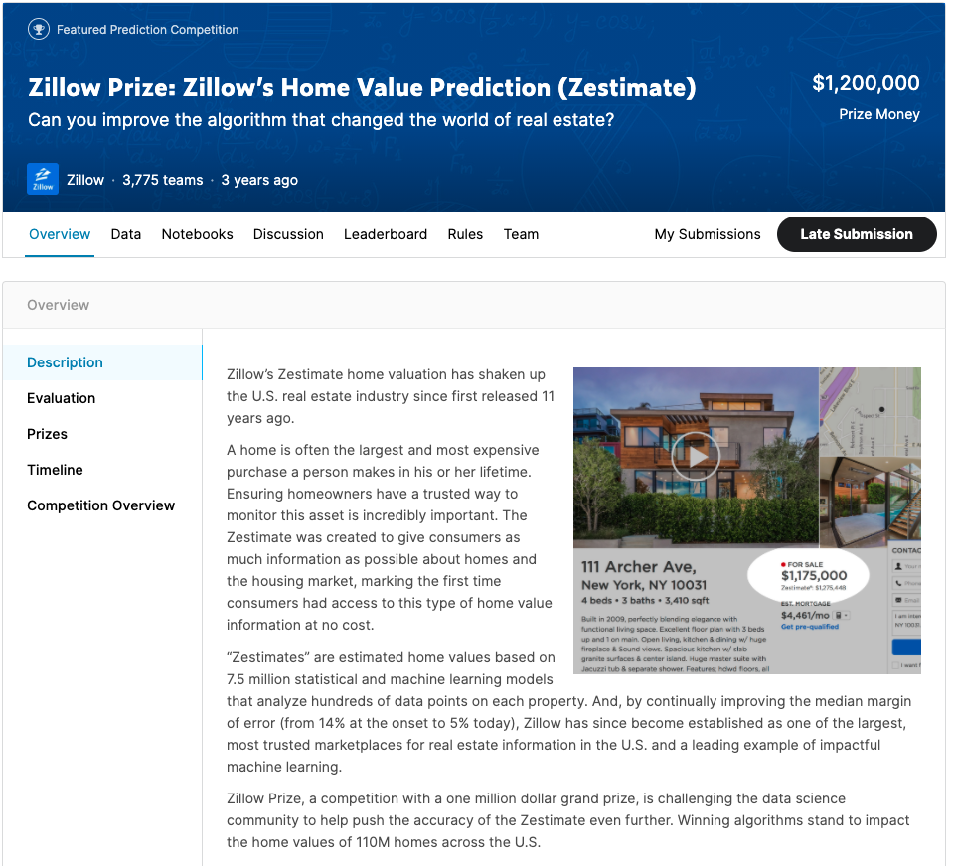
Problem to be solved
To develop a series ML algorithm that makes predictions about the future sale prices of homes in Zillow Prediction System

Slide 3
DATA and Features
The Data is split into two files
Houses sold in 2016 (Transaction data)-90k Properties
Properties data– 27 Million Properties (58 attributes)
Mortgage Records Attached
Tax Assessments
Physical features of the Property(Bed Count , Living Area, Age of the building)
Location Details about the properties
Amenities available in the property

Slide 4
Chosen approach
Exploratory Data Analysis
Impute
Missing Values
Feature Engineering
Model Building & Fine Tuning

Slide 5
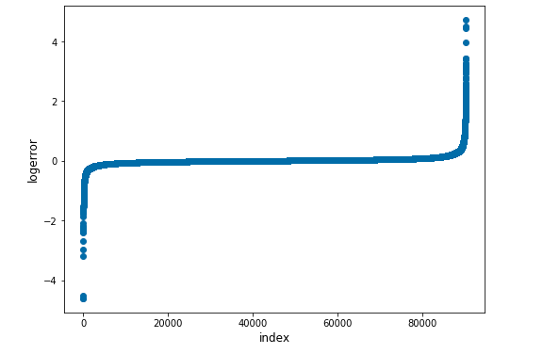
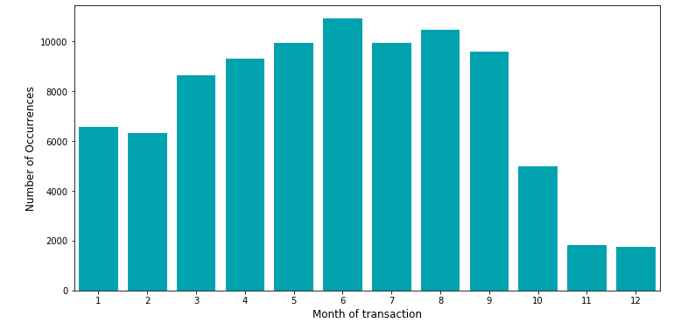
Exploratory Data Analysis
Logerror
Trasanction_date

Slide 6
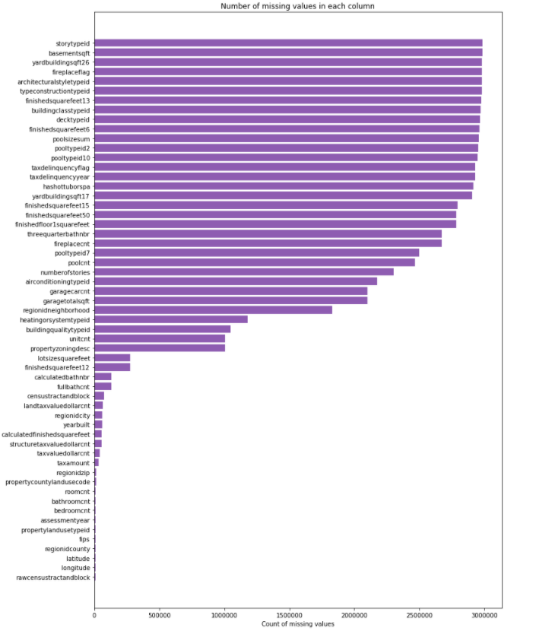
Exploratory Data Analysis
There are 34.5% of all attributes whose the number of missing values take 90% of total records

Slide 7
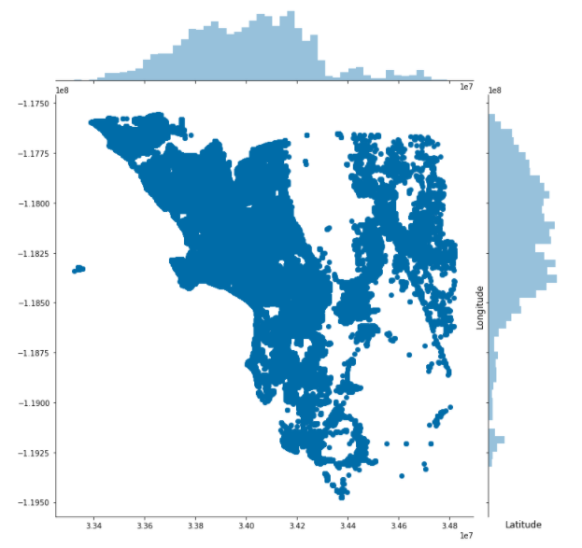
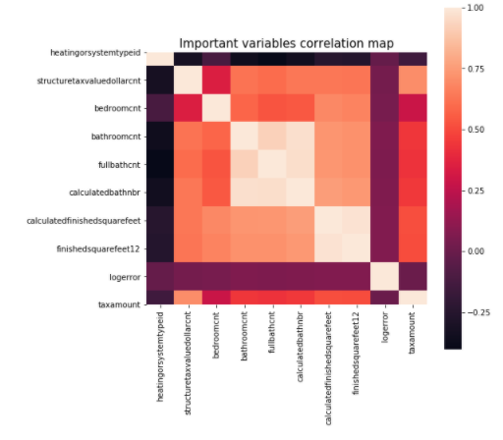
Exploratory Data Analysis
Location analysis
Correlation heatmap

Slide 8
ImPUTATION
The Data is split into two files
Transaction data-90k Properties
Properties data – 27 Million Properties
Knn Imputation (Euclidean distance)
Imputation after join operation -90k
Using KNN classifier and regressor to find better neighbors to impute

Slide 9
Feature Engineering
Creating new features using variable interaction
Total rooms = bath_count + bedroom_count
Average room size = total_finished_living_area_sqft/roomcnt
Ratio of structure tax to land tax = structure_tax/land_tax
ExtraSpace = lot_area_sqft - total_finished_living_area_sqft

Slide 10
Feature SELECTION & Dimensionality Reduction
Used the following techniques
Recursive feature elimination (RFE)
XgBoost feature importance (Information Gain & Gini Index)
TreeRegressor feature importance (Information Gain & Gini Index)
PCA (Principal Component Analysis)

Slide 11
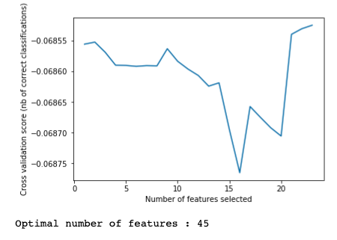
Recursive feature elimination (RFE):
rfe_selection

Slide 12
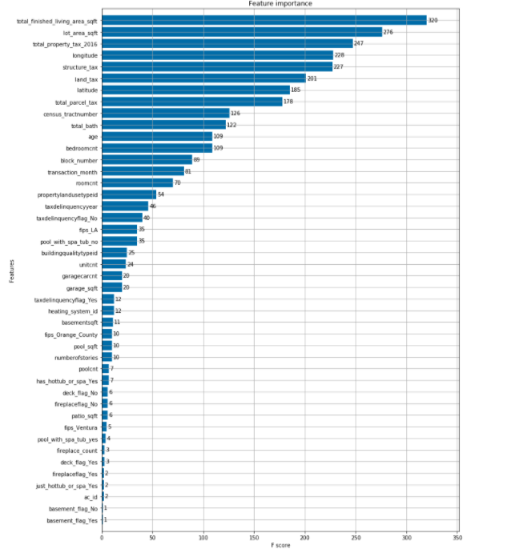
XgBoost feature importance :
xgboost_selection

Slide 13
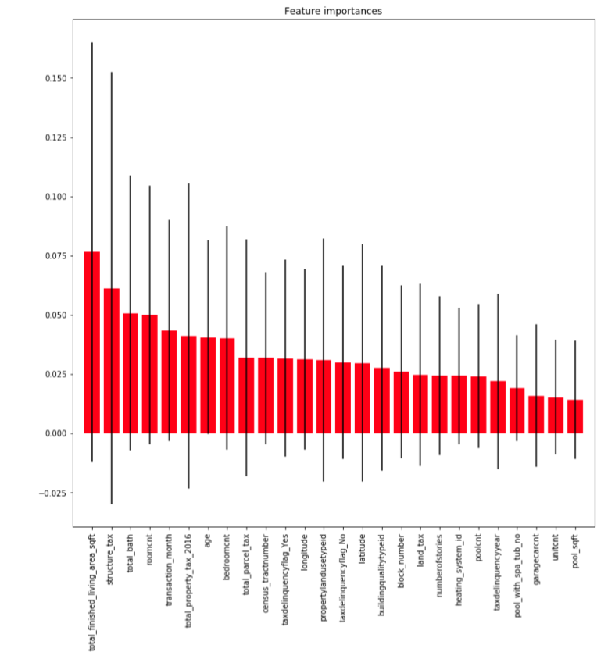
TreeRegressor feature importance :
tree_selection

Slide 14
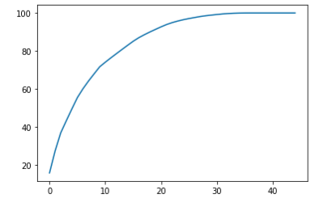
PCA (Principal Component Analysis) :
pca_selection

Slide 15
Results of feature engineering:
 | Rfe_selection | Xgboost_selection | Tree_selection | Pca_selection
The number of features | 45 | 25 | 26 | 25

Slide 16
Model Building & Fine Tuning
Three algorithms :
Linear regression,
Ridge regression,
Gradient boosting decision tree
All the ML algorithms used in this project are tuned with gridsearchcv using scikit-learn algorithms
They are conducted based on four groups of attributes selected by feature engineering:
rfe_selection, xgboost_selelction, tree_selection, pca_selection respectively.
The whole data is divided into train 90% and test 10%, models are built on train data using cross-validation techniques.
For gradient boosting decision tree, I tuned the ‘n_estimators’, which is the parameter meaning the number of gradient boosted trees. The result of best ‘n_estimators’ for four selections
 | Rfe_selection | Xgboost_selection | Tree_selection | Pca_selection
best ‘n_estimators’ | 100 | 80 | 140 | 20

Slide 17
Results (MAE)
Kaggle Benchmark : 0.064
 | Rfe_selection | Xgboost_selection | Tree_selection | Pca_selection
Linear Regression | 0.06732 | 0.06728 | 0.06724 | 0.06752
Ridge Regression | 0.06731 | 0.06722 | 0.06723 | 0.06736
Gradient Boosting | 0.06746 | 0.06738 | 0.06757 | 0.06736
For each selection, Ridge regression has the lowest MAE.

Slide 18
Inferences and future improvements
The main reason why even the widely used boosting algorithms couldn’t increase the error metric is:
The main reason could be because the amount of missing information in each attribute
The other reason could the limitation with the hardware, where I couldn’t build an imputation model using all 27 million records and couldn’t run the XGBOOST algorithm in limited time.
Some of the imputation techniques that I used using mean and median, could have potentially changed the distribution of data
The future improvements could be potentially trying different imputation techniques

