Slide 1
Forecasting USD/EUR Exchange Rate using Arima, GARCH, VAR and RNN models
Group members: Mingwen Yang, Yijing Tan, Xin Shu, Shijie Zhao

Slide 2
Introduction:
--Euro has become one of the most important currencies in the foreign exchange market.
--Model used:
--ARIMA and GARCH
--VAR(Vector Autoregression Model)
VEC( Vector Error Correction Model )
--RNN(Recurrent Neural Network),

Slide 3
Data Description
Money supply: total value of money available in an economy
Gross domestic product (GDP): a monetary measure of the market value of all the final goods and services produced in a specific time period
Consumer Price Index(CPI):measures changes in the price level of a weighted average market basket of consumer goods and services purchased by households
Philadelphia Gold and Silver Index (XAU/USD):an index of thirty precious metal mining companies that is traded on the Philadelphia Stock Exchange
West Texas Intermediate(WTI): a grade of crude oil used as a benchmark in oil pricing
USD/EUR exchange rate: currency exchange rate between USD and EUR

Slide 4
Indicator | Data Range | Frequency | Source
Money Supply | 2015-01-01---2020-02-28 | Monthly | https://fred.stlouisfed.org/series/M1NS
GDP | 2015-01-01---2020-02-28 | Monthly | https://fred.stlouisfed.org/series/GDP/
CPI | 2015-01-01---2020-02-28 | Monthly | https://fred.stlouisfed.org/series/CPALCY01USQ661N
Philadelphia Gold and Silver Index (XAU/USD) | 2015-01-01---2020-02-28 | Daily | https://www.investing.com/currencies/xau-usd
WestTexas Intermediate(WTI) | 2015-01-01---2020-02-28 | Daily | https://www.investing.com/commodities/crude-oil
USD/EUR | 2015-01-01---2020-02-28 | Daily | https://www.ecb.europa.eu/stats/policy_and_exchange_rates/euro_reference_exchange_rates/html/eurofxref-graph-usd.en.html

Slide 5
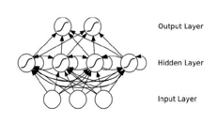
Long Short-Term Memory Model
•Recurrent neural network (RNN) is a kind of neural network specially dealing with time series problems.
•LSTM is a kind of time recursive neural network (RNN), which can learn long-term dependency information.

Slide 6
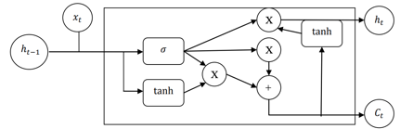

Slide 7
LSTM model development
Step1:
Data preprocessing
•transforming the time series into a supervised learning problem
•making series stationary
•scaling the data
•splitting into a training set and a test set

Slide 8
LSTM model development
Step2:
Determine Configuration
Batch size: 1 Number of batches: 1343 Epochs: 30 Neurons: 4
Loss function: RMSE
Optimization algorithm: ADAM
Backend: Tensorflow

Slide 9
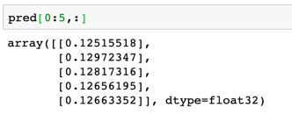
LSTM model development
Step3:
Forecast
•fit the model once on all the training data(non-dynamic)
•call the predict() function on the model

Slide 10
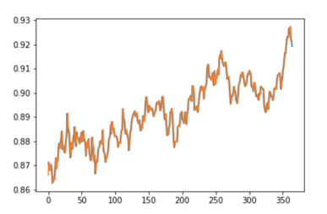

LSTM model development
Step4:
Evaluation
•RMSE=0.03

Slide 11
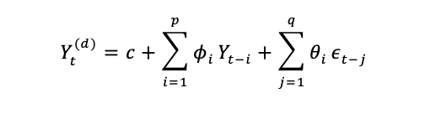
ARIMA model
ARIMA (AutoRegressive Integrated Moving Average): to generalize ARMA models to analysis non-stationary time series data
We can write the general ARIMA(p, d, q) model has p autoregressive terms and q moving average terms, with d degree of differencing in the form:

Slide 12
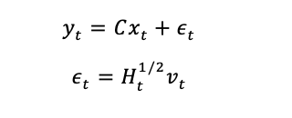
Multivariate GARCH model(MGARCH)
Multivariate GARCH models :allow the conditional covariance matrix of the dependent variables to follow a flexible dynamic structure and allow the conditional mean to follow a vector autoregressive (VAR) structure.
The general MGARCH model:

Slide 13
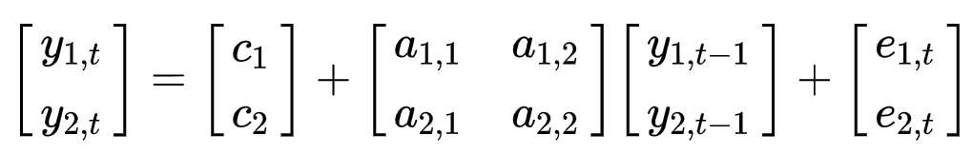
VAR Model
Vector autoregression (VAR) is a stochastic process model used to capture the linear interdependencies among multiple time series. VAR models generalize the univariate autoregressive model (AR model) by allowing for more than one evolving variable. For a p-order vector autoregressive model containing n variables, it is written as VAR(p).
Take VAR(1) in two variables of matrix form as an example:
Indicator used:
-- Philadelphia Gold and Silver Index(XAU)*
-- West Texas Intermediate(WTI)*
-- USD/EUR Exchange Rate* *Daily data from 2015-01-01 to 2020-02-28

Slide 14
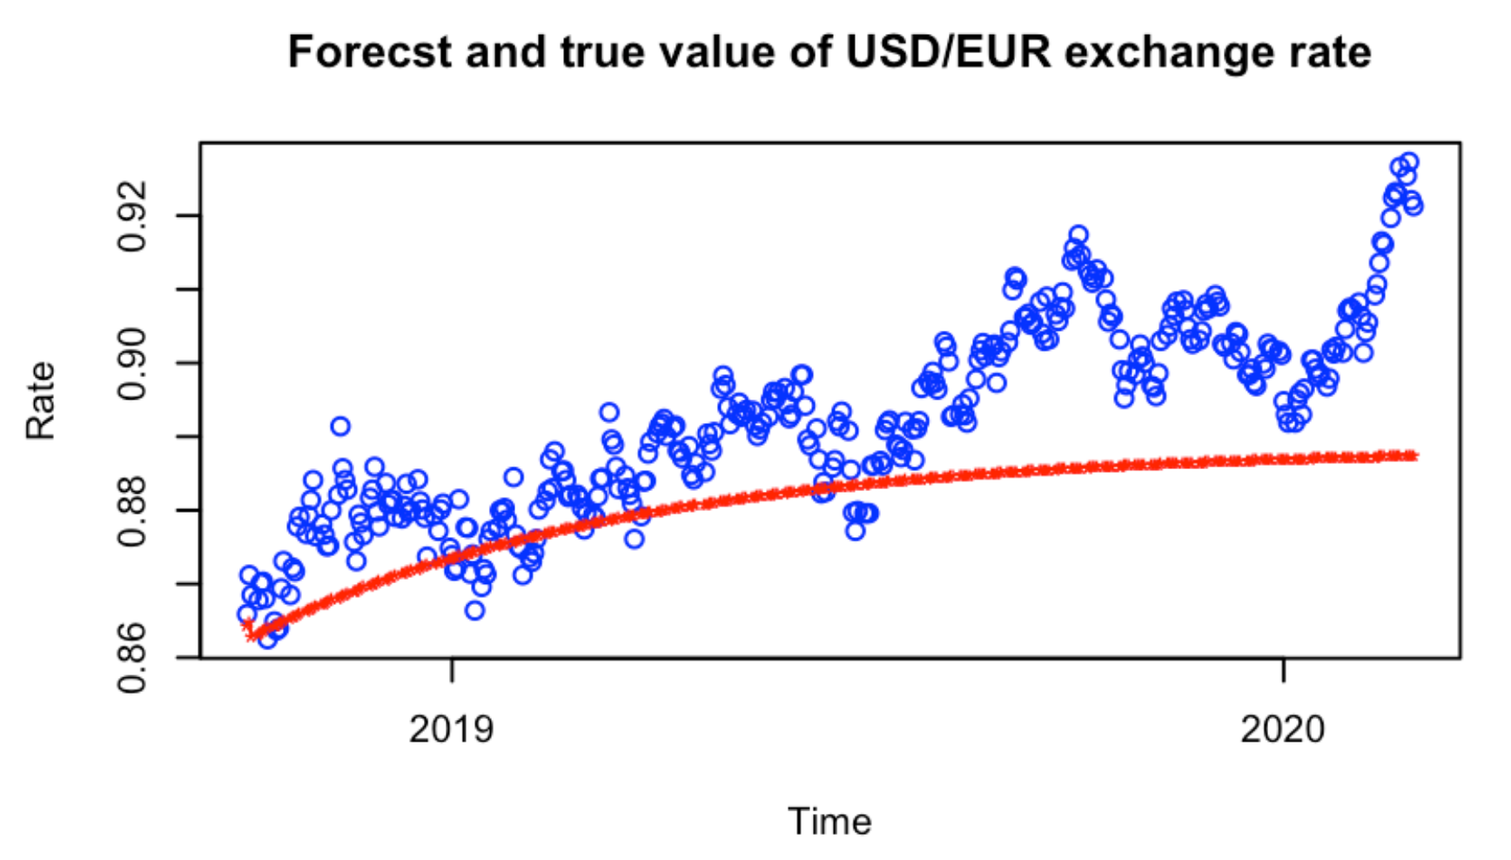
PROCESS：
Order estimation: VAR(3) Model test: with multivariate portmanteau test
Simplified Model Test
Model simplification: constrained VAR(3)
Granger causality test
Predict：test data
RESULT：
Predictions:
A growing trend but more gentle and conservative
More Accurate in short term
——Forecasting
——True rates

Slide 15
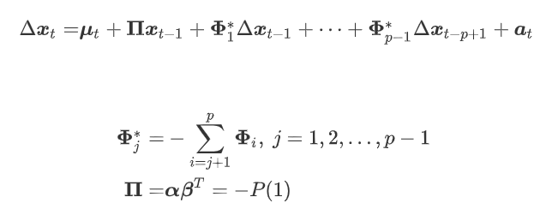
VEC Model
The VEC model is a VAR model with co-integration constraints. It is mostly used in the modeling of non-stationary time series with co-integration relationships. According to Johnson's definition, the VAR model of Xt (including the p-order lag variables) can be expressed as :

Slide 16
Process
Step1:
Co-integration test
Use the value of p-value from Durbin-Watson test of linear model to check the residual sequence independent or not.
Check the unit roots test results of the residual series. If it is stable, indicating that there is a co-integration relationship between time series.
Get the rank of the co-integration vector from the result of Johansen procedure.

Slide 17
Process
Step2:
Build Model
cajorls() to estimate the VEC model.
Converted VEC model to horizontal VAR model .
Predict currency rate, and do evaluation.
RMSE=0.007

Slide 18



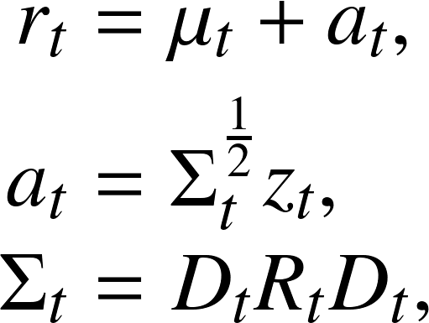
DCC GARCH
Dynamic Conditional Correlation GARCH models :
The idea of the models is that the covariance matrix, , can be decomposed into conditional standard deviations, , and a correlation matrix, . In the DCC-GARCH model both and are designed to be time-varying.
The DCC-GARCH model:

Slide 19
Process
ARCH effect test
Build DCC-GARCH model
Get conditional correlation plot of XAU and WTI with currency rate

Slide 20
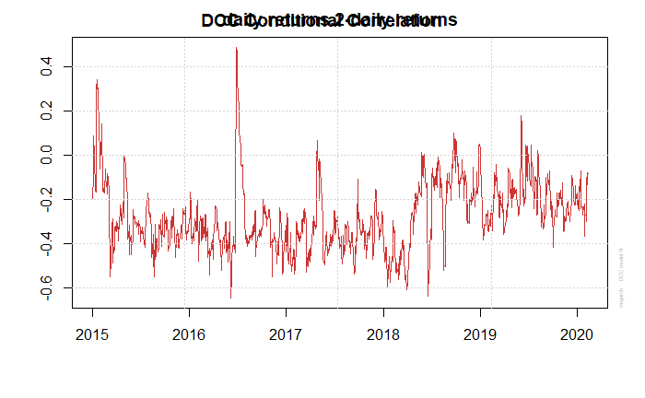
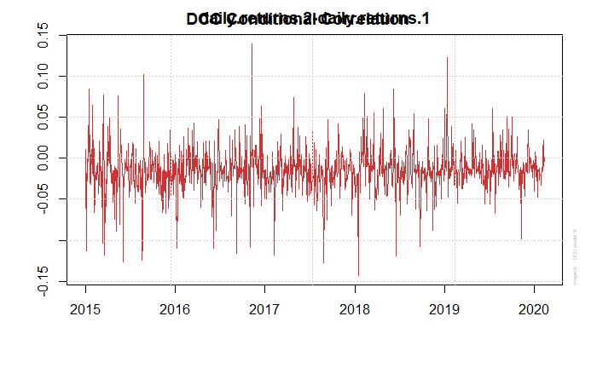
Result
RSME = 0.0027

Slide 21
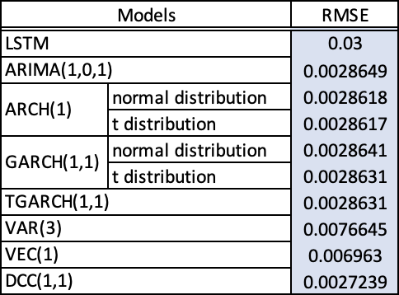
Model Comparison
DCC model is the best one among all 10 models.
ARIMA and GARCH models have similar great performance.

