Slide 1
工作汇报
2019年8月12日 赵天明

Slide 2
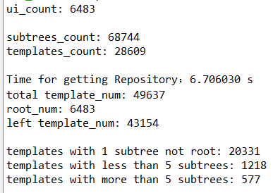
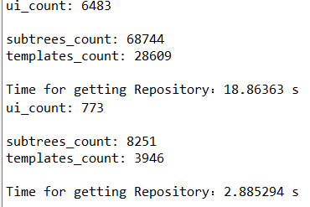
Data Collection
(1). Get the professional GUIs from the profession apps.(13060 GUIs in 1864 apps)
(2).Get the Dom tree and all subtrees from each GUI saved in a txt file.
(3).1576 apps for training(85%), 101 apps for validation(5%), and 187 apps for testing(10%).
(4).Take 5 GUIs in each app: 6483 apps for training, 395 for validation, and 773 for testing.
(5).In the training apps, containing 68744 sub trees and 28609 templates.

Slide 3
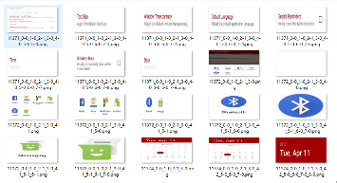
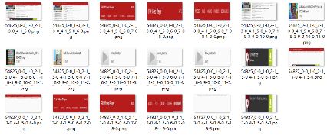
reward + Policy Gradient
G
softmax
combination of subtrees
binary-classification
muti-classification
sigmoid
Fake GUI
D
Style Embedding
Real GUI
size normalized
the structural similarity of subtrees
Repository
subtree1
subtree2
template1
template2
subtree with location info(bounds)

Slide 4
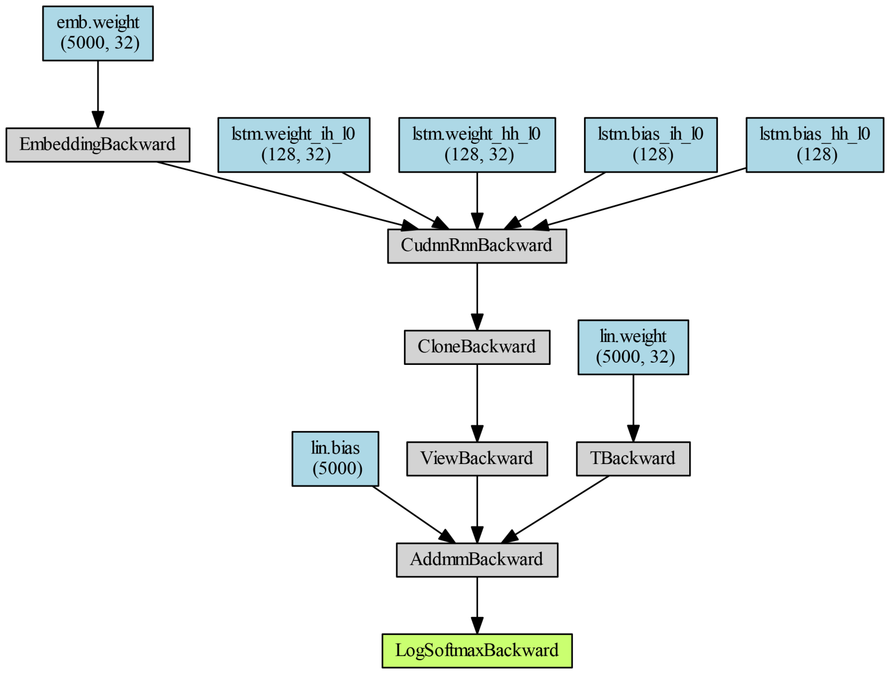
Networks:
G: LSTM

Slide 5
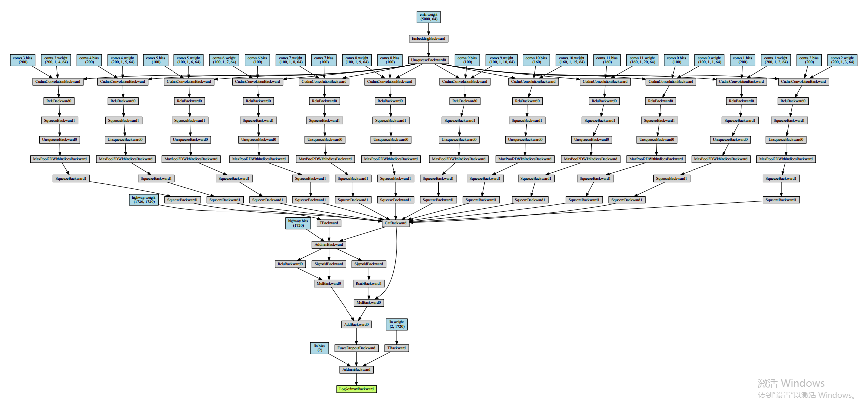
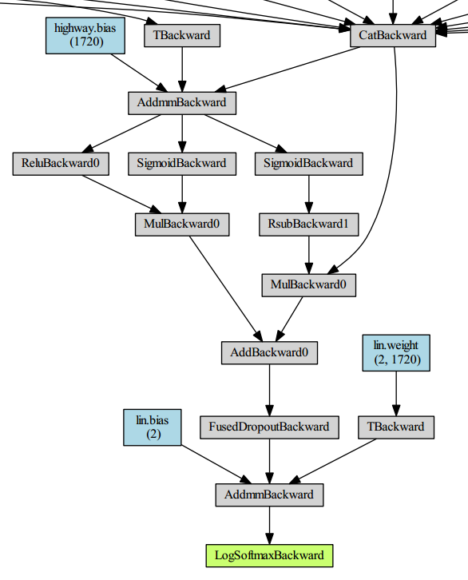
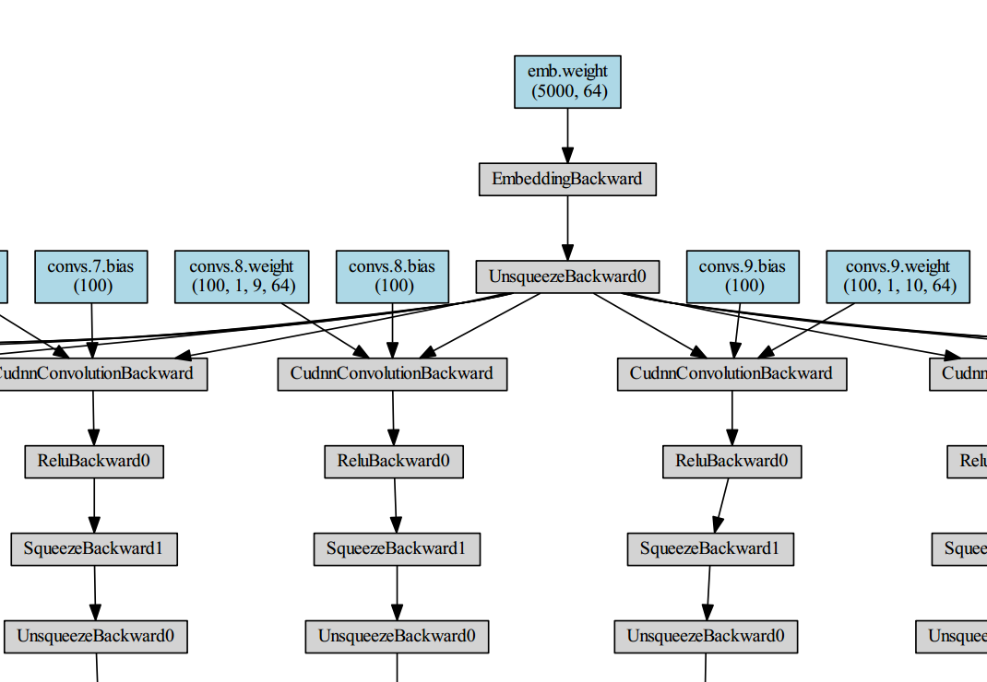
D: CNN with highway

Slide 6
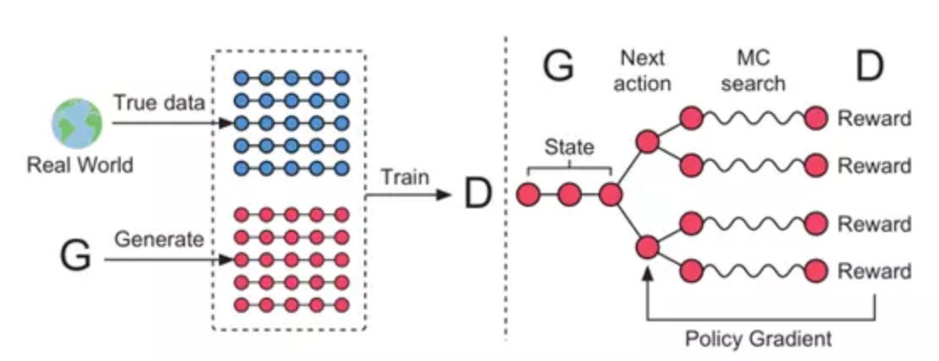
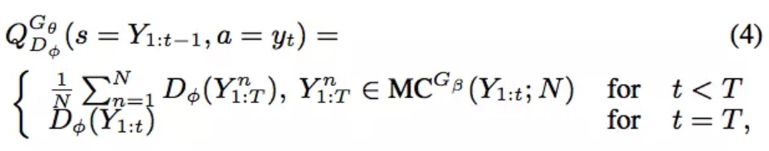

Slide 7
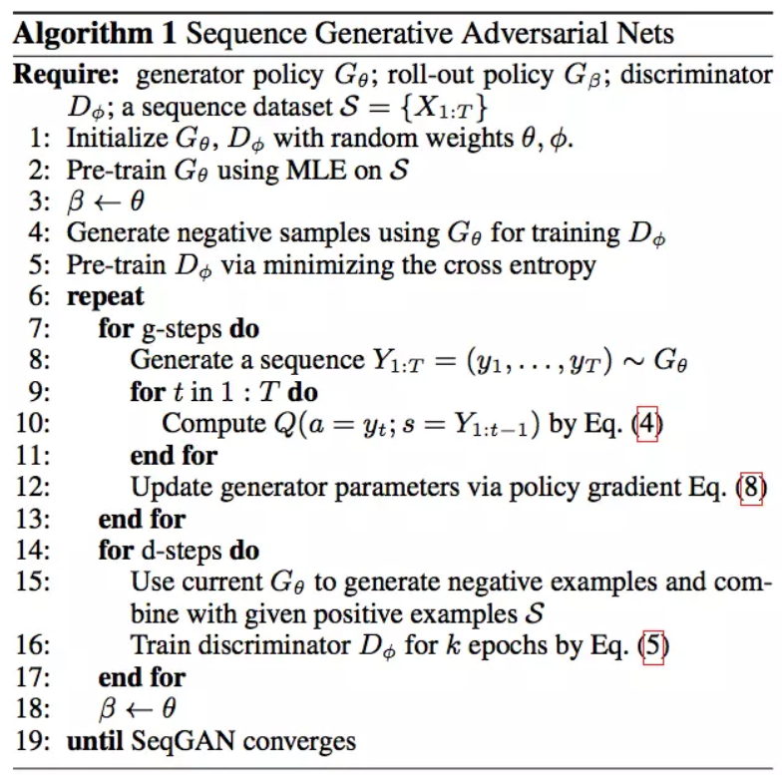

Slide 8
Procedure:
Require：generator G, discriminator D, sentence dataset S, subtree embeddings Y
1. repeat
2. for g-steps do
Generate a sentence y_1:T = (y_1,…,y_t,…,y_T), y_t ∈Y, height(1:T) < H with G
for t in 1:T do
Compute Q
end for
Update G’s parameters via policy gradient
8. end for
9. for d-step do
10. Generate negative samples with current G and combine with given positive
samples S
11. Calculate the tree-distance between negative and positive samples as the loss of D
12. Train D for k epochs
13. end for
14. Until converges

