Slide 1
工作汇报
2019年8月5日 赵天明

Slide 2
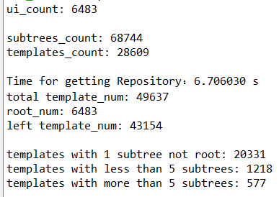
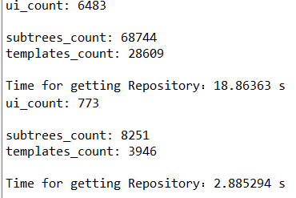
Data Collection
(1). Get the professional GUIs from the profession apps.(13060 GUIs in 1864 apps)
(2).Get the Dom tree and all subtrees from each GUI saved in a txt file.
(3).1576 apps for training(85%), 101 apps for validation(5%), and 187 apps for testing(10%).
(4).Take 5 GUIs in each app: 6483 apps for training, 395 for validation, and 773 for testing.
(5).In the training apps, containing 68744 sub trees and 28609 templates.

Slide 3
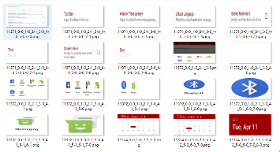
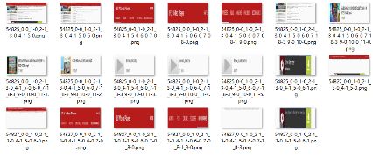
reward + Policy Gradient
G
softmax
query
combination of subtrees
binary-classification
muti-classification
sigmoid
Fake GUI
D
Style Embedding
Real GUI
size normalized
the structural similarity of subtrees
Repository
subtree1
subtree2
template1
template2
subtree with location info(bounds)

Slide 4
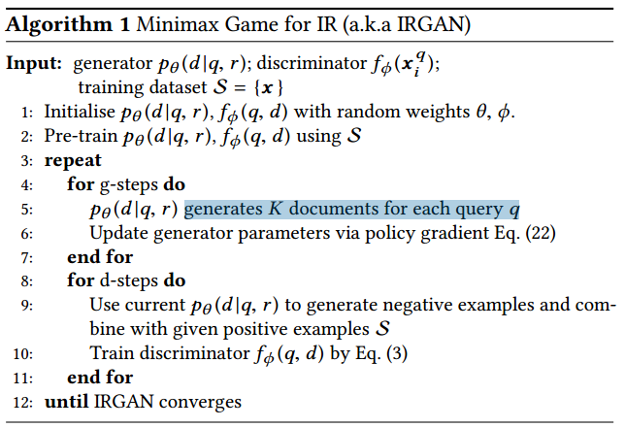
Reference：IRGAN(its generator is actually a candidate sentence, which needs softmax).

Slide 5
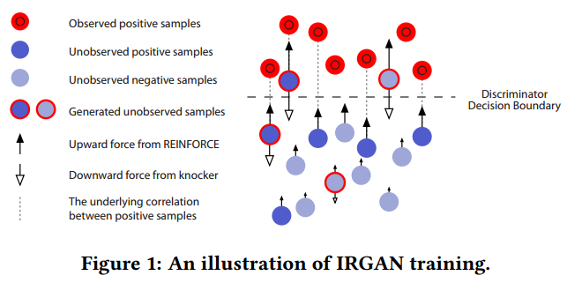
In each epoch of training, G tries to generate samples close to D’s decision boundary to confuse its training next round, while D tries to score down the generated samples. Since there exists positive correlations between the positive but unobserved (i.e., the true-positive) samples and (part of) the observed positive samples, G should be able to learn to push upwards these positive but unobserved samples faster than other samples with the signal from D.

Slide 6
Applications and EXPERIMENTS :
We first test both the IRGAN-pointwise and IRGAN-pairwise formulations within a single task, web search;
and then IRGAN-pointwise is further investigated in the item recommendation task where the rank bias is less critical,
while IRGAN-pairwise is examined in the question answering task where the rank bias is more critical (usually only one answer is correct).

Slide 7
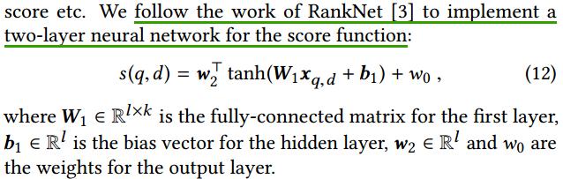
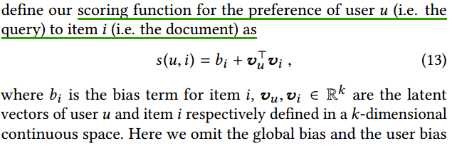
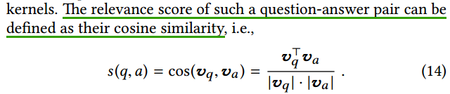
Applications and EXPERIMENTS :
1.web search,
MQ2008
2.item recommendation, 
Movielens (100k) and Netix
3.qestion answering.
InsuranceQA

Slide 8

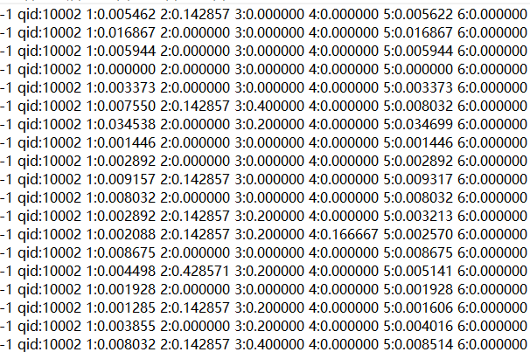
Data Description:
MQ2008 is a query set from Million Query track of TREC 2008. There are about 800 queries in it with labeled documents. In MQ2008, the 5-fold cross validation strategy is adopted and the 5-fold partitions are included in the package.
Large_norm.txt:
46 dims

Slide 9
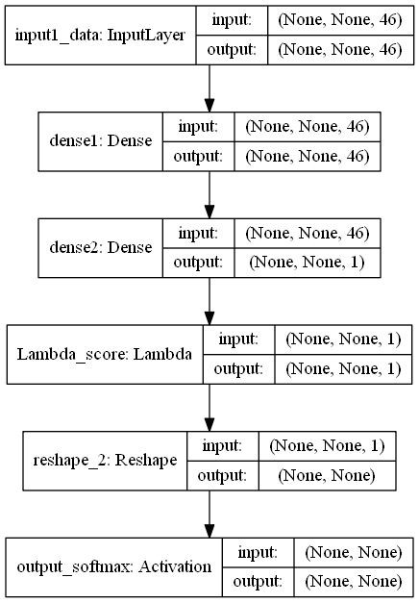
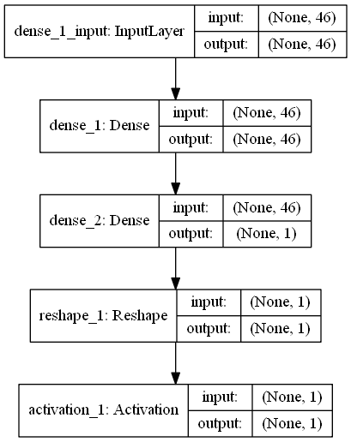
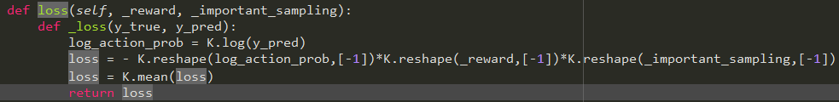
Networks:
G:
D:
loss = 'binary_crossentropy'

Slide 10
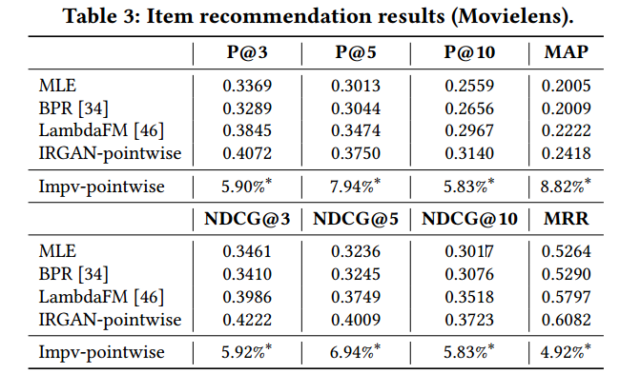
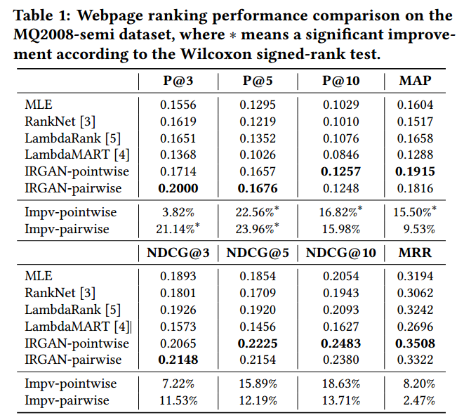
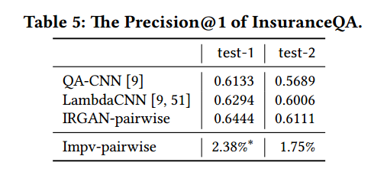
Metrics:
Precision@N, NDCG@N, MAP and MRR.

Slide 11
Q:
Our data → Computable matric
Input of the generator
Query and document
Baseline

