Slide 1
工作汇报
2019年3月25日 赵天明

Slide 2
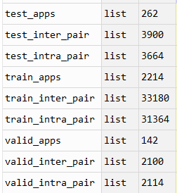
主要工作
Rico
Select the apps with Ui_num >= 10
43633 Uis , 2618 apps
resized & cut image(180,325, 3)
2214 apps (84.6%) for training
142 apps (5.4%) for validation
262 apps (10%) for testing

Slide 3
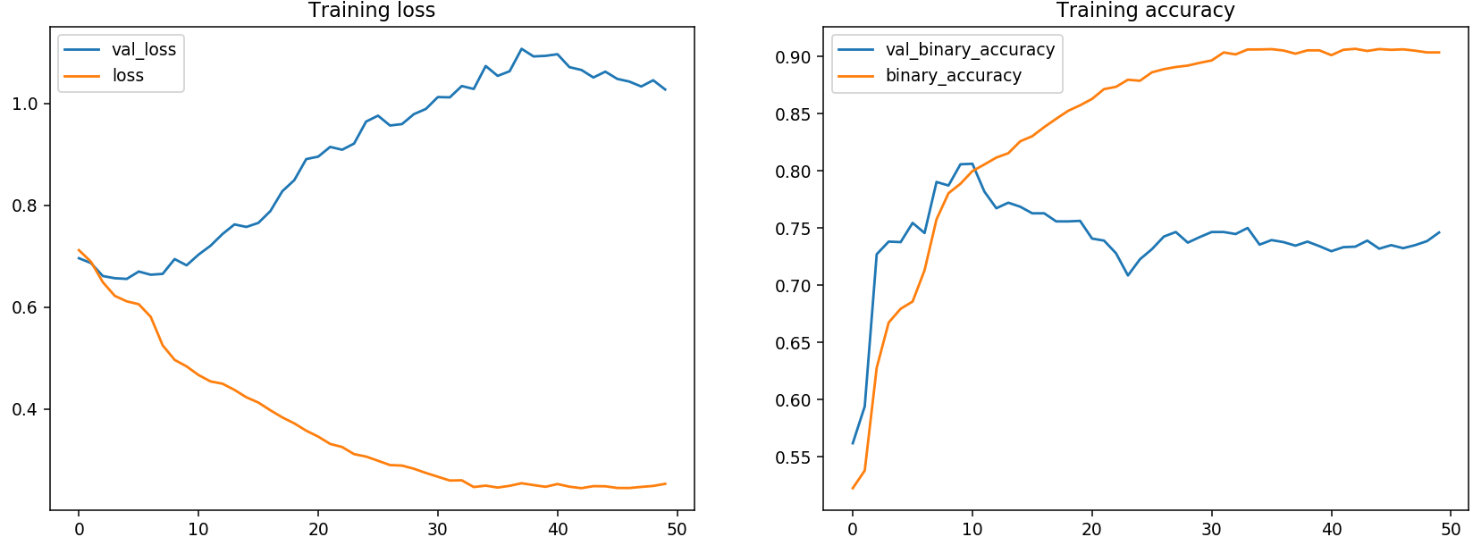
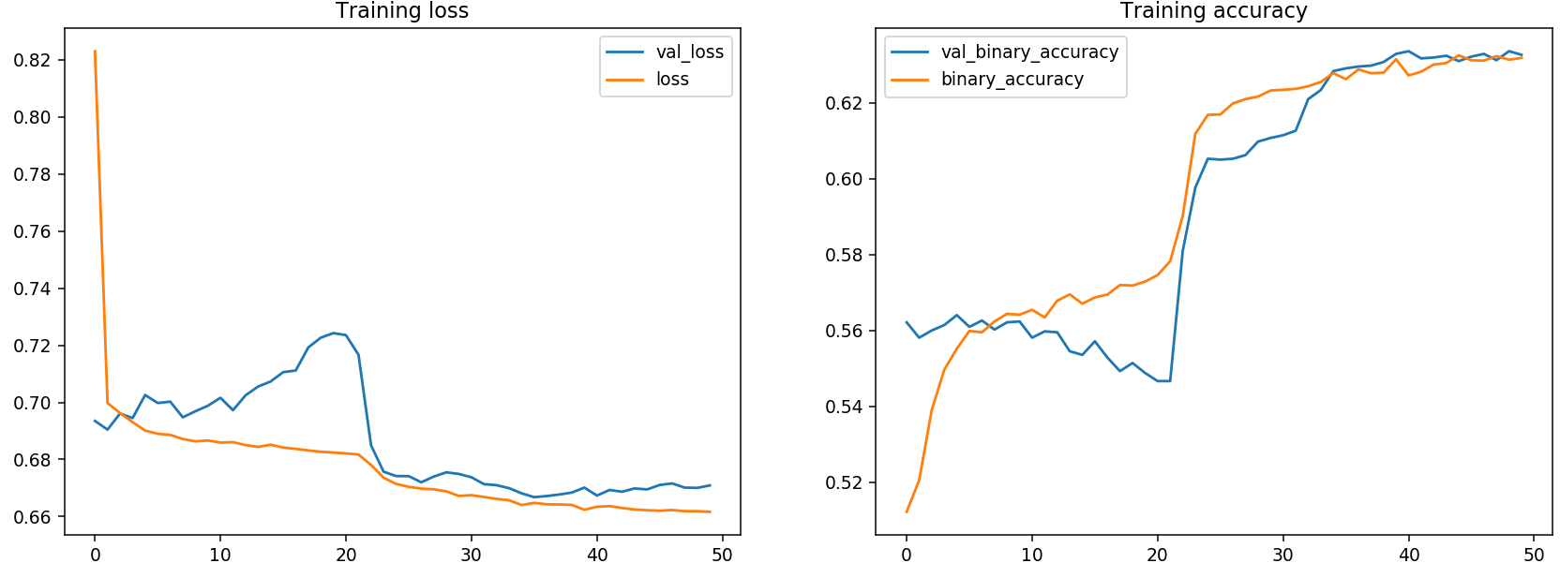
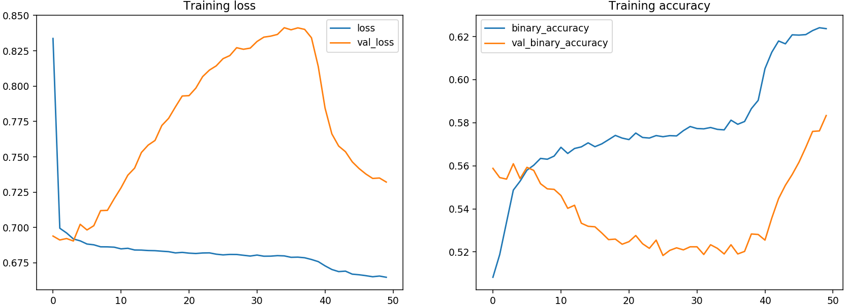



Result
1. L2 & Dropout（0.5）, output: 256 dimensions
Testing result:
L2 & Dropout（0.5）
256 with more data
L2 & Dropout（0.5）
512 with more data
Dropout（0.5）
512 with less data

Slide 4
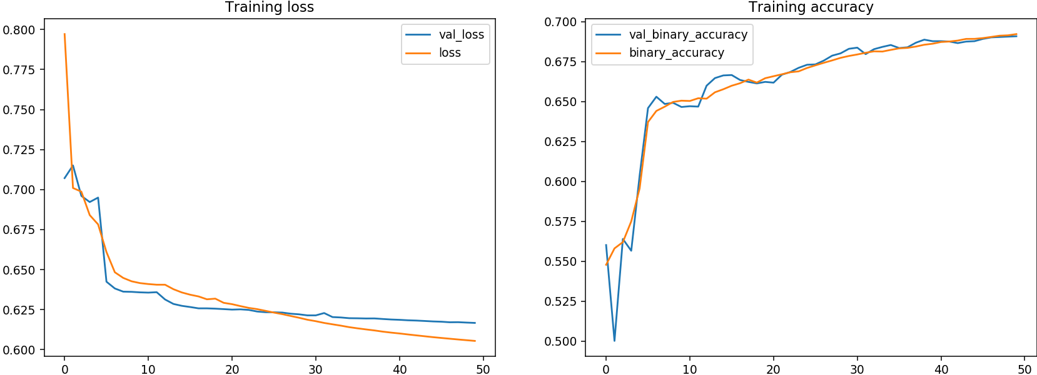
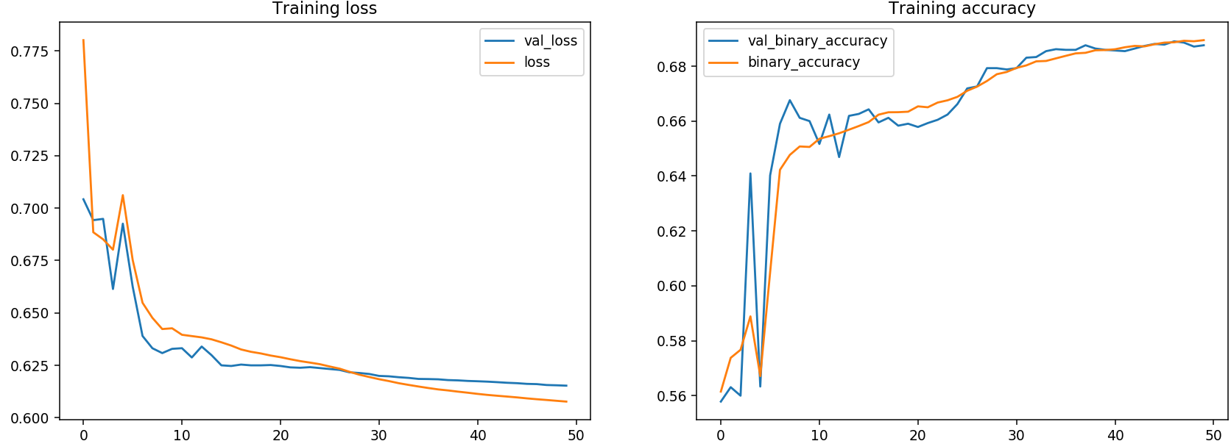
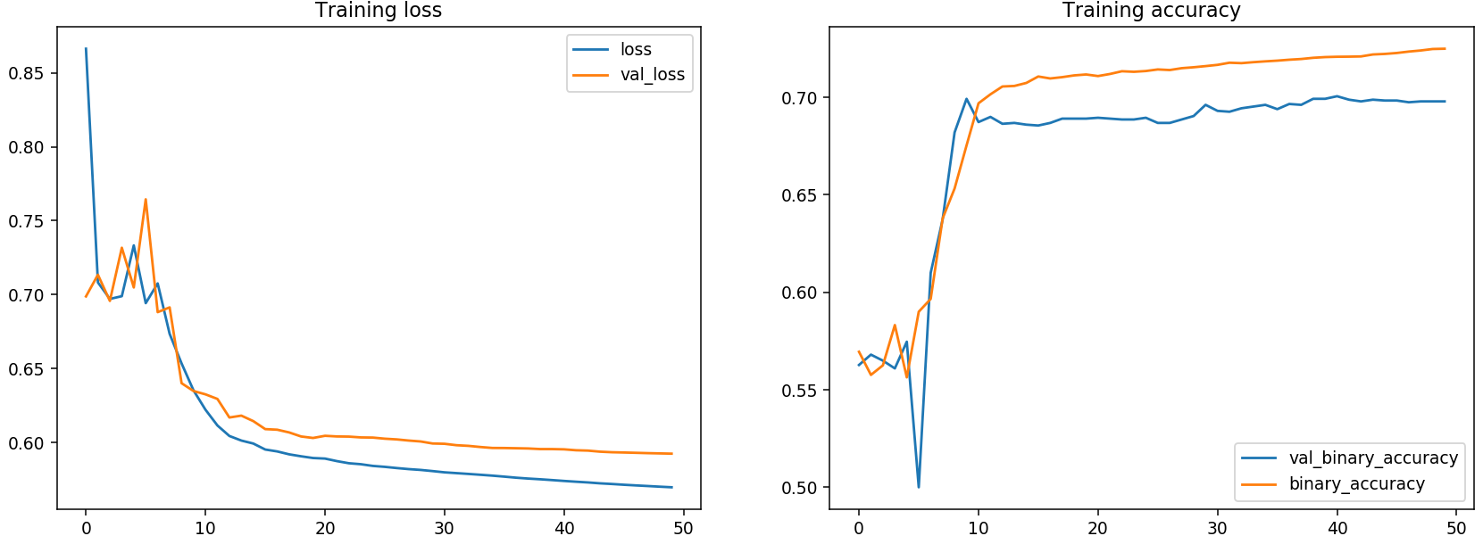



Result
2. l2_penalization only
Testing result:
L2
256 with more data
L2
512 with more data
L2
512 with less data

Slide 5
Baseline
1. Raw data + Clustering
2. Raw data + PCA + Clustering
3. RGB + Clustering
5 apps Visualization:

Slide 6
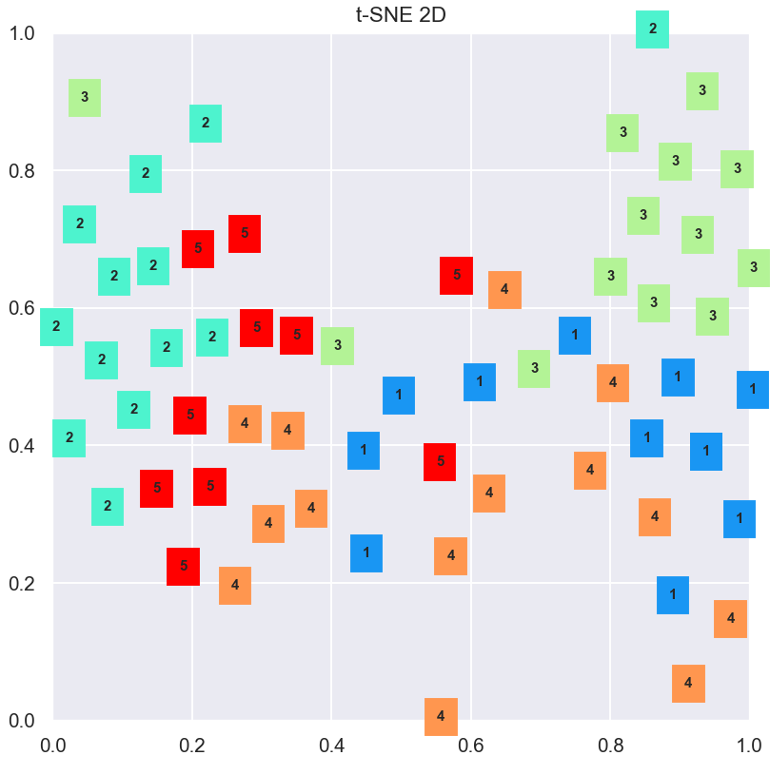
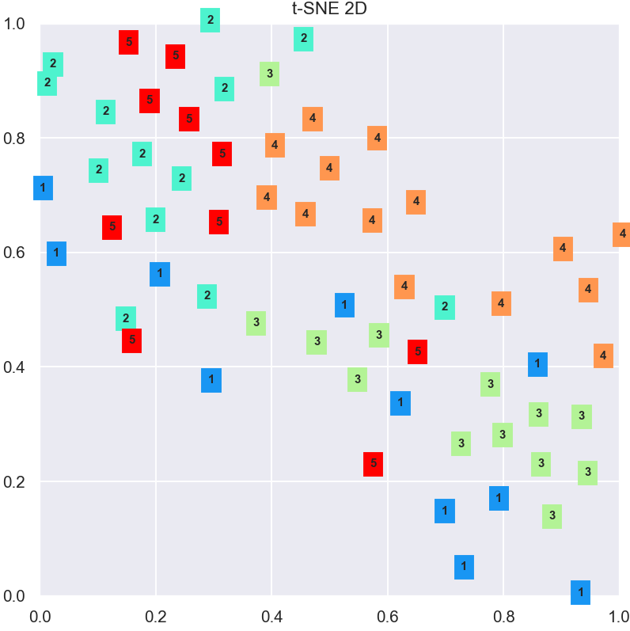
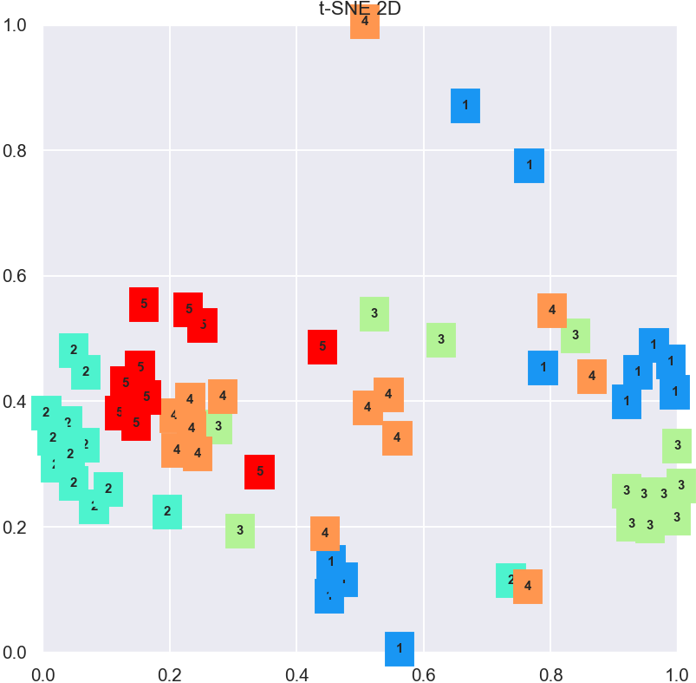
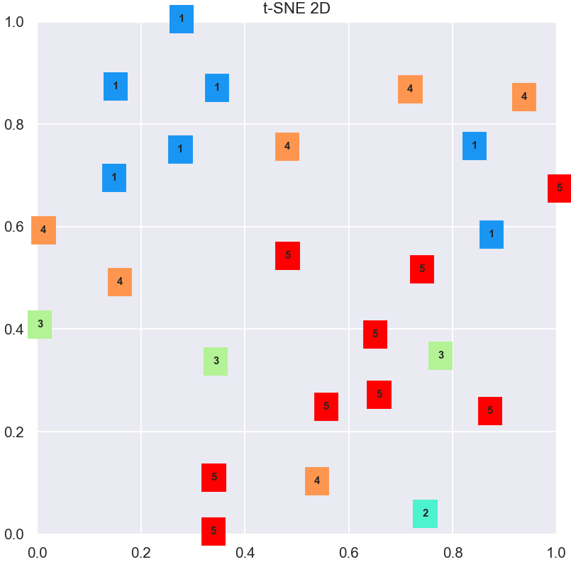
L2&Dropout
L2
Raw data
RGB

Slide 7
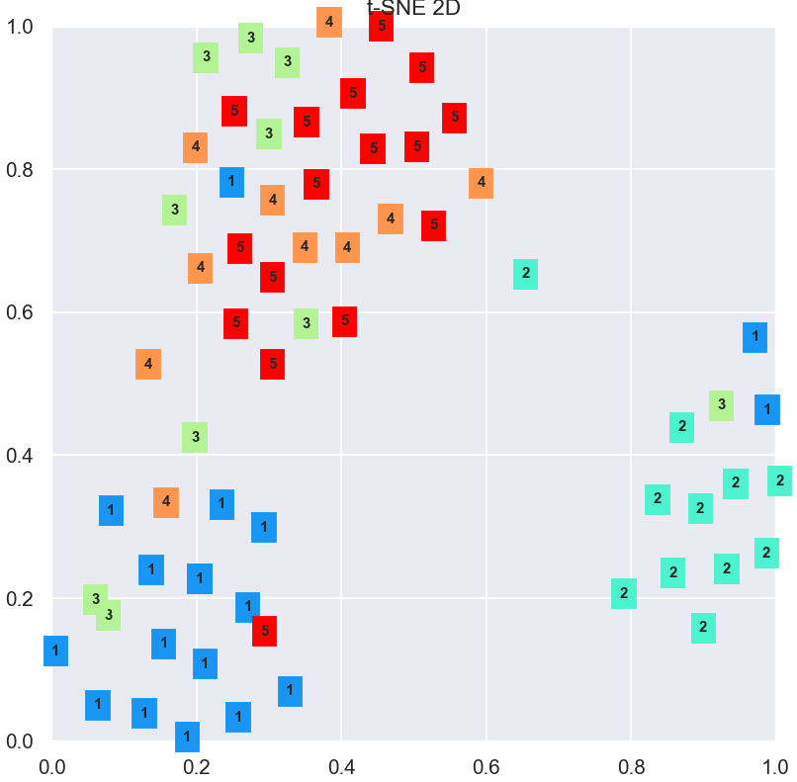
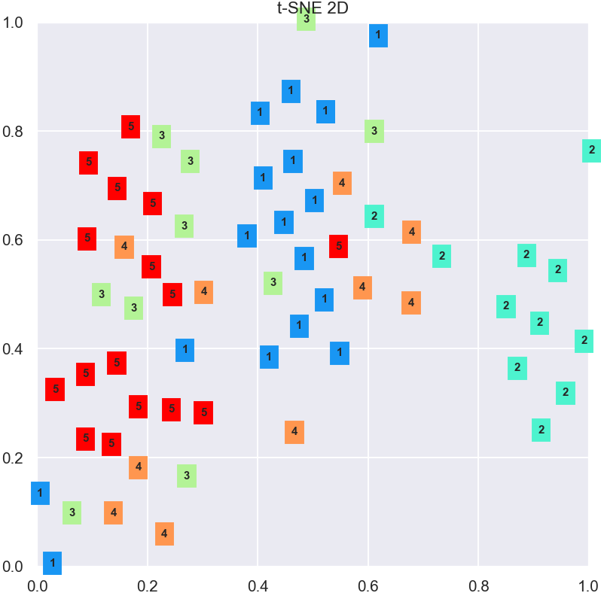
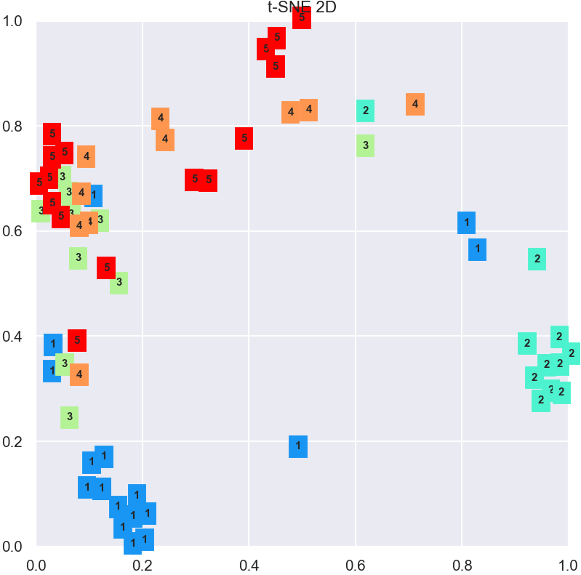
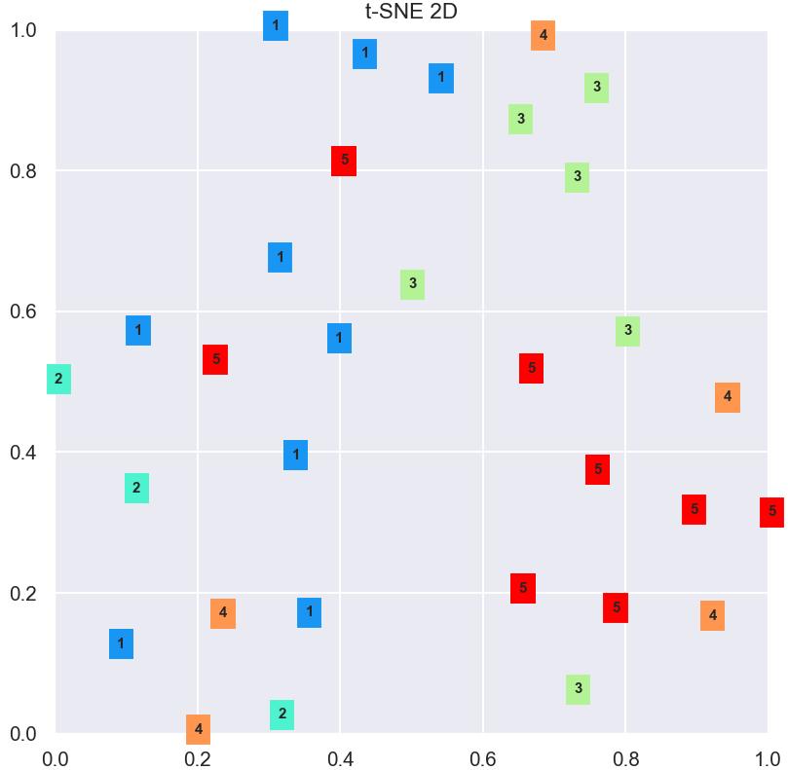
L2&Dropout
L2
Raw data
RGB

Slide 8
Baseline:
db = DBSCAN(eps=80, min_samples=4).fit(reduced_data)
db = DBSCAN(eps=.4, min_samples=4).fit(reduced_data1)
db = DBSCAN(eps=.4, min_samples=4).fit(rgbs)
L2&Dropout
db = DBSCAN(eps=.4, min_samples=4).fit(reduced_data)
db = DBSCAN(eps=.4, min_samples=4).fit(reduced_data1)
L2
db = DBSCAN(eps=.4, min_samples=4).fit(reduced_data)
db = DBSCAN(eps=.4, min_samples=4).fit(reduced_data1)
1 App clustering:

Slide 9
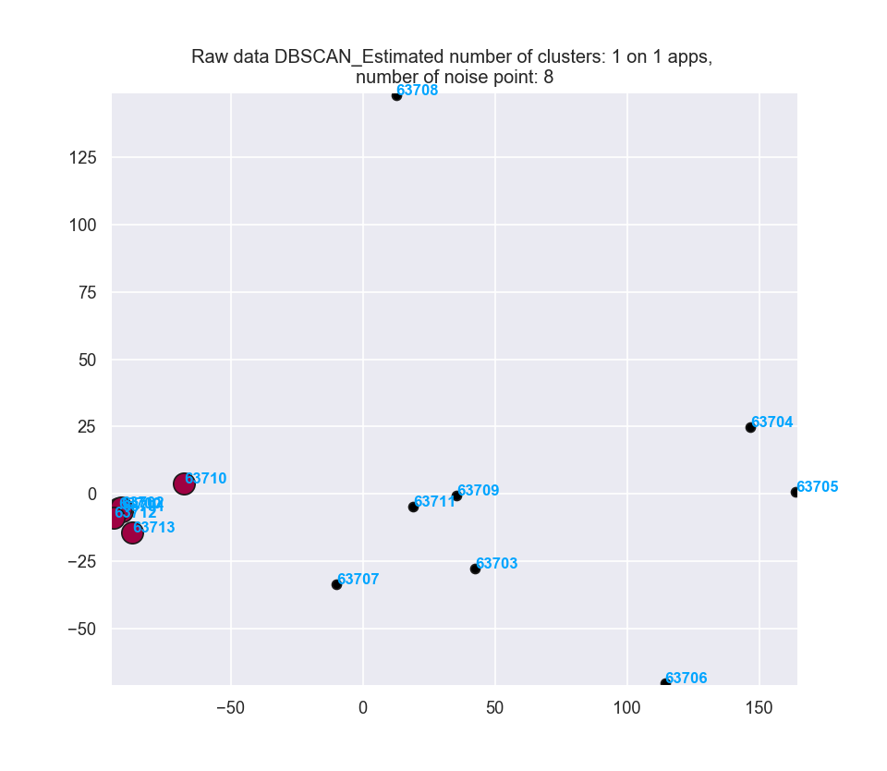
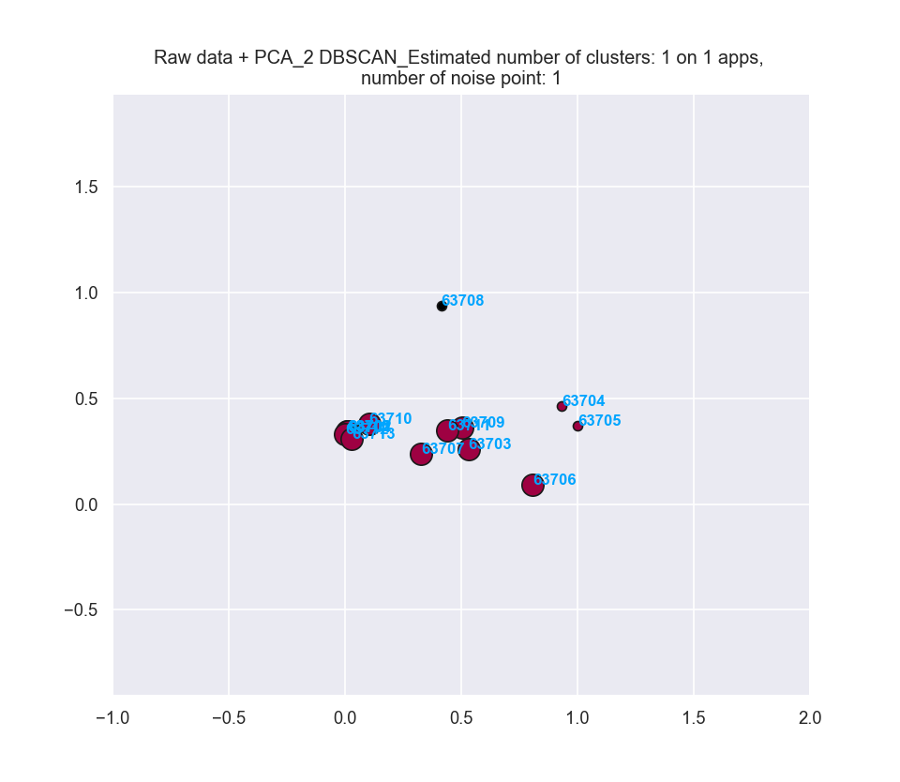
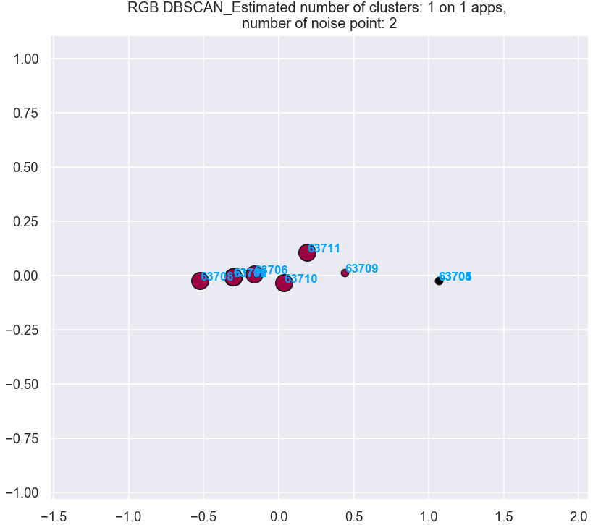
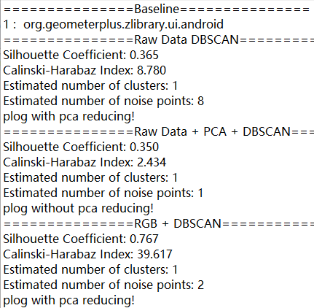
45.org.geometerplus.zlibrary.ui.android

Slide 10
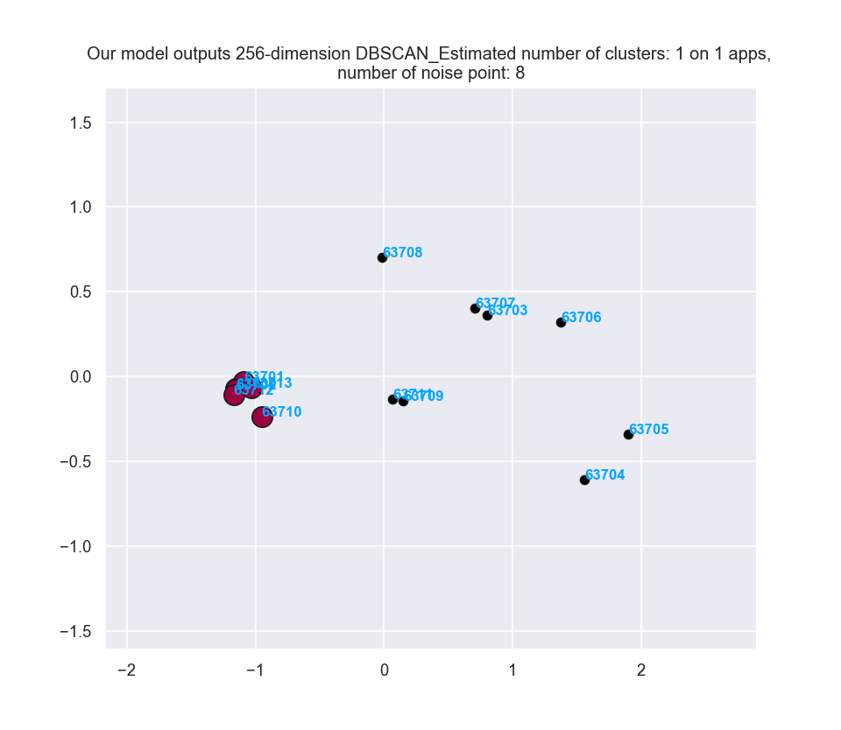
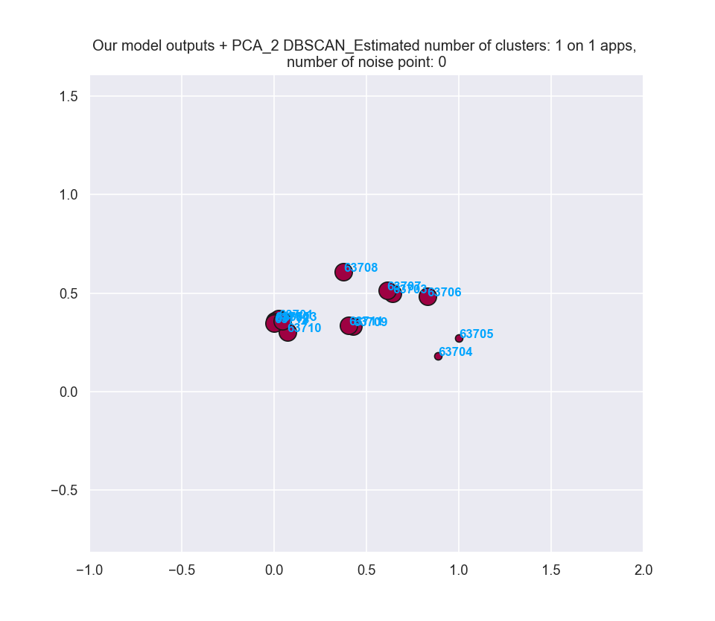
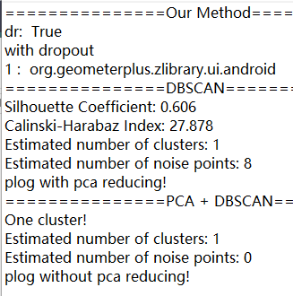
45.org.geometerplus.zlibrary.ui.android

Slide 11
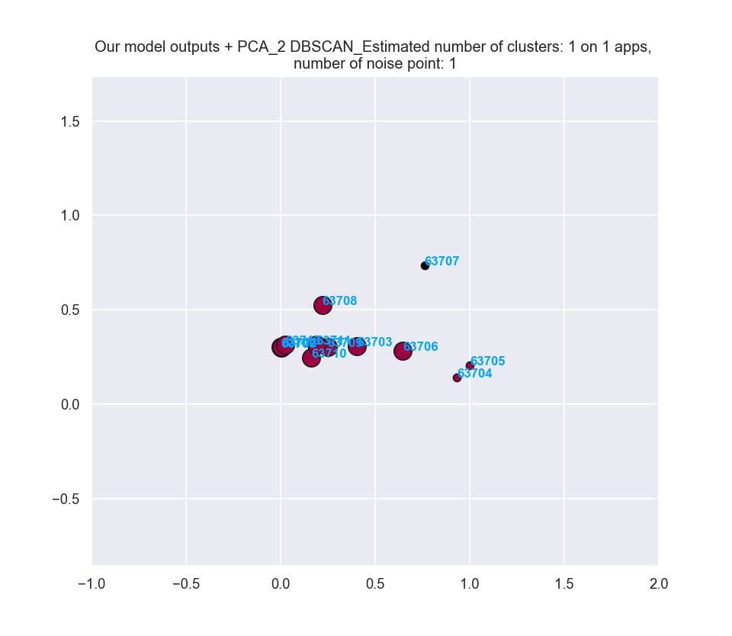
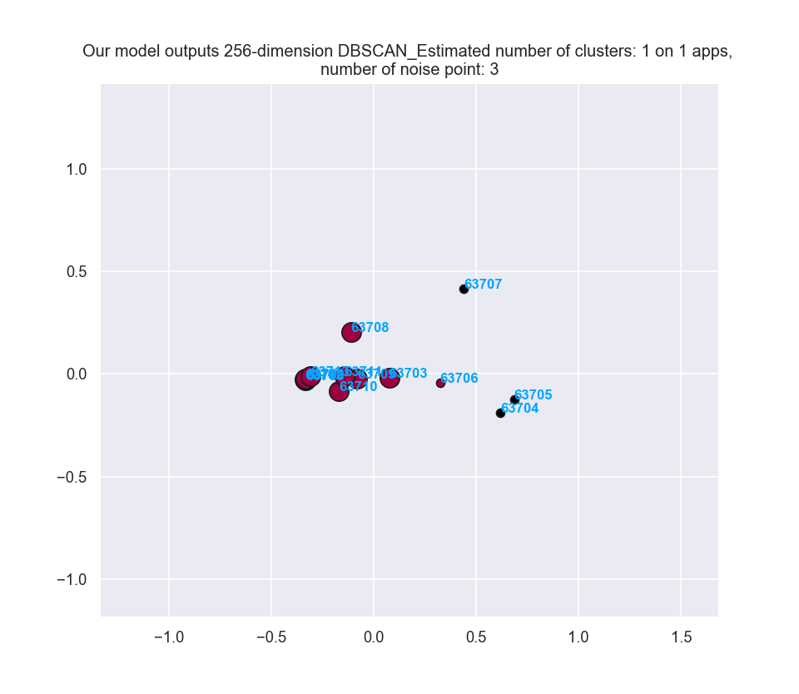
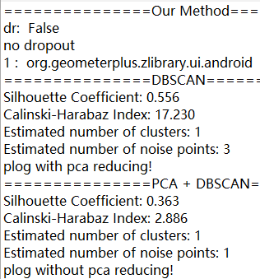
45.org.geometerplus.zlibrary.ui.android

Slide 12
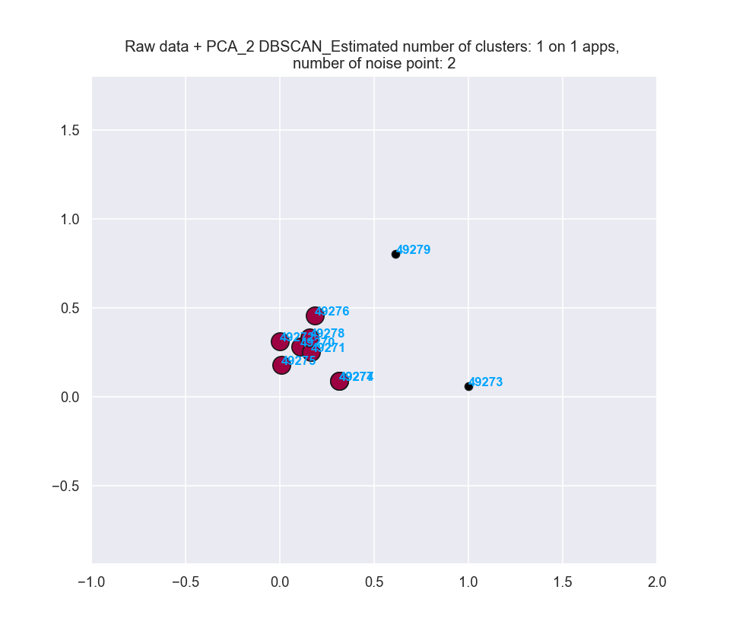
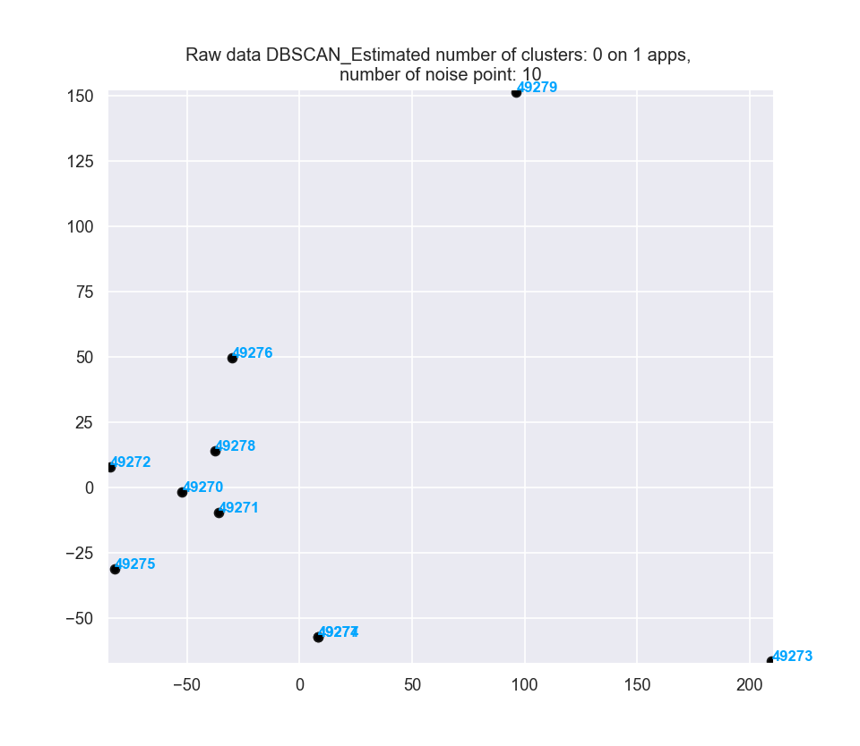
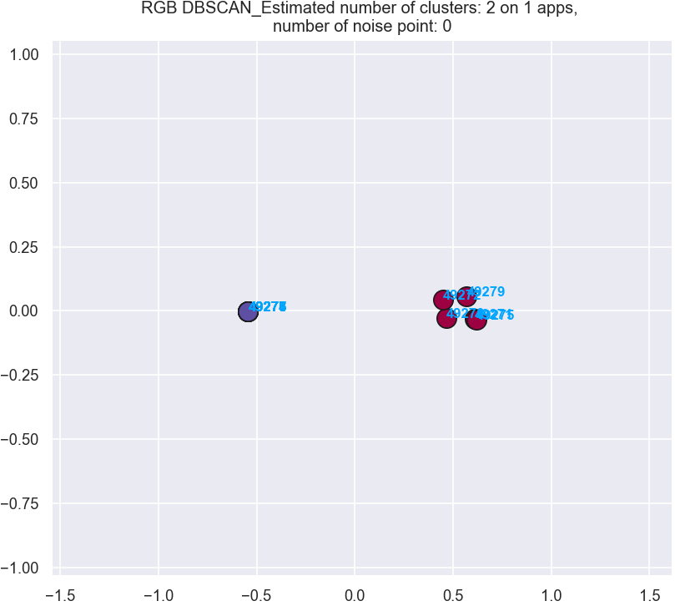
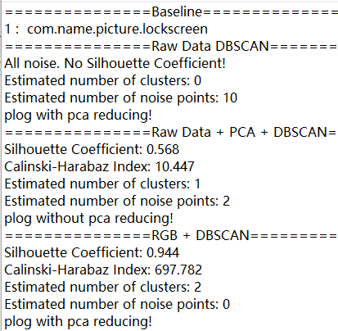
50.com.name.picture.lockscreen

Slide 13
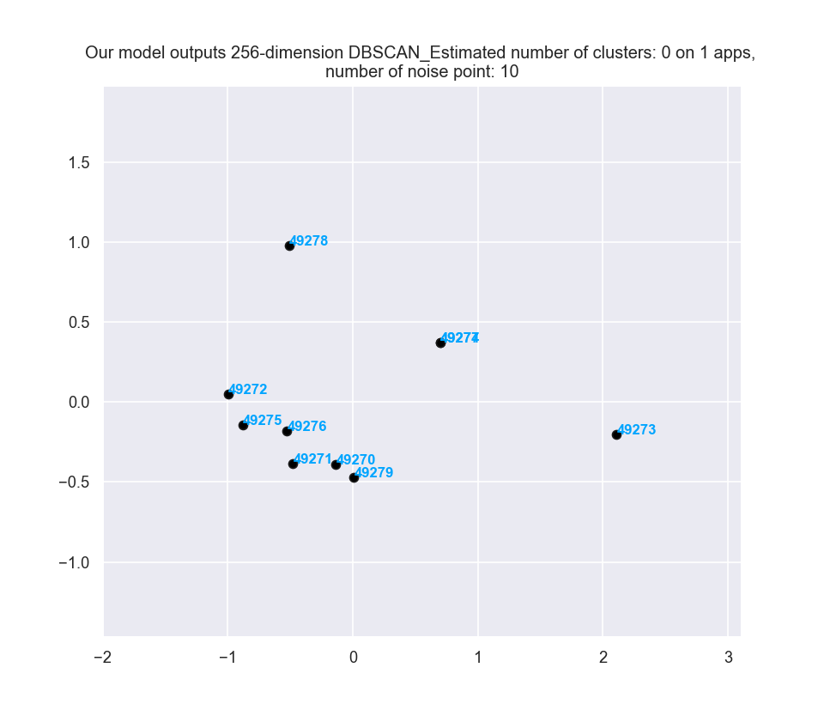
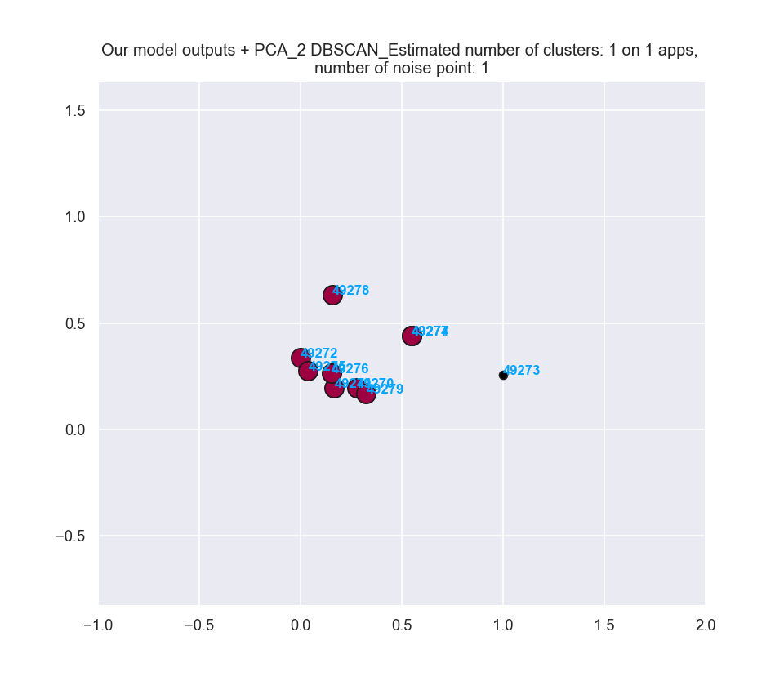
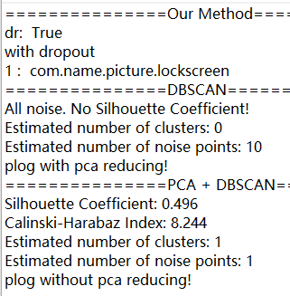
50.com.name.picture.lockscreen

Slide 14
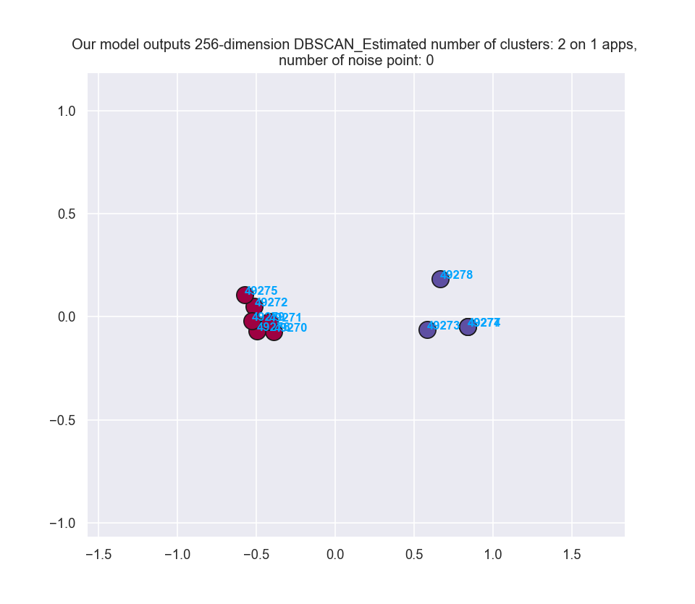
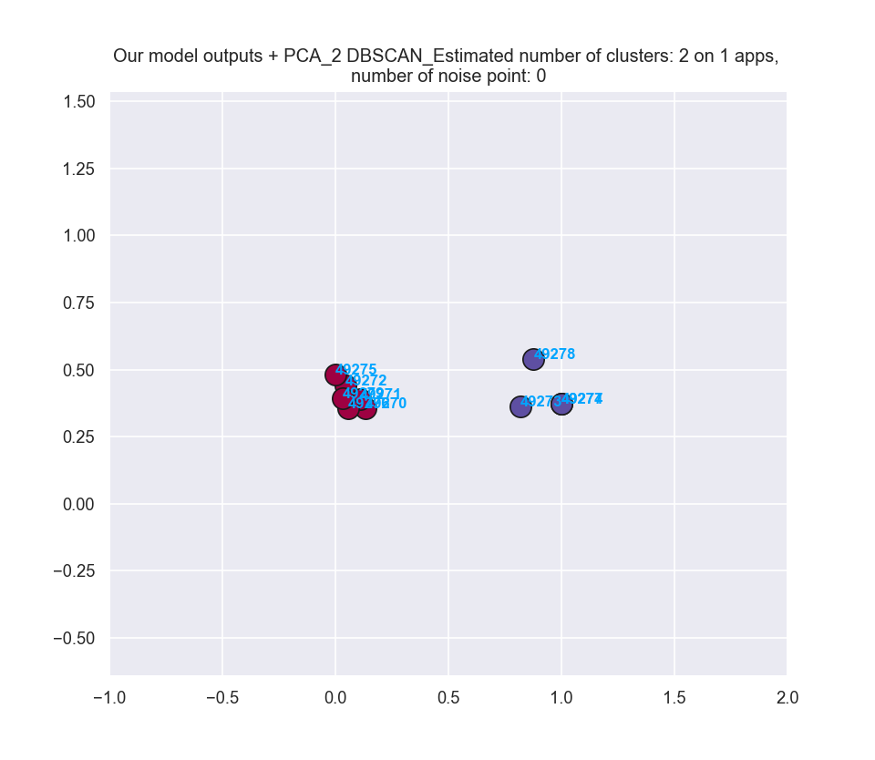
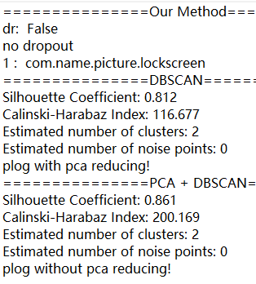
50.com.name.picture.lockscreen

Slide 15
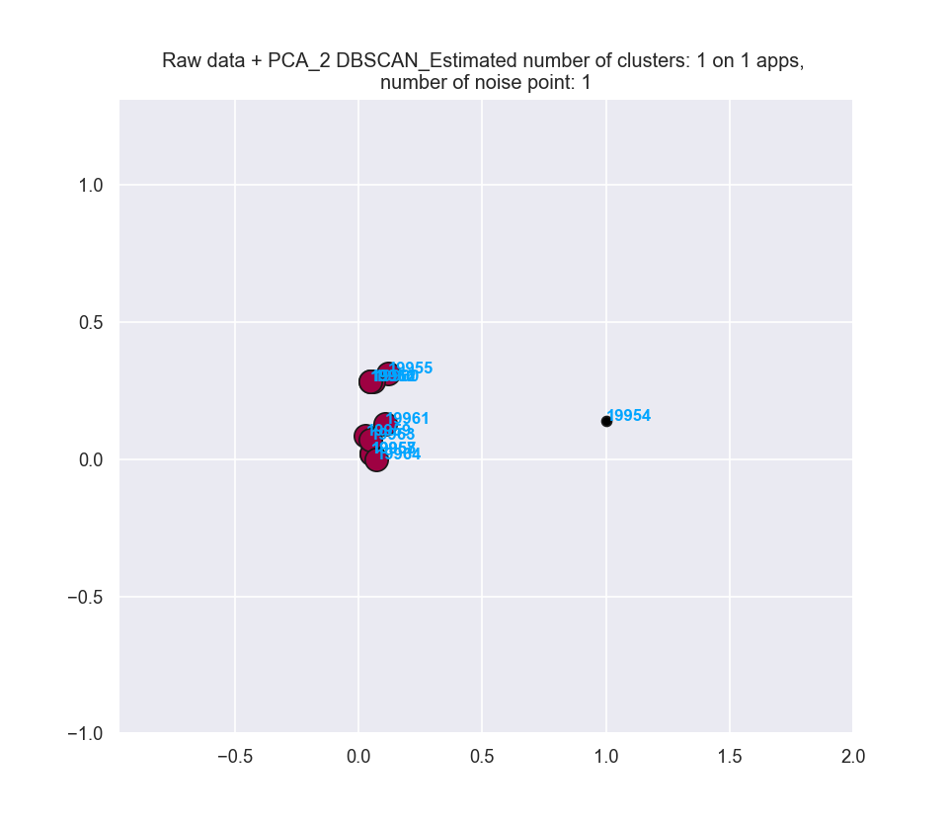
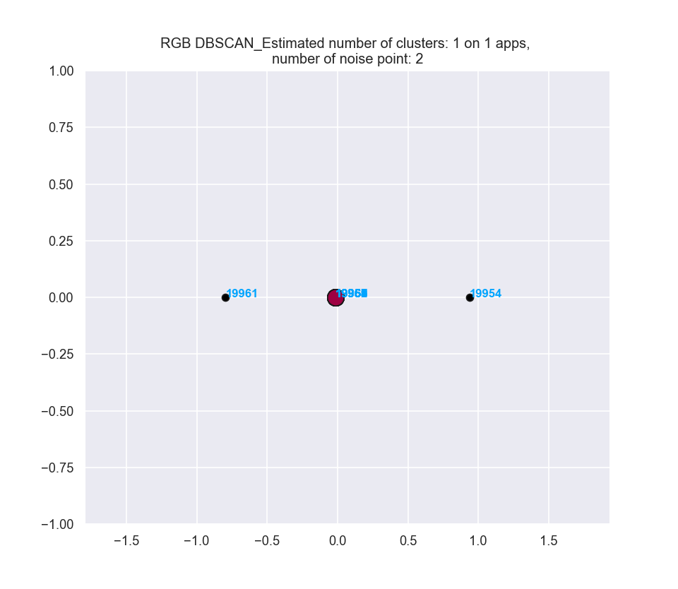
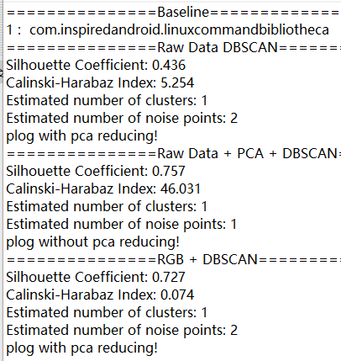
66.com.inspiredandroid.linuxcommandbibliotheca

Slide 16
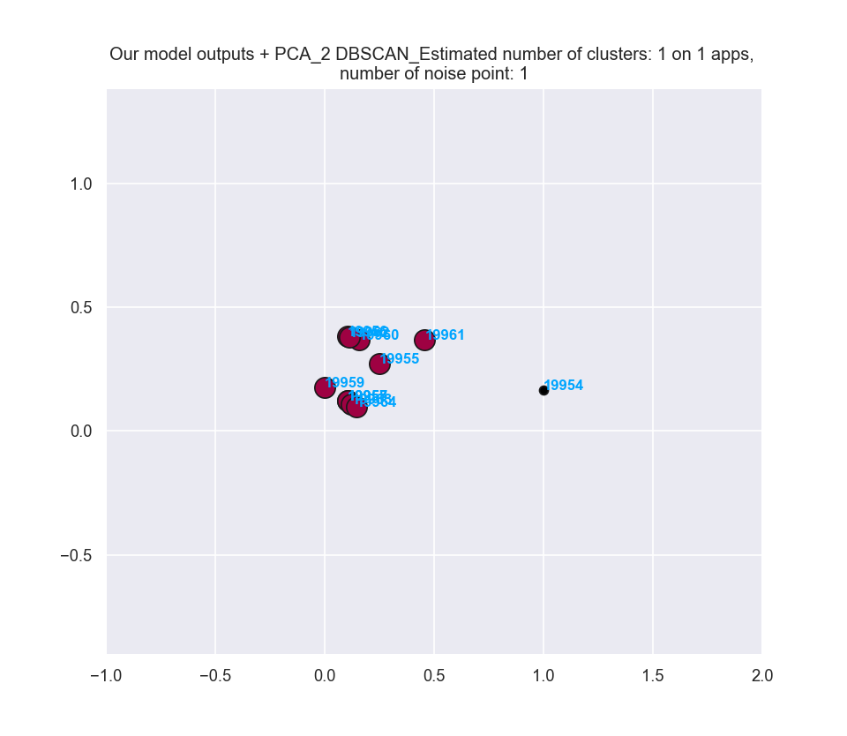
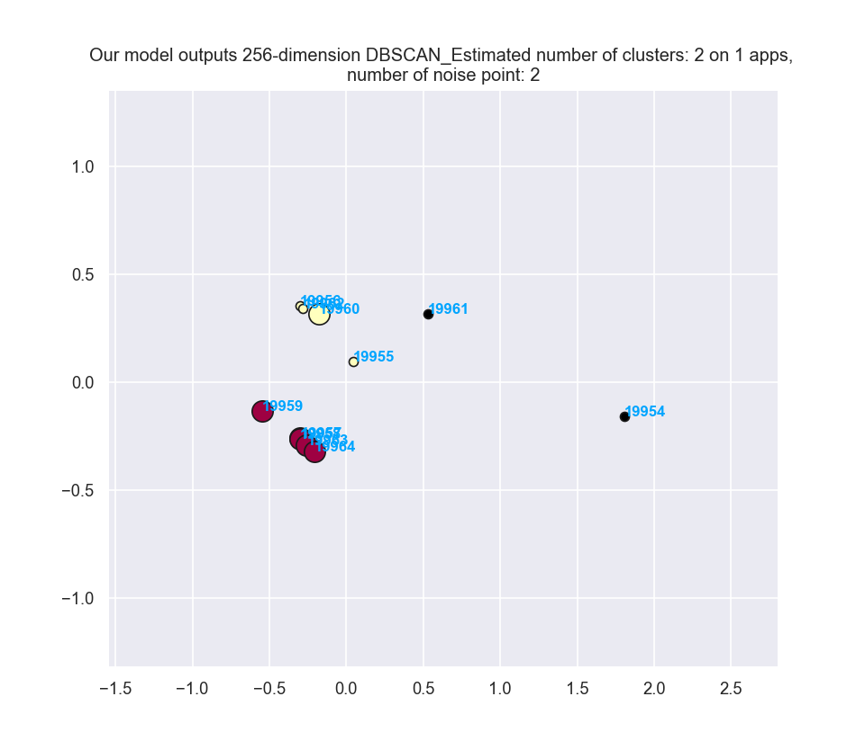
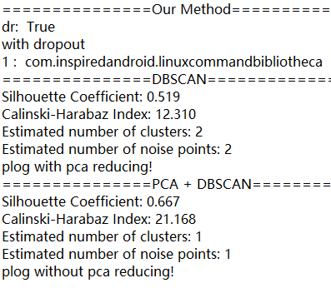
66.com.inspiredandroid.linuxcommandbibliotheca

Slide 17
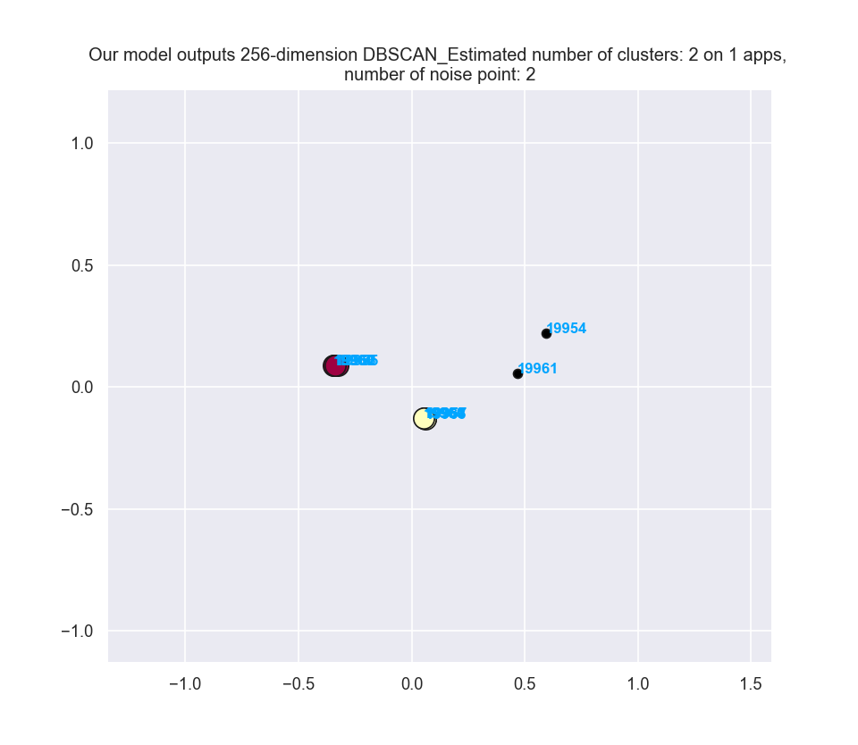
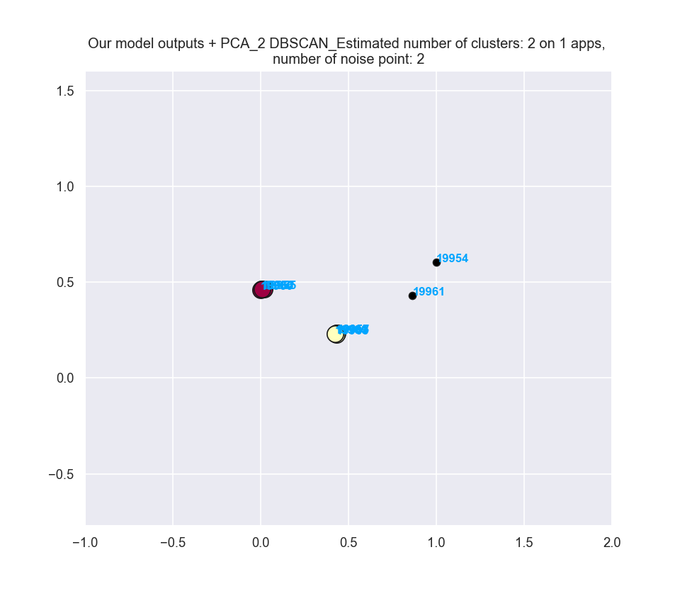
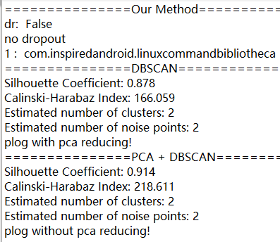
66.com.inspiredandroid.linuxcommandbibliotheca

Slide 18
Clustering ：
Parameter setting of DBSCAN :
db = DBSCAN(eps=.5, min_samples=4).fit(data)
Get eps through the curve of k-distance, get min_samples by the value of k

