Slide 1
工作汇报
2019年1月10日 赵天明

Slide 2
主要工作
1. Rico: A Mobile App Dataset for Building Data-Driven Design Applications
Rico:
72219 Uis , 9772 apps , 27 categories
png(1080×1920) , json(layout)
ui_details.csv
app_details.csv

Slide 3
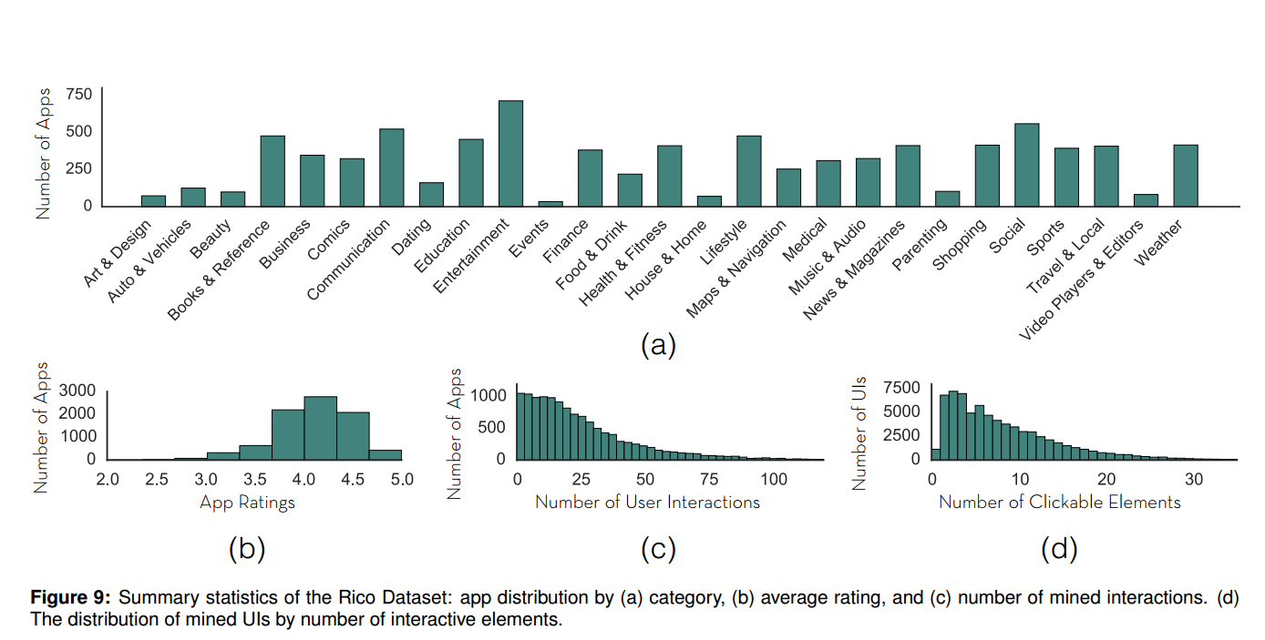
主要工作

Slide 4
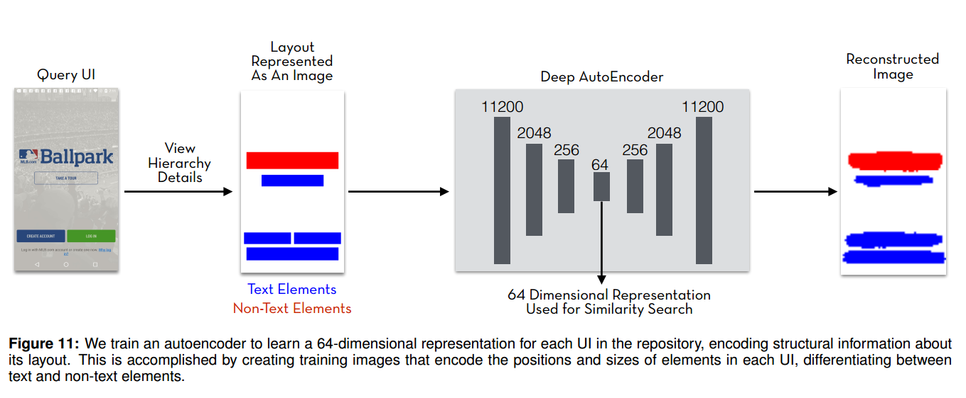
Constructed a new image for each UI encoding the bounding box regions of all leaf elements in its view hierarchy, differentiating between text and non-text elements (Figure 11). Rico’s view hierarchies obviate the need for noisy image processing or OCR techniques to create these inputs.

Slide 5
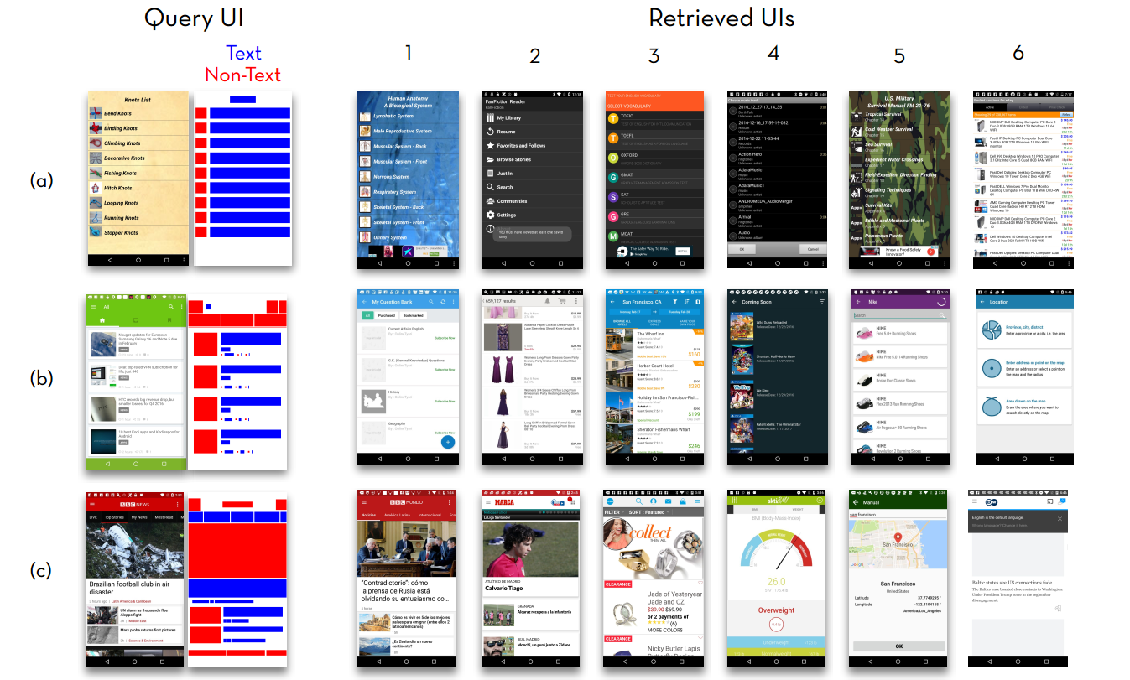
本周主要工作

Slide 6
本周主要工作
Reverse Engineering Mobile Application User Interfaces With REMAUI
Using the method in UIs of Rico.

Slide 7
主要工作
2. Rico: A Mobile App Dataset for Building Data-Driven Design Applications
This paper introduces an automatic approach for generating semantic annotations for mobile app UIs.
Through an iterative open coding of 73k UI elements and 720 screens, we contribute a lexical database of 25 types of UI components, 197 text button concepts, and 135 icon classes shared across apps.

Slide 8
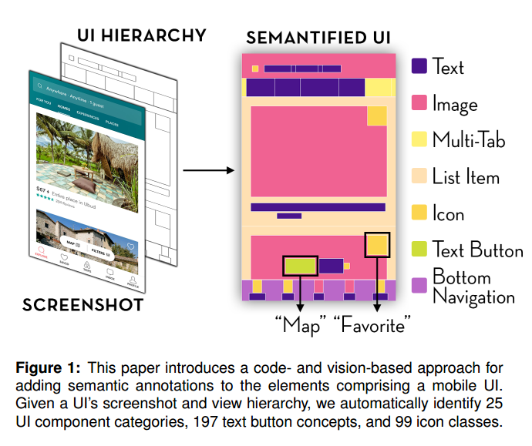

Slide 9
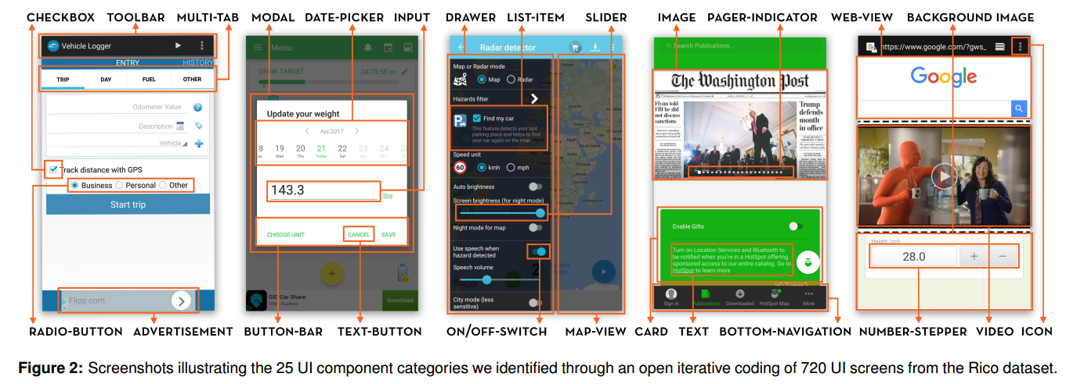

Slide 10
