Slide 1
工作汇报
2019年1月17日 赵天明

Slide 2
主要工作
Rico
Select the apps with Ui_num >= 10
43633 Uis , 2618 apps
Resized image(90,160, 3)
2094 (80%) for training, 524 (20%) for testing

Slide 3
本周主要工作
Set the intra dataset and inter dataset
(1).Loop app_num/2 times in one app folder, random selection of a pair of images. Loop in all app folders.
17016 Intra_pairs
(2). Random pairing in all apps, select 5 from each of the two paired apps.
20925 Inter_pairs

Slide 4
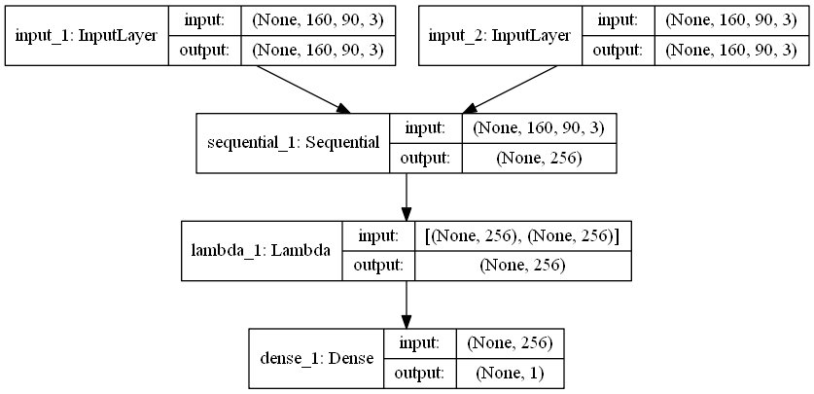
本周主要工作
Set up the siamese network

Slide 5
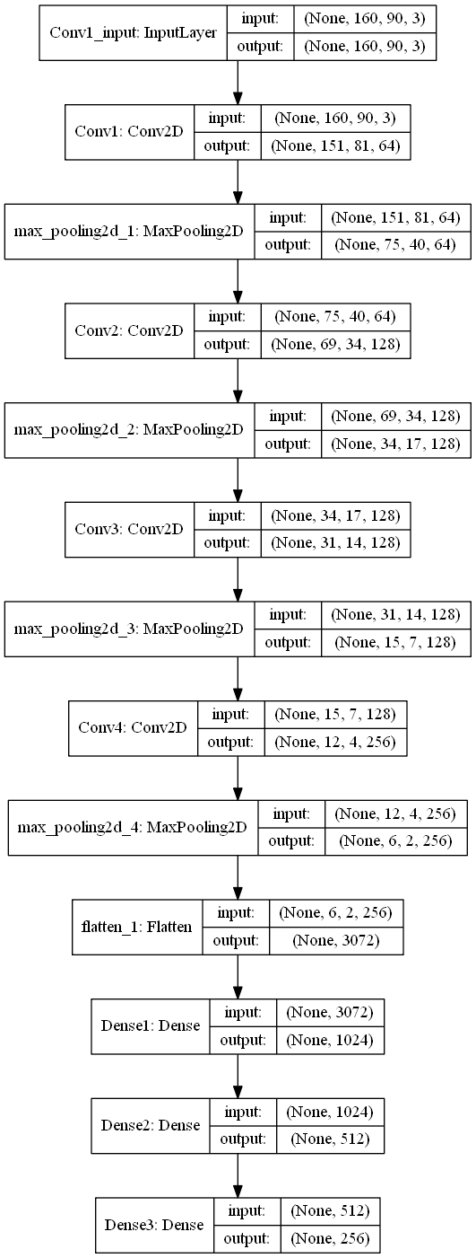
本周主要工作
Set up the siamese network

Slide 6
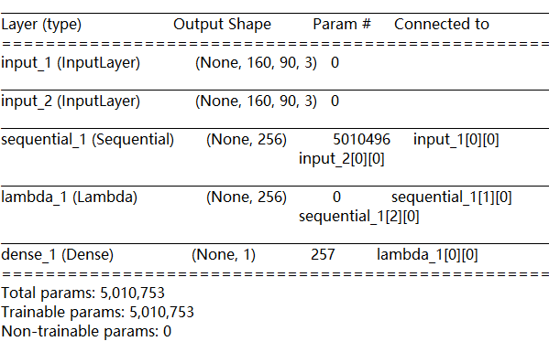
本周主要工作
Set up the siamese network

Slide 7
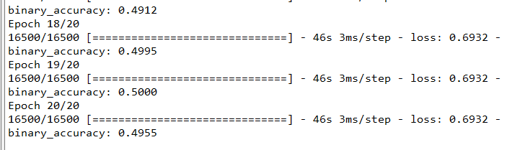
本周主要工作
Result
loss= binary_crossentropy
Learning rate = 10e-3, batch_size = 24, iterations = 20

Slide 8
主要工作
Next work
Select the apps with Ui_num >= 30
6656 Uis , 183apps

