Slide 1
工作汇报
2018年11月29日 赵天明

Slide 2
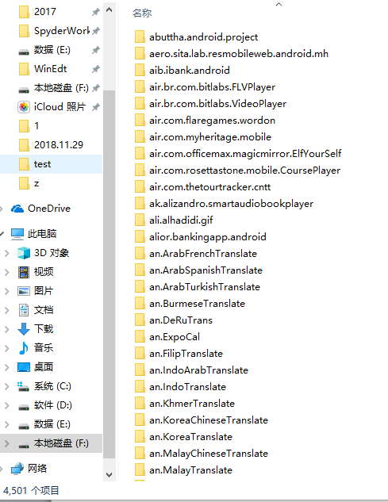

本周主要工作
Data preparing
4501 folders represent 4501 classes(labels).
4404 folders match url_id in the meta file.(remove empty folders)

Slide 3
本周主要工作
Problems about the UI images
1. duplicate images
2. samples without content
3. the number of samples varies greatly(5~1500+, with duplicates)
4. image that doesn’t belong to the UI interface

Slide 4
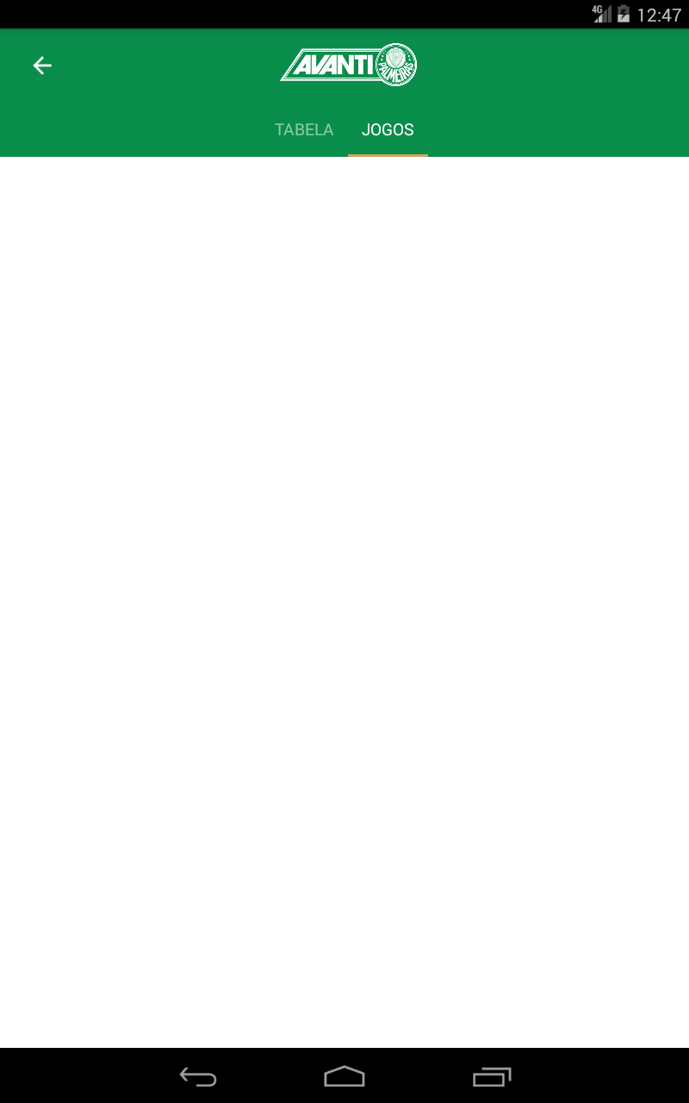
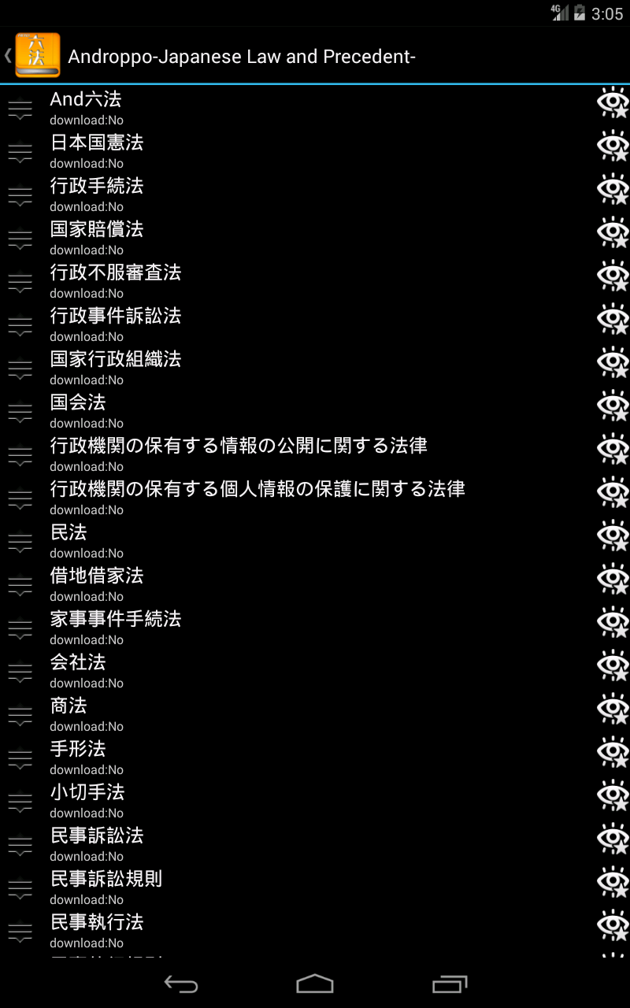
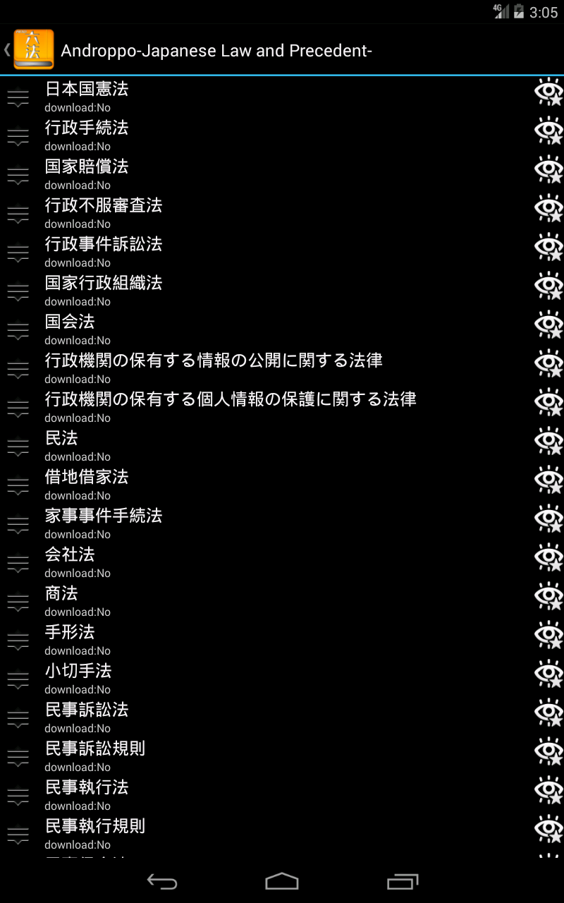
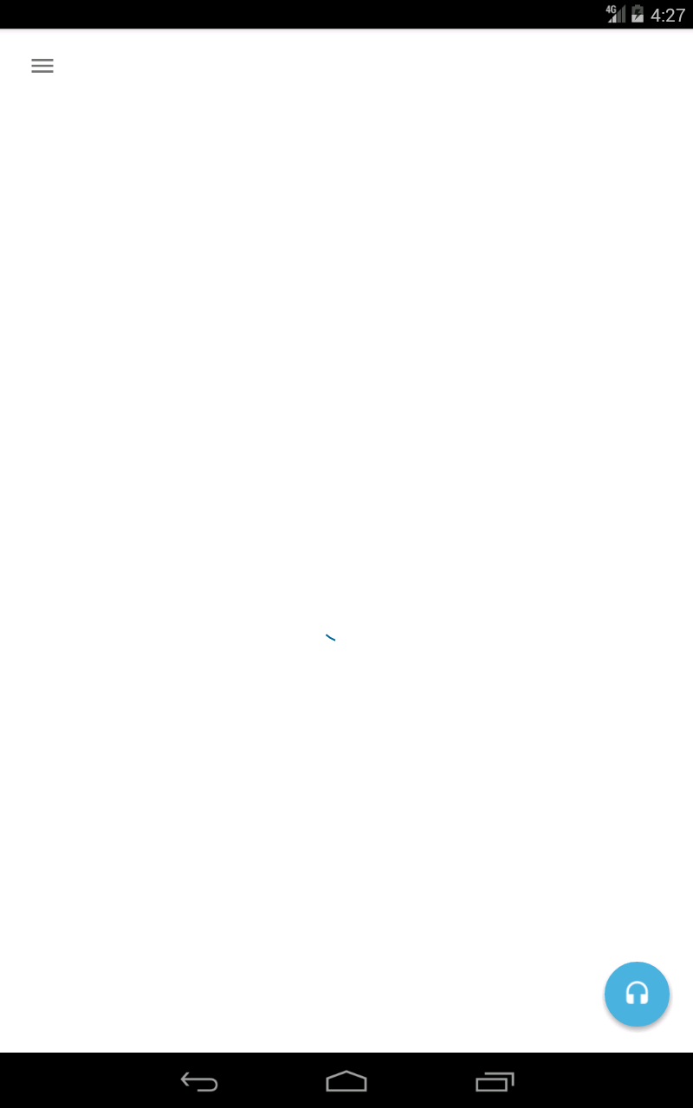
本周主要工作
Problems about the UI images
1. duplicate images
2. samples without content
3. the number of samples varies greatly(5~1500+, with duplicates)
4. image that doesn’t belong to the UI interface

Slide 5

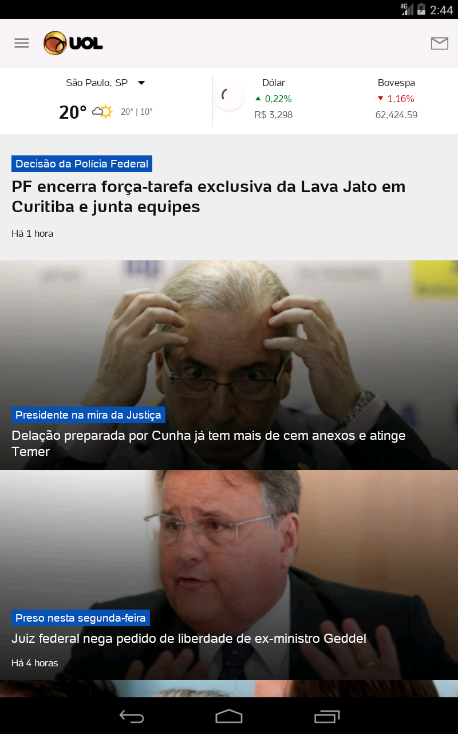
本周主要工作
Problems about the UI images
1. duplicate images
2. samples without content
3. the number of samples varies greatly(5~1500+, with duplicates)
4. image that doesn’t belong to the UI interface

Slide 6
本周主要工作
For training
The label?(Name or Category)
The input size(800×1280) is too big.(NN method to 160×256)
Regular graphics(contrast to irregular figure)

Slide 7
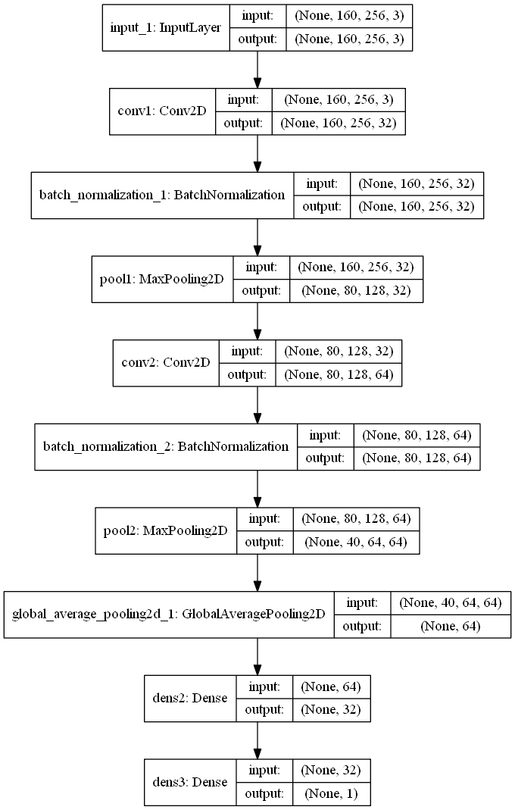
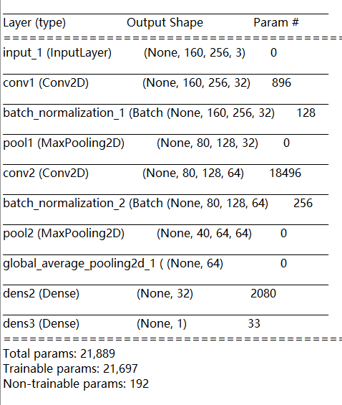
本周主要工作
227 classes
30 samples， 25 for training， 5 for testing

Slide 8
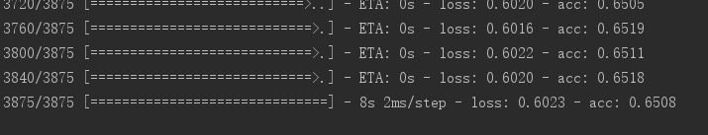
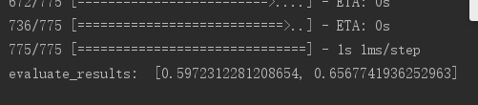
本周主要工作
epochs=5， batch_size=20
Training
Evaluating

