Slide 1
工作汇报
2019年7月29日 赵天明

Slide 2
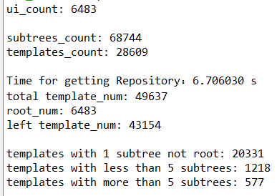
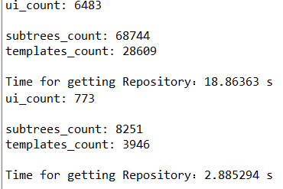
Data Collection
(1). Get the professional GUIs from the profession apps.(13060 GUIs in 1864 apps)
(2).Get the Dom tree and all subtrees from each GUI saved in a txt file.
(3).1576 apps for training(85%), 101 apps for validation(5%), and 187 apps for testing(10%).
(4).Take 5 GUIs in each app: 6483 apps for training, 395 for validation, and 773 for testing.
(5).In the training apps, containing 68744 sub trees and 28609 templates.

Slide 3
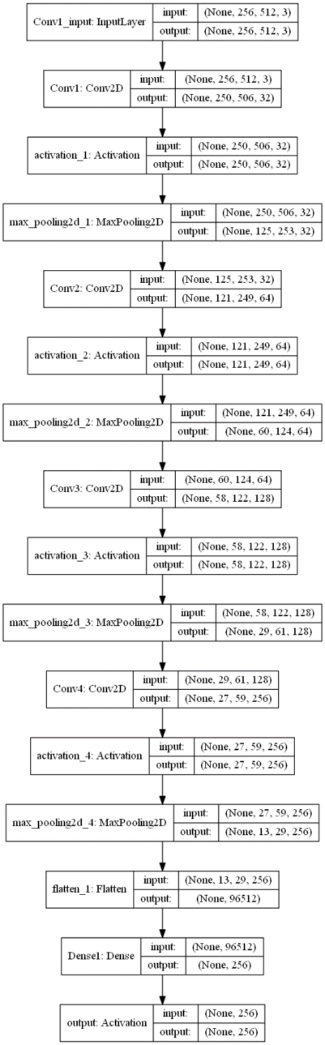
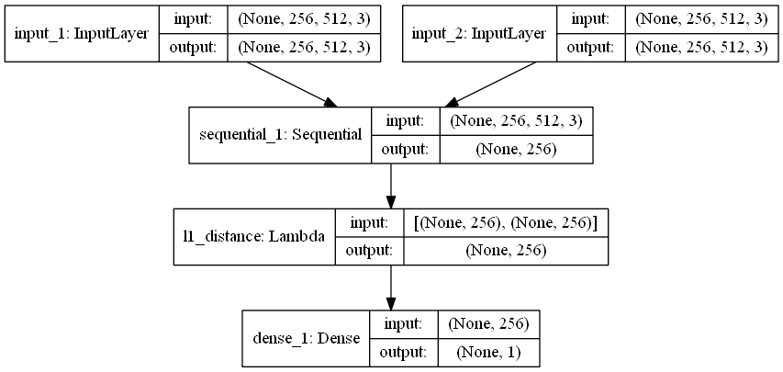
Style Embedding

Slide 4
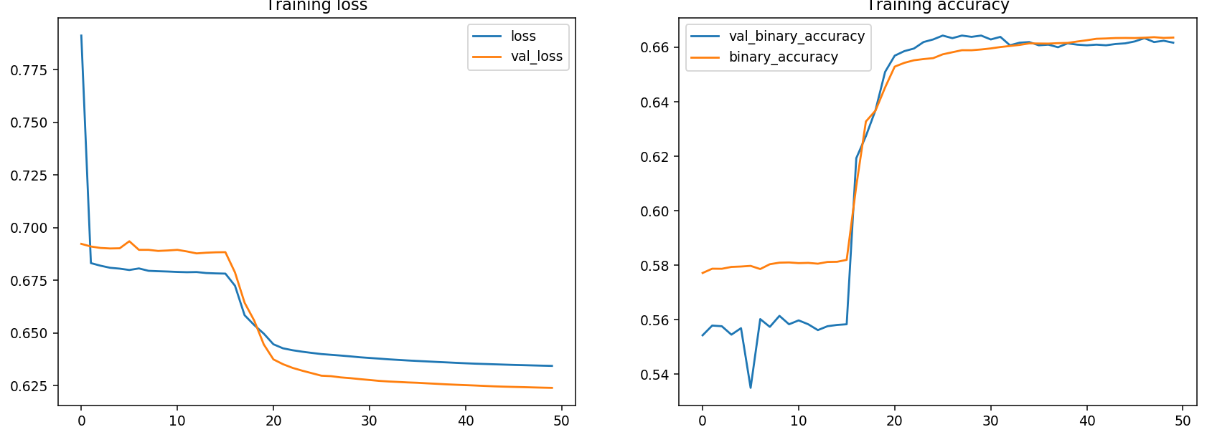
Style Embedding

Slide 5
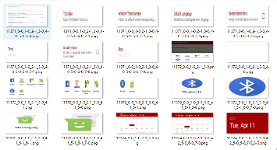
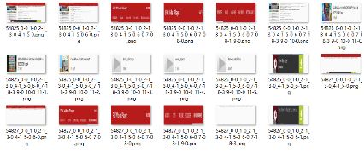
G
noise
combination of subtrees
Fake GUI
D
Style Embedding
Real GUI
the structural similarity of subtrees
Repository
subtree1
subtree2
template1
template2
subtree with location info(bounds)

Slide 6
GAN in NLP(different from the traditional GAN)
System of conversation
Plain text generation
Mechanical translation
Information retrieval
Text classification
Chinese word segmentation
Poetry generation……
The main idea is to use the discriminator to distinguish the true label from the false, and then use the policy gradient of RL to score and update.
Reference1：IRGAN(its generator is actually a candidate sentence, which needs sofmax),

Slide 7
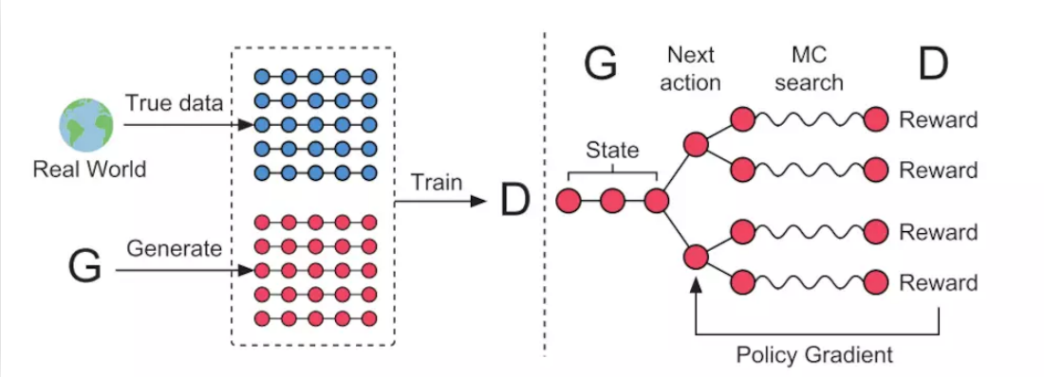
Reference2： Seq GAN
GAN+RL+NLP

