Slide 1
工作汇报
2019年6月17日 赵天明

Slide 2
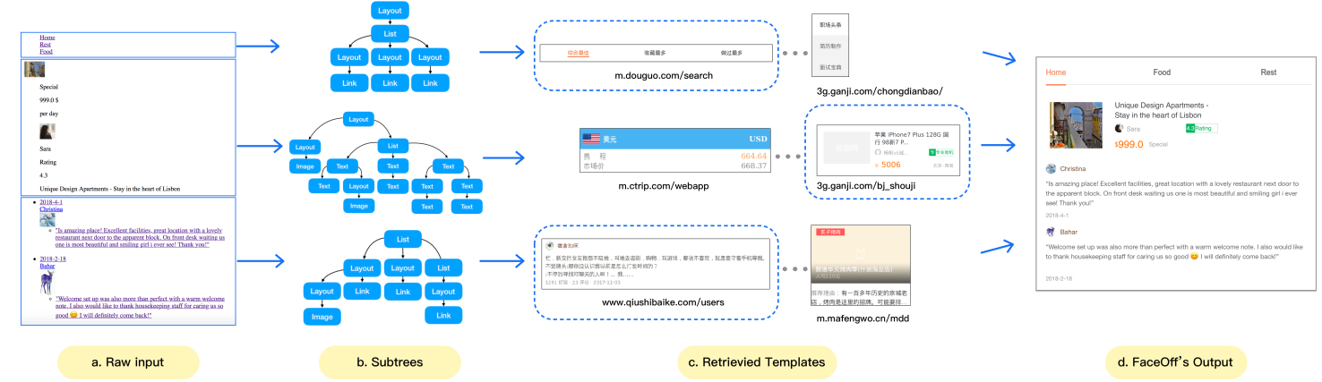
1. FaceOff(2019.2)
(1) Construct a repository of web GUI based on 15,491 web pages, a page under design (PUD) as input.
(2) Use the structure matching algorithm to implement a template retriever. (3) Train a CNN-based style embedding model to find the optimal combination of templates with harmonious style.

Slide 3
(2)
·Extract templates from these web pages, cut out all subtrees from the original DOM tree,
·Use the subtree as index to identify a template. Segments the PUD into several blocks by dividing the DOM tree into multiple subtrees,
·Use a variant of tree edit distance algorithm to define the structural similarity of subtrees.
·Adopt a top-down searching algorithm to improve the speed of searching segmentation.

Slide 4
2. Anime Characters Creation(2017)
(1) Use Illustration2Vec, a CNN-based tool for estimating tags of anime illustrations7 for (noisy) estimations of tags.(which can predict probabilities of belonging to 512 kinds of general attributes (tags)). Select 34 related tags suitable for our task.
(2) Use DRAGAN as the basic GAN model, which can give presumable results compare to other GANs, and it has the least computation cost.
(3) Use Fréchet Inception Distance(FID) as the quantitative evaluation method.(replace the Inception model trained on ImageNet with Illustration2vec feature extractor model for better measurement)
(4) Build a website interface to make our model more accessible.(We impose WebDNN, and convert the trained Chainer model to the WebAssembly based Javascript model)

Slide 5
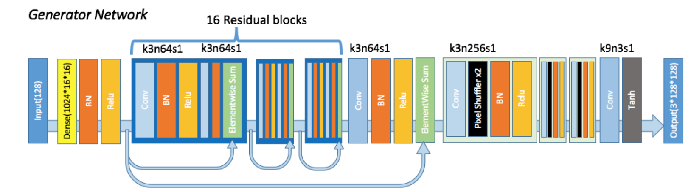
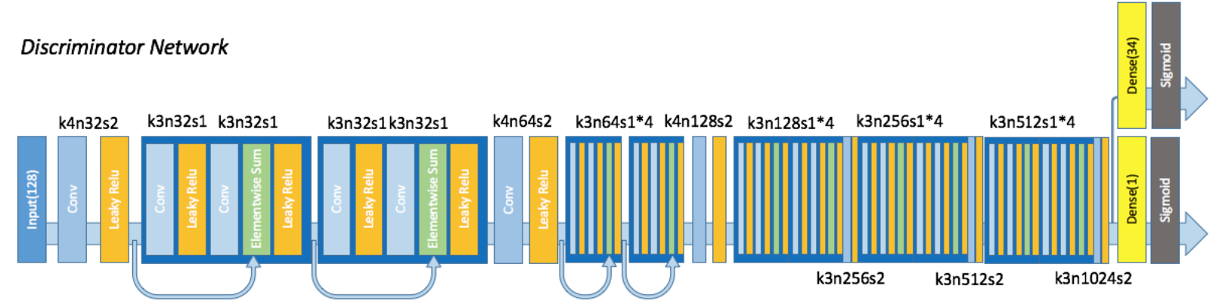
(2) ·The generator contains 16 ResBlocks and uses 3 sub-pixel CNN[27] for feature map upscaling. The discriminator contains 10 Resblocks, add an extra fully-connected layer to the last convolution layer as the attribute classifier.

Slide 6
(2)
·Use DRAGAN as the basic GAN model, which can give presumable results compare to other GANs, and it has the least computation cost. Also find it is very stable under several network architectures, we successfully train the DRAGAN with a SRResNet(2017)[12]-like generator. Utilization of the label information is inspired by ACGAN.
·Compared with shape attributes(e.g. “hat”, “glasses”), color attributes are easier to learn. Super-Resolution (failed)
Making generation of high resolution facial images from the GAN model directly is difficult, we try to build another Super-Resolution network.

Slide 7
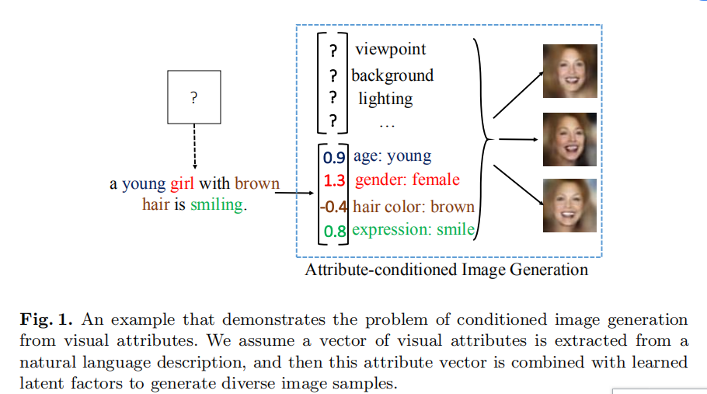
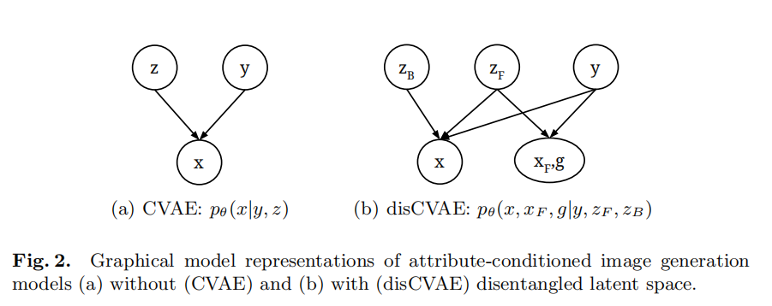
3. Attribute2Image(2016.10)
(1) Generating images from visual attributes：Image modeling is a combination of foreground and background, and a hierarchical generation model is developed.
(2) The vector of visual attributes is extracted from natural language description, and the vector is combined with potential factors of learning to generate different image samples.
(3) End-to-end learning and decryption of latent variables for VAE. Using the Energy Minimization Algorithms for posterior judgment to latent variables.

Slide 8
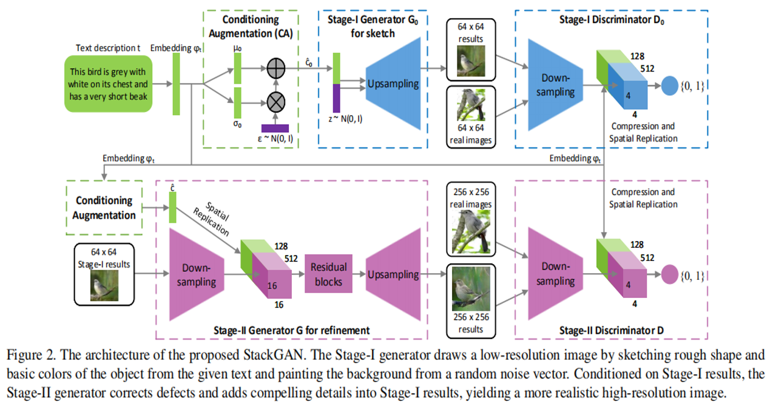
4. StackGAN(2017.8)
(1) Drawing the original shape and color of an object based on a given document description.
(2) Using results of (1) and text descriptions as input and generating realistic high-resolution images

Slide 9
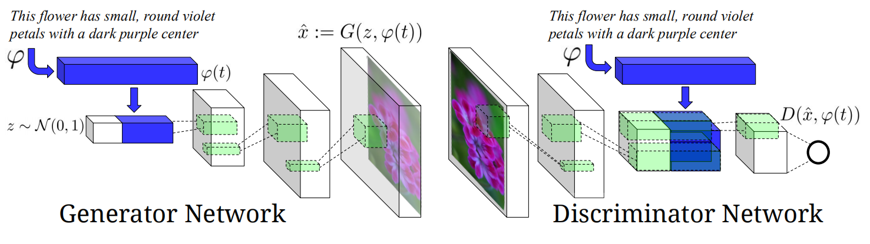
5. DC-GAN(2016)
(1) Train deep convolution generation antagonistic network (DC-GAN), which is based on the text features encoded by hybrid character-level convolution-recursive neural network.
(2) The training data is a sample set of some text descriptions and corresponding images. When any object description is given, the model attempts to generate images based on the description.

Slide 10
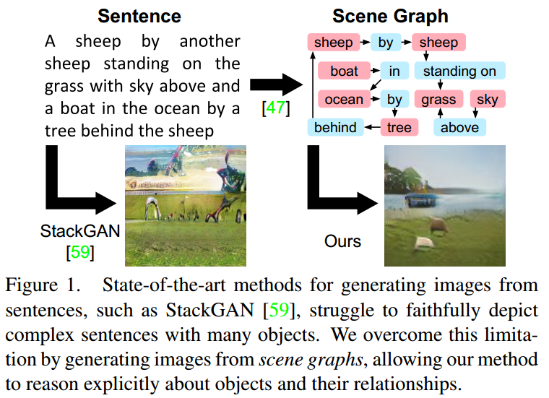
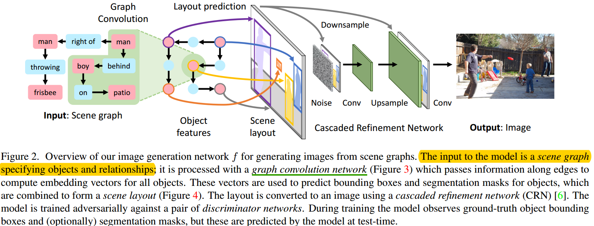
6. Image Generation
from Scene Graphs(2018)

Slide 11
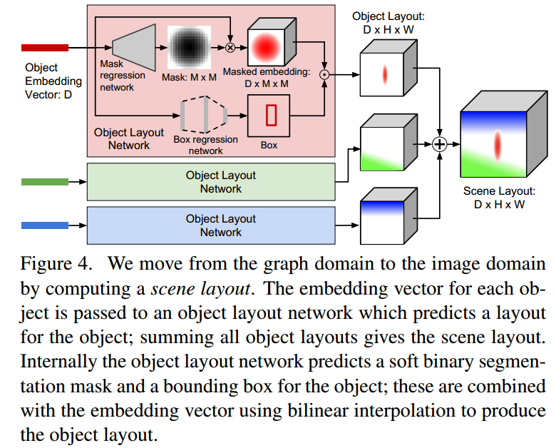
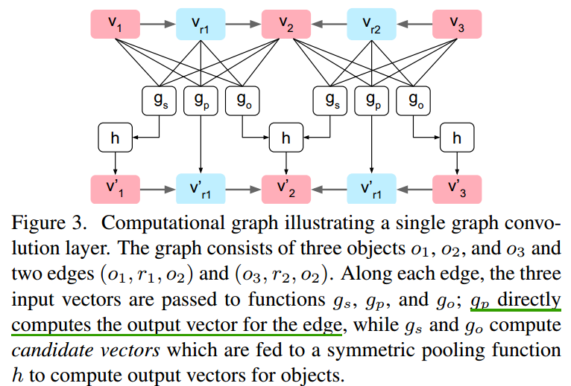

Slide 12
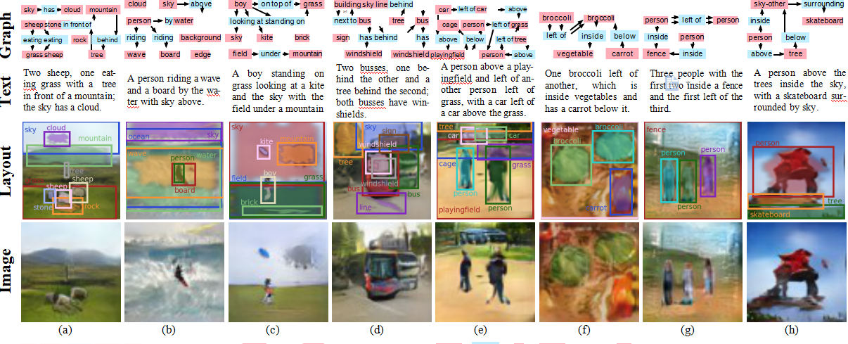
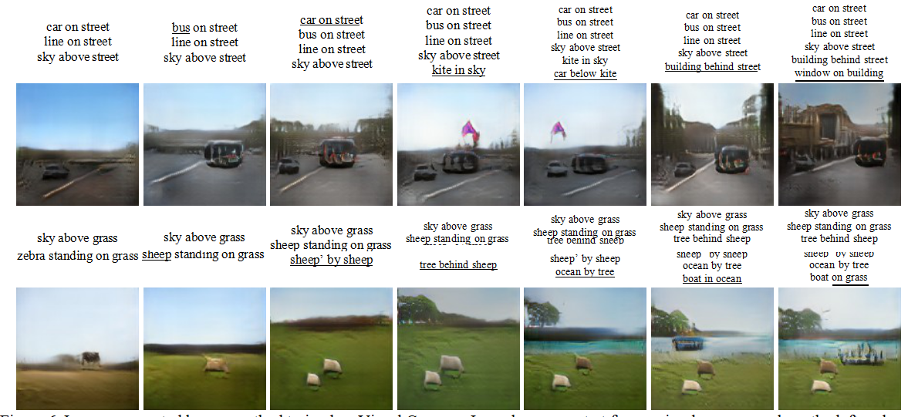

Slide 13
·Inspired by 2
Style transfer models + fashion of the corresponding age/category
Style Transfer models(Domain adaptation)
：DANN, ARDA
· To avoid GAN mode collapse Structural improvement： MAD-GAN, MRGAN
Supervised: CGAN, ACGAN
Reinforcement Learning(use a NN to learn the cost function): DDPG, TRPO
· To select the Off-the-shelf models.
· Pytorch

