Slide 1
工作汇报
2018年11月20日 赵天明

Slide 2
本周主要工作
Operating environment
Data understanding and Data preparing,
Model

Slide 3
Operating environment
Connection to the Server with MobaXterm
Pycharm

Slide 4
Data understanding and Data preparing
Ui images and Xmls
The meta file

Slide 5
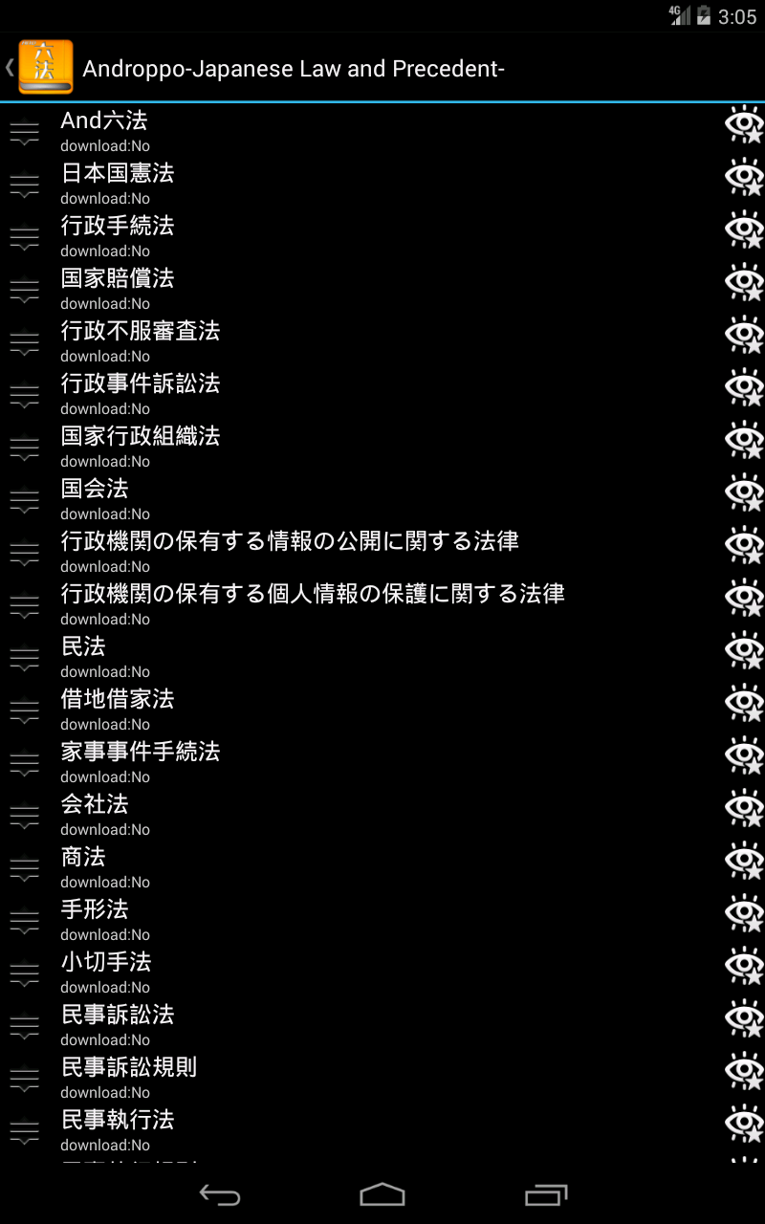
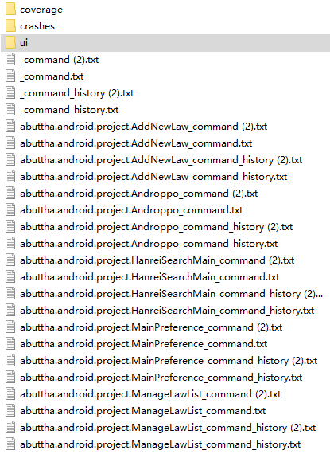
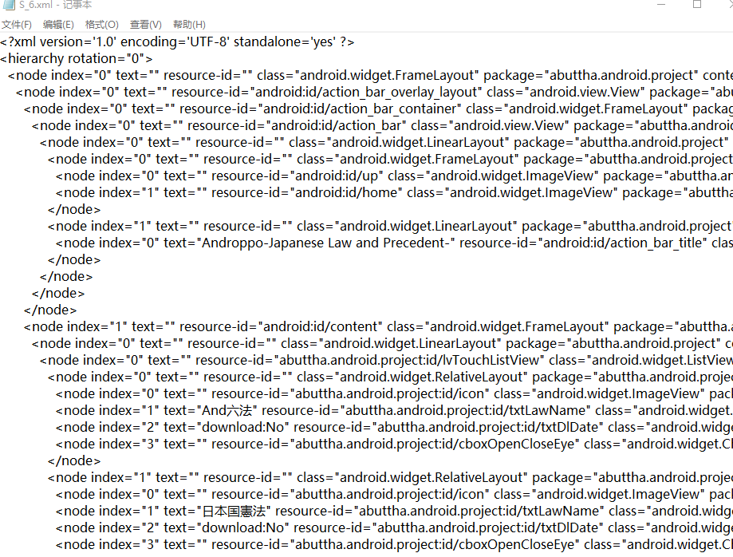

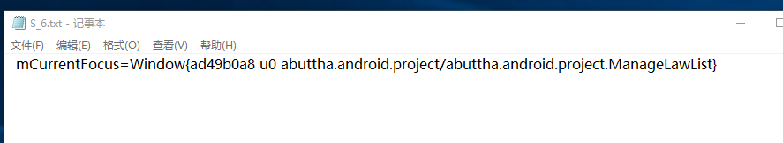
Ui images and Xmls
Png file--Image
Txt file-- mCurrentFocus
Xml file--Control layout information

Slide 6
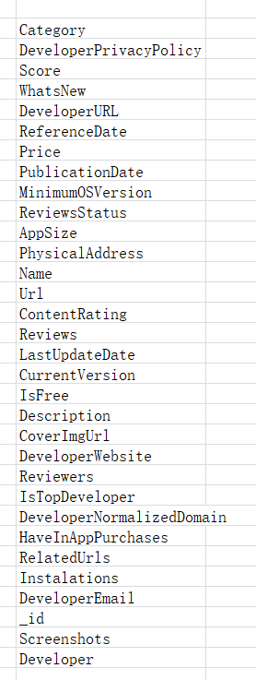
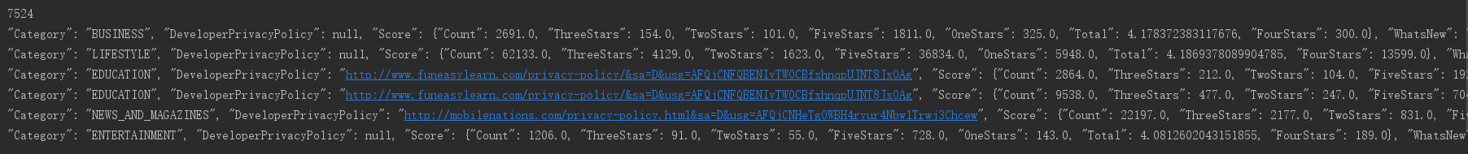
The meta file
32 dimensions of information

Slide 7
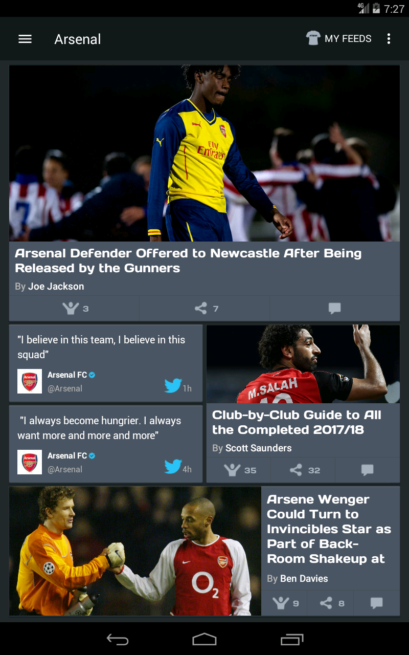
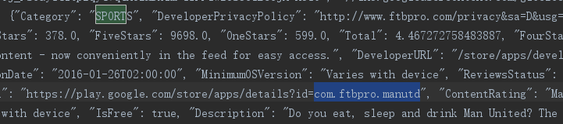

The meta file and the UI images

Slide 8
Model
Attention mechanism
Existing network models with attenion

Slide 9
Attention mechanism in image classification
soft attention
This attention mechanism is differentiable and can be trained by backpropagation.
hard attention
Usually trained with reinforcement learning.
Zhao B, Wu X, Feng J, et al. Diversified visual attention networks for fine-grained object classification[J]. arXiv preprint arXiv:1606.08572, 2016.

Slide 10
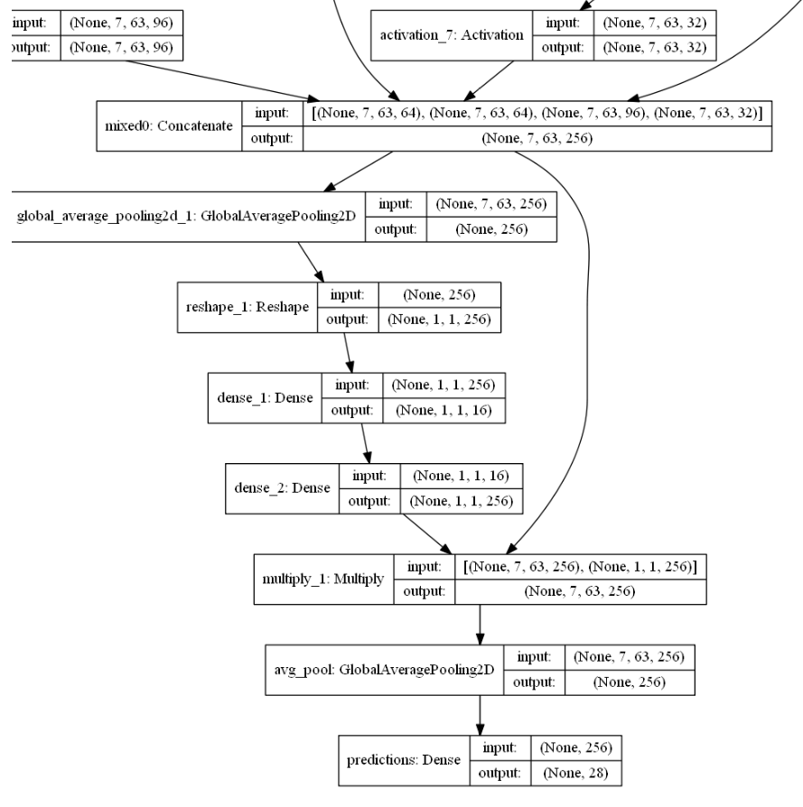
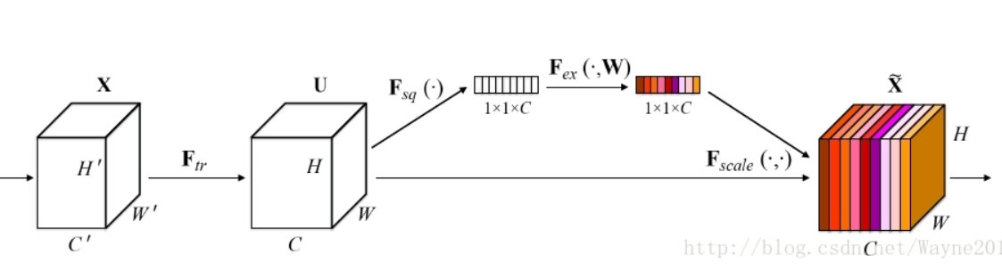
Existing network models with attenion
Residual-Attention-Convolutional-Neural-Network
Squeeze-and-Excitation Networks

Slide 11
Work next week
Data preprocessing
Model establishment
Method selection

