Slide 1
工作汇报
2018年12月25日 赵天明

Slide 2
本周主要工作
Data Distribution
Number of Commentaries:
Top: 33,368,502 Lowest: 0(without score), 2
Distribution(4399 apps in the meta file):
Range | <= 1000 | 1,000~2,500 | 2,500~ 5,000 | 5000~10,000 | 10,000~100,000 | > 100,000
Count | 347 | 735 | 677 | 637 | 1480 | 523

Slide 3
本周主要工作
Data Distribution
The top score: 4.86; The lowest score: 1.88
Score Distribution(4399 apps in the meta file):
Remove the part less than 2500 comments(4399--> 3317)
Score | 0~1 | 1~2 | 2~3 | 3~4 | 4~5
Count | 1 | 4 | 48 | 1339 | 3007
Score | 0~1 | 1~2 | 2~3 | 3~4 | 4~5
Count | 0 | 2 | 18 | 840 | 2457

Slide 4
本周主要工作
Data samples
Bad:
Good:

Slide 5
本周主要工作
Training(3317)
Top-1000: 1.88~4.04 for bad ; 4.33~4.86 for good
Top-500(Selected):
1.88~3.85 for bad ; 4.47~4.86 for good
Pick 5000 from bad, 5000 from good(10000, 256, 160, 3)
x_train, x_test, y_train, y_test = train_test_split(data, label, test_size=0.1)

Slide 6
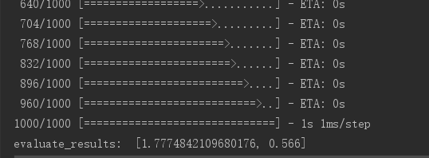

本周主要工作
Training
Model1: CNN(2 convolutional blocks 10 layers)
epochs=20， batch_size=24
Training
Evaluating

Slide 7
本周主要工作
Training
Model2: DenseNet(2 dense blocks, 28 layers)
epochs=20， batch_size=24
Training
Evaluating

