Slide 1
工作汇报
2019年2月25日 赵天明

Slide 2
主要工作
Rico
Select the apps with Ui_num >= 10
43633 Uis , 2618 apps
Resized image(180,360, 3)
2094 (80%) for training, 524 (20%) for testing

Slide 3
本周主要工作
Set the intra dataset and inter dataset
(1).Loop app_num/2 times in one app folder, random selection of a pair of images. Loop in all app folders.
17016 Intra_pairs
(2). Random pairing in all apps, select 5 from each of the two paired apps.
20925 Inter_pairs

Slide 4
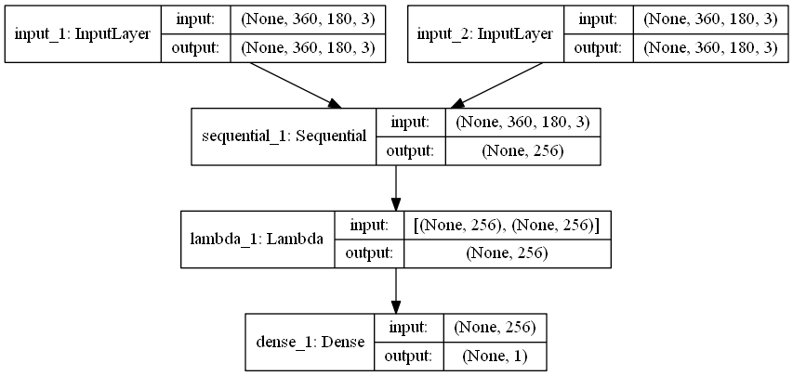
本周主要工作
Set up the siamese network

Slide 5
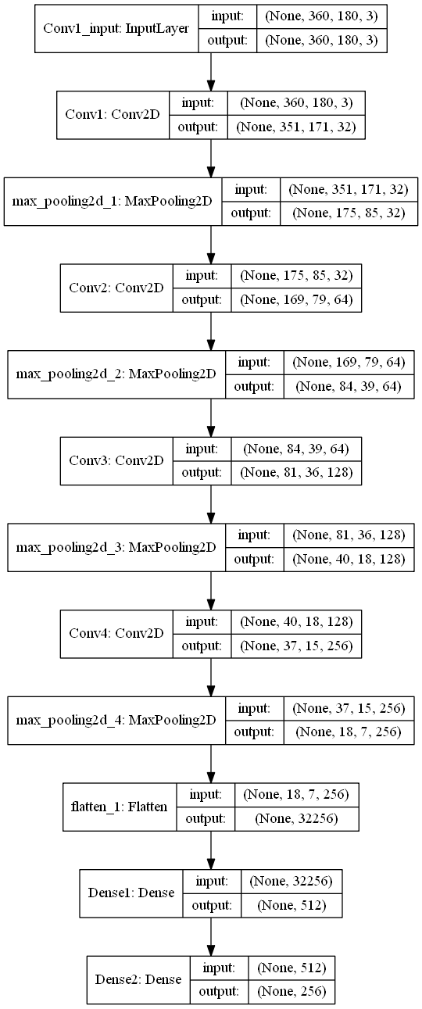
本周主要工作
Set up the siamese network

Slide 6
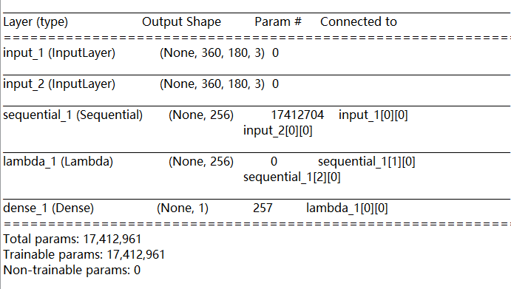
本周主要工作
Set up the siamese network

Slide 7
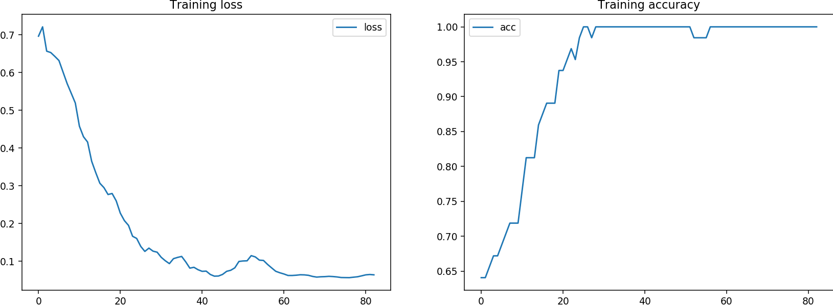
Result
loss= binary_crossentropy, Learning rate = 10e-5
batch_size = 32, 50000 iterations(44000), 83 epochs

Slide 8
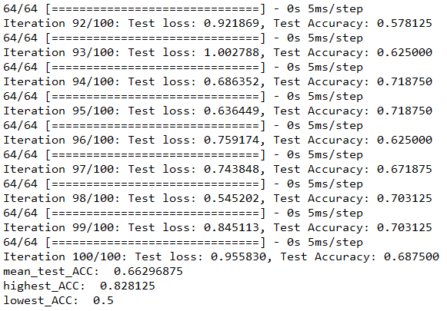
Result
Testing result:

Slide 9
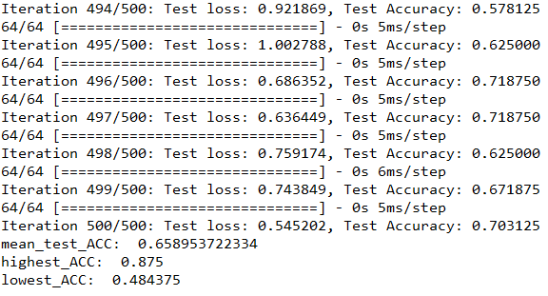
Result
Testing result:

Slide 10
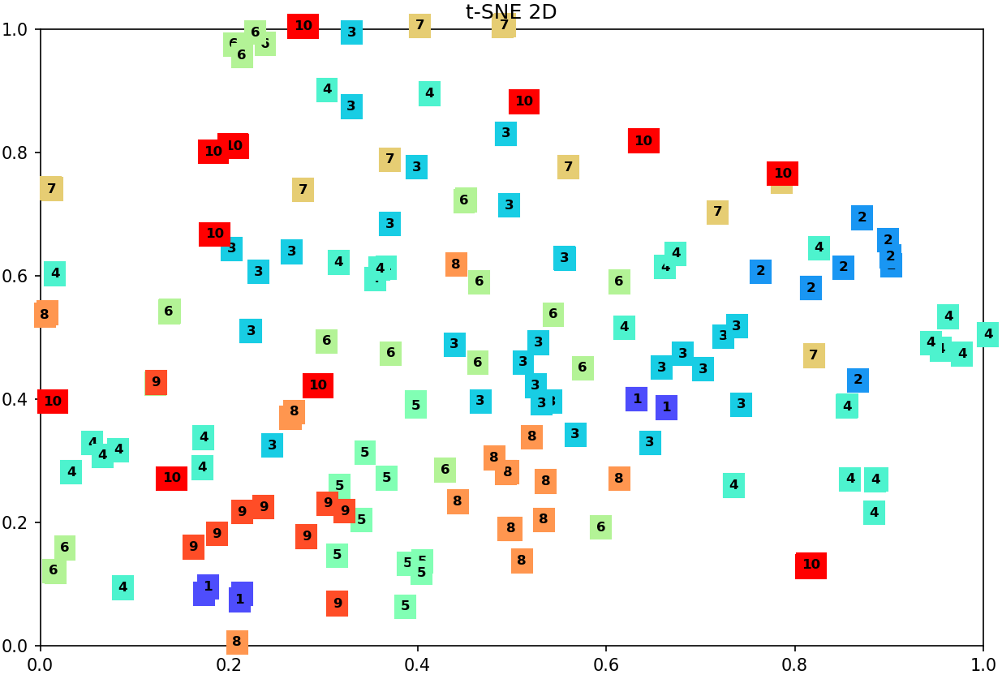
10 apps

Slide 11
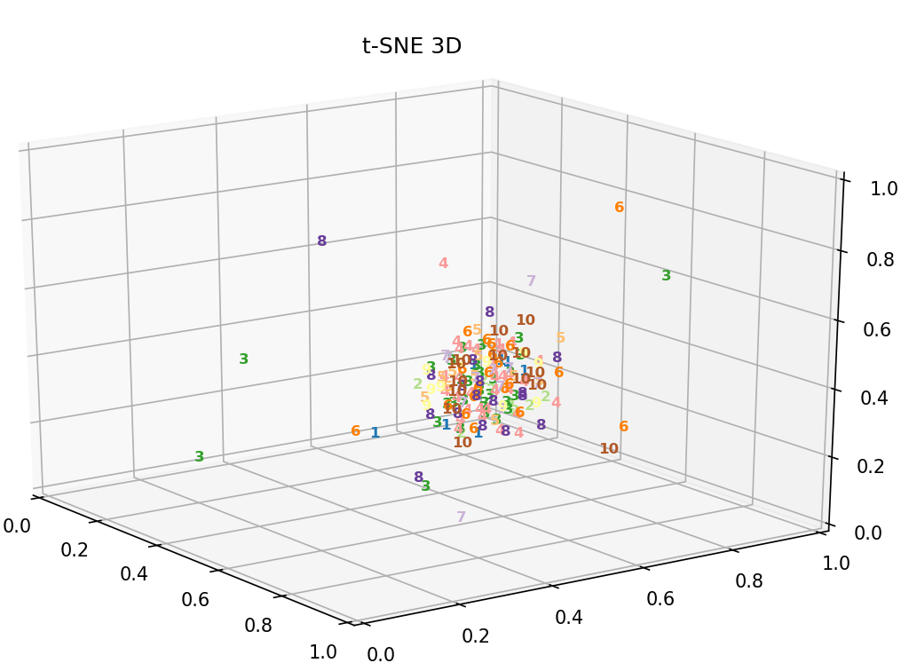
10 apps

Slide 12
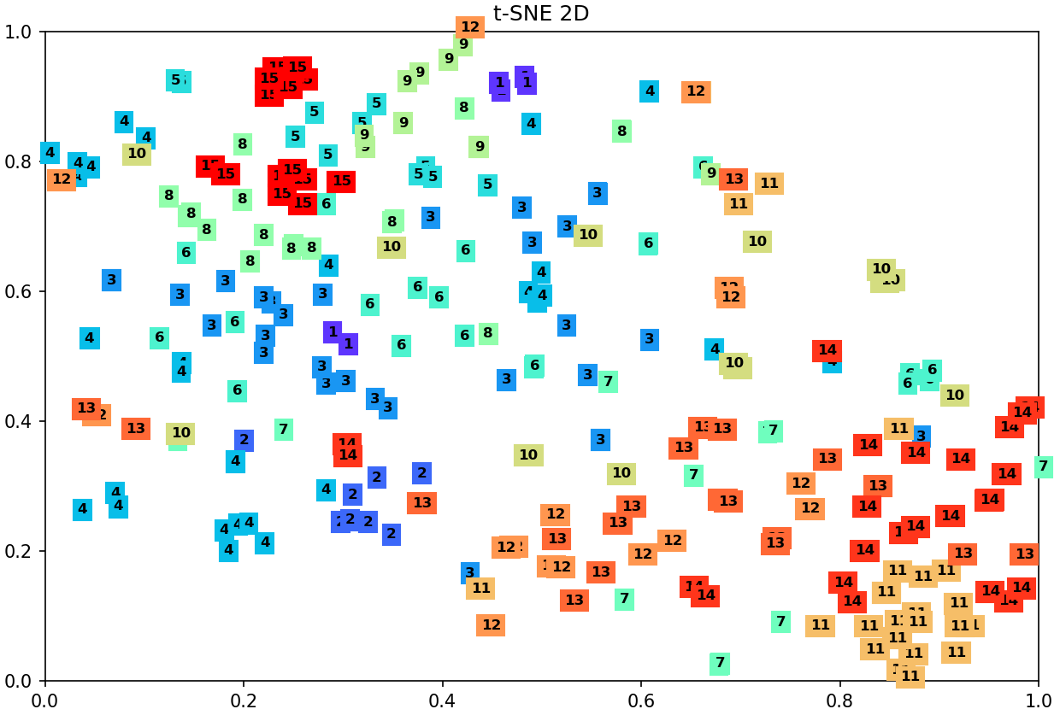
15 apps

Slide 13
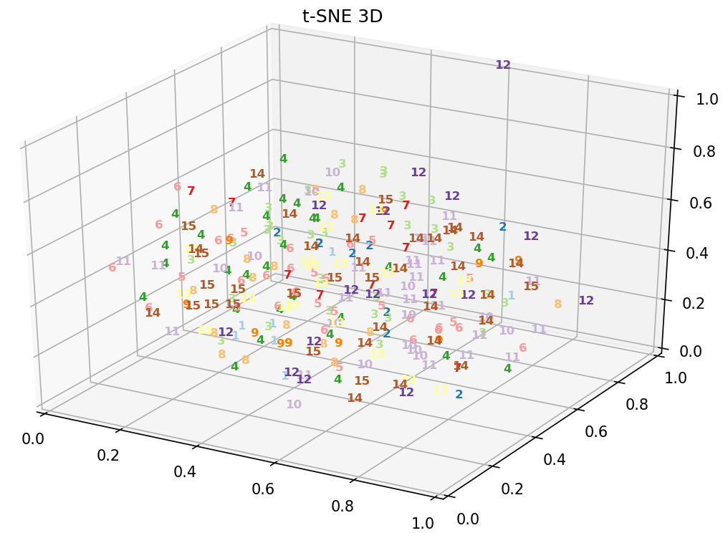
15 apps

Slide 14
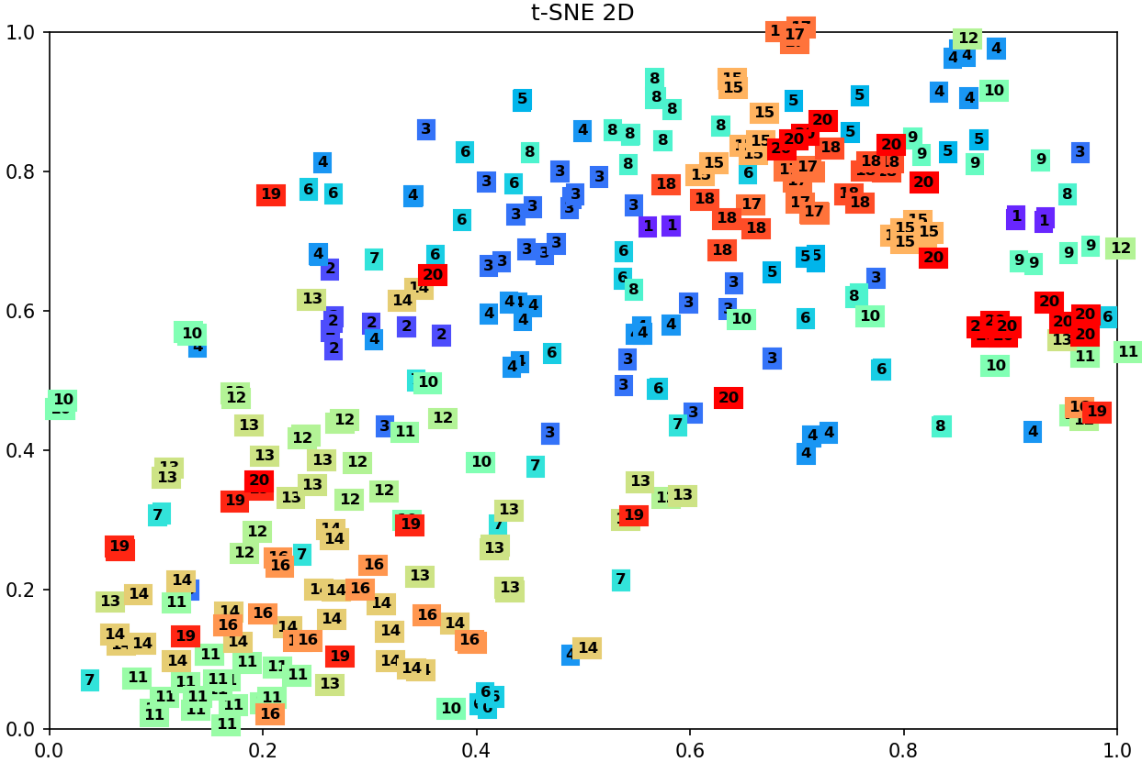
20 apps

Slide 15
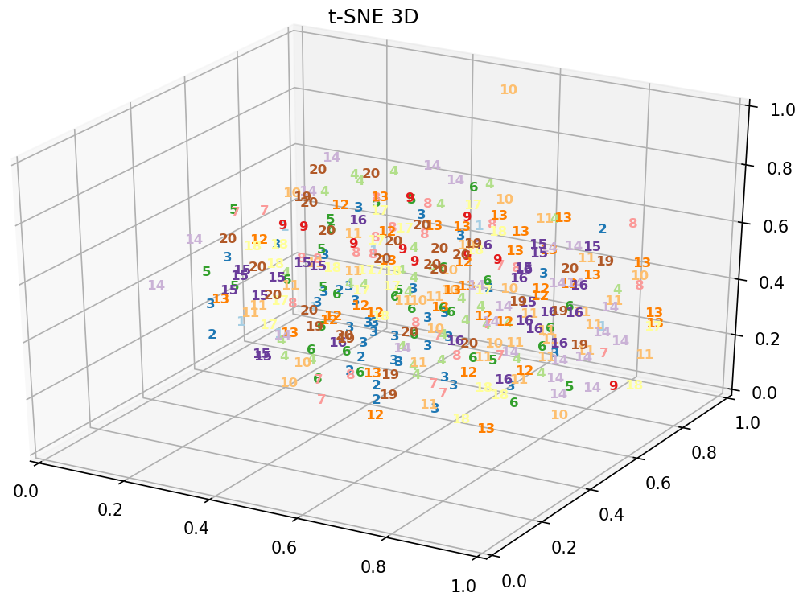
20 apps

