Slide 1
工作汇报
2019年9月2日 赵天明

Slide 2
Procedure:
Require：generator G, discriminator D, sentence dataset S, subtree embeddings Y
1. repeat
2. for g-steps do
Generate a sentence y_1:T = (y_1,…,y_t,…,y_T), y_t ∈Y, height(1:T) < H with G
for t in 1:T do
Compute Q
end for
Update G’s parameters via policy gradient
8. end for
9. for d-step do
10. Generate negative samples with current G and combine with given positive
samples S
11. Calculate the tree-distance between negative and positive samples as the loss of D
12. Train D for k epochs
13. end for
14. Until converges

Slide 3
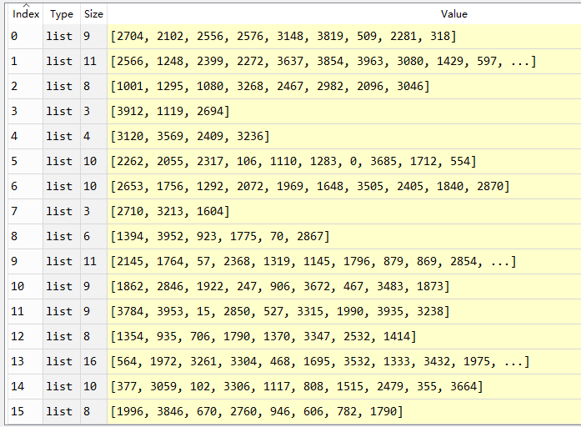
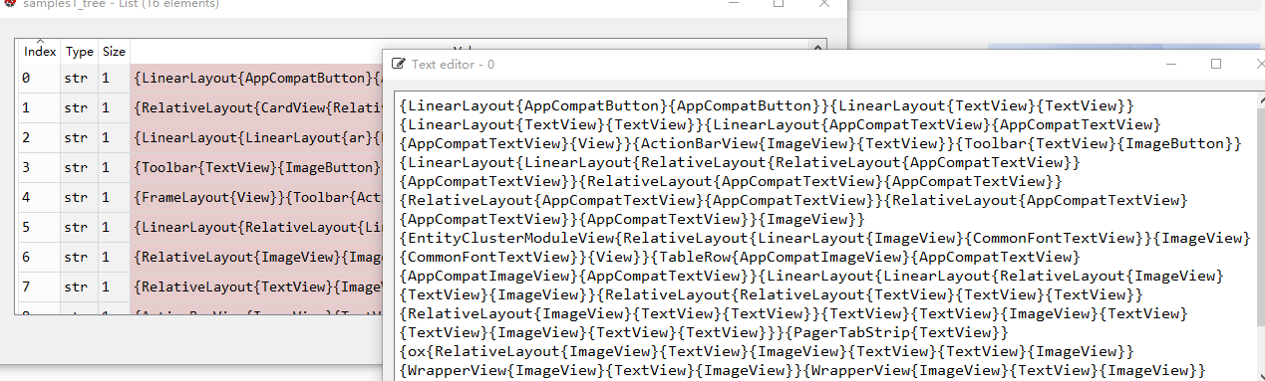
G Procedure:
load subtrees embeddings in training apps: x_emb
VOCAB_SIZE = len(x_emb).
Generate samples with same sequence_length(30,
or maybe larger)，
Cut each sample according to the height
restrictions(2560).
Connect subtrees retained in each sample sequentially

Slide 4
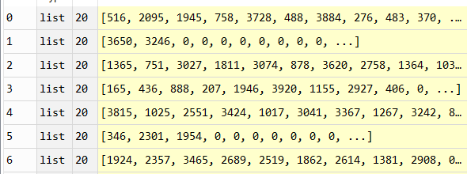
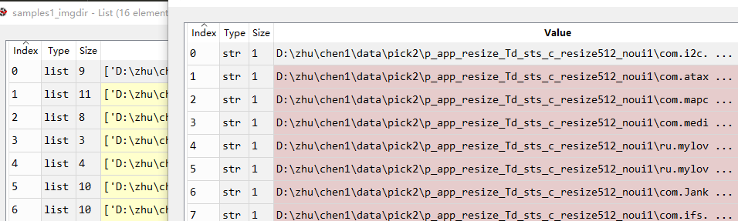
G Procedure:
Padding with zero for each sample to a same length(30).
Getting the img_dirs of the subtrees in a sample to display the generated GUI

Slide 5
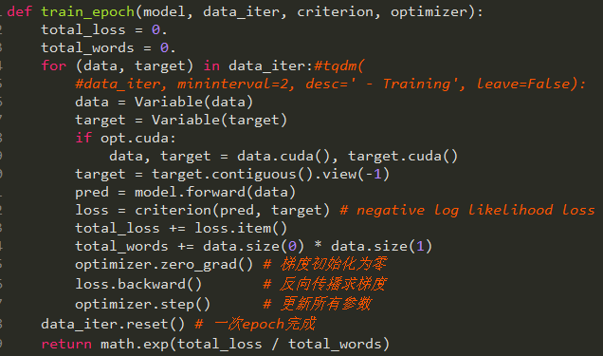
D Procedure:
Generate samples using the generator and processing the samples as fake data.
Load subtree_ID sequence of each ui as the real world data.

Slide 6
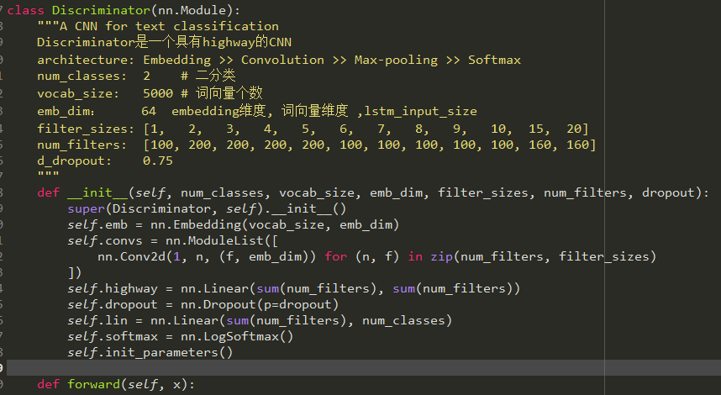
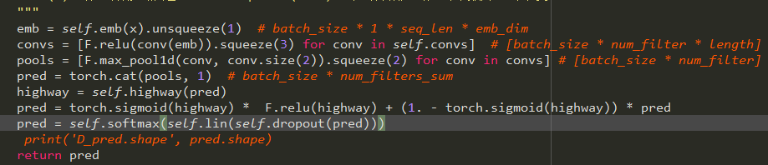
D Procedure:

Slide 7
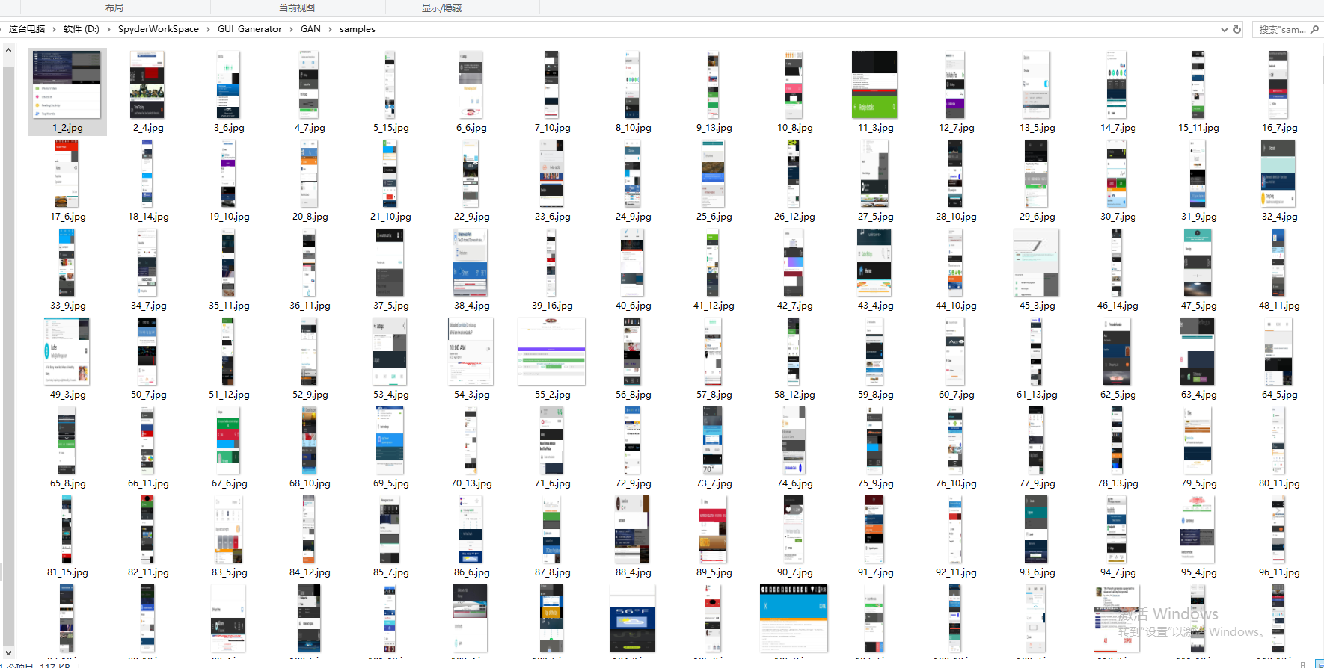
Samples after 100 epoch:

Slide 8
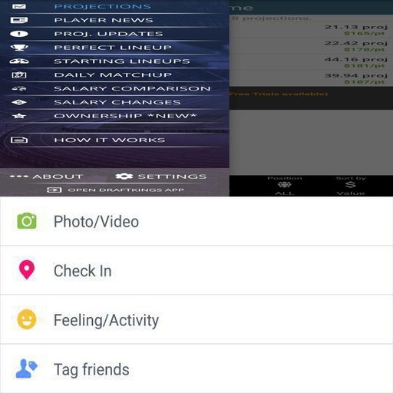
Samples after 100 epoch:
1_2

Slide 9
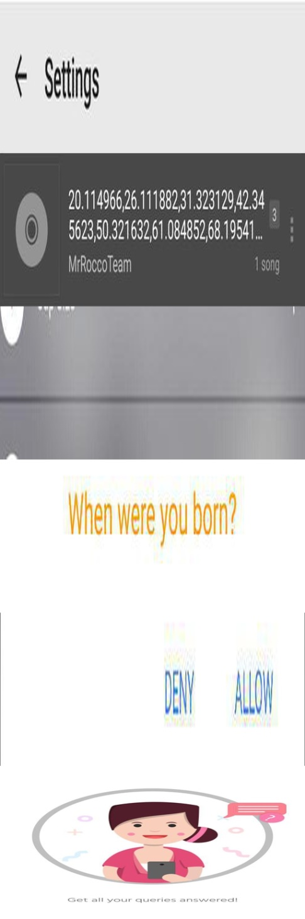

Samples after 100 epoch:
2_4
6_6

Slide 10

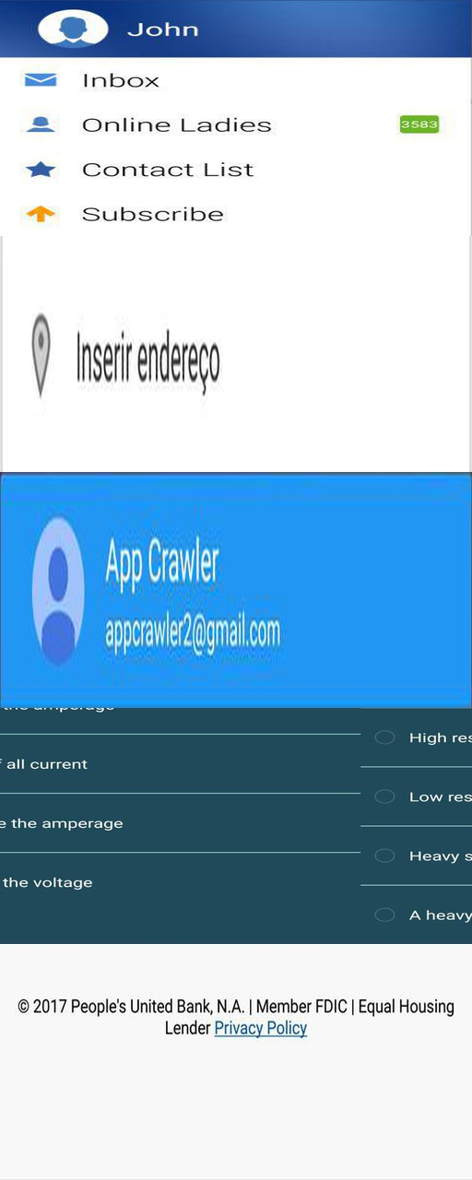
Samples after 100 epoch:
13_5
69_5

Slide 11


Samples after 100 epoch:
79_5
104_3

Slide 12

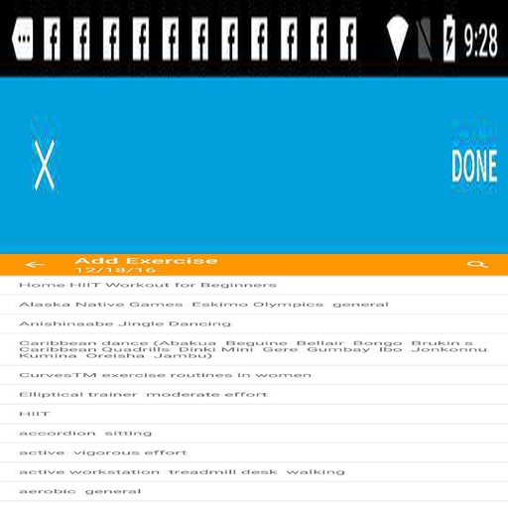
Samples after 100 epoch:
106_2
152_4

Slide 13


Samples after 100 epoch:
242_4
184_2

Slide 14


Samples after 100 epoch:
269_4
327_5

Slide 15


Samples after 100 epoch:
378_3
543_3

Slide 16


Samples after 100 epoch:
292_9
317_8

Slide 17
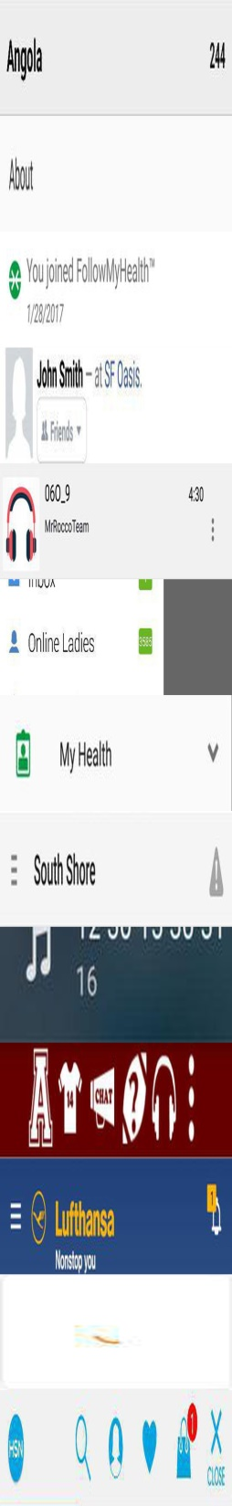

Samples after 100 epoch:
377_11
385_13

