Slide 1
工作汇报
2019年4月15日 赵天明

Slide 2
Our method(CNN from the trained siamese network)
1. CNN(L2+Dropout)_embedding + PCA_2 + MinMaxNorm + Clustering
2. CNN(L2)_embedding + PCA_2 + MinMaxNorm + Clustering
Baseline
1. SIFT_feature + PCA_2 + MinMaxNorm + Clustering
2. HOG_feature + PCA_2 + MinMaxNorm + Clustering
3. Gabor_feature + PCA_2 + MinMaxNorm + Clustering
Clustering on 25, 50, 100 apps from the testing set
1. DBSCAN
2. Kmeans
3. Hierarchical

Slide 3
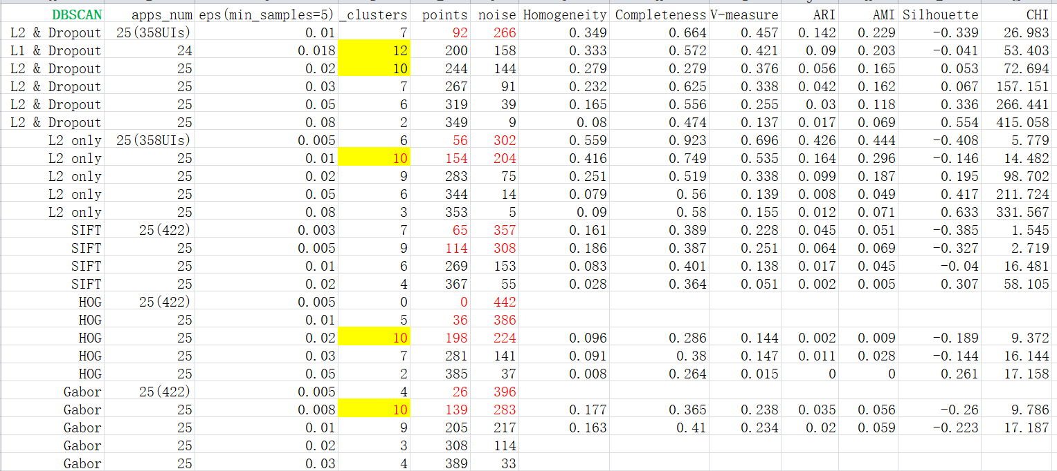
Comparison on 25 apps with DBSCAN

Slide 4
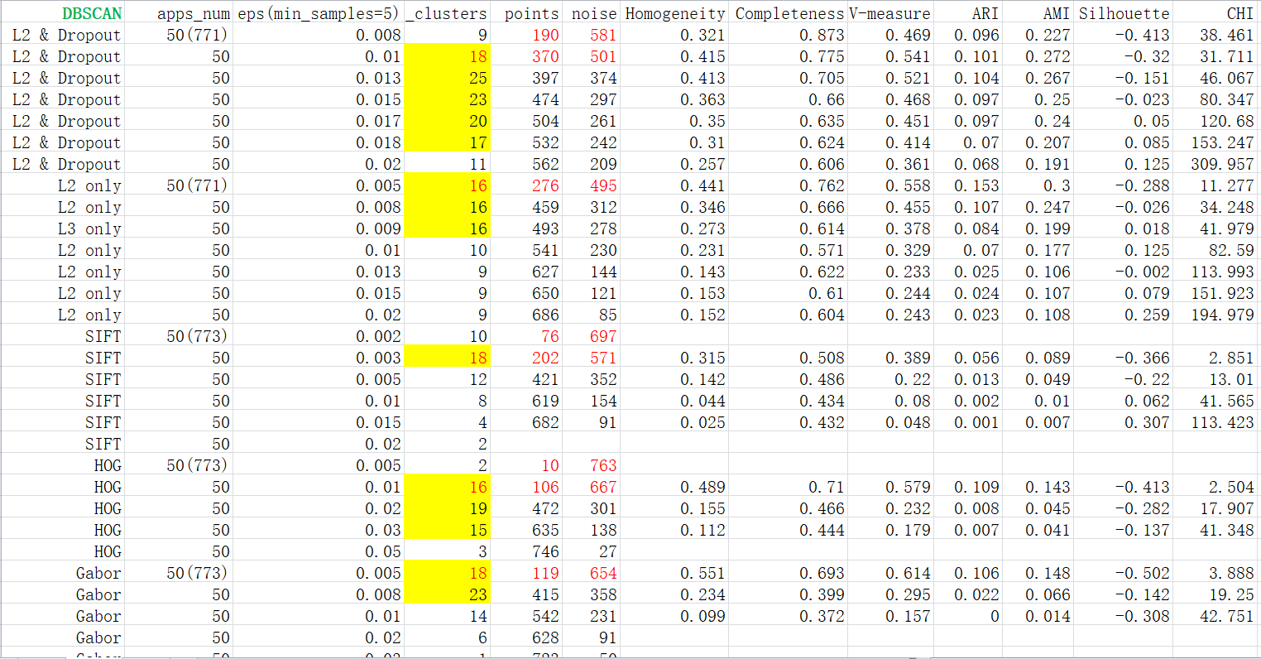
Comparison on 50 apps with DBSCAN

Slide 5
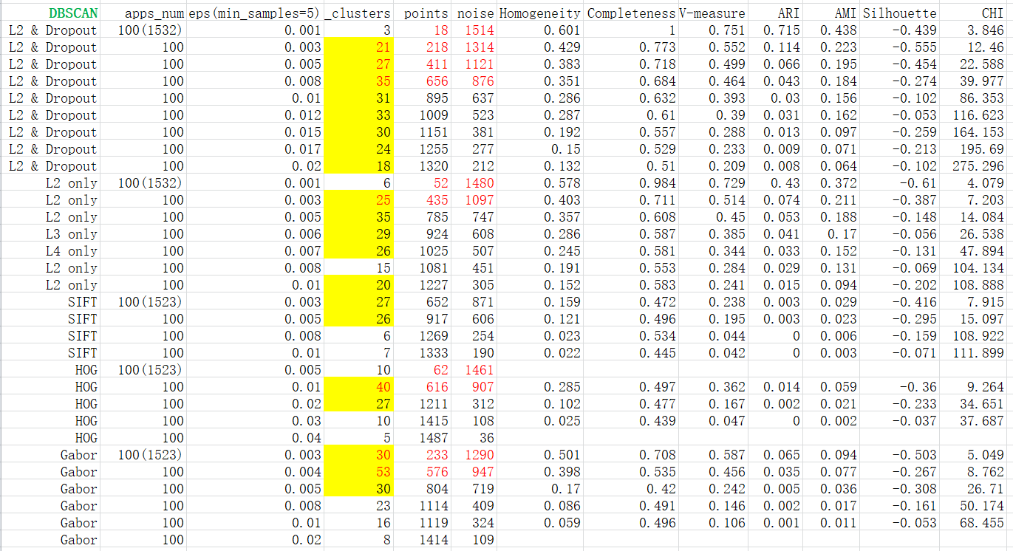
Comparison on 100 apps with DBSCAN

Slide 6
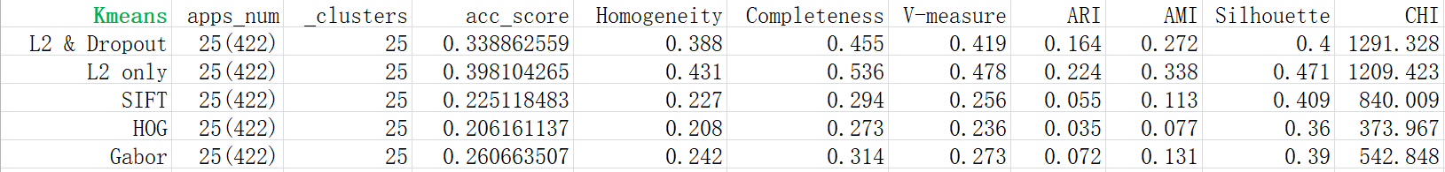
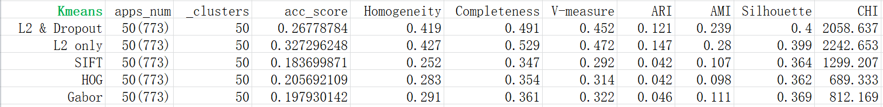
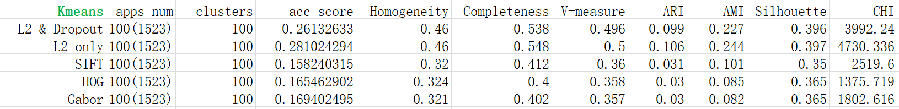
Comparison on 25 apps with Kmeans
Comparison on 50 apps with Kmeans
Comparison on 100 apps with Kmeans

Slide 7
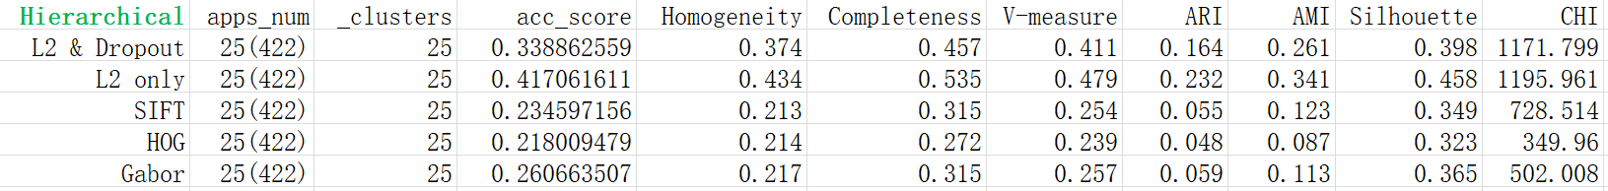
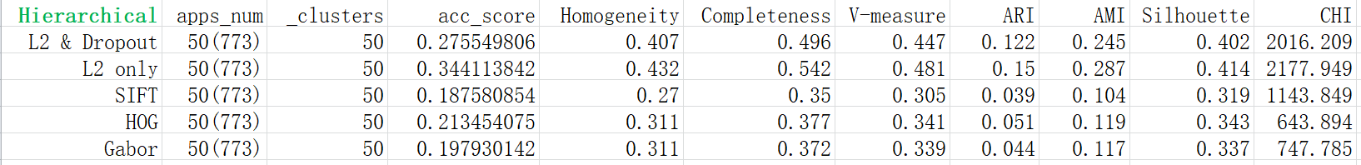
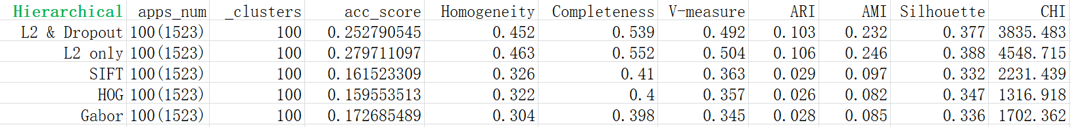
Comparison on 25 apps with Hierarchical
Comparison on 50 apps with Hierarchical
Comparison on 100 apps with Hierarchical

Slide 8
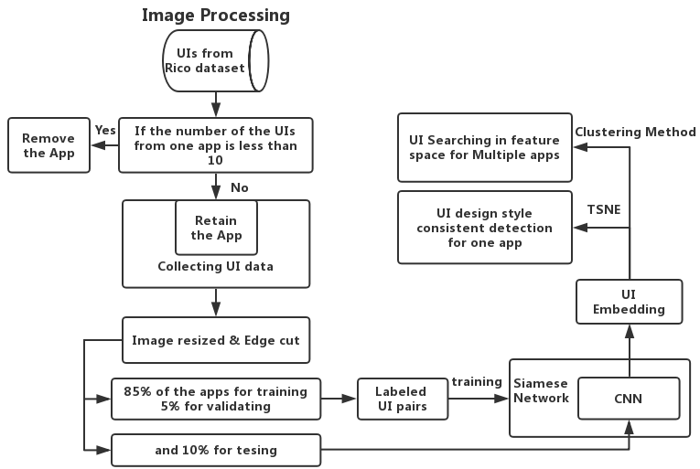
An overview of the proposed method

