Slide 1
工作汇报
2019年3月18日 赵天明

Slide 2
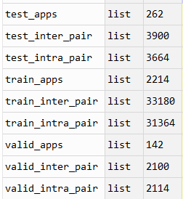
主要工作
Rico
Select the apps with Ui_num >= 10
43633 Uis , 2618 apps
resized & cut image(180,325, 3)
2214 apps (84.6%) for training
142 apps (5.4%) for validation
262 apps (10%) for testing

Slide 3
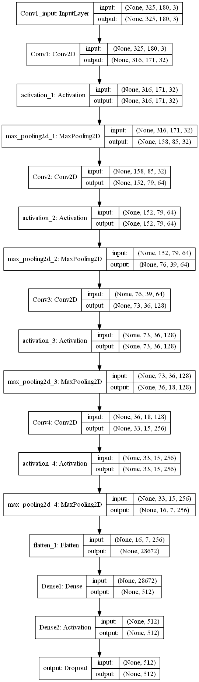
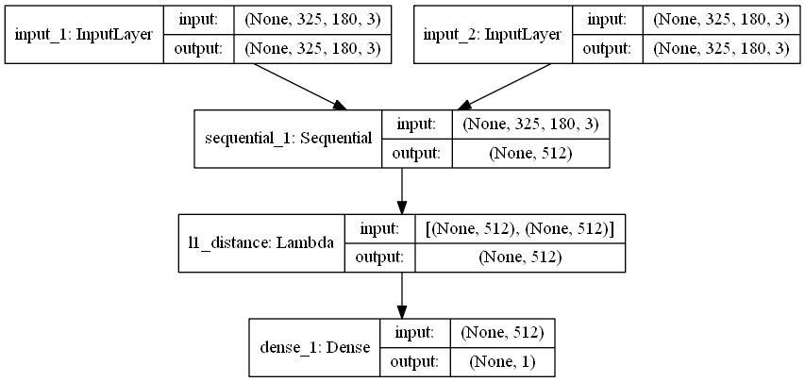
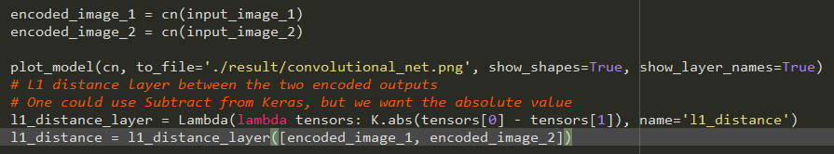
Set up the siamese network
1. L2 & Dropout（0.5）

Slide 4
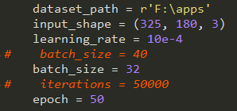
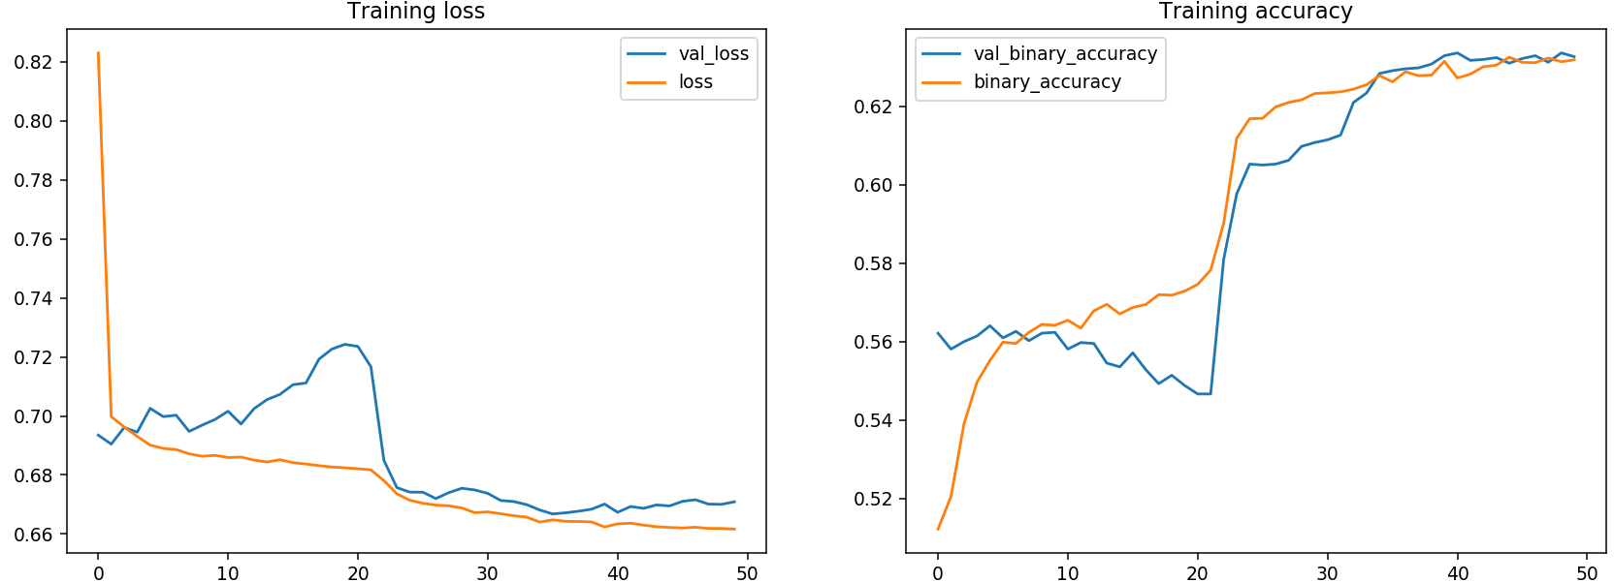

Result
Settings:
Testing result:

Slide 5
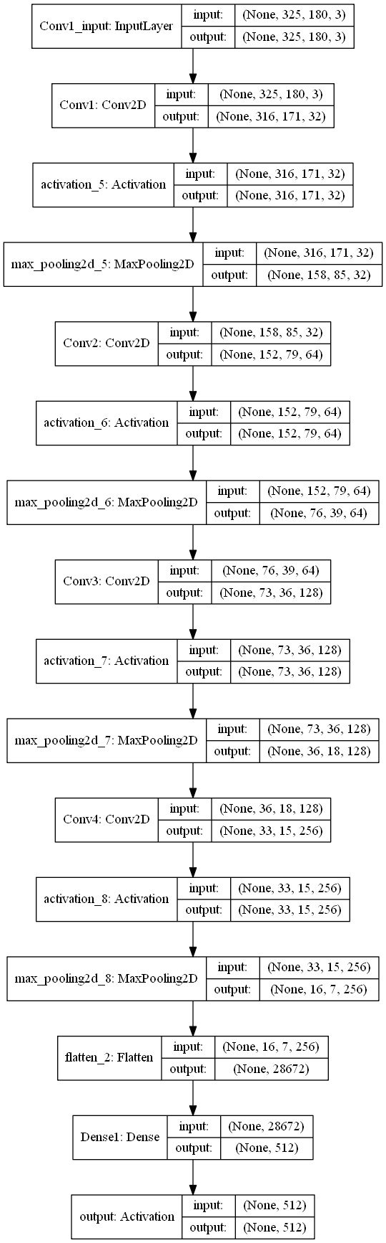

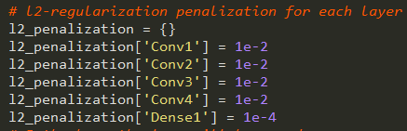
Set up the siamese network
2. l2_penalization only

Slide 6
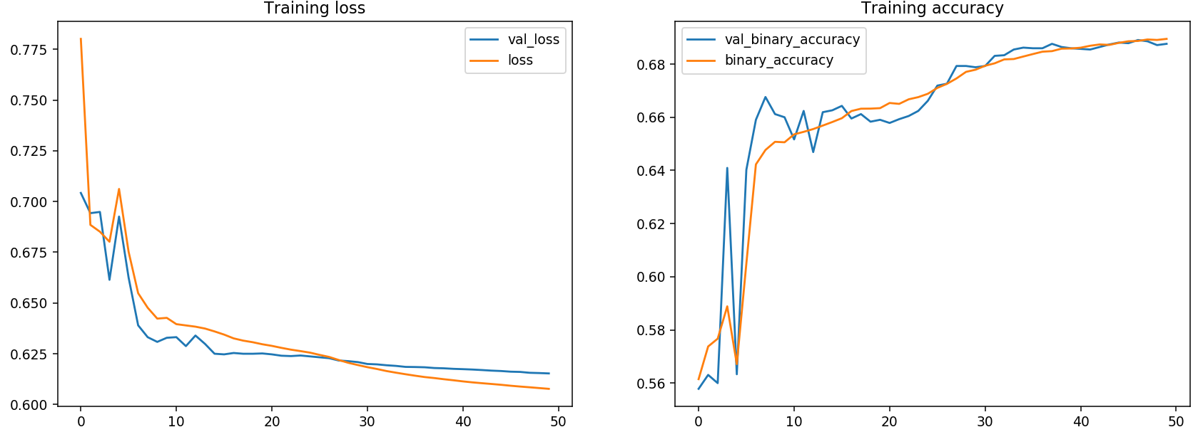

Result
Settings:
Testing result:

Slide 7
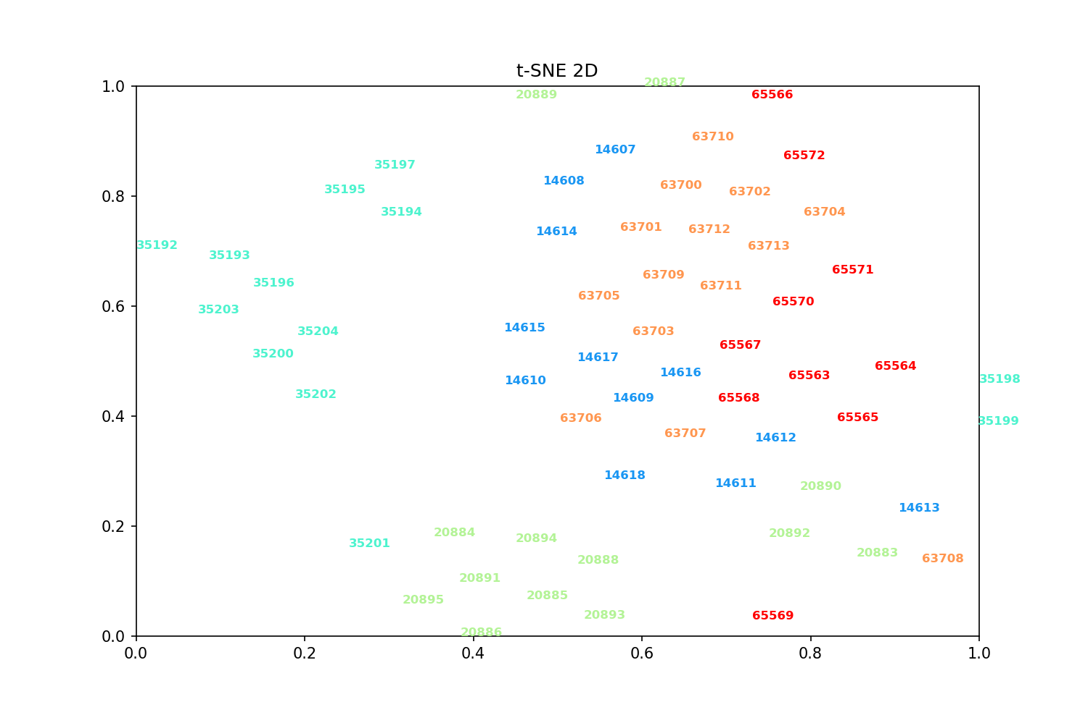
空白演示
L2&Dropout_45_5 apps
Speaker name and title here

Slide 8
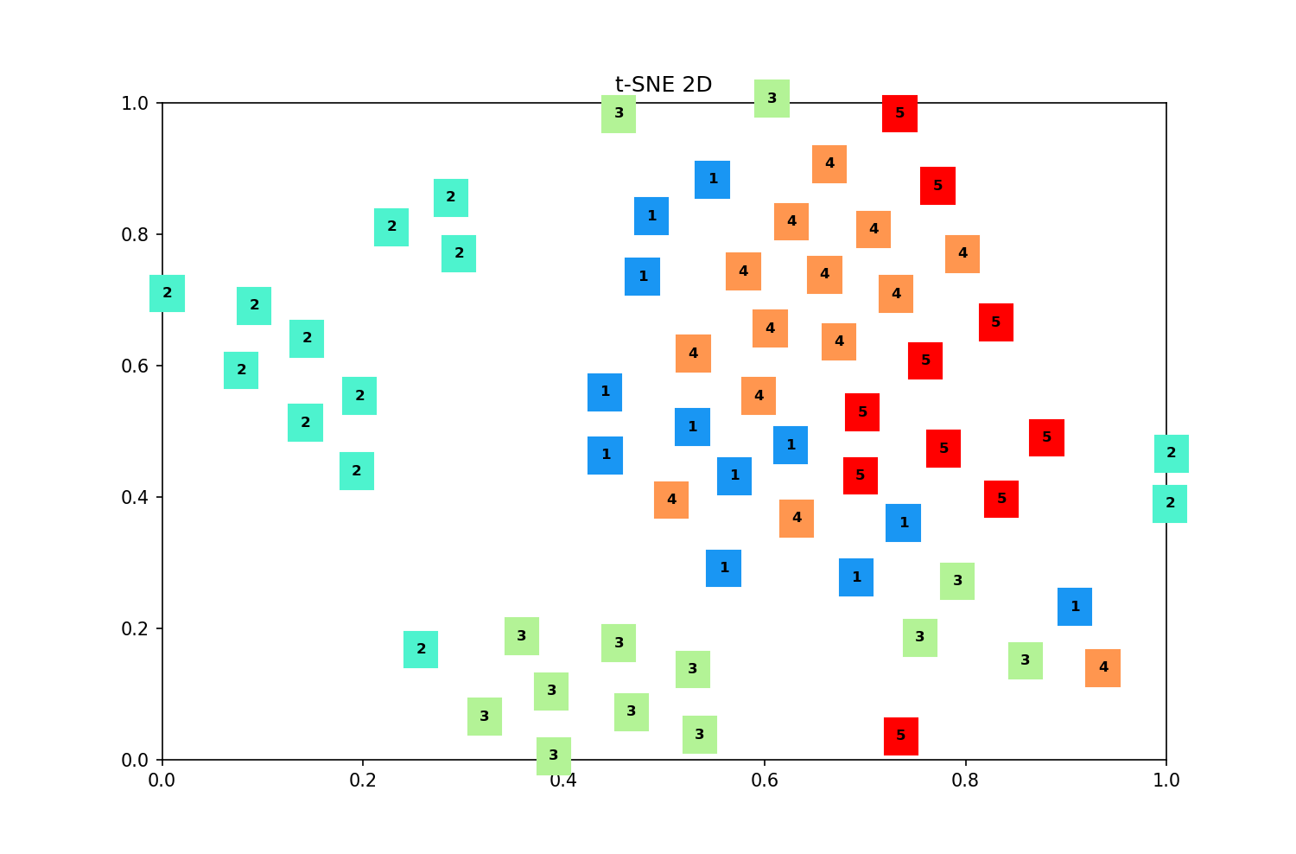
空白演示
L2&Dropout_45_5 apps
在此输入您的封面副标题

Slide 9
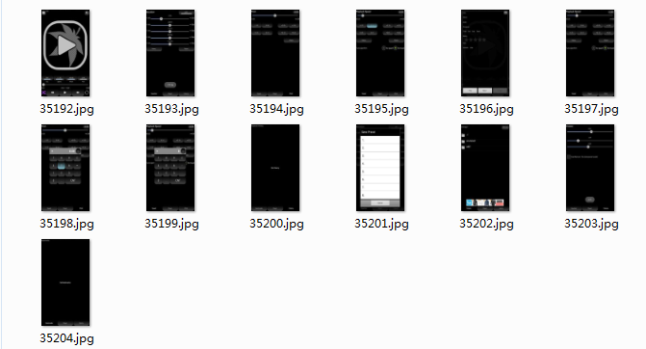
空白演示
2.com.sqr5.android.audioplayer
L2&Dropout_45_5 apps
在此输入您的封面副标题

Slide 10
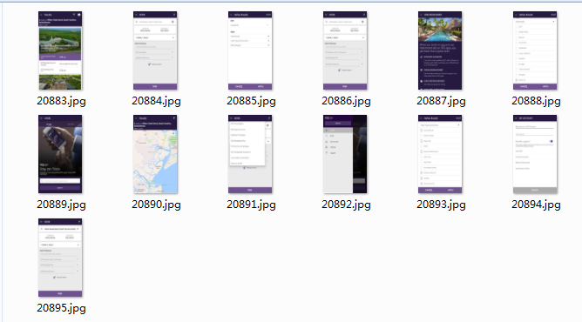
空白演示
L2&Dropout_45_5 apps
3.com.starwood.spg
在此输入您的封面副标题

Slide 11
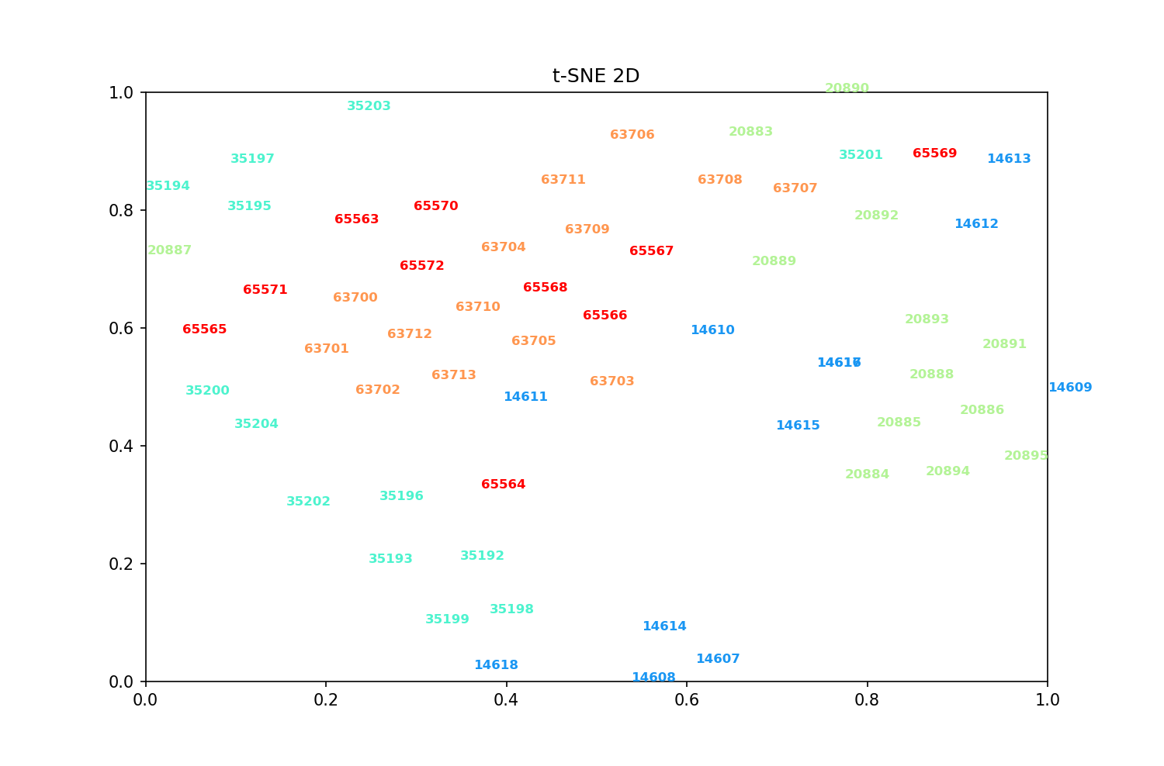
空白演示
L2_45_5 apps
在此输入您的封面副标题

Slide 12
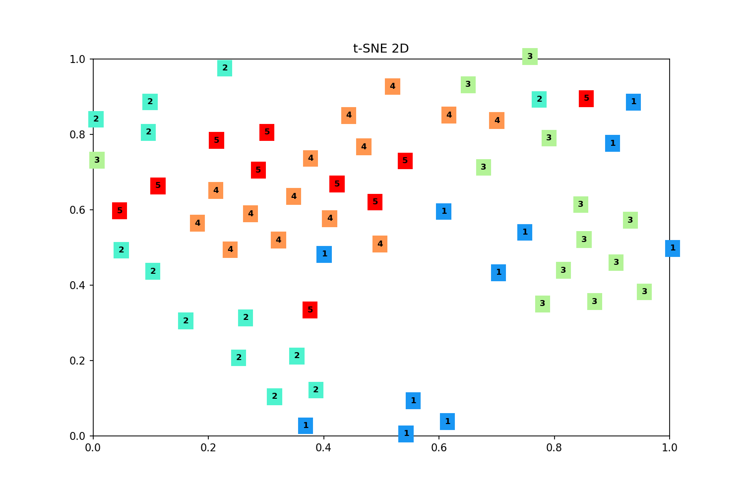
空白演示
L2_45_5 apps
在此输入您的封面副标题

Slide 13
空白演示
L2_45_5 apps
3.com.starwood.spg
在此输入您的封面副标题

Slide 14
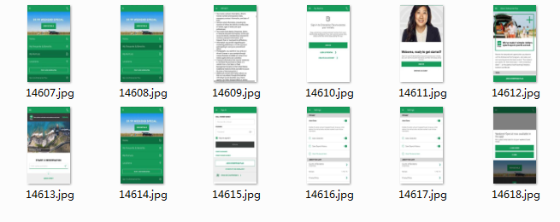
1.com.ehi.enterprise.android
2.com.sqr5.android.audioplayer

Slide 15
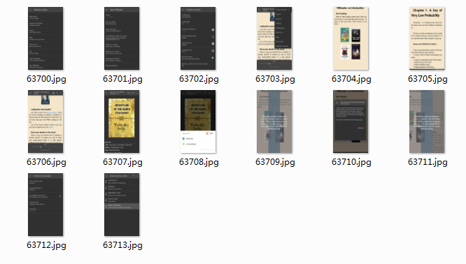
3.com.starwood.spg
4.org.geometerplus.zlibrary.ui.android

Slide 16
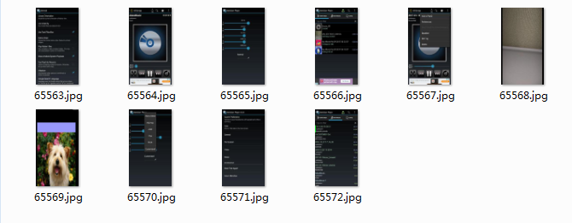
5.org.iii.romulus.meridian

Slide 17
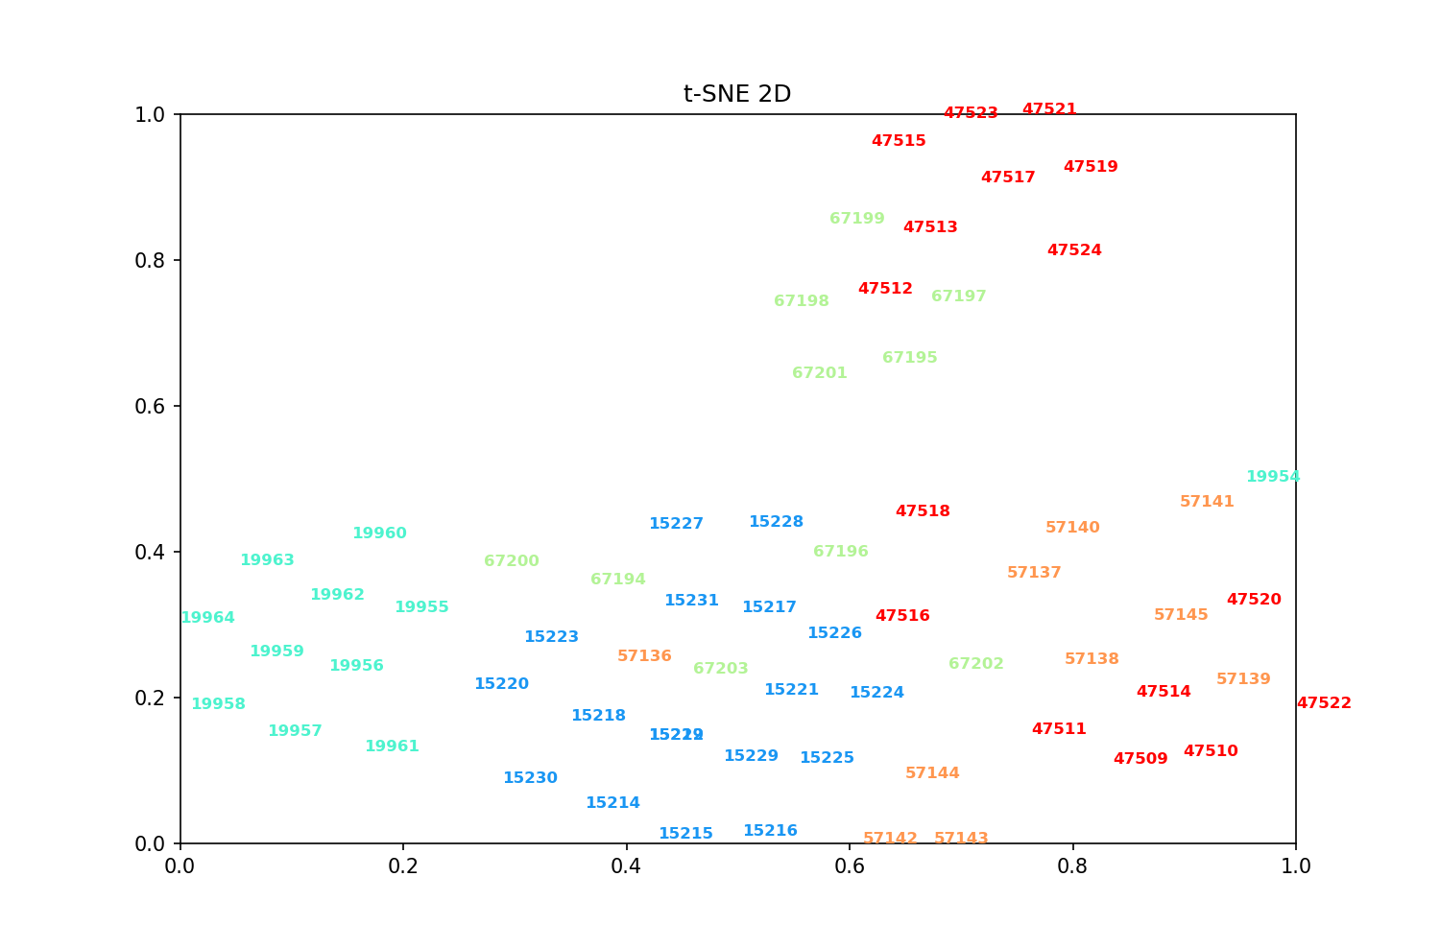
空白演示
L2&Dropout_65_5 apps
在此输入您的封面副标题

Slide 18
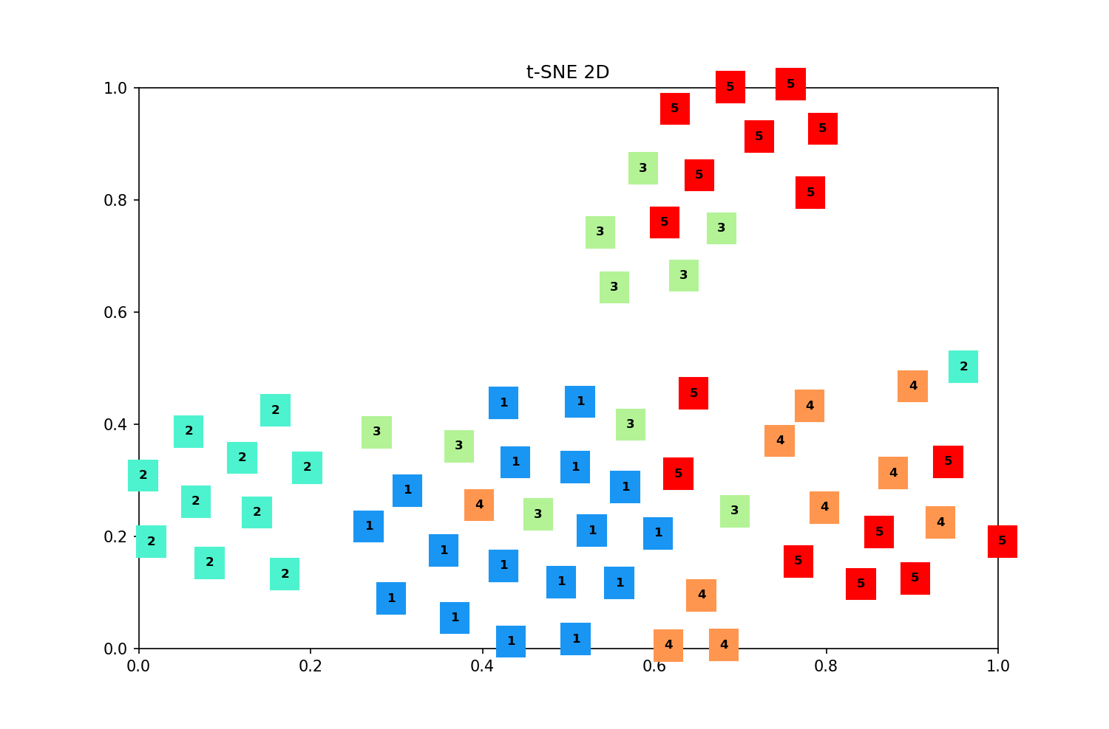
空白演示
L2&Dropout_65_5 apps
在此输入您的封面副标题

Slide 19
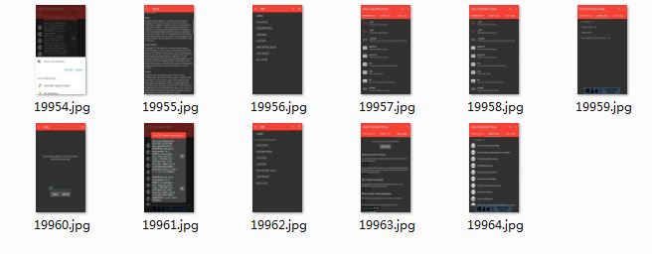
空白演示
L2&Dropout_65_5 apps
2.com.inspiredandroid.linuxcommandbibliotheca
在此输入您的封面副标题

Slide 20
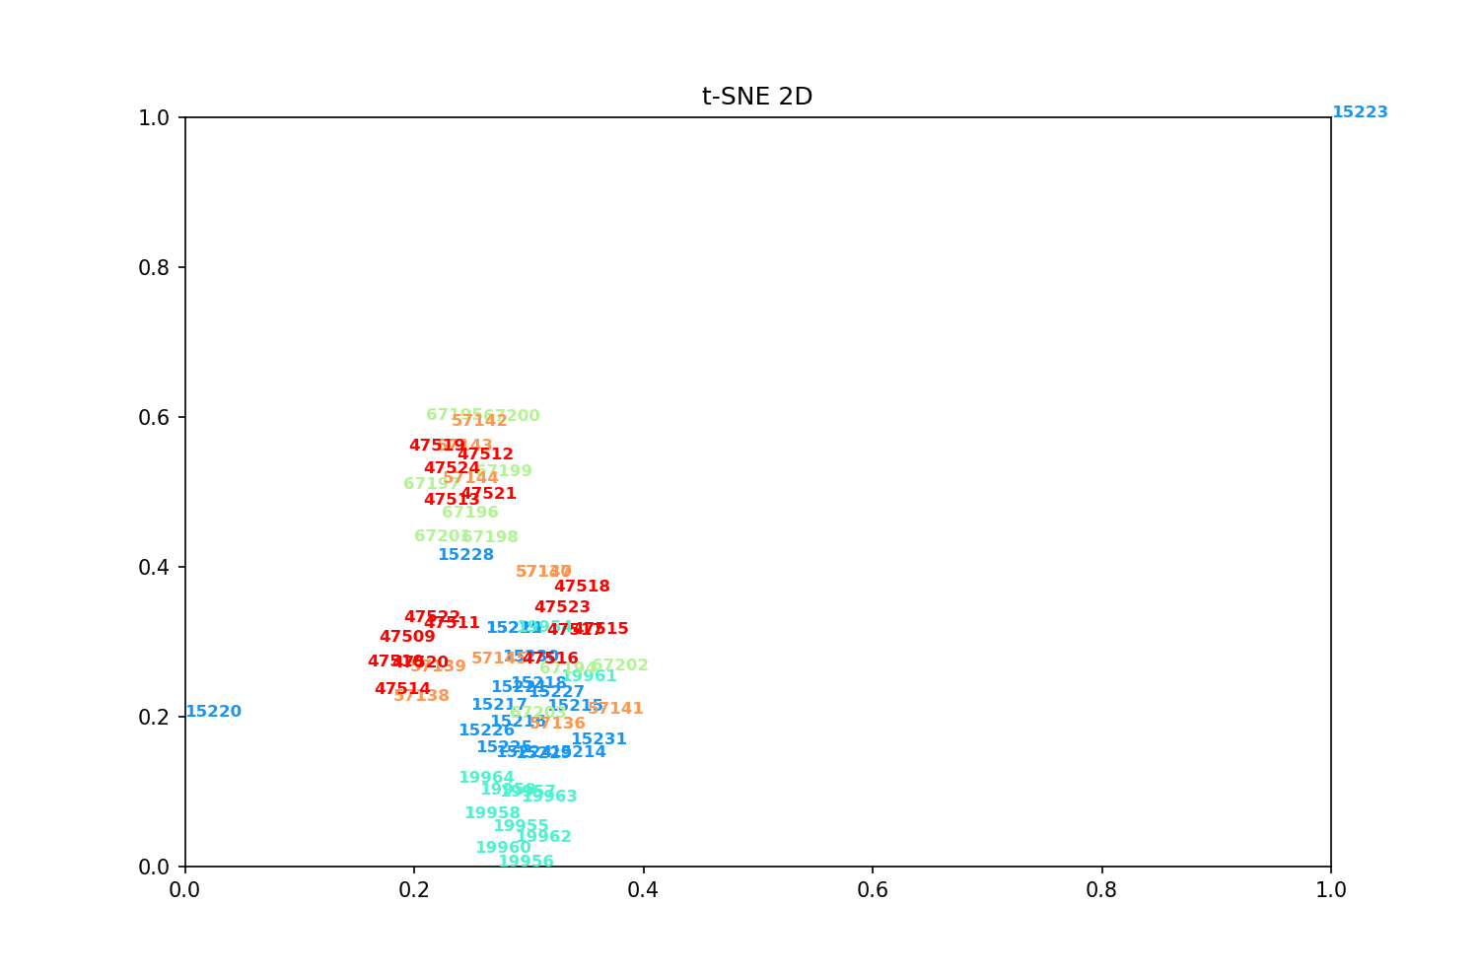
空白演示
L2_65_5 apps
在此输入您的封面副标题

Slide 21
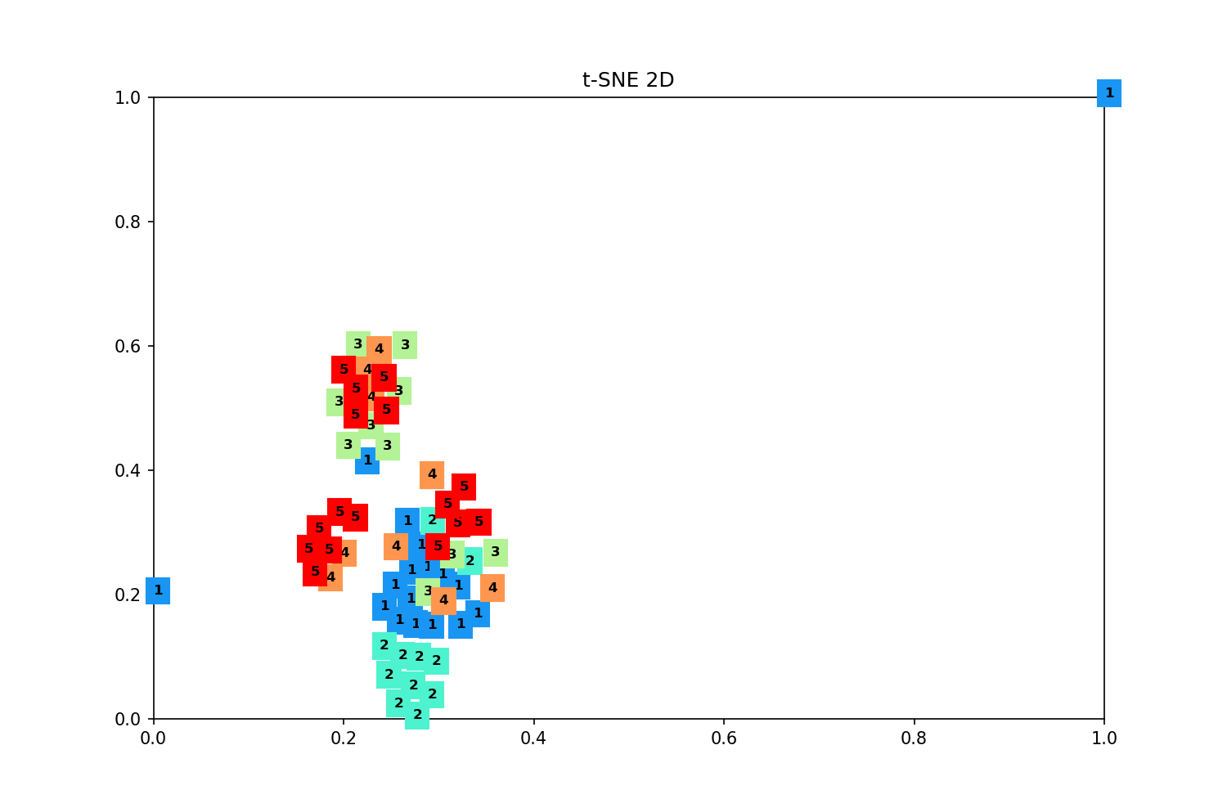
空白演示
L2_65_5 apps
在此输入您的封面副标题

Slide 22
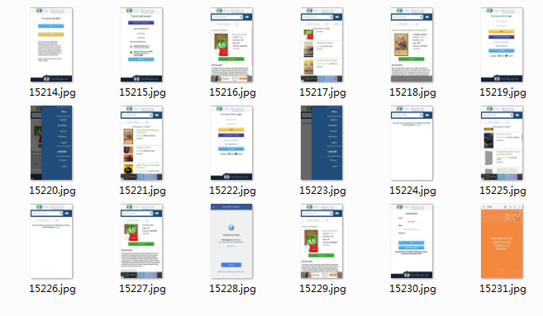
空白演示
L2_65_5 apps
在此输入您的封面副标题

Slide 23
空白演示
L2_65_5 apps
2.com.inspiredandroid.linuxcommandbibliotheca
在此输入您的封面副标题

Slide 24
1.com.ebooks.android
2.com.inspiredandroid.linuxcommandbibliotheca

Slide 25
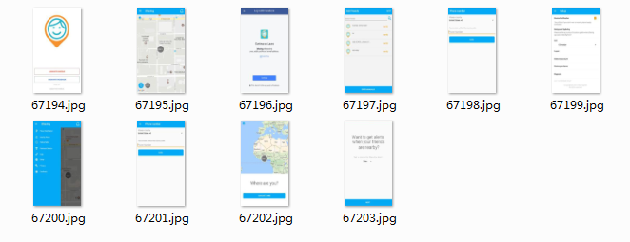
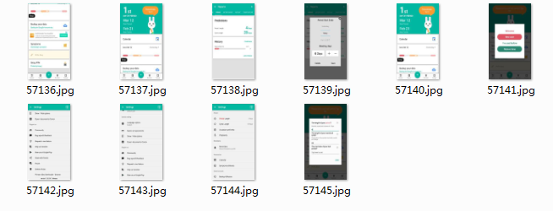
3.com.isharing.isharing
4.com.northpark.periodtracker

Slide 26
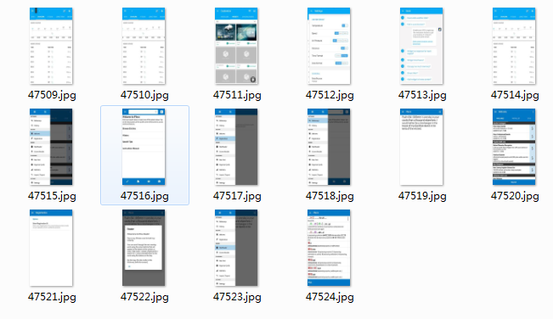
5.mobi.infolife.ezweatherlite

Slide 27
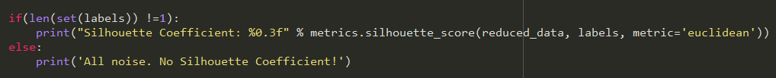
Clustering ：
DBSCAN:

Slide 28
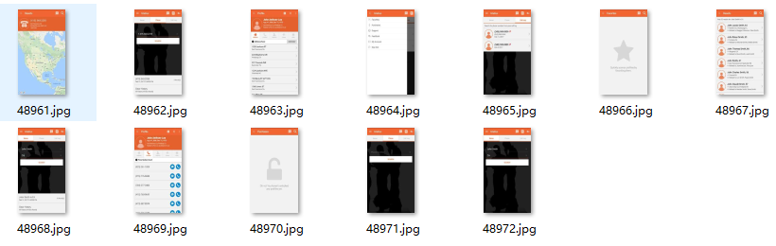
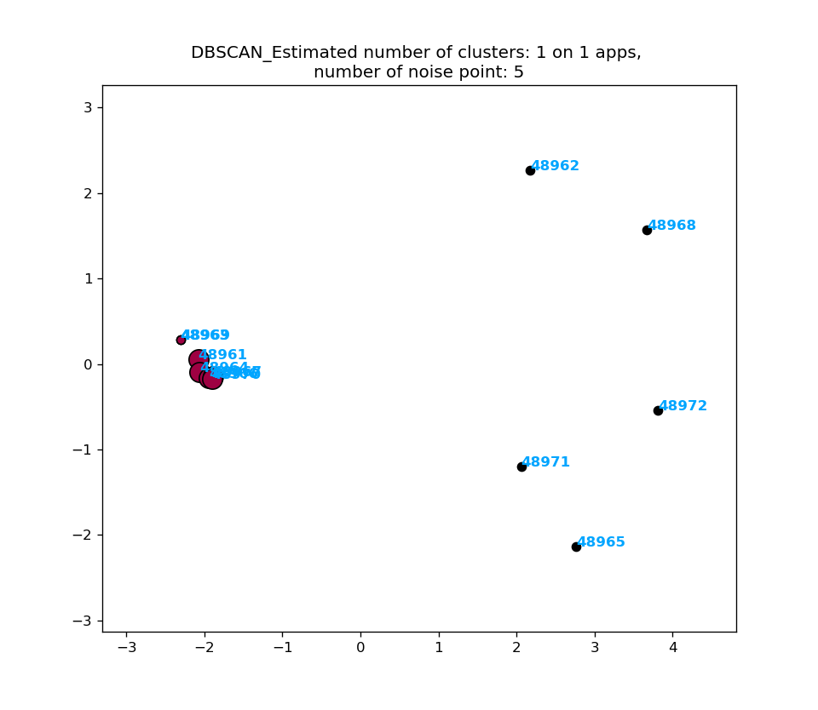
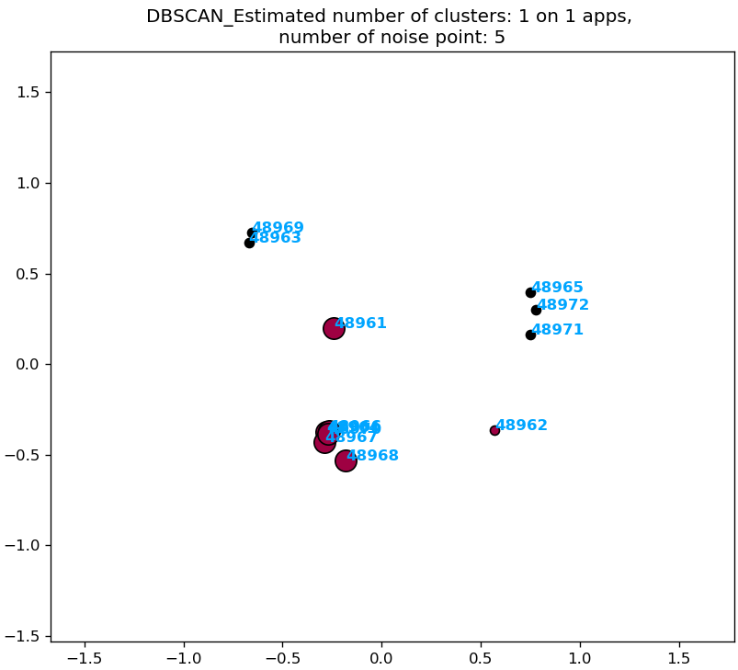
L2 & Dropout; Silhouette Coefficient: 0.594
L2; Silhouette Coefficient: 0.374

Slide 29
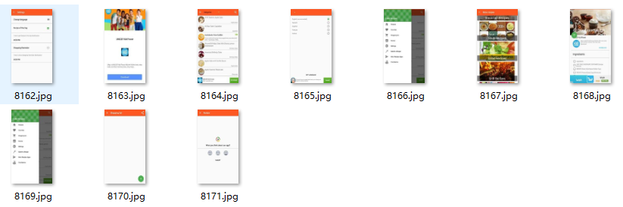
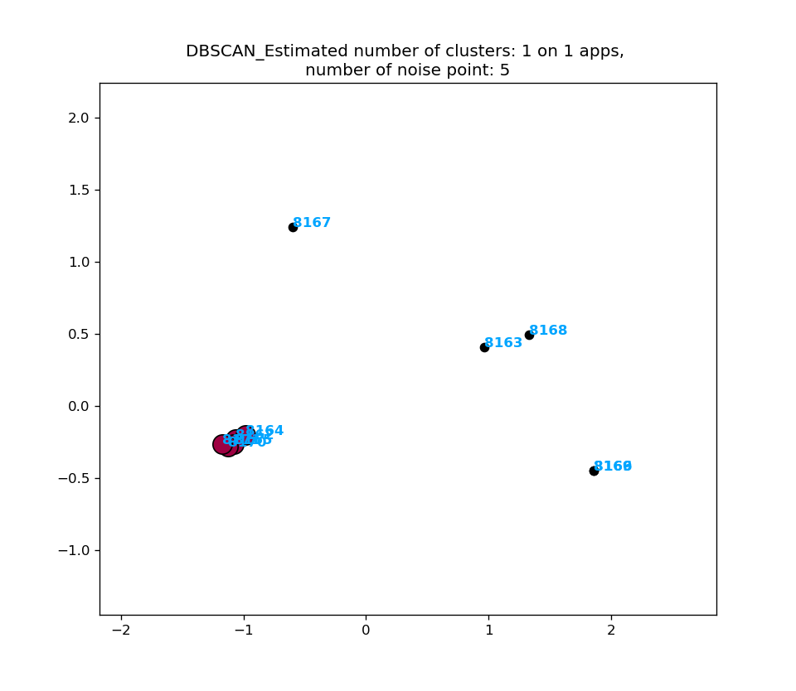
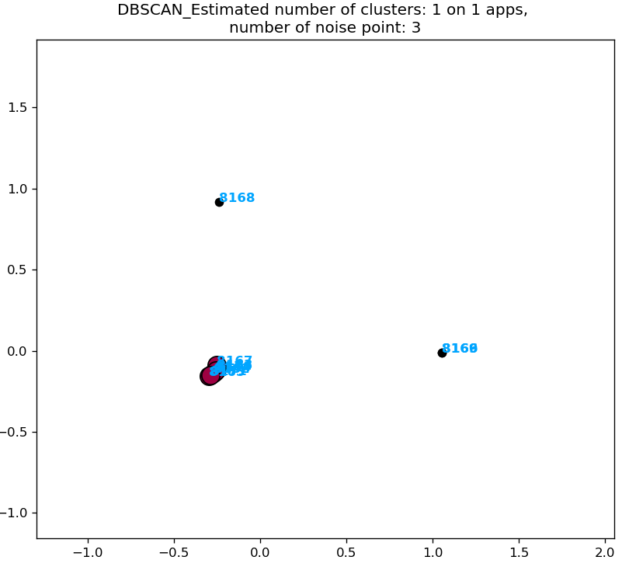
L2 & Dropout; Silhouette Coefficient: 0.584
L2; Silhouette Coefficient: 0.628

Slide 30
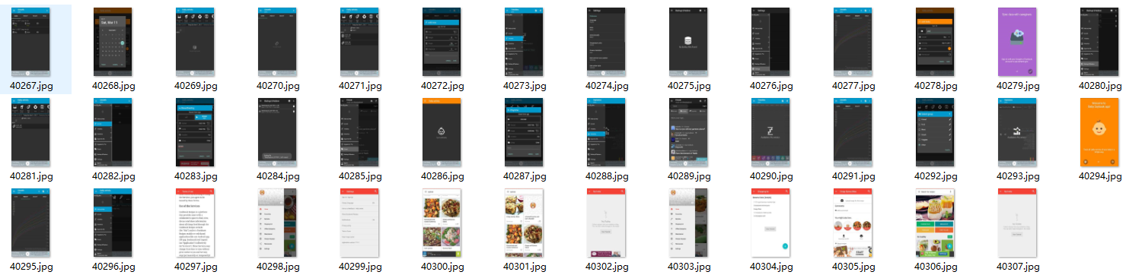
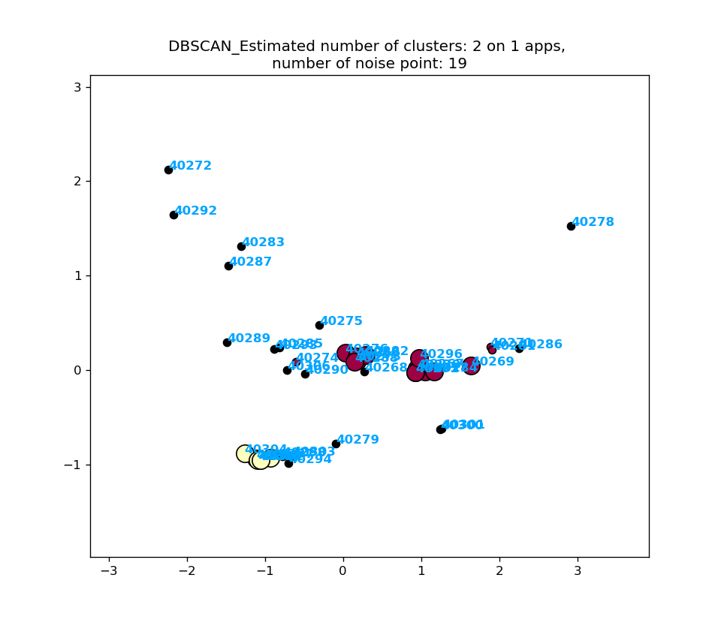
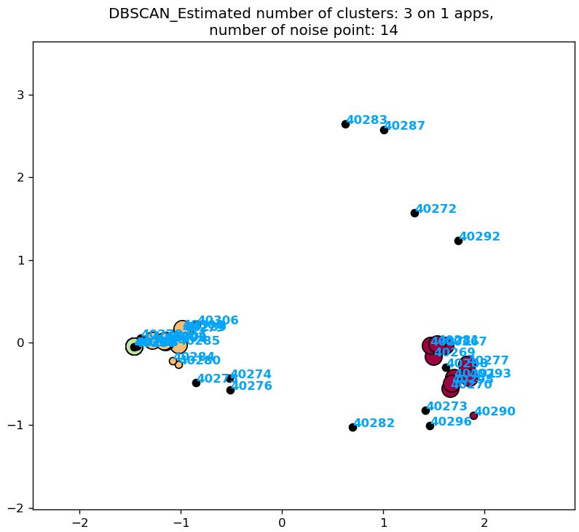
L2 & Dropout; Silhouette Coefficient: 0.191
L2; Silhouette Coefficient: 0.225

Slide 31
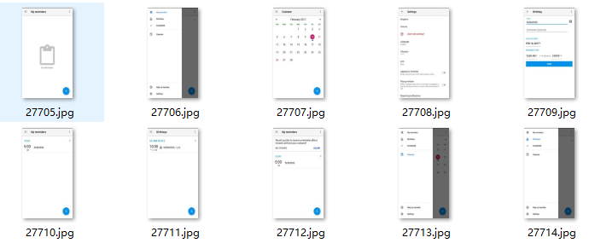
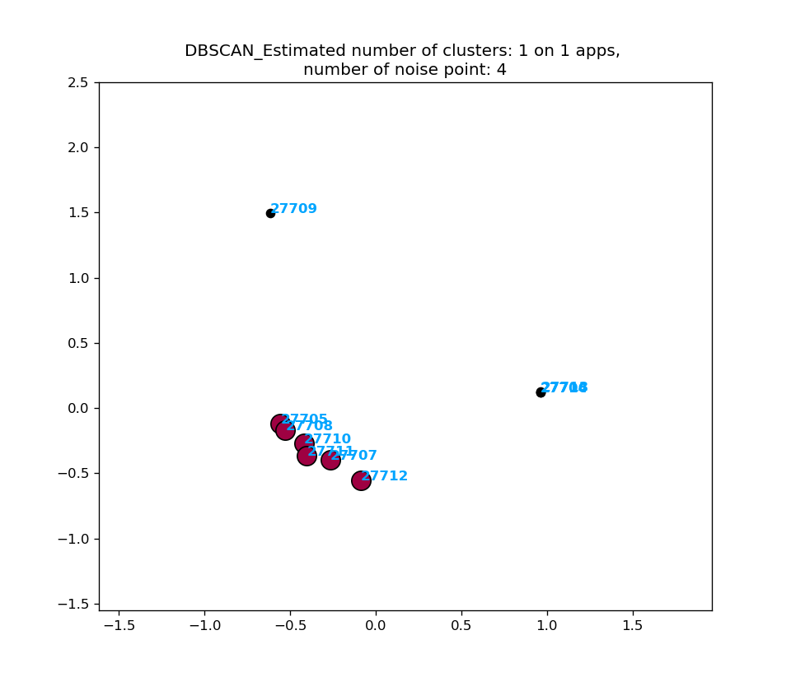
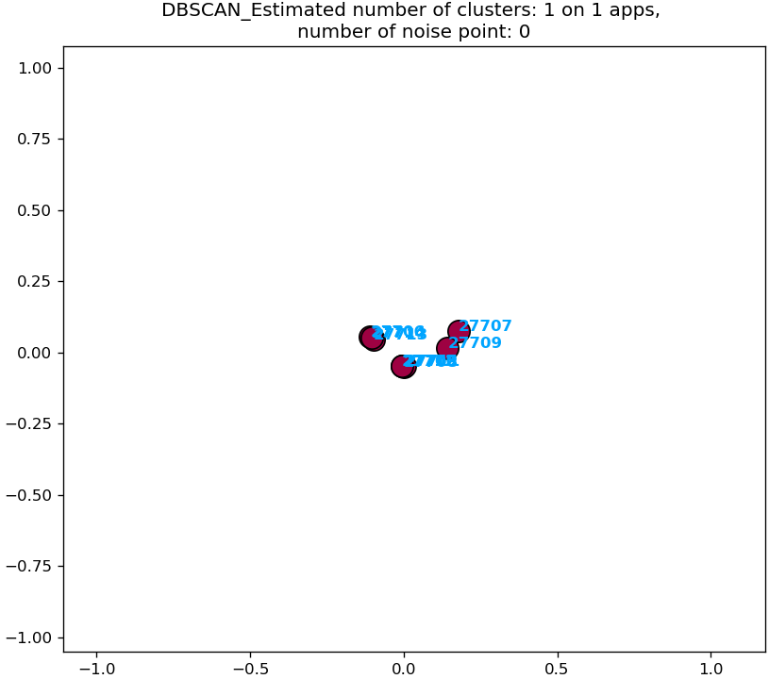
L2 & Dropout; Silhouette Coefficient: 0.580
L2; Silhouette Coefficient: --

Slide 32
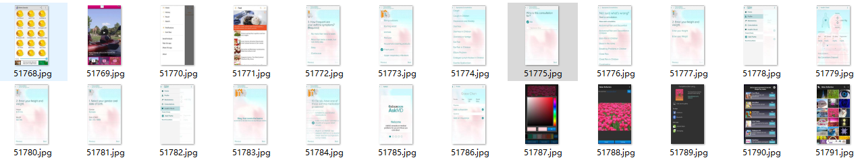
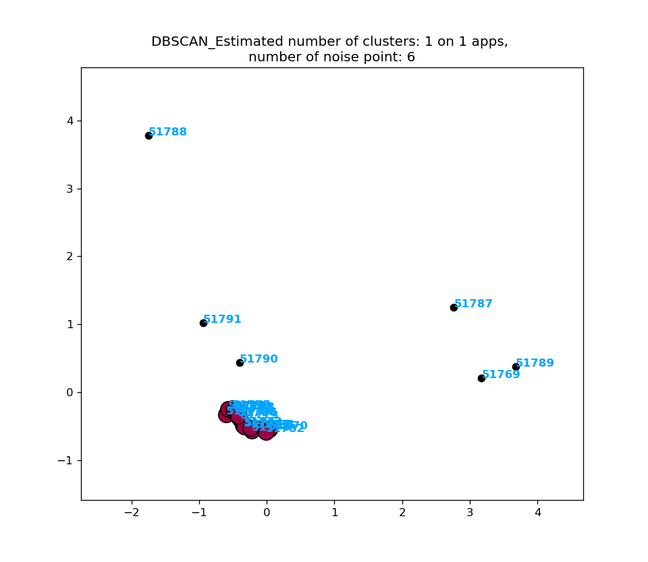
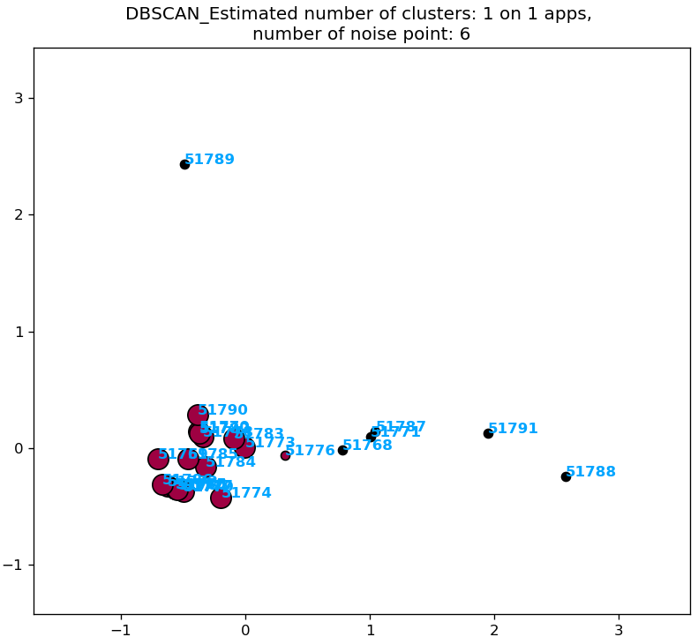
L2 & Dropout; Silhouette Coefficient: 0.553
L2; Silhouette Coefficient: 0.462

Slide 33
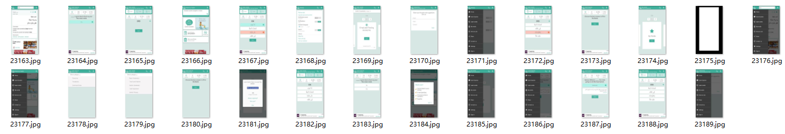
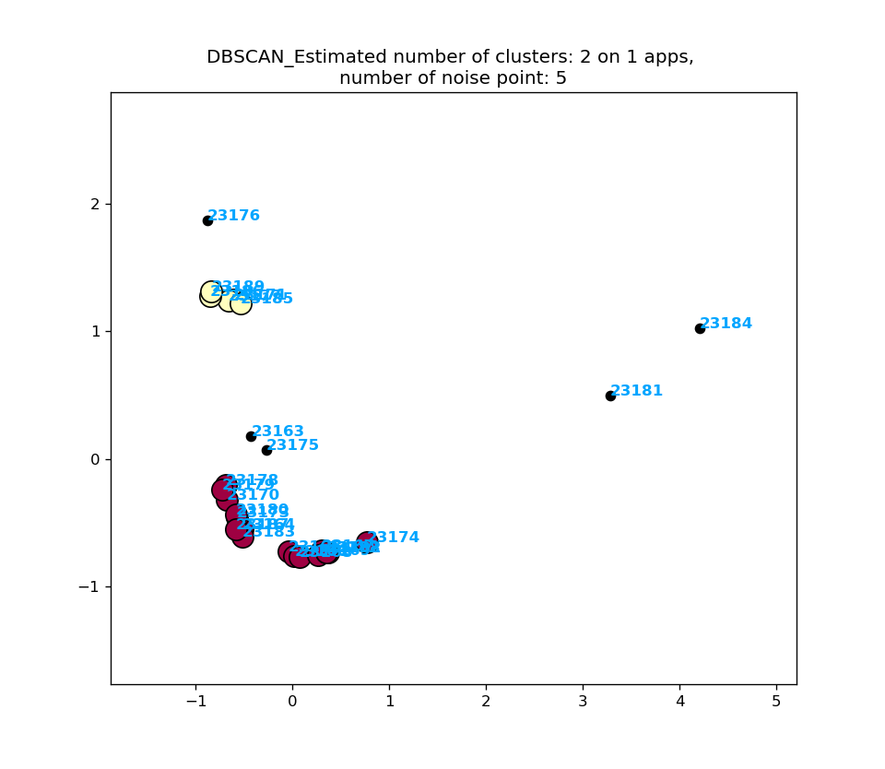
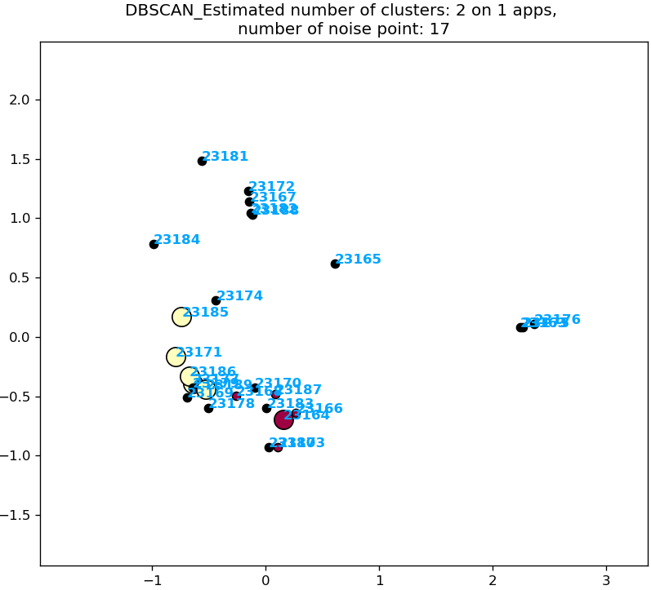
L2 & Dropout; Silhouette Coefficient: 0.407
L2; Silhouette Coefficient: 0.081

Slide 34
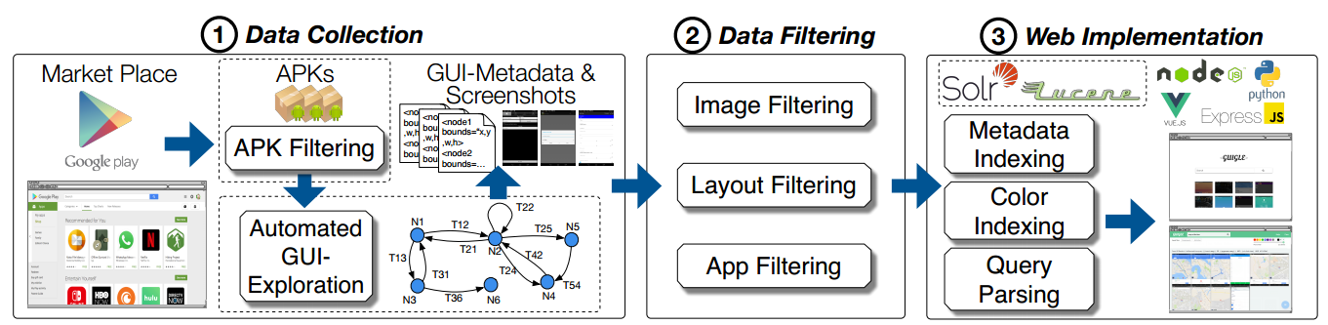
Papers ：
1. Guigle: A GUI Search Engine for Android Apps
A GUI search engine for Android app screenshots which supports queries for searching according to (i) the app name, (ii) GUI-component text, (iii) GUI-component type, and (iv) screen color.
provide a lightweight query language that allows for intuitive search of screens. We evaluate GUIGLE with real users and found that, on average, 68:8% of returned screens were relevant to the specified query.

Slide 35
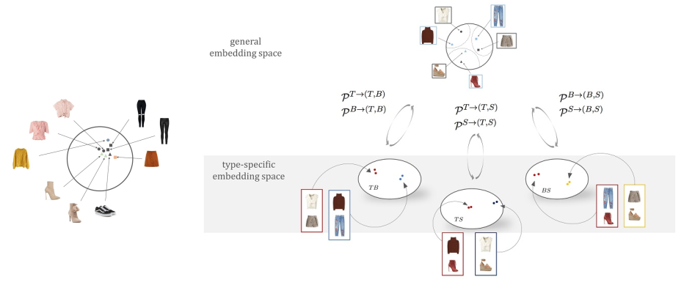
Papers ：
2. Learning Type-Aware Embeddings for Fashion Compatibility(CVPR 2018)
Learning an image embedding that respects item type, and jointly learns notions of item similarity and compatibility in an end-toend model
The approach obtains 3-5% improvement over the state-of-the-art on outfit compatibility prediction and fill-in-the-blank tasks using our dataset

Slide 36
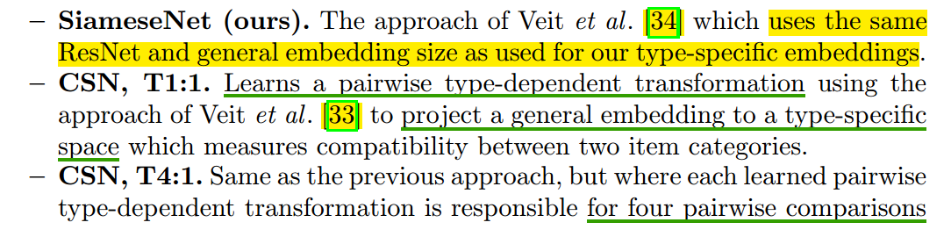
Papers ：
An embedding method that respects type can represent both: (1) similarity (e.g., when two tops are interchangeable)
(2) compatibility (items of possibly different type that can go together in an outfit)
Visualizing the learned embedding spaces suggests that the reason we obtain significant improvements on the fill-in-the-blank and outfit compatibility tasks over prior state-of-the-art is that different type-specific spaces specialize in encoding different kinds of appearance variation.

Slide 37
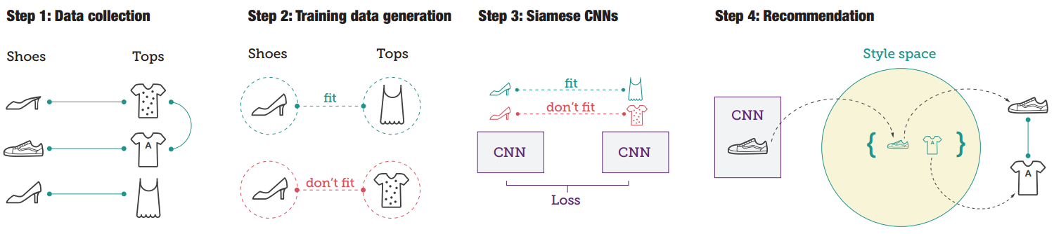
Papers ：
3. Learning Visual Clothing Style with Heterogeneous Dyadic Co-occurrences
(ICCV 2015)
(1) The input data comprises item images, category labels and links between items, describing co-occurrences. (2) From the input data, we strategically sample training pairs of items that belong to different categories. (3) We use Siamese CNNs to learn a feature transformation from the image space to the style space. (4) Finally, we use a robust nearest neighbor retrieval to generate outfits of compatible items.

Slide 38

Papers ：
Contributions ：
1. We propose a new learning framework that combines Siamese CNNs with co-occurrence information as well as category labels.
2. We propose a strategic sampling approach for pairwise training data that allows learning compatibility across categories.
3. We present a robust nearest neighbor retrieval method for datasets with strong label noise.
4. We conduct a user study to understand how users think about style and compatibility. Further, we compare our learning framework against baselines.

Slide 39

Papers ：
4. Conditional Similarity Networks(CVPR 2017)
Conditional Similarity Networks was proposed to learn nonlinear embeddings which incorporate multiple aspect of similarity within a shared embedding.
The learned embeddings are disentangled such that each embedding dimension encodes semantic features for a specific aspect of similarity.
Notes:
目的就是按照不同的condition，在embedding上得到一个可变的mask
在考虑图片之间的相似度时，不能单一地使用一种相似度的评分方法，考虑给定不同思考角度，图片之间会显示出不同的相似性。近些年来，这种多视角任务比较热门，它一定程度上对深度学习做出了解释。
1.定义了条件相似网络结构，能在学习非线性隐含表示（使用卷积神经网络）的同时，使用一套特征向量联合训练学习多种条件下的图片相似性。
2.在两个公开数据集上完成了模型测试，并取得了不错的结果。
3.作者认为它的方法一定程度上使得图片隐含表示具有可解释性。

