Slide 1
工作汇报
2019年1月30日 赵天明

Slide 2
主要工作
Rico
Select the apps with Ui_num >= 10
43633 Uis , 2618 apps
Resized image(180,360, 3)
2094 (80%) for training, 524 (20%) for testing

Slide 3
本周主要工作
Set the intra dataset and inter dataset
(1).Loop app_num/2 times in one app folder, random selection of a pair of images. Loop in all app folders.
17016 Intra_pairs
(2). Random pairing in all apps, select 5 from each of the two paired apps.
20925 Inter_pairs

Slide 4
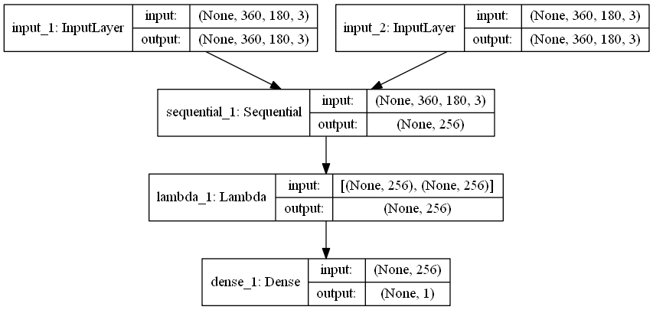
本周主要工作
Set up the siamese network

Slide 5
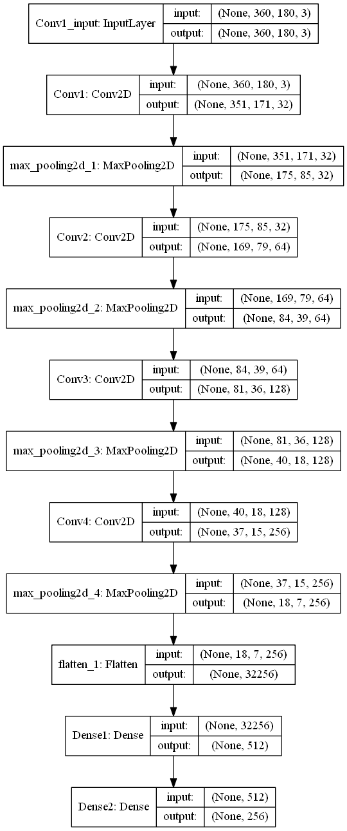
本周主要工作
Set up the siamese network

Slide 6
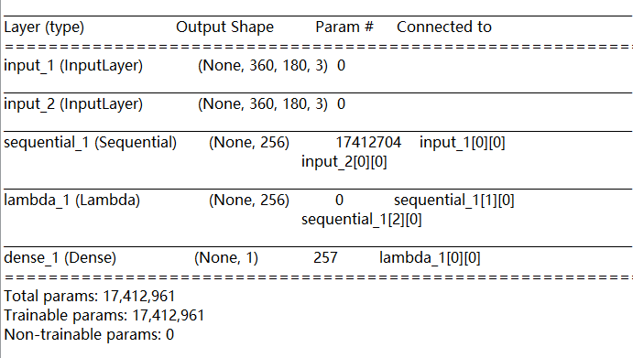
本周主要工作
Set up the siamese network

Slide 7
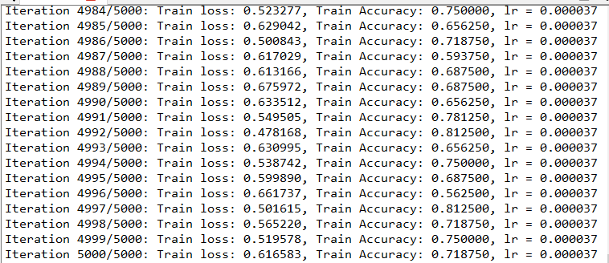
Result_1
loss= binary_crossentropy
Learning rate = 10e-5, batch_size = 32, iterations = 5000

Slide 8
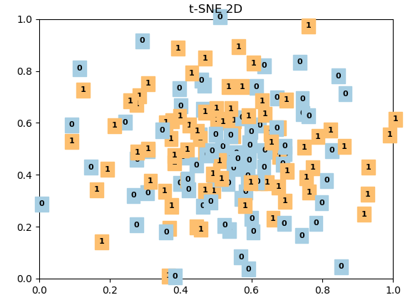
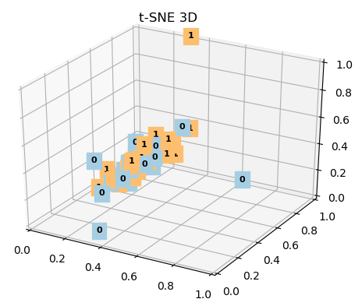
Training visualization

Slide 9
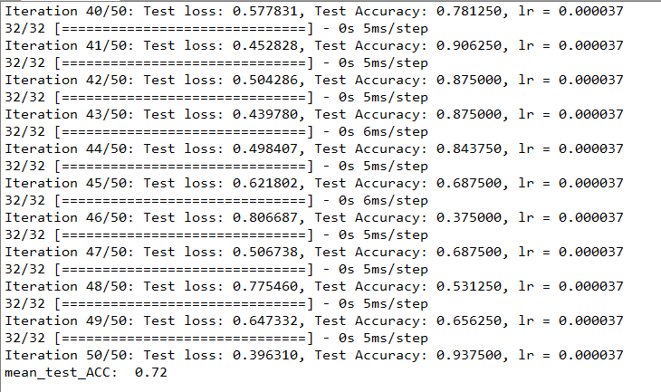
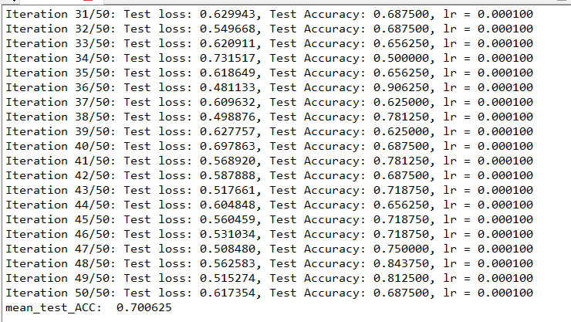
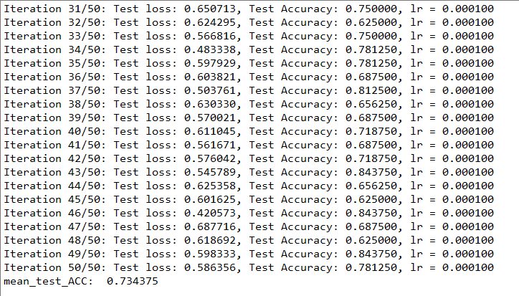
Result
loss= binary_crossentropy
Learning rate = 10e-5, batch_size = 32, iterations = 50

Slide 10
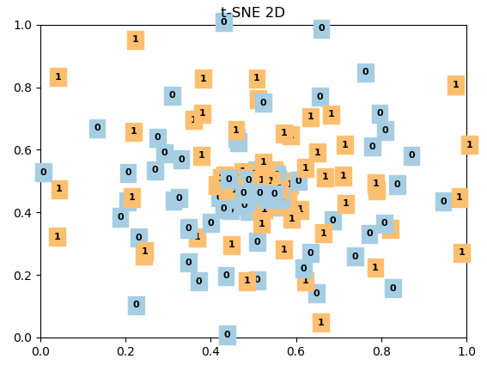
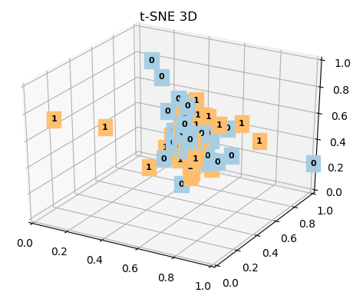
Testing visualization

Slide 11
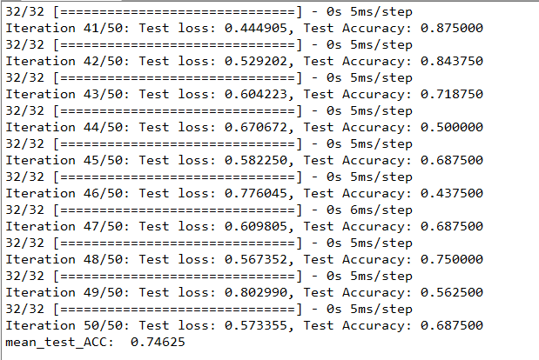
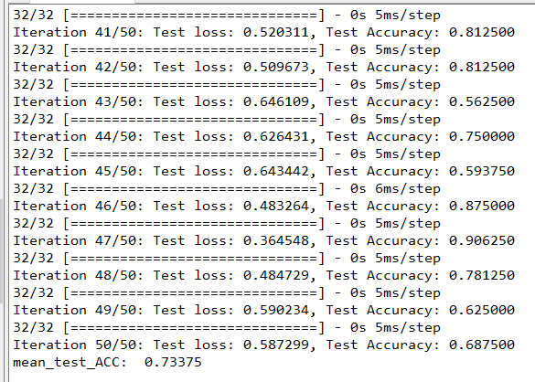
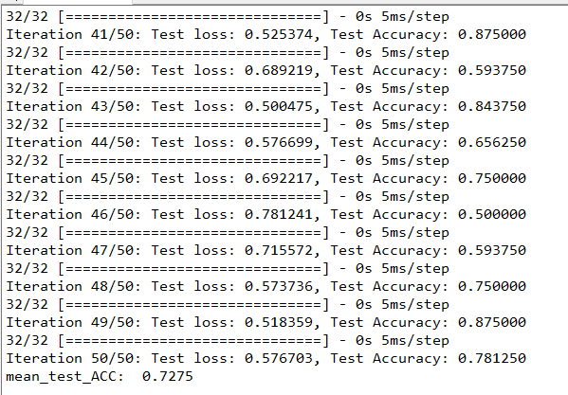
Result_2
loss= binary_crossentropy
Learning rate = 10e-5, batch_size = 32, iterations = 5000

Slide 12
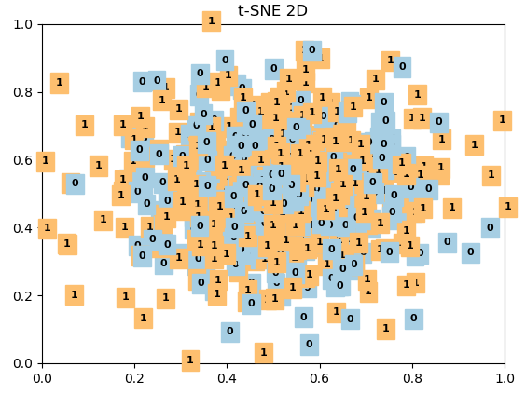
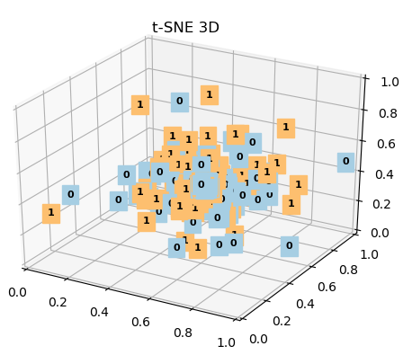
Training visualization

Slide 13
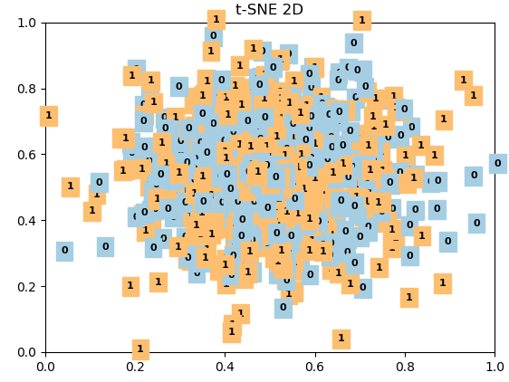
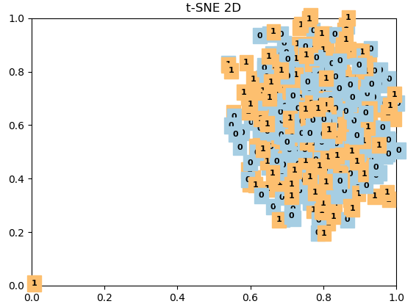
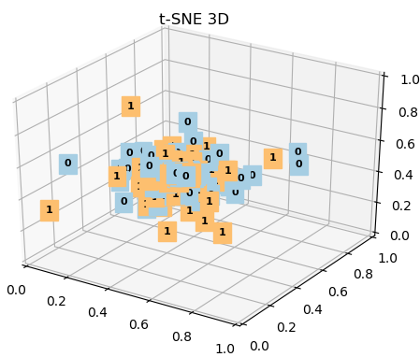
Testing visualization

Slide 14
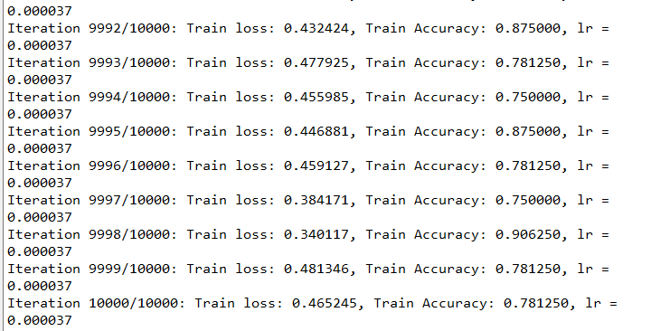
Result_3
loss= binary_crossentropy
Learning rate = 10e-5, batch_size = 32, iterations = 10000

Slide 15
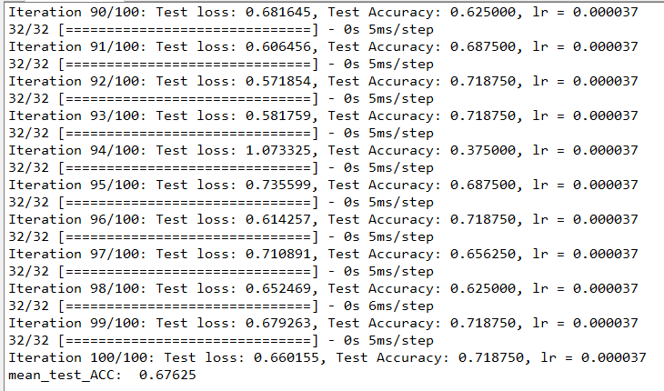
Result_3
loss= binary_crossentropy
Learning rate = 10e-5, batch_size = 32, iterations = 10000

Slide 16
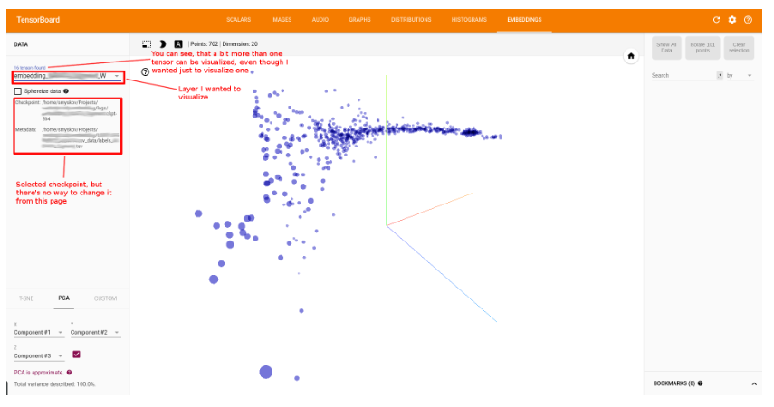
Next work
data processing and experiments
Loss curve & acc curve
cnn in the siamese network for classification
3D-visualization for each app(or category) using Embedding in TensorBoard callback

