Slide 1
工作汇报
2019年7月15日 赵天明

Slide 2
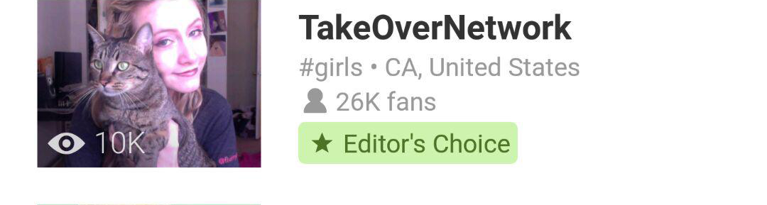
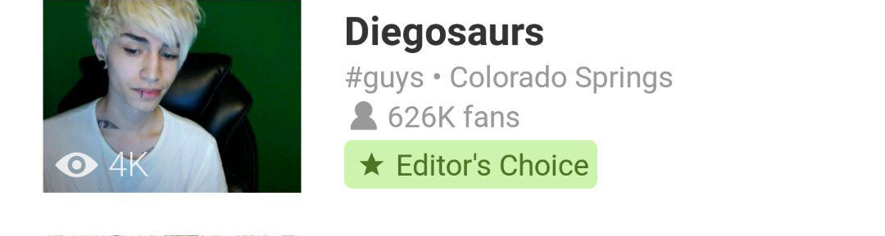

(1). Get all nodes from the json file
(2). Find nodes with the same bounds and retain the last one (furthest from the root)
(3). Delete the root(0-0_1-0) and nodes with unfit bounds (b[2]>b[0] and b[3]>b[1])
(4). Separate the leaf nodes (list_ddsf_leaf[] and list_ddsf_node[])
(5). If nodes(in list_ddsf_node) have more than 2 brothers and the width>limit, then delete their children nodes.
(6). Delete the node with different height from its
Brothers(cut covered)
(7). Delete the nodes in the same line and with same
size as their brothers
(8). Delete the nodes with the situation that: w/h>=30 or h/w>= 50
1)
2)
3)

Slide 3
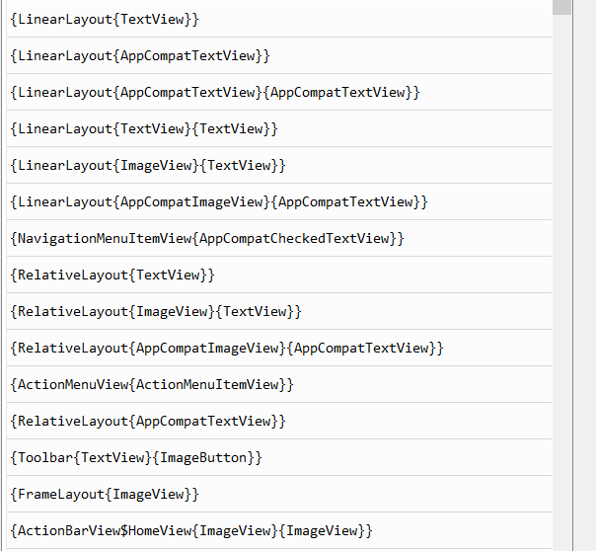
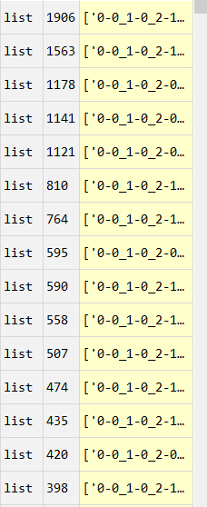
Data Collection
(1). Get the professional GUIs from the profession apps.(13060 GUIs in 1864 apps)
(2).Get the Dom tree and all subtrees from each GUI saved in a txt file.
(3).1576 apps for training(85%), 101 apps for validation(5%), and 187 apps for testing(10%).
(4).We get 13060 GUIs form the training apps,
containing 84737 subtrees and 31045 templates.
One tree searching in 31045 templates takes 316 s
(5). We observe that there are 7781 templates left
Including 23258 GUIs after removing the
templates with only one subtree.
Searching time takes 36. s

Slide 4
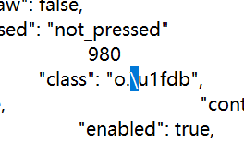
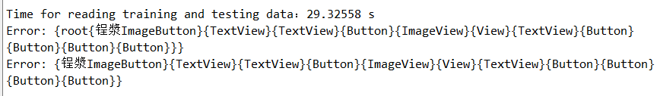
IndexError
‘\’ in json file:

Slide 5
Find out the optimized segmentation
(1). Get the Query_GUI and its tree_dict.
(2).Get the template repository of training data.
(3).Compare the Dom tree with all templates in repository and find the template with the least distance.
(4). Get all children subtrees, compare each of them with all templates and find the template with the least distance. Calculate the sum of these distances, if it is less than that of the Dom tree, we take this segmentation.
(5).Repeat this action until reach the leaf node or the sum of these distances from the children subtrees is bigger than that of the father subtree.
(6).We get the optimized list of subtree id of the Query_GUI and least distance.

Slide 6
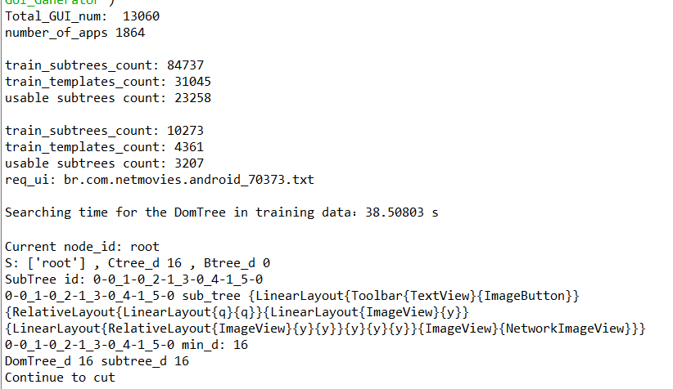
Find out the optimized segmentation

Slide 7
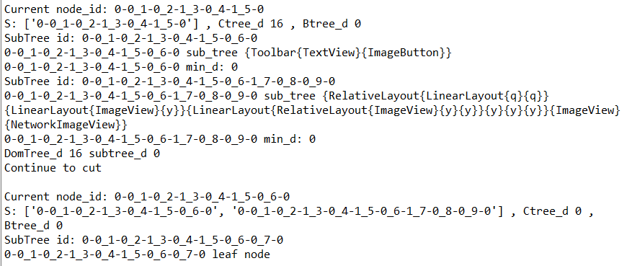
Find out the optimized segmentation

Slide 8
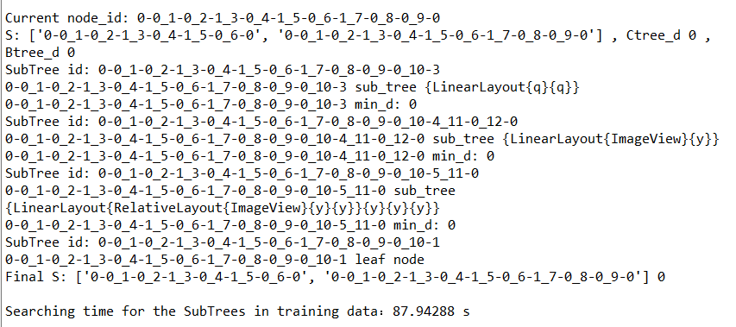
Find out the optimized segmentation

