Slide 1
工作汇报
2019年8月26日 赵天明

Slide 2
Procedure:
Require：generator G, discriminator D, sentence dataset S, subtree embeddings Y
1. repeat
2. for g-steps do
Generate a sentence y_1:T = (y_1,…,y_t,…,y_T), y_t ∈Y, height(1:T) < H with G
for t in 1:T do
Compute Q
end for
Update G’s parameters via policy gradient
8. end for
9. for d-step do
10. Generate negative samples with current G and combine with given positive
samples S
11. Calculate the tree-distance between negative and positive samples as the loss of D
12. Train D for k epochs
13. end for
14. Until converges

Slide 3
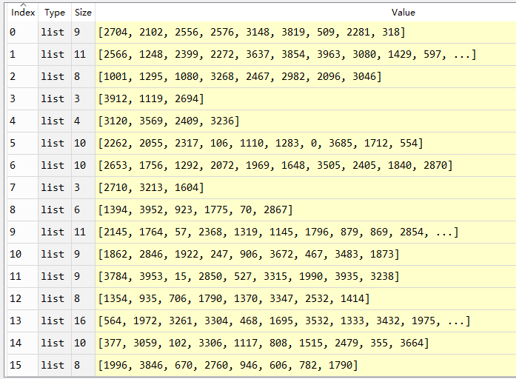
Procedure:
107319 subtrees means VOCAB_SIZE = 107319 nearly without reduplication.
34964 subtrees used in training embedding network.
Generate samples with same sequence_length(20)，
Cut each sample according to the height restrictions(2560).

Slide 4
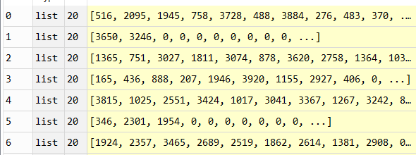
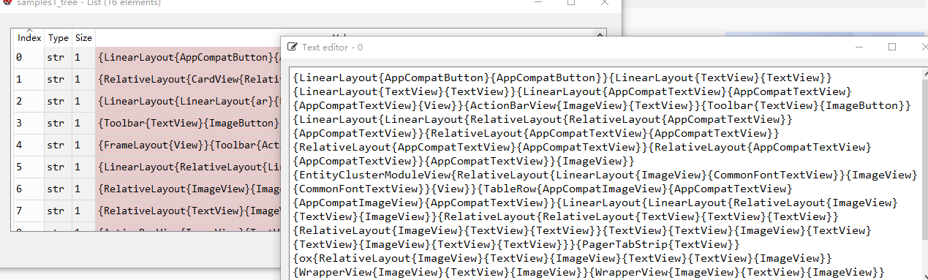
Procedure:
Padding with zero for each sample to a same length(20).
Connect subtrees retained in each sample sequentially

Slide 5
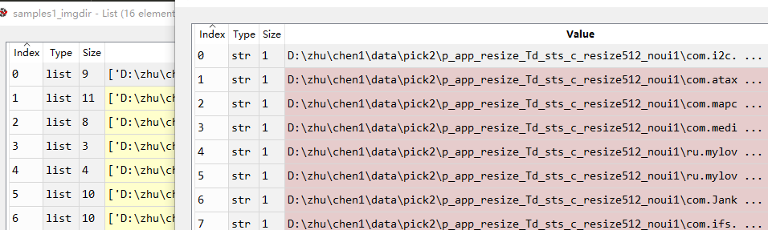
Procedure:
Getting the img_dirs of the subtrees in a sample to display the generated GUI
Loading the DomTree of each GUI as the labels(34964 in training data).
Calculate the tree-distance between samples_tree and DomTree as the loss of D.
(Current Step)

