Slide 1

Reflection
Network Communication
By ZHAO WEI

Slide 2

Groups7 Panel Introduction
Liu Wanpeng（Leader）
Zhao Wei
Thamer Alharbi
Notes:
面向演示者的注释：
在一侧用自己的表述说明你所学的内容。
包含主题信息
主题详细信息在此处也很有用。
讲述你的学习经验。就像讲故事一样，应始终有开头、中间和结尾。
可在另一侧添加能证明你所学内容的图形。
请随意使用多张幻灯片来反映你的进度。添加一些进度视频也很有帮助。

Slide 3
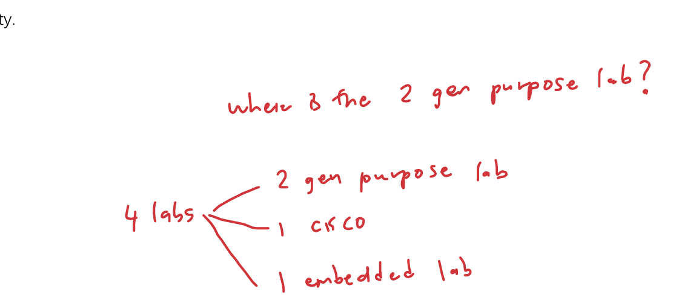
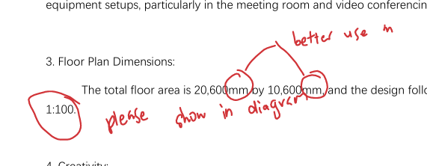
Task1
Design Shortcomings:
The scale was included in the document rather than the diagram.
The wrong unit (mm instead of m) was used.
Missing some lab
Teamwork Effort:
Each team member participated in drawing the design to assign tasks effectively, demonstrating strong teamwork skills.
Notes:
In Task 1, we asked each member to draw the design in order to assign tasks reasonably, which showed mature teamwork ability. However, our design fell short in some areas, for example, we put the scale in the document instead of the diagram, and we used mm instead of m for the units. Because we didn't discuss exactly which LABS were needed, part of the design was missing.

Slide 4
Task2
Focus Areas of Discussion:
Network security
Budget
Management
Technical solutions
C:\Users\zw\Desktop\nt\NetworkTask2 GroupG.pdf
Challenges with Suggestions:
Some suggestions, such as introducing AI tools, were costly and technically complex.
The potential complexity and maintenance costs of these suggestions were not thoroughly discussed
Notes:
Every member carefully studied, investigated, and discussed the problrm we provided. We had in-depth discussions on network security, budget, management, and technical solutions. Some suggestions (such as the introduction of AI tools) were costly and technically complex, and we did not discuss their potential complexity and maintenance costs in detail.

Slide 5
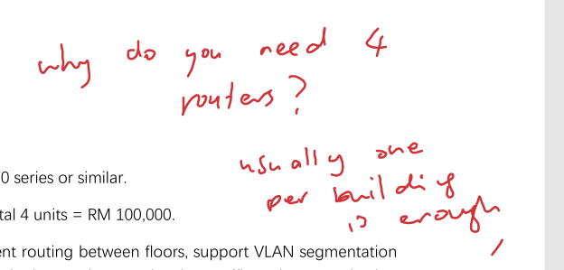
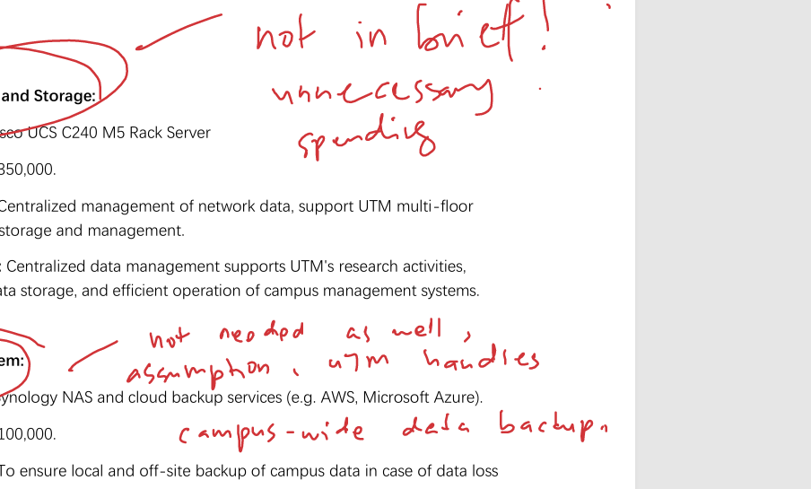
Task3
Documentation of Equipment Selection:
The reasons and purposes for equipment selection in Task 3 were documented in detail.
Issues with Equipment Choice:
A large quantity of high-performance network equipment was selected without considering the actual budget allocation.
Additional equipment was added, which could not be utilized on campus, and many of these items were not adequately described
Notes:
The reasons and purposes for the equipment selection in Task 3 have been documented in detail. Unfortunately, we only chose a large number of high-performance network equipment without considering the actual budget allocation, and we added a lot of additional equipment that could not be used in the campus, and many of them were not described.

Slide 6
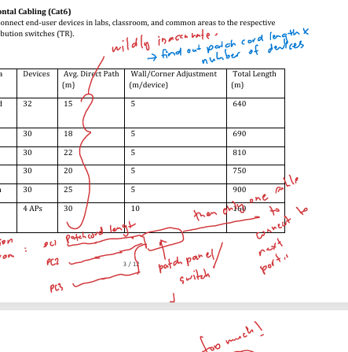
Task4
Perceived Quality of Calculations:
The calculations in the report appeared detailed and analyzable.
Feedback from the Lecturer:
The cabling path and length were deemed unreasonable.
The cables were not clearly marked in the newly modified drawing.
Notes:
The calculations in our report may seem detailed and analyzable, but according to the lecturer's feedback, we learned that the cabling path and length were unreasonable, and we did not clearly mark the cables in the newly modified drawing.

Slide 7
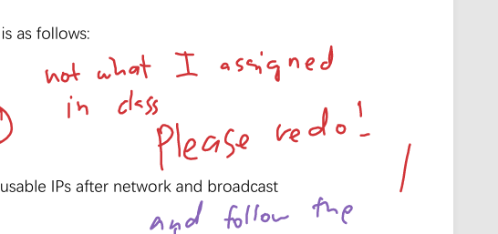
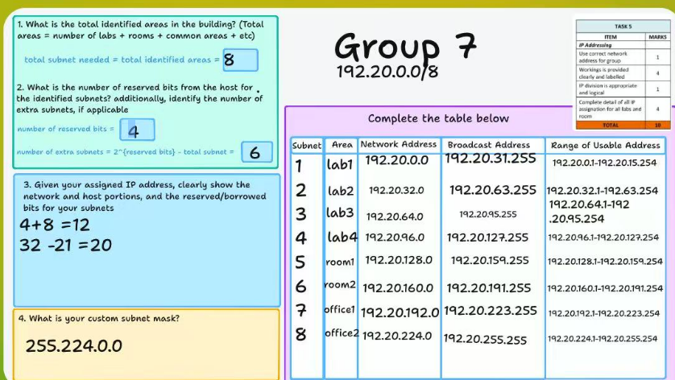
Task5
because our team did not follow the ip address in the class, we did it again according to the requirements and updated it in task 6.

Slide 8
Task6
Shortcomings
·Space constraint problem
·Long-term maintenance cost
·The allocation of expenses is not reasonable
Notes:
We put a lot of effort into this project, covering the network infrastructure design from the initial planning to the final implementation. We mentioned in our report that space in the integrated service area and server room was limited, but did not go into depth to describe specific equipment layout optimization strategies. In actual deployment, devices may be too compact and heat dissipation may be insufficient. Our report has little discussion of the long-term maintenance costs of equipment, the cost of technology upgrades and network renewal plans, and lacks a holistic consideration of the network life cycle.

Slide 9

Summarize
4
The report highlights the team's experience in network design, technology selection, and budget management but reveals weaknesses in implementation complexity, cost assessment, traffic management, and long-term planning. Despite these, the experience enhanced my understanding of systematic thinking and teamwork, emphasizing the importance of detail optimization and a long-term perspective, offering valuable lessons for future work.
3
2
1
Notes:
面向演示者的注释：
你在拥有此学习经验中将采取哪些行动？
你从失败经历中学到内容了吗？你将如何按不同的方式行事？
你将给予其他人哪些建议来让他们能从你的经验中学到内容？
你可如何与实际观众分享你学到的内容？
后续步骤可能是（略举一二）：
在进行我的第一个极具说服力的演示后，我在思考加入辩论队。
在制作了我的第一部电影之后，我在思考用它来参加我们的学校电影节或当地电影节。
在与此职业专家联系后，我向就该职业领域做一些研究，因为它听起来很有趣。
借助此 SmartArt，你可添加图像和文本来帮助概述你的进度。一图胜千言，图片和文字定会帮助你完美地阐述该项学习反思！你可随时单击“插入”>“SmartArt”来更改此图形，或者选择图形，再打击“设计”上下文菜单来更改颜色。
请随意使用多张幻灯片来分享你的未来行动。添加一些内容视频来解释你的说明也很有用。

Slide 10
Thanks！！！

