Slide 1
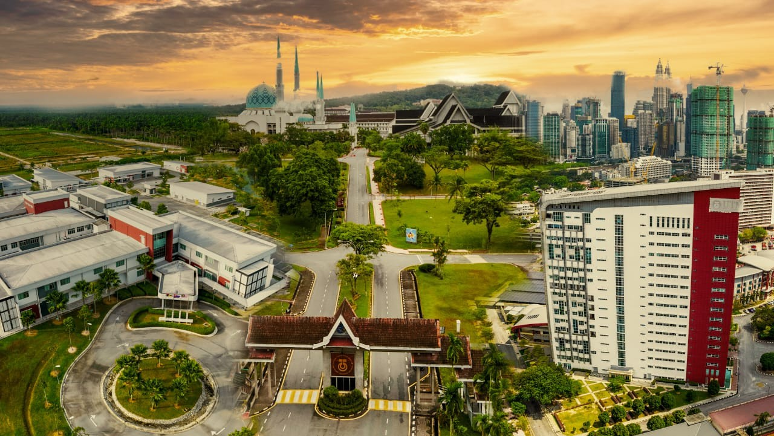




SECJ 2203 SOFTWARE ENGINEERING
SELF REFLECTION VIDEO: LEADERSHIP
Student Name : Zhao Wei
Matric No. : A23MJ4018
Section :16
Team ID & name:5

Slide 2



UNIVERSITI TEKNOLOGI MALAYSIA
PRESENTATION SLIDE
PRESENTATION TITLE / DESCRIPTION
www.utm.my

Slide 3


Self-Introduction
Name: zhao wei
Age:20
Major: SE(Software Engineering)
Faculty: MJIIT
Project: Redesign “MyGreen UTM” Applicition
www.utm.my

Slide 4
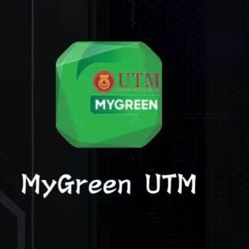
Project Background
Domain
MYGreen UTM aims to fill this gap, drive the campus community to become more actively involved in environmental activities, and increase students' green awareness and campus sustainability.
System
MyGreen UTM is a mobile and stand-alone application designed to:
Encourage participation in green activities through gamification elements like points and rankings.
Educate users about sustainability topics via interactive modules.
Facilitate community engagement by organizing, sharing, and participating in sustainable development activities.
www.utm.my

Slide 5
Stakeholders
UTM Students:
Primary users who participate in green activities, learn about sustainability.
Require simple, engaging, and interactive features.
UTM Staff:
Responsible for organizing and managing green activities.
Development Team:
Includes roles such as programmers, system analysts, and designers working to build, optimize, and maintain the system.
Purpose
To create a platform that integrates education, community participation, and technology to support UTM’s green initiatives, fostering a more sustainable campus environment.
www.utm.my

Slide 6
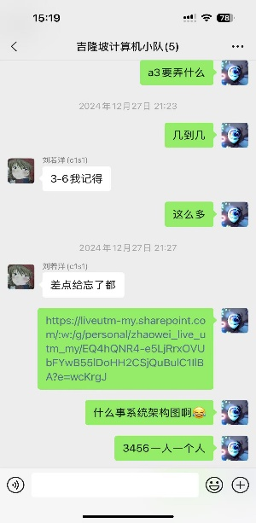
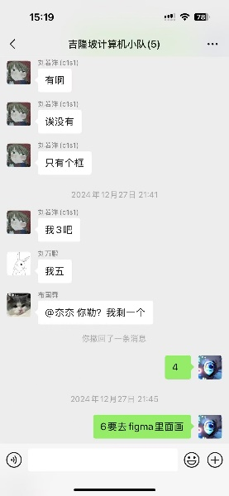
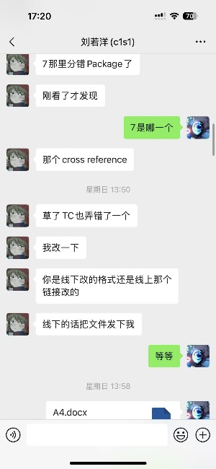
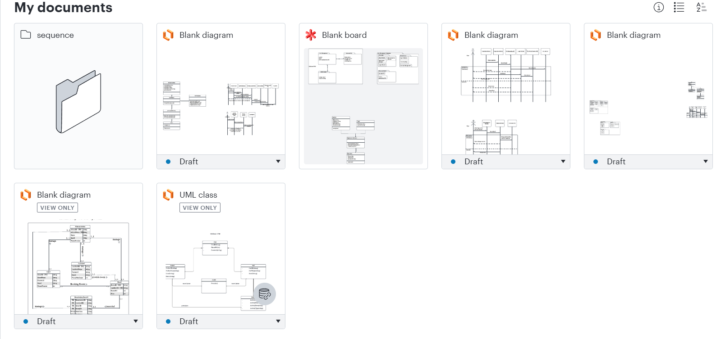
Self-Reflection
Knowledge and Skills:
1.Task allocation and team management
Through group chat, we assign tasks according to the skills of each team member to ensure that team goals and individual tasks are aligned, promoting collaboration and efficiency.
1
3
We usually discuss problems in a group chat, and if there is any inconsistency or data between the previous and the latter, this allows us to correct the problems more quickly.
2.Communication and feedback
2
4
When I draw class diagrams and sequence diagrams, there will be many problems such as incorrect logic, do not match the previous use case diagrams, but I will try to solve them.
www.utm.my
3.Problem solving ability
Documents
Link for each diagram:
Notes:
When I draw class diagrams and sequence diagrams, there will be many problems such as incorrect logic, do not match the previous use case diagrams, but I will try to solve them.

Slide 7



Leadership Qualities
01
Clear goals and vision
02
Team communication and collaboration
03
Responsibility and decision-making ability
The team establishes clear direction and specific goals, ensuring all members align with the project’s core values and desired outcomes. This clarity enables consistency in complex environments, efficient resource allocation, and concentrated efforts toward achieving the goals
At each stage of the project, the team assigned tasks according to the skills and strengths of the members, and if it was found that there was no need to communicate with the member responsible for the part, to ensure that the team direction was consistent.
Team members proactively addressed technical challenges and design feedback. When stakeholders proposed new requirements, the team prioritized critical features based on time and resources, ensuring tasks were completed on time with strong accountability.
www.utm.my
Notes:
Based on our experience of teamwork and cooperation, there are three traits that I think are more important

Slide 8


THANK YOU
univteknologimalaysia
utm.my
utmofficial

