Slide 1
Sprint 1: RSNA-MICCAI Brain Tumor Radiogenomic Classification
Team Members:
Rahaf Alharbey
Jiawei Zhao
Shuyi Fan
Zhaowen Zhou

Slide 2
Contents
Product mission
Comprehensive Literature Review
MVP & MVP User Stories
Technologies

Slide 3
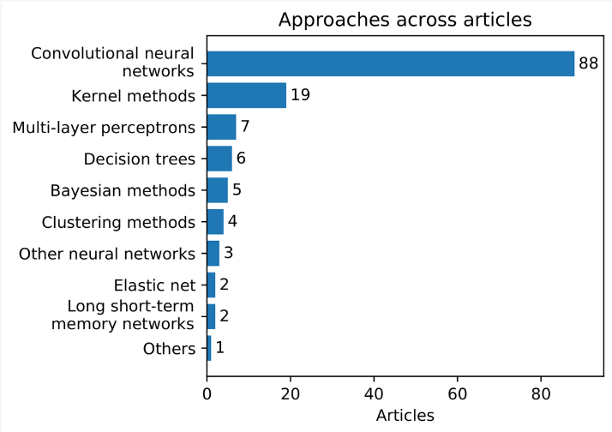
Comprehensive literature review
Deep learning with transfer learning
TL stores knowledge while solving one problem and applies it to another related field(Day and Khoshgoftaar, 2017).
Reports show that Deep learning with transferred high-level features can make precise diagnosis possible and medical resource be full use of (Valverde et al., 2021).

Slide 4
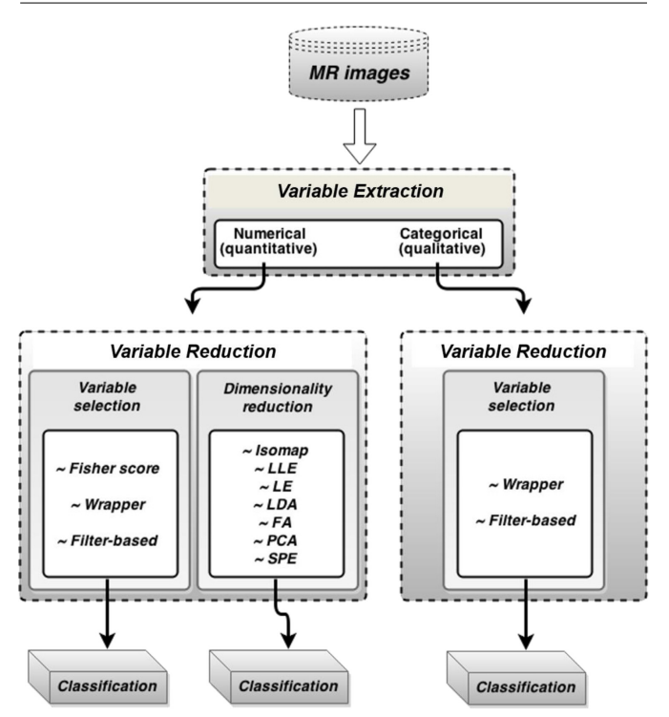
Comprehensive literature review
Variable selection for traditional machine learning method
This prediction problem can be easily turned into a supervised classification problem which can be solved by traditional machine learning method.
Variable selection and dimensionality reduction both need to be used for the high dimension dataset contained in the MRI scan to reduce variable.
None of the variable selection method can be called the best. So a systematic empirical comparison of several best-known methods is needed. (Vasileios G.Kanas et al., 2016)

Slide 5
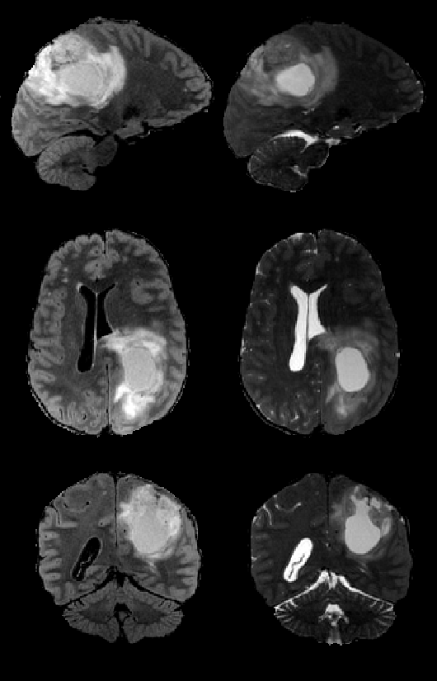
MVP user stories
As a doctor,
Already got the MRI scans, want to know whether if patients have brain tumor or not;
Already find tumor in MRI, want to make sure if it is cancerous or not;
tumor?
cancerous or denign?

Slide 6
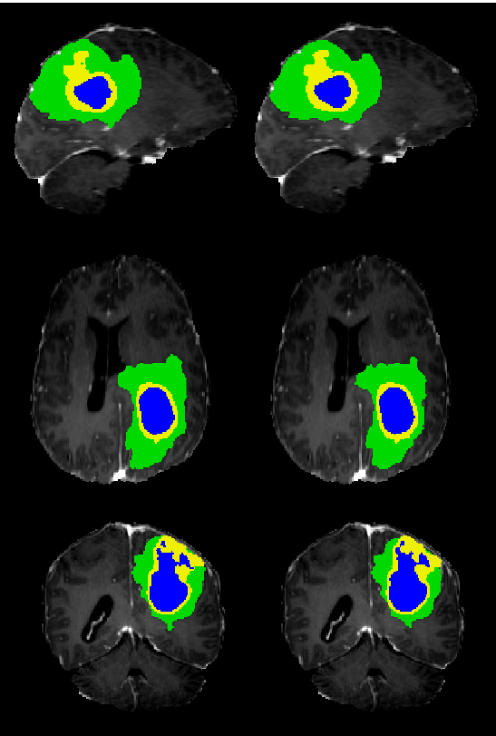
MVP user stories
As a doctor,
Already got the MRI scans, want to know whether if patients have brain tumor or not;
Already find tumor in MRI, want to make sure if it is cancerous or not;
Make sure it’s cancerous, want to recognize the tumor’s type (location);
Make sure it’s cancerous, want to know the status of the tumor.
tumor’s type? status?

Slide 7
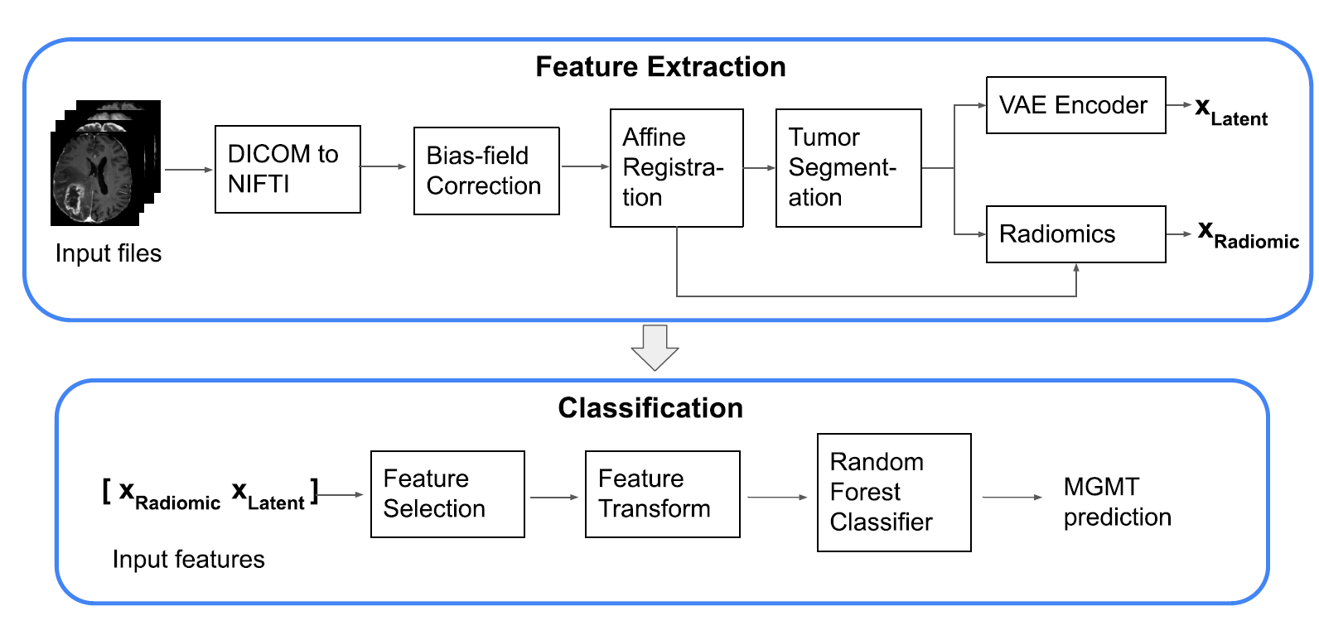
MVP user stories
As a student / researcher,
learn classify model in their own field, want to know details of our product;
Already have their own model, and want to compare their products with ours;

Slide 8
MVP
The product should:
recognize whether patient has brain tumor or not;
make sure whether the tumor is cancerous or not;
find Tumor’s type (location);
get the status of the tumor.
supply code and dataset of our product.
supply detail of brain tumor
open source

Slide 9
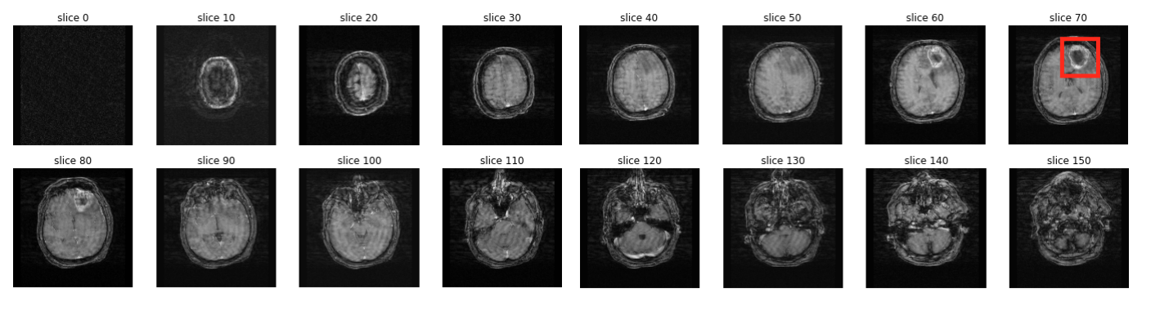
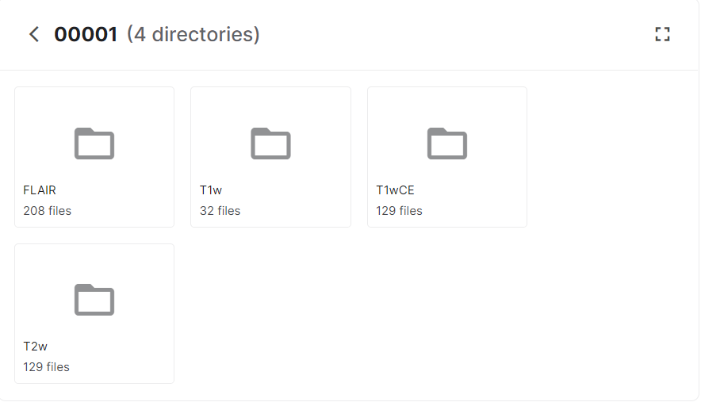
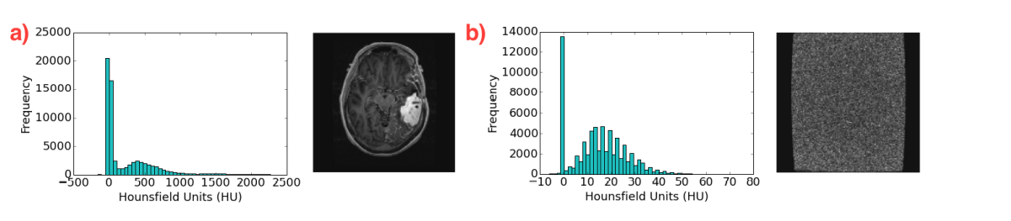
Technologies
Y
Positive methylation status
Value = 1
Methylation beta value > threshold?
Methylation data
Site selection
Negative methylation status
Value = 0
N
Label selection
T1/T2/Flair axial
Filter out noise image
Slices selection
Slices rotation
MRI data

Slide 10
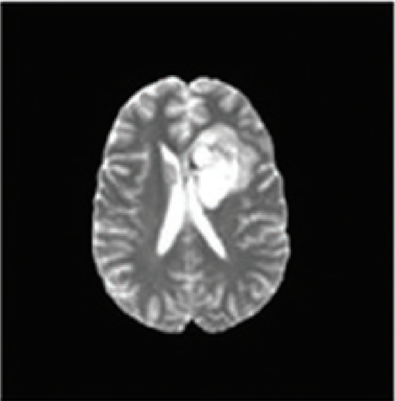
Technologies
Batch
Norm
Conv
Pool
Bi-directional GRU
Softmax
Input
ReLU
Dropout
ReLU
Dropout

Slide 11
Thank you

