Slide 1
FLchain
Federated Learning via MEC-enabled Blockchain Network
汇报人：葛均易

Slide 2
01
PRELIMINARIES AND DEFINITIONS
目录
02
BLOCKCHAIN OPERATIONS IN FLCHAIN
CONTENT
03
CONCLUSION

Slide 3
01
PRELIMINARIES
AND
DEFINITIONS

Slide 4
Channel
Fabric introduces the concept of channels which are private subnet used for enabling isolated communication between at least two peers. Only channel-associated peers are entitled to read, submit, and validate the transaction within a channel. A separate ledger is maintained for each channel. The consensus is also applied on per-channel basis . In FLchain, for each global learning model, a new channel with the genesis block is created which stores channel-speciﬁc ledger. The genesis block stores the initial weights of the global learning model, dimensions of weights, hyper-parameters, activation function, and bias.

Slide 5
Global Model State Trie
Similar to the “Account State Trie” for pursuing the state of accounts in Ethereum , we propose “Global Model State Trie” for pursuing the weights of the global learning model in FLchain. Each channel has its own global model state trie in the form of Merkle Patricia tree. The global model state trie stores the weights in key-value pair where the key is weight location (subscripts indicating indexes of weight) and value is actual weight coefﬁcients. The weight coefﬁcients are updated concurrently with the generation of a block in FLchain. After the consensus, the global model state trie provides the updated weight coefﬁcients for global learning model.

Slide 6
Edge devices
The edge devices serve two purposes. First, they provide network resources to the resource-constraint mobile devices. Second, they serve as nodes in the blockchain network of FLchain.

Slide 7
02
BLOCKCHAIN OPERATIONS
IN FLCHAIN

Slide 8
Initialization
Channel Inquiry
When a device i wants to join the FLchain for a speciﬁc channel, ﬁrst it carries out the channel inquiry; subsequently, the list of available channels C is sent to the mobile device by blockchain network.
Channel selection
When a device i wants to contribute to FL for a particular global model, It performs channel inquiry. Once, the list of accessible channels C is available, It selects the relevant channel ci for that particular global model. Let the channel selected by device i be ci = j.
Local Model Update
Device Registration
After the registration, the user device is assigned the private & public keys through which it can submit its revised local model weights to the channel. Prii,j and Pubi,j denote the assigned private key and public key for device i and channel j, respectively

Slide 9
Local Model Update
the device downloads the most recent global model parameter wj(t−1) from blockchain network through its associated edge node. Whereas, t is the current global model iteration.
The local model update wi,j(t) is determined by the device i and is forwarded to blockchain network in form of transaction. transi,j(t) is the transaction generated by device i for channel j at iteration t and signed by the device private key Prii,j.
Transaction Pool
The submitted transactions are accumulated in the transaction pool (mempool). In particular, each node in blockchain network keeps its own channel-speciﬁc mempool. The transactions are validated, veriﬁed and authenticated. The peers on the channel j wait for time Twait,j for accumulation of transactions in mempool .

Slide 10

Global Model Update
The global model weights are updated using distributed approximate Newton-type Method
Global model state trie is determined which securely stores the global model parameters wj(t). The root of global model state trie is added in block header of block with block-height t.
When the waiting time Twait,j is surpassed, Peers (Edge nodes) in channel j compete to generate the next block by bundling transactions for iteration t from their own mempool.
Consensus Protocol
The peers compute their own global model state trie from transactions within the block and verify the root of the global model state trie against the broadcasted block. If the block is found to be valid, the blockchain network must reach consensus for blockchain upto respective block and the
corresponding miner is regarded as a winner miner
Notes:
where, Dj,t are set of devices whose transactions are received by the winner miner and included in block with block-height t. Nk,t,j are number of data samples contributed by device k ∈ Dj,t at iteration t. Moreover, St,j = i∈Dj,t Si,t,j with St,j = NS,t,j. Where, Si,t,j is set of samples contributed by device i at iteration t for channel j.

Slide 11
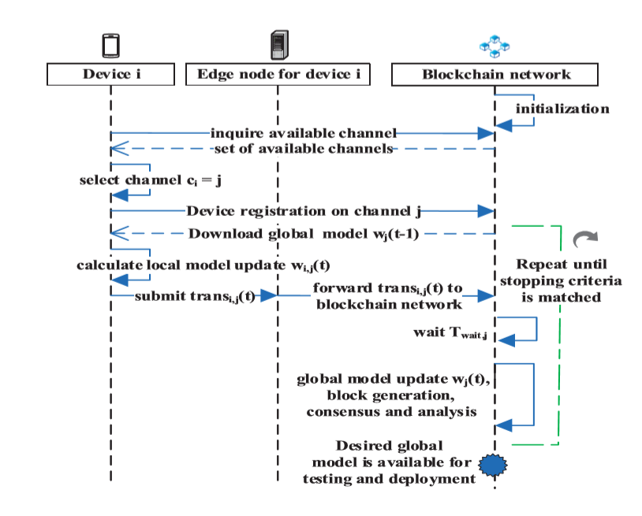

Slide 12
03
CONCLUSION

Slide 13
CONCLUSION
every blockchain node computes, veriﬁes and validates the global model state trie for consensus,so blockchain-based FL is more reliable and robust than the typical FL.
The limitation of the proposed approach is that the user-devices depend on the integrity of their corresponding edge devices for forwarding of transactions to the blockchain network.

Slide 14
Thanks

