Slide 1
VPriv: Protecting Privacy in Location-Based Vehicular Services
Raluca Ada Popa and Hari Balakrishnan Computer Science and Artificial Intelligence Laboratory, M.I.T.
Andrew Blumberg Department of Mathematics Stanford University

Slide 2
Outline
Motivation动机
VPriv
Model 模型
Protocols 通讯协定
Notes:
Dòngjī
VPriv
Móxíng
tōngxùn xiédìng

Slide 3

Motivation
Location-based vehicular services are being increasingly adopted: - Automated toll collection (E-ZPass), traffic law enforcement, statistics collection
自动收费（E-ZPass），交通执法，统计收集 - Insurance pricing based on driver behavior
基于驾驶员行为的保险定价
Promises efficiency, better driver experience, safety, revenue
承诺效率，更好的驾驶员体验，安全性，收益
Serious threat to the locational privacy of drivers!
严重威胁驾驶员的位置隐私！
Notes:
动机Dòngjī
Yuè lái yuè duō dì cǎiyòng jīyú wèizhì de chēliàng fúwù Location based 地采用基于位置 Vehicle service车辆服务
(E-ZPass), jiāotōng zhífǎ, tǒngjì shōují
jīyú jiàshǐ yuán xíngwéi de bǎoxiǎn dìngjià
chéngnuò xiàolǜ, gèng hǎo de jiàshǐ yuán tǐyàn, ānquán xìng, shōuyì
Yánzhòng wēixié jiàshǐ yuán de wèizhì yǐnsī!

Slide 4
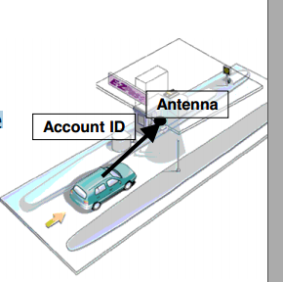
Example: E-ZPass
Antenna reads account ID, knows time, location
A centralized server can assemble a drier’s path
Civil cases used driver path from E-ZPass data
VPriv: a system for preserving privacy
VPriv：一种保护隐私的系统
Notes:
VPriv: Yī zhǒng bǎohù yǐnsī de xìtǒng系统 system

Slide 5
VPriv
►Observation: Most vehicular services are functions over time-location tuples
观察：大多数车辆服务是随时间位置元组的功能
►Compute functions on drivers' time-location tuples without revealing any information other than result
计算驾驶员时间位置元组的功能，不显示结果以外的任何信息
Perform computations in zero-knowledge 以零知识执行计算
Secure multi-party computation安全的多方计算
►Efficiency through homomorphic encryption
►Applicable to sum of cost functions 适用于成本函数之和
Notes:
►Guānchá: Dà duōshù chēliàng fúwù shì suí shíjiān wèizhì yuán zǔ de gōngnéng
►jìsuàn jiàshǐ yuán shíjiān wèizhì yuán zǔ de gōngnéng, bù xiǎnshì jiéguǒ yǐwài de rènhé xìnxī
yǐ líng zhīshì zhíxíng jìsuàn
ānquán de duōfāng jìsuàn
►
►shìyòng yú chéngběn hánshù zhī hé

Slide 6
Model
Two parties: car/driver and server 两方：汽车/驾驶员和服务器
F is a function to compute on driver's path F是在驾驶员路径上进行计算的函数
Car's transponders periodically generate tuples: <tag, time, iocation>
汽车的应答器会定期生成元组：<标签，时间，位置>
- Tag is random and changing for privacy 标签是随机的，并且为了隐私而更改
- Sent to server while driving or at end of month 在开车时或月末发送到服务器
Notes:
Liǎng fāng: Qìchē/jiàshǐ yuán hé fúwùqì
F shì zài jiàshǐ yuán lùjìng shàng jìnxíng jìsuàn de hánshù
qìchē de yìngdá qì huì dìngqí shēngchéng yuán zǔ:<Biāoqiān, shíjiān, wèizhì >
-biāoqiān shì suíjī de, bìngqiě wèile yǐnsī ér gēnggǎi
-zài kāichē shí huò yuèmò fāsòng dào fúwùqì

Slide 7
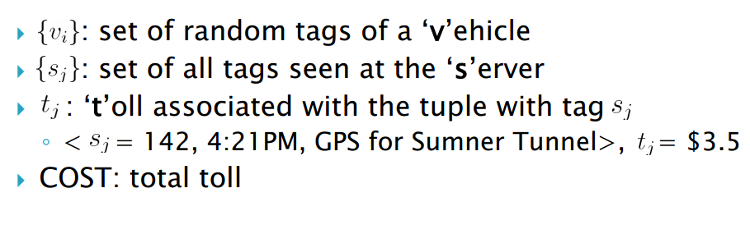
Notation

Slide 8
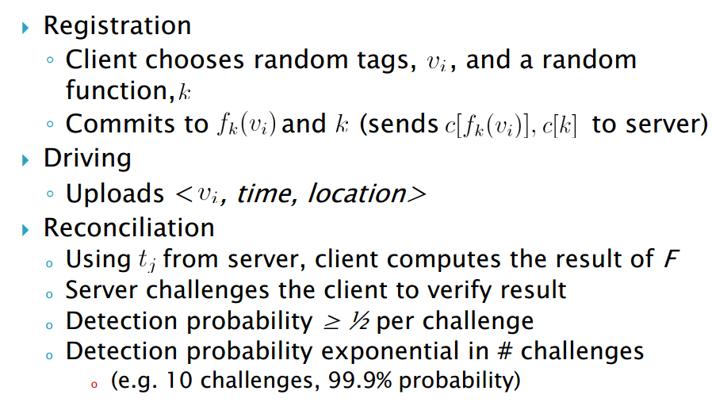
Protocol

Slide 9
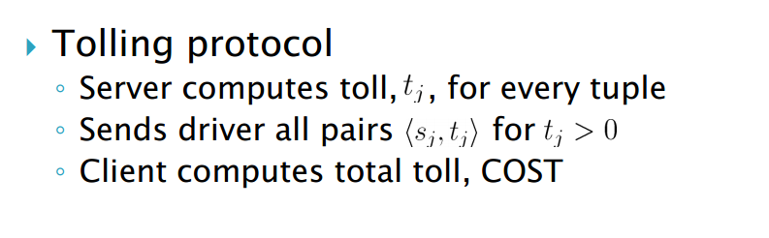
Reconciliation 和解
Notes:
hé jiě

Slide 10
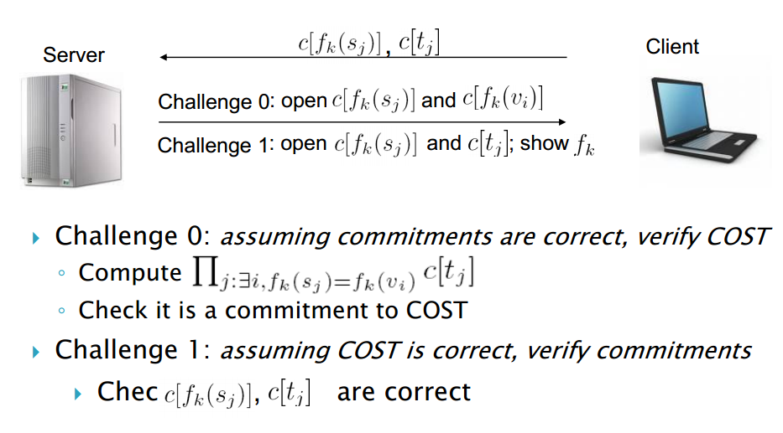
Challenge Phase 挑战阶段

Slide 11

Why does it work? 为什么行得通？
- Correctness正确性
- Soundness健全性
Malicious client: commitments or COST are incorrect
- Locational privacy:位置隐私
Notes:
Zhèngquè xìng,
jiànquán xìng
Wèizhì yǐnsī

Slide 12
Question？

