Slide 1










Monoxide
Scale out Blockchains with Asynchronous Consensus Zones
以异步共识组来拓展区块链
Jiaping Wang, Hao Wang
Sinovation Ventures
ICT/CAS
The Ohio State University

Slide 2
概述
传统区块链结构
异步共识区域区块链结构
系统设计
异步共识区
思考：异步共识区带来的问题
跨区域交易
跨区域交易的实例
最终原子性的提出
挖矿安全性
攻击模型
连弩挖矿
总结

Slide 3

Public Blockchain
Readable by public
State (Ledger)
...
Block t+0
Block t+1
Block t+2
Block t+3
Block t+4
Confirmed
Transactions
Confirmed
Transactions
Confirmed
Transactions
Confirmed
Transactions
Confirmed
Transactions
Mining
1MB per-block
10 Minute per-block
Writable by public
Unconfirmed Transactions

Slide 4
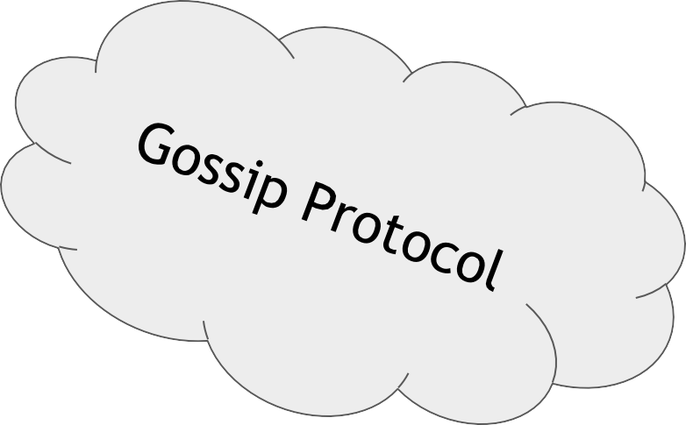
Not Scalable: Low TPS
Block Creator

Slide 5
Not Scalable: Low TPS
Block Creator
Every single node is required to
replicate
validate
Store
← Network I/O Bound
← CPU Bound
← Disk I/O Bound
all transactions !
Every single node is required to
maintain states ← Memory Bound of all users in entire network !

Slide 6
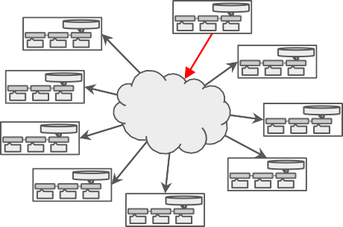


Asynchronous Consensus Zones
… …
Zone 0
Zone 1
Zone n-1

Slide 7
SYSTEM DESIGN

Slide 8
Partitioning in Consensus Zones
Zone Count: n=2^k
User Address:
Consensus Zone #0
c64493a658f6ffca1fc8884120c7f7b5c0940946
Consensus Zone #1
First k-bits maps to zone index
Consensus Zone #2
Consensus Zone #3
… …
Consensus Zone #n-1

Slide 9
Partitioning in Consensus Zones
Zone Count: n=2^k
User Address:
Consensus Zone #0
c64493a658f6ffca1fc8884120c7f7b5c0940946
Consensus Zone #1
First k-bits maps to zone index
Consensus Zone #2
Transaction:
Consensus Zone #3
From:5e032243d507c743b061ef021e2ec7fcc6d3ab89 To: eba290cf248cb14442a071fbcb58a9cc5dcde28e
… …
First k-bits of From maps to zone index
Consensus Zone #n-1

Slide 10

Consensus Zones
Consensus Zone #0
Intra-Zone State
...
Block t+0
Block t+1
Block t+2
Block t+3
Block t+4
...
Intra-Zone Gossip Network
Full Nodes
Miners
Zone isolates
Consensus Zone #1
Mining competition and chain growth
State (ledger) for intra-zone users only
Unconfirmed TX (mempool)
Gossip network
Consensus Zone #2
… …
Consensus Zone #n-1

Slide 11
小结1：
1、每个"共识组"其组成部分和现在单链系统完全一致，有自己的账簿状态，区块的链条，未确认交易的集合，同步区块数据和交易数据的广播网络以及一堆全节点（包括矿工）。
2、各个共识组之间完全对等，无主次之分，除此之外这个网络就没有任何其它的角色了，没有之前那些方案提出的母链，根链之类的，也没有任何掌控全局的调度节点或验证节点。
一句话概括：
每个共识区有相同的、平行的、十分简洁的结构。

Slide 12

Consensus Zones
Scalability
√ Linear scaled capacity: CPU, Memory, Disk I/O Throughput ?? Cross-zone transaction ??
… …
Consensus Zone #0
Consensus Zone #1
Consensus Zone #2
Consensus Zone #3
Consensus Zone #n-1

Slide 13
Consensus Zones
Scalability
√ Linear scaled capacity: CPU, Memory, Disk I/O Throughput ?? Cross-zone transaction ??
… …
Consensus Zone #0
Security
Attack bar: mining power dilution ??
√ Sybil resistant
Consensus Zone #1
Consensus Zone #2
Consensus Zone #3
Consensus Zone #n-1

Slide 14
Consensus Zones
Scalability
√ Linear scaled capacity: CPU, Memory, Disk I/O Throughput ?? Cross-zone transaction ??
… …
Consensus Zone #0
Security
Attack bar: mining power dilution ??
√ Sybil resistant
Consensus Zone #1
Consensus Zone #2
Decentralization
√ Permissionless mining
√ Low barrier of participate (full nodes)
Consensus Zone #3
… …
Consensus Zone #n-1

Slide 15

Consensus Zones
Scalability
√ Linear scaled capacity: CPU, Memory, Disk I/O Throughput ?? Cross-zone transaction ??
… …
Consensus Zone #0
Security
Attack bar: mining power dilution ??
√ Sybil resistant
Consensus Zone #1
Consensus Zone #2
Decentralization
√ Permissionless mining
√ Low barrier of participate (full nodes)
Consensus Zone #3
Consensus Zone #n-1

Slide 16
CROSS-ZONE TRANSACTION

Slide 17
Cross-Zone
Payment Transaction
Transfer x tokens from user A to user B in different zones
Relay
A ← A - x , (A ≧ x)
B ← B + x
…
Block t+0
Block t+1
Block t+2
Block t+3
…
A ← A - x (A ≧ x)
Zone a
…
Block r+0
Block r+1
Block r+2
Block r+3
Block r+4
B ← B + x
Zone b

Slide 18
区块链系统，每一个交易都是一个原子操作。在单链系统中，就好比单线程，这个原子操作并没有被强调，因为交易本来就是被一个一个地确认和处理，系统无需任何额外的事情，原子性就自然有保障。而在 Monoxide 中，不同地址的状态在不同共识组中维护，互相不可见，其状态的更新也被两个不同的链驱动，就好比多线程。
通常为了协同多线程，有两种办法，一个是互相对涉及的资源加锁，一个是借由消息传递。本文选择了后者，不仅是因为加锁将阻塞对应的共识组的吞吐，严重影响性能，也是因为所有的单链区块链天生就有一个消息传递机制（未确认交易集合），从而避免引入新的实体。

Slide 19
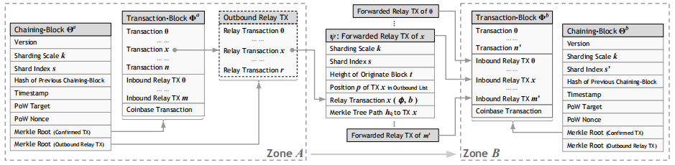
a withdraw operation p from payer a and a deposit operation φ to payee b
Tx<p,a,φ,b> -----> validate------>create chaining-block and transaction block ----->
Pow puzzle ----->broadcast ------>Intra-zone(first) cross-zone(then)---->
derive relay Tx ( ψ := <φ,b, r>)----->picked by b miner----->verify its originate block
------>create chaining-block and transaction block----->broadcast---->execute

Slide 20
小结：
1、Transaction-Block broadcast in own zone
2、relay Tx create originate zone and broadcast to destination zone
3、 chaining block broadcast to all zones
如何验证交易的正确性

Slide 21
ψ := <φ,b, r>---->r := <s, k,t, p,{hq}>----->recalculate path{hq} and tx<φ,b>
------>match originate block
参数说明：zone index s;sharding scale k;height t;
pointer p (position in the list of outbound relay Tx)
path {hq} refers to hash values of all sibling nodes on the path from Merkle tree root to its entry;

Slide 22
Message Passing
Payment Transaction = Initiate TX + Relay TX
Transfer x tokens from user A to user B in different zones
A ← A - x , (A ≧ x)
B ← B + x
Block s
Block d
Initiate TX
Transfer x tokens from A to B
Relay TX
Deposit x tokens to B
Verified by A’s signature
Verified by block header s
Zone a
Zone b

Slide 23
Eventual Atomicity
解释：once the withdraw operation is confirmed, the deposit operation will be executed eventually. We call such an atomicity, Eventual Atomicity.
-----------------------------------------------------------------------------------------
例子讨论：Transfer x tokens from user A to user B in different zones
1、relay Tx 在B中长时间不执行
it will never expire before being picked up by a miner
2、主动无效
its initiative transaction is invalidated, e.g., being orphaned block due to the chain fork

Slide 24
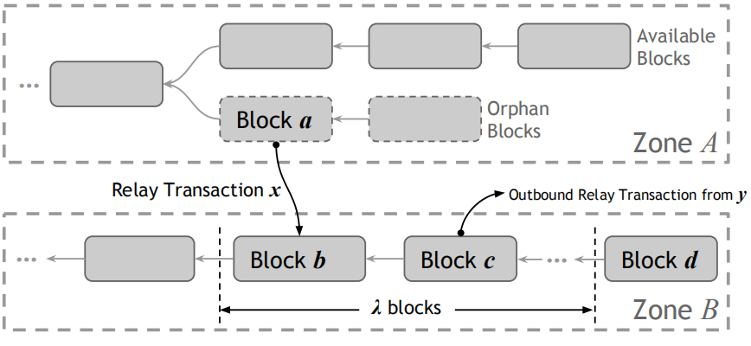
1、Pre-Comfirmed:
An unconfirmed relay transaction will not be considered in new block creation until its originate block is in available state.
2、Post-Comfirmed:
Tx x 已经在b中确认，并加入到Zone B 的链上
3、如图情况:Block c将无效
Delaying execution of inbound relay transaction for λ blocks. Thus, transaction y will be not be confirmed until block d, which makes such case unlikely since block a already received at least λ confirmations.例子：
State S is G-Block b || State λ is G-block d-1------>执行blocks b ~d-1的所有交易，除了inbound relay Tx ---->下一个跨区域交易在保证State S~State λ都有效前提下进行出块。
把所有情况都变成了第一、二种情况。
解决方法：The ledger state in zone b 重新执行所有历史区块的交易，并跳过所有无效的relay Tx（包括Tx x）。块b是有效的，但是交易x无效了。

Slide 25
小结：最终原子性是一个过程的原子性，通过relay Tx的安全性验证以及解决分叉来保障。
…
Block t+0
Block t+1
Block t+2
Block t+3
…
A ← A - x (A ≧ x)
Zone a
…
Block r+0
Block r+1
Block r+2
Block r+3
Block r+4
B ← B + x
Zone b
Atomicity In-progress
Atomicity Fulfilled

Slide 26
Consensus Zones
Scalability
√ Linear scaled capacity: CPU, Memory, Disk I/O
√Throughput ！！ Cross-zone transaction ！！
… …
Consensus Zone #0
Security
Attack bar: mining power dilution ??
√ Sybil resistant
Consensus Zone #1
Consensus Zone #2
Decentralization
√ Permissionless mining
√ Low barrier of participate (full nodes)
Consensus Zone #3
Consensus Zone #n-1

Slide 27
MINING POWER DILUTION

Slide 28
攻击模型：
在有 n 个共识组的 Monoxide 系统中，全网有效算力为 H，每个共识组的有效算力为 H/n。攻击者在实施攻击的时候，将其所有物理算力 T 分配到一个特定共识组，在这个共识组中获得有效算力T。那边当其物理算力超过 T > H/n × 51% 的时候，攻击将可以成功，并构造不一致交易（例如双花交易）。
解决思路：
1、防止用户将所有算力集中在同一区域；
2、扩大系统的有效算力。
连弩挖矿

Slide 29
Effective Mining Power
for(nonce=0;;nonce++){ ... }
Single Chain
Block
000000000000000000221aca6af29cba4
4df1708ac1eef7ac6e9394defc39116
Effective Mining Power
H
Physical Mining Power
H

Slide 30
Effective Mining Power
for(nonce=0;;nonce++){ ... }
Consensus Zone #1
Block
000000000000000000221aca6af29cba4
4df1708ac1eef7ac6e9394defc39116
Consensus Zone #2
Block
000000000000000000227522827f9c8c
4ee3f57555e99ba96ad683d21f0d8efa
Consensus Zone #3
Block
0000000000000000002bb8e009cecb5c
4a1249eab285a479a1a83b8a17b4be53
… …
… …
Consensus Zone #n
Block
0000000000000000001c6251ef8876fa6
a28368c6461d7a477fce57a71abc834
Effective Mining Power
H
Physical Mining Power
H

Slide 31
Effective Mining Power
for(nonce=0;;nonce++){ ... }
Consensus Zone #1
Block
000000000000000000221aca6af29cba4
4df1708ac1eef7ac6e9394defc39116
Consensus Zone #2
Block
000000000000000000227522827f9c8c
4ee3f57555e99ba96ad683d21f0d8efa
Consensus Zone #3
Block
0000000000000000002bb8e009cecb5c
4a1249eab285a479a1a83b8a17b4be53
… …
… …
Consensus Zone #n
Block
0000000000000000001c6251ef8876fa6
a28368c6461d7a477fce57a71abc834
each zone
Effective Mining Power
H/n
Physical Mining Power
H

Slide 32
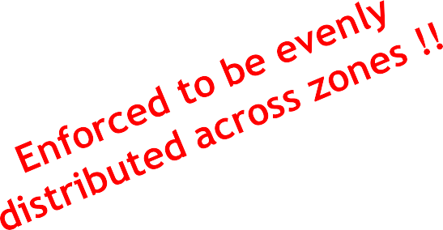
Chu-ko-nu Mining (连弩挖矿)
for(nonce=0;;nonce++){ ... }
Consensus Zone #1
Block
Consensus Zone #2
Block
0000000000000000000ba3295985f2370
68b89b3738200d77ba5bbc79280a76e
Consensus Zone #3
Block
… …
… …
Consensus Zone #n
Block
Effective Mining Power
Hxn
Physical Mining Power
H
Aim:为了放大有效算力，并强制均分在各个共识组

Slide 33
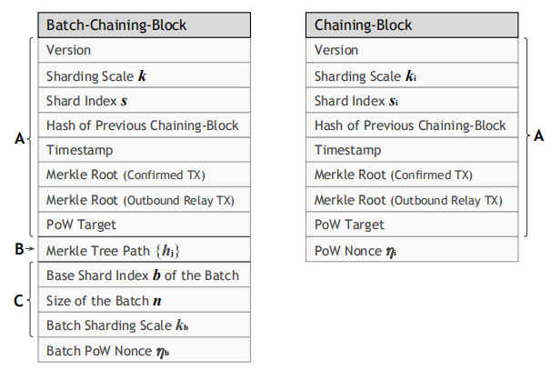
Chu-ko-nu Mining (连弩挖矿)
连弩挖矿允许矿工同时参与多个编号连续的共识组（例如从编号b到b+n-1），每次出块的时候哈希函数将覆盖多个将要出块的块头进行计算，同时这些块头将共用一个 Nonce。具体做法是将这个 n 个块头按序排列，构造 Merkle 树。然后算力哈希计算将覆盖下列数据结构：
<h, b, n, ηb>
出块时,下列数据结构会被广播到特定的共识组 i （b≤i<b+n），仅包含该共识组的块头以及一个该块头被包含在内的证明，不涉及到其它共识组的块头。
<h, b, n, ηb, Blocki, MerkleTreePathi>
其 MerkleTreePathi 是 Blocki 在 Merkle 树路径上的左右兄弟节点的哈希值。连弩挖矿并不要求各个共识组同步接受这些块，甚至有些块最终被认为是无效分叉，也不会影响其它块在其它共识组中被接受。同时，这个结构允许连弩挖矿是可以包含算力难度不同的共识组，一旦部分共识组的出块难度被满足，这些部分的块就可以优先出去。
连弩挖矿将矿工有效算力放大，同时也放大了单位物理算力可以获得的出块奖励，同样的物理算力，同样的能源消耗，参与到越多的共识组挖矿，所获得的出块奖励也会越多。所以，全网会收敛到主流的矿工都会采用连弩挖矿，并且参与到所有的共识组中。从而，使得全网的有效算力达到 H × n，单个共识组的有效算力达到 H 。这样使得攻击单个共识组的物理算力要求和攻击全网的物理算力相当。

Slide 34

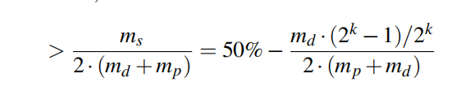
Chu-ko-nu mining can make an attack on a single zone as hard as the attack on the entire network
用哈希率来描述挖矿的能力，简单理解为单位时间内挖块的数量。
其中2的k次方表示zone的数量；md表示不用连弩挖矿的哈希率；mp表示用连弩挖矿
的哈希率；ms表示分配每个zone的哈希率。
如果获得在某个attack获得ms/2的哈希率则可以控制该zone
所以每个zone 的attack bar (防御壁垒)可以计算为：
For example, if the mining facility contributes 99% hash rate in a 256-zone network,
a successful attack requires 49.5% of total physical hash rate in the network.

Slide 35
Monoxide
Scale out Blockchains with Asynchronous Consensus Zones

