Slide 1
OUROBOROS CRYPSINOUS: Privacy-Preserving Proof-of-Stake
Instructor: Xiaotong Liu
Date:2019.10.17

Slide 2
Introduction
A significant limitation of traditional blockchain protocols, such as the Bitcoin, is the fact that the transaction ledger is a public resource and thus information about the transaction issuers may be leaked to an adversary.
Thus,this state of affairs motivated the development of privacy enhancing and privacy-preserving techniques for distributed ledgers.
Concurrently with these developments however, another line of research works in blockchain design focused on resolving fundamental issues with the energy consumption requirements of the underlying proof-of-work (PoW) mechanism of Bitcoin. This lead to a sequence of works in proof-of-stake (PoS) blockchain protocols that include Ouroboros, Ouroboros Praos,Ouroboros Genesis and so on .
Notes:
underlying proof-of-work (PoW)解决比特币基本工作证明(PoW)机制的能耗需求的基本问题

Slide 3
Proof of Work
工作量证明算法(PoW，Proof of Work)：在PoW算法中，挖新的货币需要大量的计算能力。PoW算法让所有节点解决密码难题，这个难题被矿工所解决，率先完成的能够获得奖励。这导致人们构建越来越大型的挖矿设备，对于那些有更好更多设备的人群，工作量证明将给予更多的奖励。你的计算能力越高，就越有可能去创建下一个区块，从而获得矿工奖励。为了进一步提高机会，矿工们一起组成了矿池(mining pools)，他们结合各自的算力，把奖励平均分配给矿池中的每个人。总而言之，工作量证明让矿工们需使用大量的能量，从而促进了矿池的产生，这让区块链变得更加中心化，而不是去中心。

Slide 4
Proof of Stake
权益证明算法(PoS，Proof-of-Stake)：在PoW算法中，让每个人互相竞争挖矿是很浪费的。因此权益证明PoS与之相反，采用选举的形式，其中任意节点被随机选择来验证下一个区块。在这里有一些小的术语区别，权益证明中没有矿工，但是有验证者(validator)。并不让人们“挖(mine)”新区而是“铸造(mint)”或“制造(forge)”新区块。验证者并不是被完全随机选择的，要成为验证者，节点需要在网络中存入一定数量的货币作为权益，可以将这理解为保证金。权益的份额大小决定了被选为验证者的几率，从而得以创建下一个区块，这是线性相关的。假设Bob在网络中存入100美元 Alice存入1000美元，那么Alice比Bob有高于10倍的几率选为验证者。

Slide 5
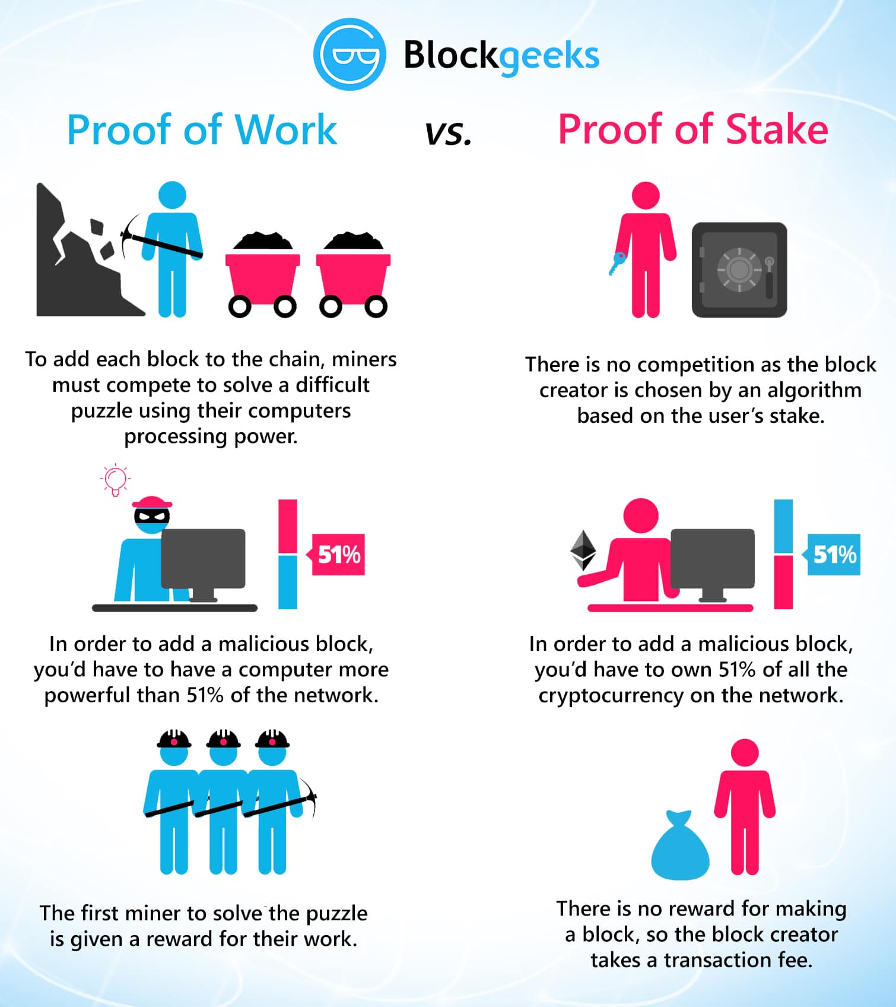
Proof of Work VS Proof of Stake

Slide 6
The Problem of PoS
Idea: participants elected proportionally to stake
Constructions rely on knowing the “stake” each party has.
⇒ hard to implement securely
It is worth noting that PoS and transaction privacy is, seemingly, a contradiction in terms:
⇒ Issuing a block by proof-of-stake fundamentally leaks information about the issuer and the state of the ledger.
Notes:
Pos:参与者按照股份比例进行选举。实现依赖于了解各方持有的股份信息。
因此实现隐私安全很困难。
值得注意的是，PoS和交易隐私在术语上似乎是矛盾的:通过股权证明来发行一个区块，从根本上泄露了发行者和分类帐状态的信息

Slide 7
The Main Motivation Of This Work
The above state of affairs raises an important open question:
⇒ Is it possible to build a PoS-based privacy enhanced distributed ledger?
We circumvent the contradiction by designing a new privacy-enhancing PoS operation that enables on the way a proof of stake-eligibility that does not leak any additional information.
Notes:
上述情况提出了一个重要的开放问题:是否有可能建立一个基于PoS协议的隐私增强分布式账本?
我们通过设计一个新的隐私增强PoS操作来规避矛盾, 在不泄露任何附加信息的情况下，启用对股权资格的证明。

Slide 8
Our Result
We propose a new formal model for a PoS-based privacy-preserving distributed ledger in the universal composition (UC) setting, and a new protocol that realizes it—Ouroboros Crypsinous.
Our protocol achieves simulation-based privacy that is forward-secure.It ensures that privacy (as well as consistency and liveness) are preserved independently of any other protocols running concurrently with our ledger implementation, and even under adaptive corruption
Notes:
本文提出了一种新的在通用组合(UC)环境中基于PoS协议的隐私保护分布式账本模型，以及一种实现该模型的协议(Ouroboros Crypsinous)
我们的协议第一次实现了基于模拟的前向安全的隐私保护。它确保了隐私(以及一致性和活动性)与分类帐同时运行的任何其他协议是独立的，甚至在自适应损坏的情况下也不受影响。

Slide 9
Background – Development of Ouroboros
Ouroboros(第一代):伪随机函数是公开的，也就是在epoch开始的时候，实际上恶意节点已经可以知道整个epoch中所有slot leader是谁了。恶意节点可以利用这一点进行攻击。
Ouroboros Praos(第二代):主要改进:采用可验证随机函数(VRF)代替公开伪随机函数进行slot leader选择。VRF是一种伪随机函数，可以使用私钥参与随机数的计算，同时别人可以使用公钥对计算结果进行验证。这样每个节点可以使用不同的伪随机函数判定自己是否是slot leader。
最后每个区块出块者会额外生成一个随机数放在区块中，用于产生下一个epoch的seed
⇒具体方法:判定产生的随机数是否低于一个阀值，该阀值的值与节点stake比例相关。 如果节点是leader则直接出块，并在块中包含验证需要的proof信息；其他节点直到收到区块后才知道谁是slot leader。
Notes:
可验证随机函数(VRF)一种伪随机函数，可以使用私钥参与随机数的计算，同时别人可以使用公钥对计算结果进行验证。
使用这个工具，每个节点可以使用不同的伪随机函数判定自己是否是slot leader，具体方法是判定产生的随机数是否低于一个阀值，该阀值的值和节点stake比例相关。 如果是leader则直接出块，并在块中包含验证需要的proof信息。其他节点直到收到区块，才知道谁是slot leader。

Slide 10
Background – Ouroboros Development
Ouroboros Genesis (第三代):
主要改进:为了防止“grinding attacks”，Genesis将时间进一步划分为若干个epochs。grinding attacks指的是parties企图用不同的账户任意选举领导人，并将资金转移给自己。
⇒具体方法：在每个epoch，领导者的股权分配是固定的，并且用来确定它的伪随机值只在epoch开始时才能被预测。
Ouroboros Crypsinous (第四代):
主要改进:第一个基于PoS的隐私增强区块链协议，实现了前向安全隐私保护，在不泄露任何附加信息的情况下，启用对股权资格的证明。它确保了隐私(以及一致性和活动性)是独立于ledger其他并行运行的任何协议，甚至在自适应损坏的情况下也不受影响。

Slide 11
Background – Ouroboros Genesis
Time is divided into discrete units: large epochs, and small slots.
At protocol start, parties are assigned initial stake in the system. Typically, only the relative amount of such stake is considered, how much each party holds out of the total stake.
Each slot, users have a probability proportional to their relative stake to be “elected” as a leader of the slot.
This relies on a pseudo-random value being below a user-specific target(VRF). Such leaders may then create a new block, and sign it with a proof of leadership eligibility.
Notes:
1将时间划分为离散的时间点。
2在协议启动时，为各方分配系统的初始股份，通常，只考虑此类股份的相对数量，即双方各持有多少股份。 3每一个时间点slot，用户都有一个与他们的相对股份成比例的概率被“选举”为该时刻的领导者（验证者）。
4这依赖于一个低于用户指定目标的伪随机值。然后，这些领导人可能会创建一个新的区块，并在其上签字，证明其具备领导资格。

Slide 12
Background – Ouroboros Genesis
In each epoch, the distribution of stake considered for leadership is fixed, and the pseudo-random values used to determine it can only be predicted once the epoch starts.
When an epoch starts, its entropy η is determined.
In every slot sl, stakeholders evaluate a VRF at (η, sl).
If the result falls under a target, determined by their stake, they create a block.
Notes:
在每个epoch，领导者的股权分配是固定的，并且用来确定它的伪随机值只在epoch开始时才能被预测。
Epoch开始时，确定随机熵值η。
在每个slot，股份持有者使用伪随机函数VRF判定自己是否是slot leader。
如果结果落在由他们的股份决定的目标之下（选为leader），他们就创建一个块（出块）

Slide 13
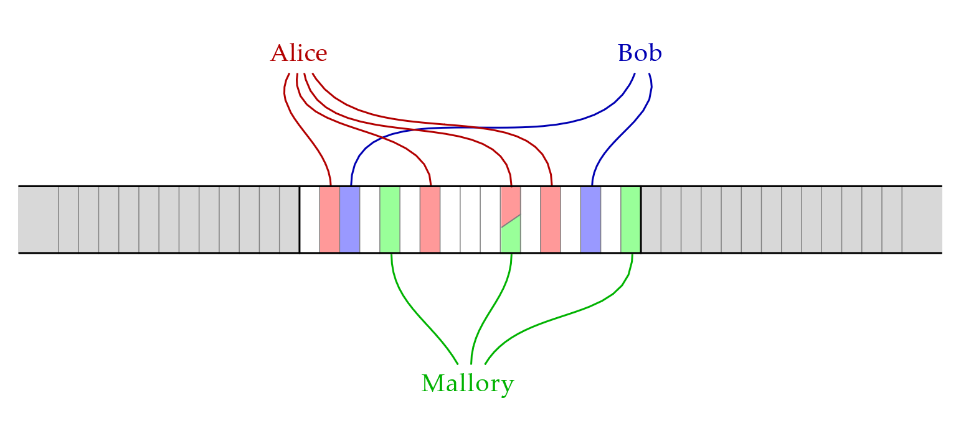
Background – Ouroboros Genesis
Notes:
未解决的问题：两个leader同时落到同一个target（slot时）

Slide 14
The Private Ledger
Privacy of Crypsinous is captured by the following modifications:
⇒ First, transactions returned from the functionality are blinded by a function BlindTx which is a parameter of a functionality. This function hides any information a party should not see from the ledger state, while state validation operates over the entire, non-blinded state.
⇒ Further, we parameterize the private ledger with a general purpose leakage algorithm, Lkg, which may additionally leak any function of the ledger state to the adversary.
Notes:
Crypsinous的隐私可以通过以下修改来获取:
首先，交易信息被函数BlindTx隐藏。此函数隐藏了一方不应该从分类帐状态中看到的任何信息，而状态验证在整个非盲状态下进行。
此外，使用泄漏算法Lkg对私有分类帐进行参数化，该算法还可以向对手泄漏分类帐状态的任何函数

Slide 15
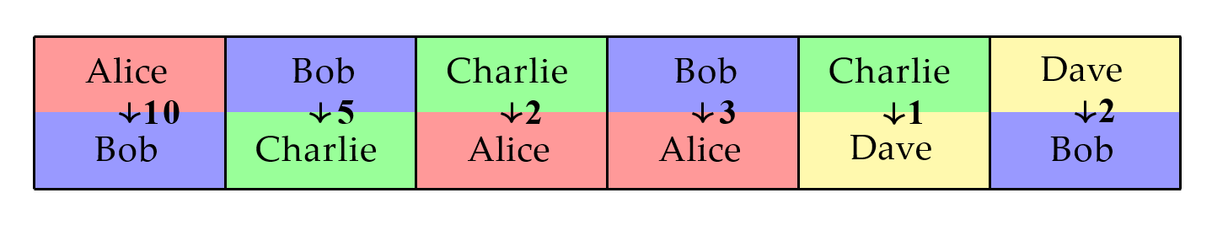
The Public Ledger

Slide 16
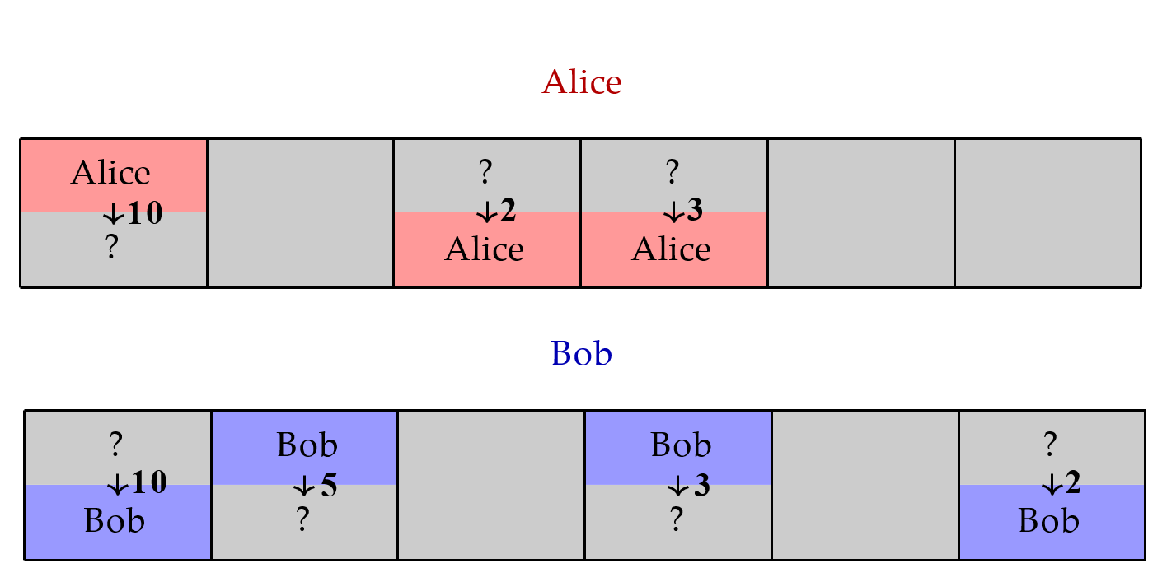
The Private Ledger

Slide 17
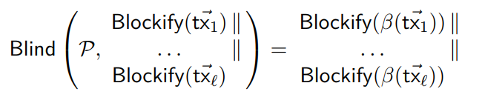
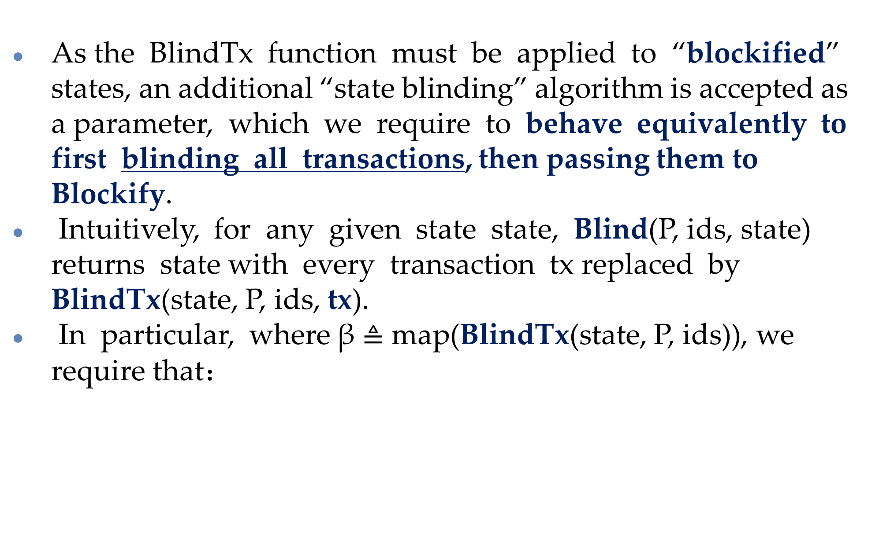
The Private Ledger – BlindTx function
As the BlindTx function must be applied to “blockified” states, an additional “state blinding” algorithm is accepted as a parameter, which we require to behave equivalently to first blinding all transactions, then passing them to Blockify.
Intuitively, for any given state state, Blind(P, ids, state) returns state with every transaction tx replaced by BlindTx(state, P, ids, tx).
In particular, where β $≜$ map(BlindTx(state, P, ids)), we require that：
Notes:
P为a set of parties；blockified（块化） ——将每个party的交易tx块（Blockify）进行隐藏，得到新的交易块（Blockify）！！！
由于BlindTx函数必须应用于“块化”状态，另一种“状态盲”算法作为一个参数被接受，我们要求它的行为等价于首先屏蔽所有的传输，然后将它们传递给Blockify。直观地说，对于任何给定的状态状态，Blind(P, ids, state)将每个事务tx替换为BlindTx(state, P, ids, tx)后返回状态。特别是,β¾地图(BlindTx(状态、P id)),我们要求

Slide 18
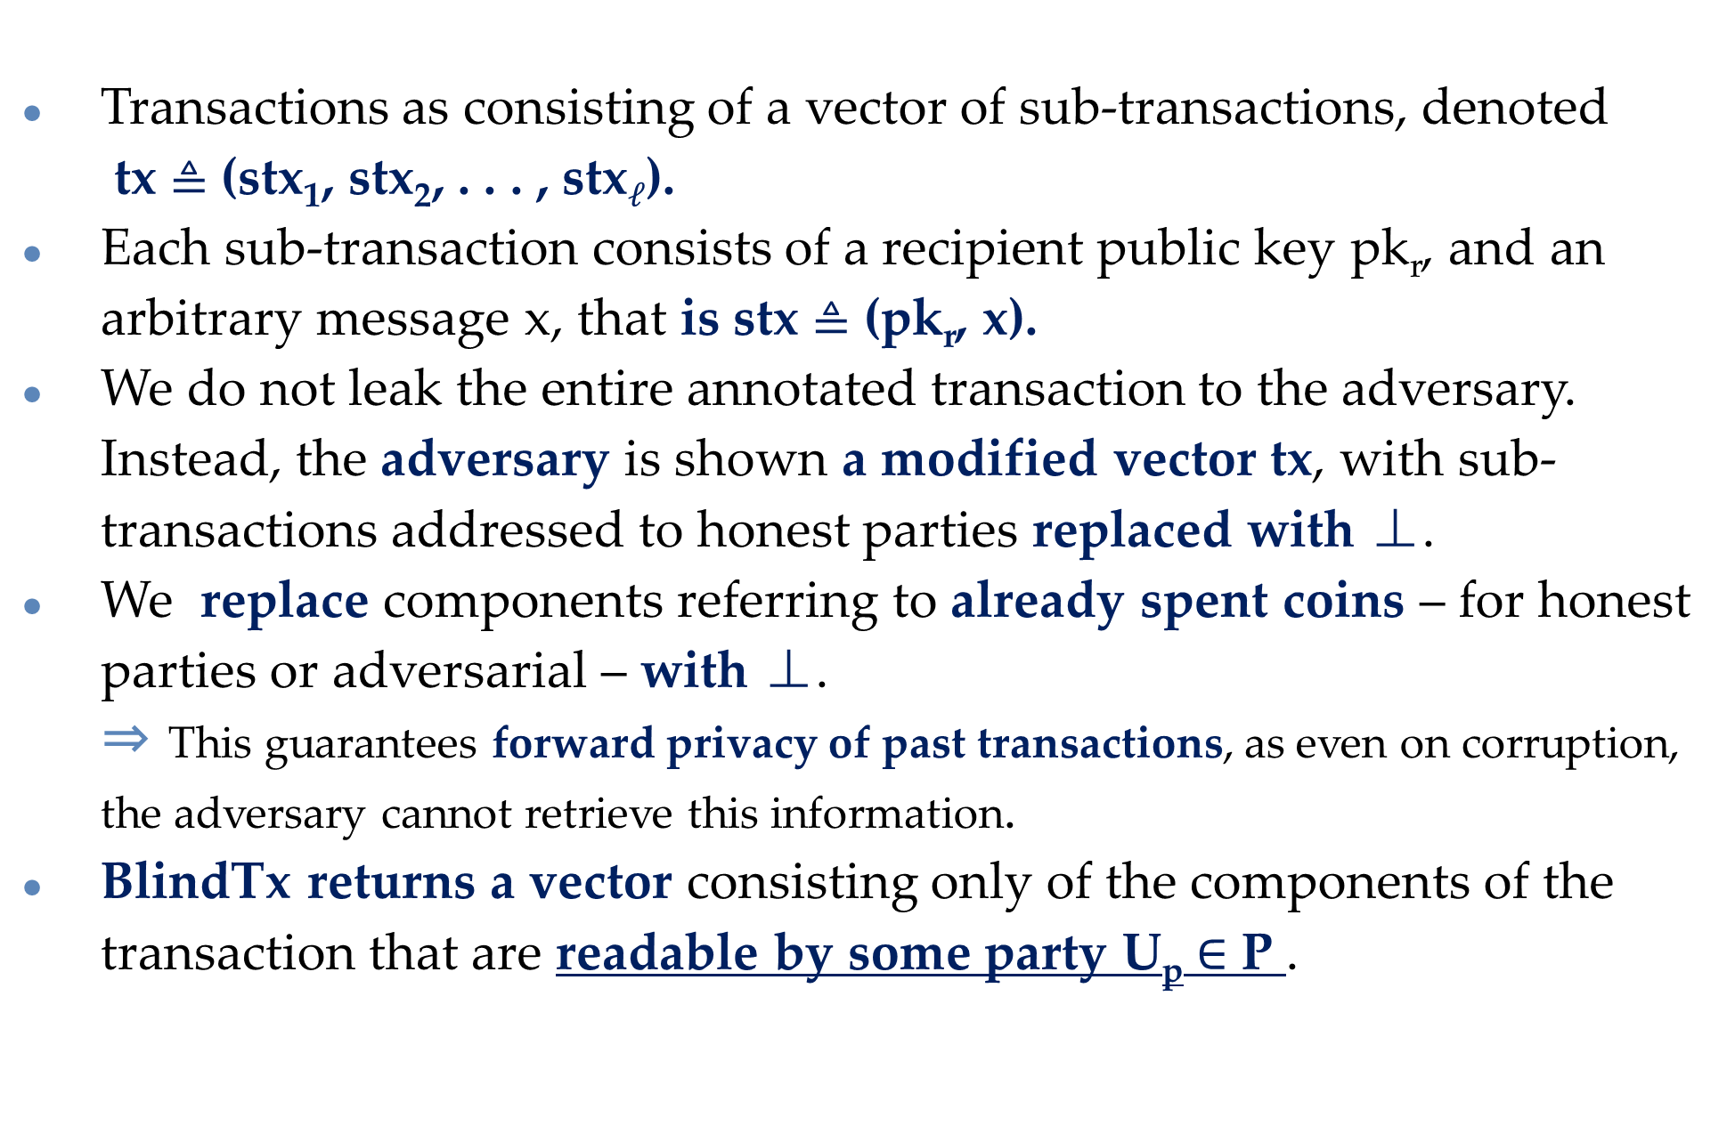
The Private Ledger – Blinding for Forward-Secure Transactions
Transactions as consisting of a vector of sub-transactions, denoted
tx $≜$ (stx₁, stx₂, . . . , stx$ℓ$).
Each sub-transaction consists of a recipient public key pk_{r}, and an arbitrary message x, that is stx $≜$ (pk_{r}, x).
We do not leak the entire annotated transaction to the adversary. Instead, the adversary is shown a modified vector tx, with sub-transactions addressed to honest parties replaced with ⊥.
We replace components referring to already spent coins – for honest parties or adversarial – with ⊥.
⇒ This guarantees forward privacy of past transactions, as even on corruption, the adversary cannot retrieve this information.
BlindTx returns a vector consisting only of the components of the transaction that are readable by some party U_{p} $∈$ P .
Notes:
P:a set of parties ids :the set of generated ids annotated：注释的 modified：修改过的
对手收到一个被替换为⊥的修改过的向量tx，它本来是发送给诚实方的子交易。
我们用⊥来替换已经花掉的coins组件（对于诚实parties或敌对的人）。
这保证了过去交易的前向隐私安全，因为即使在破坏的情况下，对手也无法检索到这些信息。
blindtx返回一个向量，该向量仅由某一方可读的事务组件组成。

Slide 19
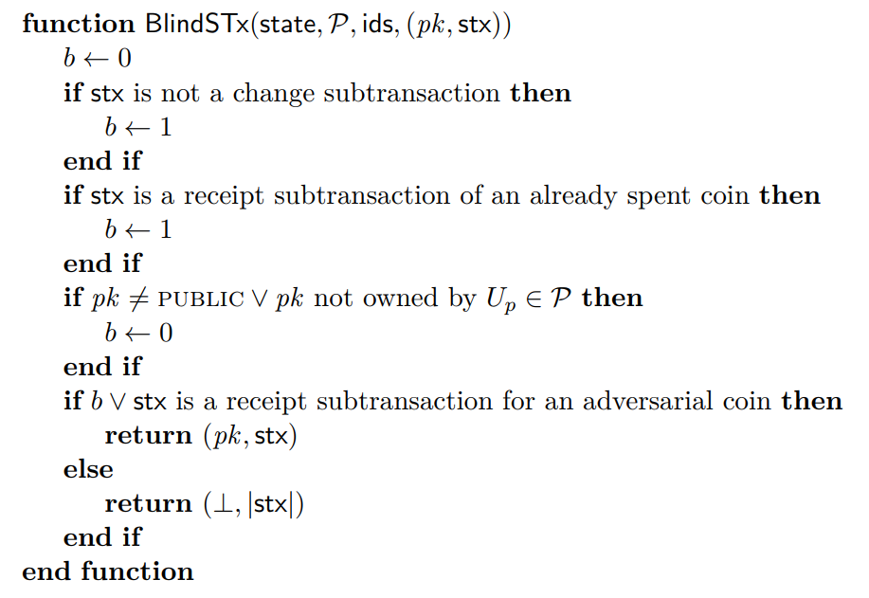
The Private Ledger – Blinding for Forward-Secure Transactions
state :the full ledger state； BTX :an annotated transaction BTX = (tx, txid, τ_{L}, U_{s}) ；
$Ρ :$a set of parties ； ids ：the set of generated ids

Slide 20
The Private Ledger – leakage function
In our system, we permit the leakage Lkglead, which effectively simulates the protocols leadership election, and leaks the winning party.
⇒ for each time τ , the adversary receives a set of parties that won the leadership election. This set is selected by sampling a random coin for each party, weighted by their stake.
⇒ Leakage follows a general principle of leaking the elected leaders in a protocol.
⇒ Honest parties will be selected by Lkg_{lead} with the probability of them winning a leadership election in Ouroboros Crypsinous. This probability is the same as in Ouroboros Genesis, and is the function φ_{f} of their stake.
Notes:
对手收到一组获得选举胜利的parties，它是随机抽样coin，股份加权来随机选择的。
原则:泄露被选择的leaders
诚实parties将由Lkg_{lead}选出，他们有可能赢得领导选举。

Slide 21
The Private Ledger – leakage function
In our system, we permit the leakage Lkglead, which effectively simulates the protocols leadership election, and leaks the winning party.
⇒ In addition to this, we note Zerocash-style protocols will allow an adaptively corrupting adversary to compute the serial number of coins it sent to an honest party after corrupting them. As the serial number is by necessity committing, the simulator must know when such adversarially sent coins are spent, to ensure the consistency of the simulation. For this reason, we also leak the points adversarially sent coins are spent.
Notes:
Zerocash-style允许自适应破坏对手，并计算它在破坏后发送给诚实方的硬币序列号。
由于序列号是必须提交的，因此模拟器必须知道对手发送的硬币什么时候花掉的，以确保模拟的一致性。
出于这个原因，我们还泄露了对手硬币何时被消费。

Slide 22
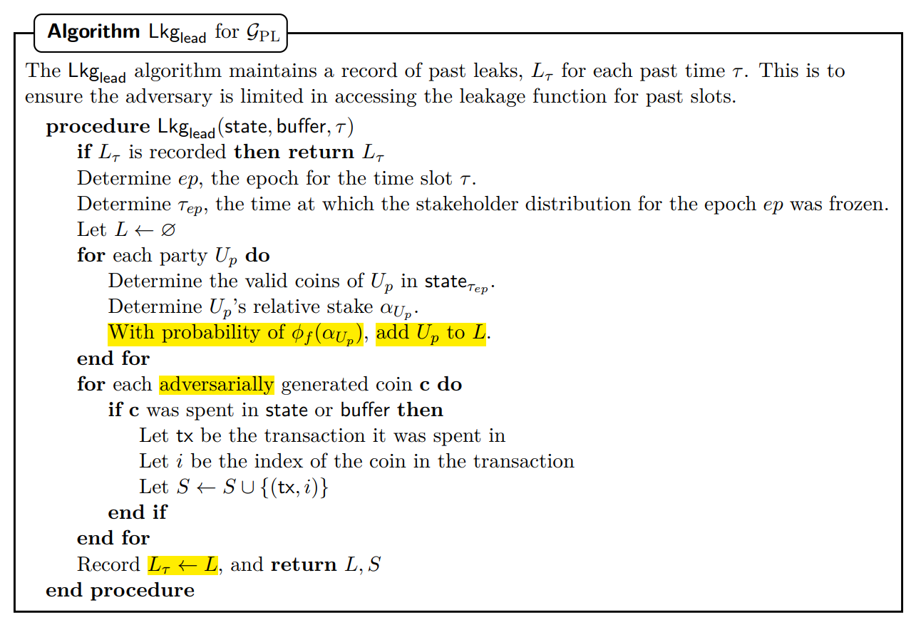
The Private Ledger – leakage function
Notes:
Leakage保持过去泄漏的记录，每个过去时间泄露为Lr。这是为了确保对手在访问泄露函数过去slot是有限的。
Leakage两个作用：有效模拟验证者选举并泄露获胜方；泄露对手的coin何时被消费

Slide 23
Conclusion
We construct a privacy-preserving proof-of-stake protocol.
We model the private ledger, and use it to construct a private currency.
Notes:
我们构造了一个隐私保护的PoS协议。
我们对私人账本进行建模，并用它来构造一种私人货币。

Slide 24
谢谢观看

