Slide 1
OmniLedger: A Secure, Scale-Out, Decentralized Ledger via Sharding
IEEE Security & Privacy 2018-05-22, San Fransisco
汇报人：刘小童
日期：2019.11.6

Slide 2
Talk Outline
•
Motivation
•
OmniLedger
•
Evaluation
•
Conclusion

Slide 3
分片技术(sharding)：
以太坊网络低吞吐量原因:
网络中的每个节点都需要处理所有交易
解决方案: Sharding(分片)：让网络中的所有节点只处理所有工作中的一部分。
即将网络中的工作分摊给所有参与的节点。
在分片中，不会只运行一条区块链，而是运行很多条链，并将每一条链称为“分片”。每个分片将拥有自身的验证者(Validator),分片设计依赖于某种随机性(randomness)来为所有分片分配验证者。
Sharding (分片)是一种通过增加参与网络运行的节点数来实现网络扩张的技术。
Scale-Out

Slide 4
No Scale-Out (Bitcoin)
Blockchain

Slide 5
Scale-Out (OmniLedger)
How do validators choose which blockchain to work on?
How can I pay a yellow vendor with greencoins?
Shard
Shard
Double Throughput
Notes:
（横向扩展 - OmniLedger期望的吞吐量随着参与验证者的数量而线性增加。）

Slide 6
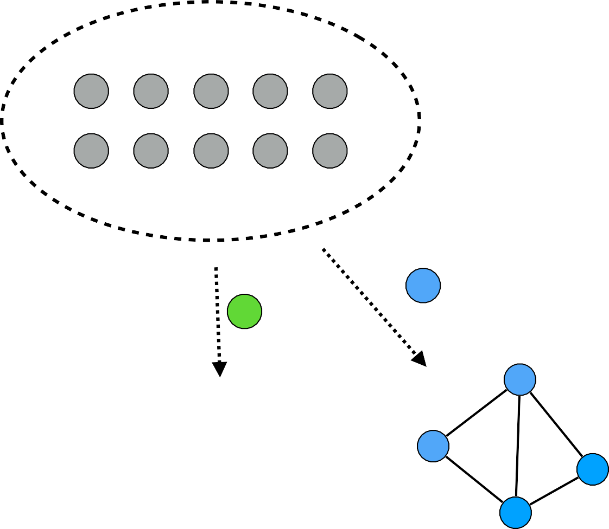
Strawman: SimpleLedger
Trusted randomness beacon
Overview
rnde
•
Evolves in epochs e
•
Trusted randomness beacon emits random value rnde
Validators
•
Validators:
‣
Use rnde to compute shard assignment (ensures shard security)
‣
Process tx using consensus within one shard
Shard ledgers
Shard 1
Shard 2
Shard 3

Slide 7
Strawman: SimpleLedger
Security Drawbacks
•
Randomness beacon: trusted third party
•
No cross-shard tx support
Performance Drawbacks
•
High storage and bootstrapping cost
•
Throughput vs. latency trade-off
Notes:
完全去中心化 – 随机信标是一个可信任的第三方机构)
安全的交易 - 分片内或跨分片的交易都能原子性的提交确认或最终取消。
横向扩展 - OmniLedger期望的吞吐量随着参与验证者的数量而线性增加。
更低的存储开销 - 验证者不需要存储完整的交易历史，而仅仅需要存储汇总分片状态的定期计算的参考点。状态区块(state blocks)，在OmniLedger上部署以减小存储空间和更新开销。
低延迟 :二层模型(或者叫乐观验证)来降低小额交易延迟。

Slide 8
Roadmap
SimpleLedger
Sharding via distributed randomness
Security
Atomix: Atomic cross-shard txs
State Blocks :minimize storage and update overhead
Performance
Trust-but-verify validation: Throughput / Latency trade-oﬀ
(to minimize the latency of low-value transactions.)
OmniLedger
Notes:
完全去中心化 – 删除信任的随机数指标---第三方机构
更低的存储开销 - 验证者不需要存储完整的交易历史，而仅仅需要存储汇总分片状态的定期计算的参考点。状态区块(state blocks)，在OmniLedger上部署以减小存储空间和更新开销。
低延迟 -信任但验证二层模型(或者叫乐观验证)来降低小额交易延迟。

Slide 9
RandHound
1. As the randomness beacon is a trusted third party, we remove it.
OmniLedger uses RandHound , a distributed randomness generation protocol that provides unbiasable, decentralized randomness.
2. RandHound securely assign validators to shard.
Notes:
1.我们删除了可信任的随机数信标。
RandHound协议，一种分布式随机数生成协议-------提供无偏见的去中心化的随机性。
2. RandHound安全地为分片分配验证者。

Slide 10
RandHound:chicken-and-egg problem
1. As RandHound relies on a leader to orchestrate the protocol run, we need to select one of the validators for this role.
2. The selection mechanism must be unpredictable and unbiasable, which has a chicken-and-egg problem.
Because we need RandHound to generate random Numbers, but RandHound itself needs randomly elected leaders, so how can this random leader be generated in the first run?
Combine RandHound with a VRF-based leader election algorithm.
Notes:
因为RandHound依靠领导者来协调协议运行，需要从验证者中选举一个出来。
但当我们在第一次使用RandHound时，就碰到了先有鸡还是现有蛋的问题。
（因为我们需要RandHound来产生随机数，但是RandHound自己又需要随机选举的领导者，那么第一次运行时，这个随机领导者怎么产生？

Slide 11
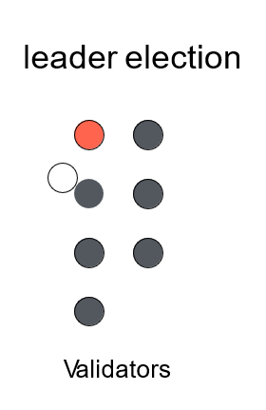
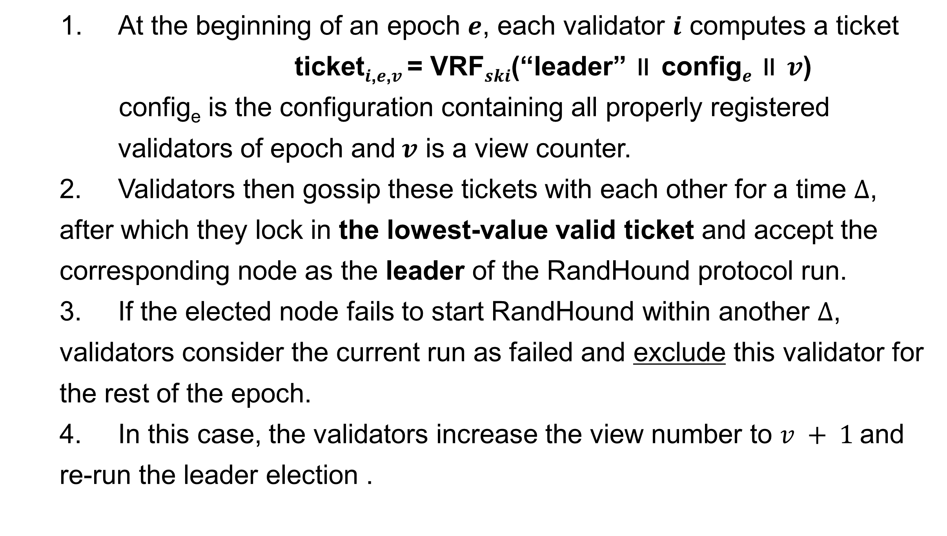
VRF-based leader election algorithm
1. At the beginning of an epoch $e$, each validator $i$ computes a ticket
ticket$i$,$e$,$v$ = VRF$ski$(“leader” ∥ config$e$ ∥ $v$)
config_{e} is the configuration containing all properly registered validators of epoch and$v$ is a view counter.
2. Validators then gossip these tickets with each other for a time $∆$, after which they lock in the lowest-value valid ticket and accept the corresponding node as the leader of the RandHound protocol run.
3. If the elected node fails to start RandHound within another $∆$, validators consider the current run as failed and exclude this validator for the rest of the epoch.
4. In this case, the validators increase the view number to $v + 1$and re-run the leader election .
Notes:
1 e时代开始，每个验证者i计算一张门票:----VRF使用私钥产生的随机数。-------伪随机数 config[e]包含所有合理注册的验证者的配置信息（保存在身份区块链中）v是一个视图计数
2 验证者们开始相互传播他们的门票，持续一个时间∆，之后他们锁定一个他们迄今看到的最小的合法门票，并接收该门票对应的节点为运行RandHound协议的领导者.
3 如果被选举的节点在另一个时间∆内启动RandHound失败，那么验证者们认为本次运行失败，并在本时代之后的时间将该验证者排除在外，即使他后来上线了。
4 这种情况下，验证者们增加视图计数值为v+1，重新运行选举

Slide 12
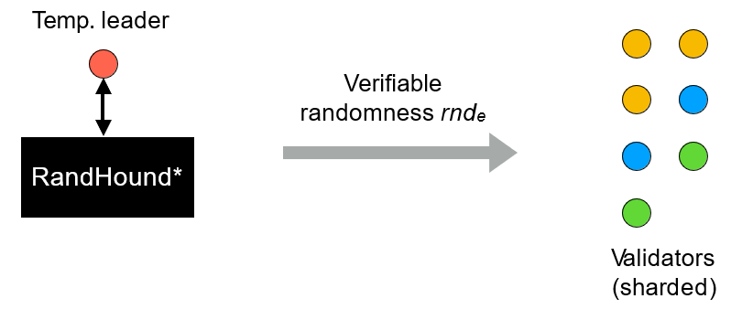
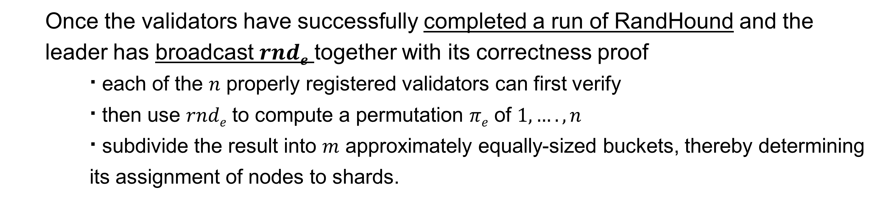
Sharding via distributed randomness
Once the validators have successfully completed a run of RandHound and the leader has broadcast $rnde$ together with its correctness proof
∙ each of the $n$ properly registered validators can first verify
∙ then use $rnde$ to compute a permutation $πe$ of $1, …. ,n$
∙ subdivide the result into $m$ approximately equally-sized buckets, thereby determining its assignment of nodes to shards.
Notes:
当验证者们成功完成了RandHound的运行，并且领导者已经成功广播了rand[e]（携带正确性证明），
n中的每个合理注册的验证者就可以先验证正确性，
然后用rand[e]来计算1,...,n的π[e]排列，
再将结果分配到大小都为m的水桶里(bukets)，决定将哪些节点分配到哪个分片。

Slide 13
Shard Validator Assignment
1. Temp. leader election
2. Randomness generation (Output is unbiasable)
3. Shard assignment (using rnde)
Temp. leader
Verifiable randomness rnde
RandHound*
Validators
Validators (sharded)
* Syta, Ewa, et al. "Scalable bias-resistant distributed randomness." Oakland ‘17
17

Slide 14
Atomix
The strawman approach to a cross-shard transaction:
(1)Concurrently send a transaction to several shards for processing ;
(2)Some shards might commit the transaction , while others might abort ;
(3)The UTXOs at the shard who accepted the transactions are lost as there is no straightforward way to roll back a half-committed transaction
Solution:
Atomix improves with a two-phase client-driven “lock/unlock” protocol that ensures that clients can either fully commit a transaction across shards, or obtain “rejection proofs” to abort and unlock state affected by partially completed transactions.
Notes:
针对跨分片交易de稻草人方式，是将一个交易同步地发送给多个分片处理，因为有些分片会提交交易，其它的会取消。这种情况下，这些UTXO在接受交易的分片中被丢失，因为没有一种直接的方式可以回退半提交的交易
Atomix通过一种2阶段客户端驱动的“锁/解锁”协议改进稻草人方式，用来保证客户端可以要么在跨分片完全提交一个交易，要么获取”拒绝证据“来取消或解锁被部分完成交易影响的状态。

Slide 15

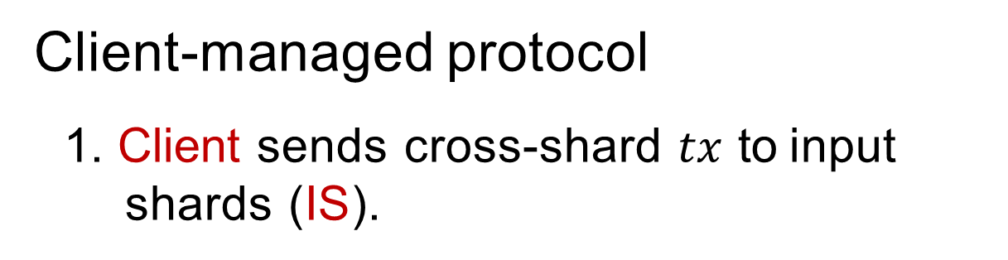
Atomix: Cross-Shard Transactions
Challenge:
(1) Initialize
(2) Lock
client
(3a) Unlock to Commit
client
•
Cross-shard $tx$ commit atomically or abort eventually
accept1
cross-shard transaction tx
commit tx
inputs outputs
accept2
shard1 shard3 shard2
Solution: Atomix
shard1
shard2
shard3
shard1 shard2
shard3
•
Client-managed protocol
1. Client sends cross-shard $tx$ to input shards (IS).
client
tx
(2) Lock
client
(3b) Unlock to Abort
client
reclaim tx inputs
tx
accept1
reject2
2. Each IS leader validates the transaction within Shard.
3. Collect proofs from input shards.
If all input shards issued proofs-of-acceptance , then client gossips commit tx to output shard;
Otherwise,abort and reclaim tx input funds.
shard1
shard2
shard3
shard1 shard2
shard3
shard1 shard2
shard3
The Atomix protocol for secure cross-shard transactions
Commit tx:The client creates and gossips an unlock-to-commit transaction that consists of the lock transaction and a proof-of-acceptance .
Reclaim tx: The client must request the involved ISs to unlock that particular transaction by gossiping an unlock-to-abort transaction that includes (at least) one proof-of-rejection for one of the input shards.
Notes:
每个IS的领导者检查tx
如果交易合法，领导者在状态上标记这个输入被花费，，然后广播一个接受证明；如果交易被拒绝，领导者创建一个拒绝证明，
如果所有的(IS)领导者都返回了接受证明，那么对应的交易就可以被提交。然而如果只要有一个(IS)返回了拒绝证明，那么该交易就无法提交，必须被取消并且回收资金。
输入分片(IS)领导者接收到解锁取消请求后，会标记原先的UTXO重新可花费

Slide 16
Atomix: Cross-Shard Transactions
Under our assumptions, shards are honest, do not fail, eventually receive all messages.
(1) If all input shards issue a proof-of- acceptance, then every output shard unlocks to commit;
(2) If even one input shard issues a proof-of-rejection, then all input shards unlocks to abort;
(3) If even one input shard issues a
proof-of-rejection, then no output shard unlocks to commit.
(1) Initialize
(2) Lock
client
(3a) Unlock to Commit
client
accept1
cross-shard transaction tx
commit tx
inputs outputs
accept2
shard1 shard3 shard2
shard1
shard2
shard3
shard1 shard2
shard3
client
tx
(2) Lock
client
(3b) Unlock to Abort
client
reclaim tx inputs
tx
accept1
reject2
shard1
shard2
shard3
shard1 shard2
shard1 shard2
shard3
shard3
The Atomix protocol for secure cross-shard transactions
Notes:
所有分片都忠诚地处理合法交易；
如果所有输入分片返回接收证明，那么每个输出分片都进行解锁提交；
即使只有一个输入分片返回拒绝证明，那么所有输入分片都解锁取消；
即使只有一个输入分片返回拒绝证明，那么没有输出分片需要解锁提交。

Slide 17
Atomix: Cross-Shard Transactions
(1)In Atomix, if a transaction cannot be committed, then the locked funds can be reclaimed.
(2)If a transaction cannot be committed, then there must exist at least one proof-of-rejection issued by an input shard.
(3) Once all input shards unlock to abort, the funds become available again.
(1) Initialize
(2) Lock
client
(3a) Unlock to Commit
client
accept1
cross-shard transaction tx
commit tx
inputs outputs
accept2
shard1 shard3 shard2
shard1
shard2
shard3
shard1 shard2
shard3
client
tx
(2) Lock
client
(3b) Unlock to Abort
client
reclaim tx inputs
tx
accept1
reject2
shard1
shard2
shard3
shard1 shard2
shard1 shard2
shard3
shard3
The Atomix protocol for secure cross-shard transactions

Slide 18
Throughput / Latency trade-oﬀ
1. A higher number of smaller shards results in a better performance but its security is poor.
2. Choose large shards at the cost of higher latency but guarantee the finality of transactions.
This might not appropriately reflect the priorities of clients with frequent,low- value transactions and who would like to have transactions processed as quickly as possible.
Notes:
具有大量的小分片数量可以获得更好的性能，但是安全性很差。
选择大的分片会以更高的延迟为代价，但保证交易的最终性。然而这不能反映那些具有频繁使用,低价值交易的客户的优先级（比如杂货店支付或咖啡），他们喜欢交易处理地越快越好。

Slide 19
Trust-but-Verify
To minimize transaction latency such as low-value payments：
OmniLedger supports optional trust-but-verify validation :
(1)a first small tier of validators processes the transactions quickly
(2)then,hands them over to a second larger, hence slower, tier that reverifies the correctness of the first tier transactions and ensures long-term security.
This two-level approach ensures that any misbehavior within the first tier is detected within minutes, and can be strongly disincentivized through recourse such as loss of deposits.
Clients can wait for both tiers to process highvalue transactions for maximum security , or just wait for the first tier to process low-value transactions.
Notes:
为降低小额交易延迟
OmniLedger支持可选的"trust-but-verify"验证方式，
即在较小的第一层的验证者快速处理这些交易，然后把它们提交给更大但更慢的第二层，来重新验证第一层交易的正确性以及长期的安全性。
这种2层解决方案保证任何第一层的不当行为可以在数分钟内被检测，然后以损失押金的形式进行严厉地惩罚。
客户可以等待两层处理完大额交易以保证最大的安全性，或者可以只等待第一层处理完小额交易（选择实时处理和乐观的最终保证）

Slide 20
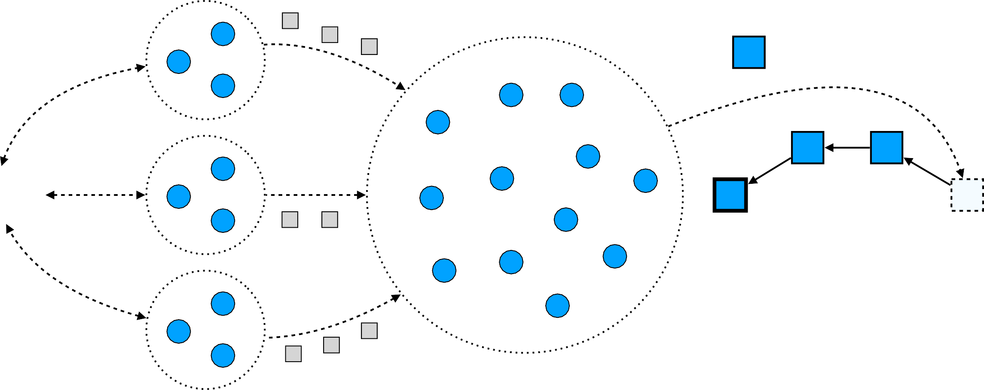
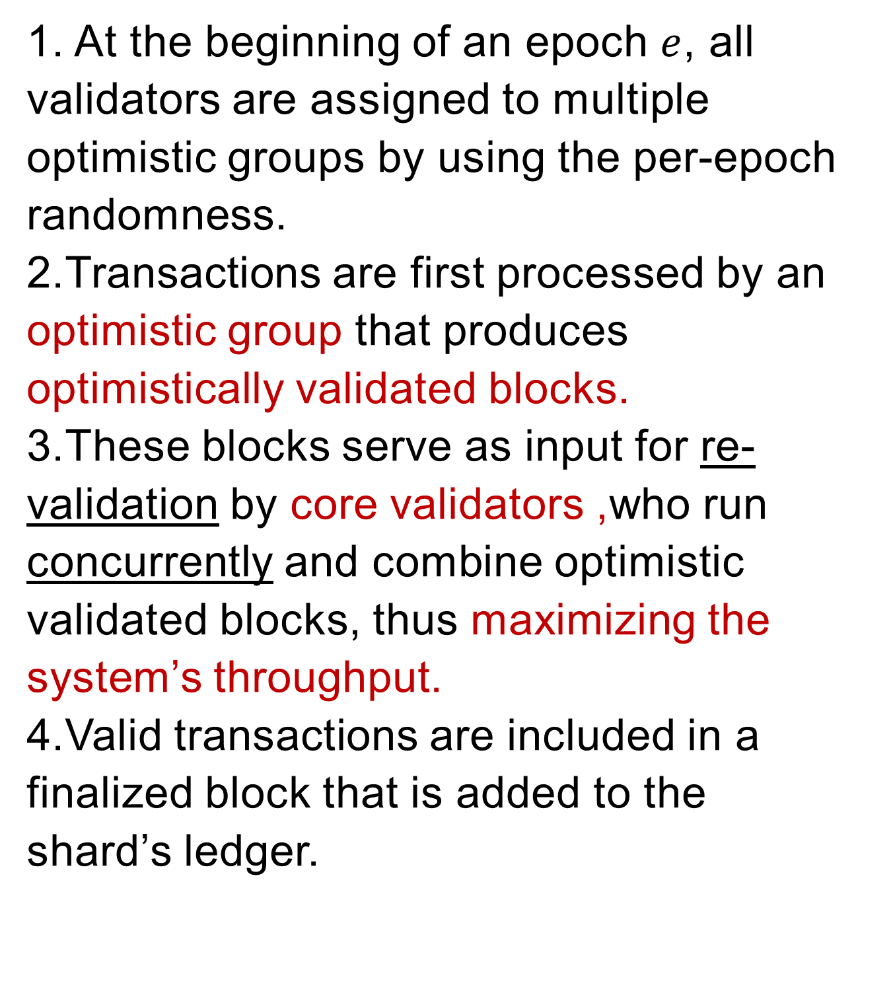
Trust-but-Verify Transaction Validation
Steps:
1. At the beginning of an epoch $e$, all validators are assigned to multiple optimistic groups by using the per-epoch randomness.
2.Transactions are first processed by an optimistic group that produces optimistically validated blocks.
3.These blocks serve as input for re-validation by core validators ,who run concurrently and combine optimistic validated blocks, thus maximizing the system’s throughput.
4.Valid transactions are included in a finalized block that is added to the shard’s ledger.
optimistically validated blocks
tx
finalized block
tx
clients
sbj,e-1
tx
shard ledger (with state block)
core validators
optimistic validators
Notes:
1 e时代开始时，所有验证者采用每个时代的随机数将自己分配到分片中(多个乐观分组或一个核心分组)，从对应分片的上个状态区块启动他们的状态。
2 交易被乐观分组首先处理并生成乐观验证区块，
3 这些区块会作为核心验证者的输入进行重新验证， 核心验证者会并行运行，并将乐观验证区块进行重新组合,以显示最大化系统吞吐量。

Slide 21
Throughput / Latency trade-oﬀ
Trust but verify model:
Optimistic validators form much smaller groups,and they produce smaller blocks with real-time latencies but are potentially less secure , as the adversary needs to control a smaller number of validators to subvert their operation.
As a result, some bad transactions might be committed, but ultimately core validators verify all provisional commitments, detecting any inconsistencies to punish rogue validators and to compensate the customers for the damages.
The trust-but-verify approach strikes a balance for processing small transactions in real-time, as validators are unlikely to misbehave for small amounts of money
Notes:
“信任但检查”模型:
乐观验证者会组成更小的分组，甚至可能一个验证者一个组。因此他们实时地生成更小的区块，但是可能很不安全，因为攻击可能会按比例控制较小数量的验证者来破坏交易。
结果，一些不合法的交易被提交，但是最终核心验证者会检查所有临时的提交，检测任何不一致，然后惩罚恶意验证者，并赔偿被欺诈的客户的损害。
这种“信任但检查”的方法在实时处理小额交易时取得平衡，因为验证者不会因为少量的钱进行作恶。

Slide 22
Trust-but-Verify Transaction Validation
Challenge:
optimistically validated blocks
•
Latency vs. throughput trade-off
tx
finalized block
Solution:
•
Two-level “trust-but-verify” validation
tx
clients
•
Low latency:
sbj,e-1
‣
Optimistically validate transactions by “insecure” shards
tx
shard ledger (with state block)
core validators
•
High throughput:
optimistic validators
‣
Batch optimistically validated blocks and audit by “secure” shards

Slide 23
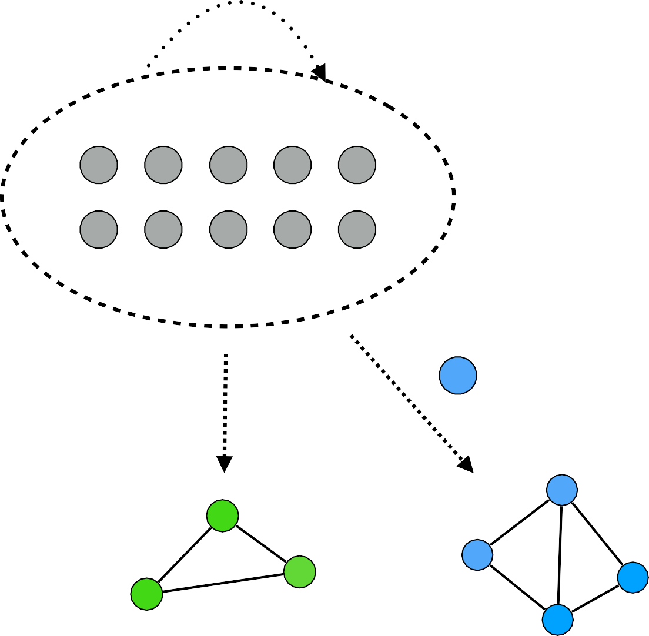
Conclusion
Epoch randomness rnde
(RandHound)
Validators
•
OmniLedger – Secure scale-out distributed ledger framework
‣
RandHound: distributed randomness generation
Atomix: Client-managed cross-shard tx Sharding: Visa-level throughput and beyond
Trust-but-verify validation: latency vs throughput tradeoff
‣
‣
Shard ledgers
‣
Shard 1
Shard 2
Shard 3
tx2,in
tx1,in
tx3,out
Client
(Atomix coordinator)

Slide 24
Evaluation: Scale-Out
#validators (#shards) | 70 (1) | 140 (2) | 280 (4) | 560 (8) | 1120 (16)
OmniLedger (tx/sec) | 439 | 869 | 1674 | 3240 | 5850
Bitcoin (tx/sec) | ~4 | ~4 | ~4 | ~4 | ~4
Scale-out throughput for 12.5%-adversary and shard size 70 and 1200 validators
Notes:
OmniLedger随着验证者数量线性横向扩展
（横向扩展 - OmniLedger期望的吞吐量随着参与验证者的数量而线性增加。）

Slide 25
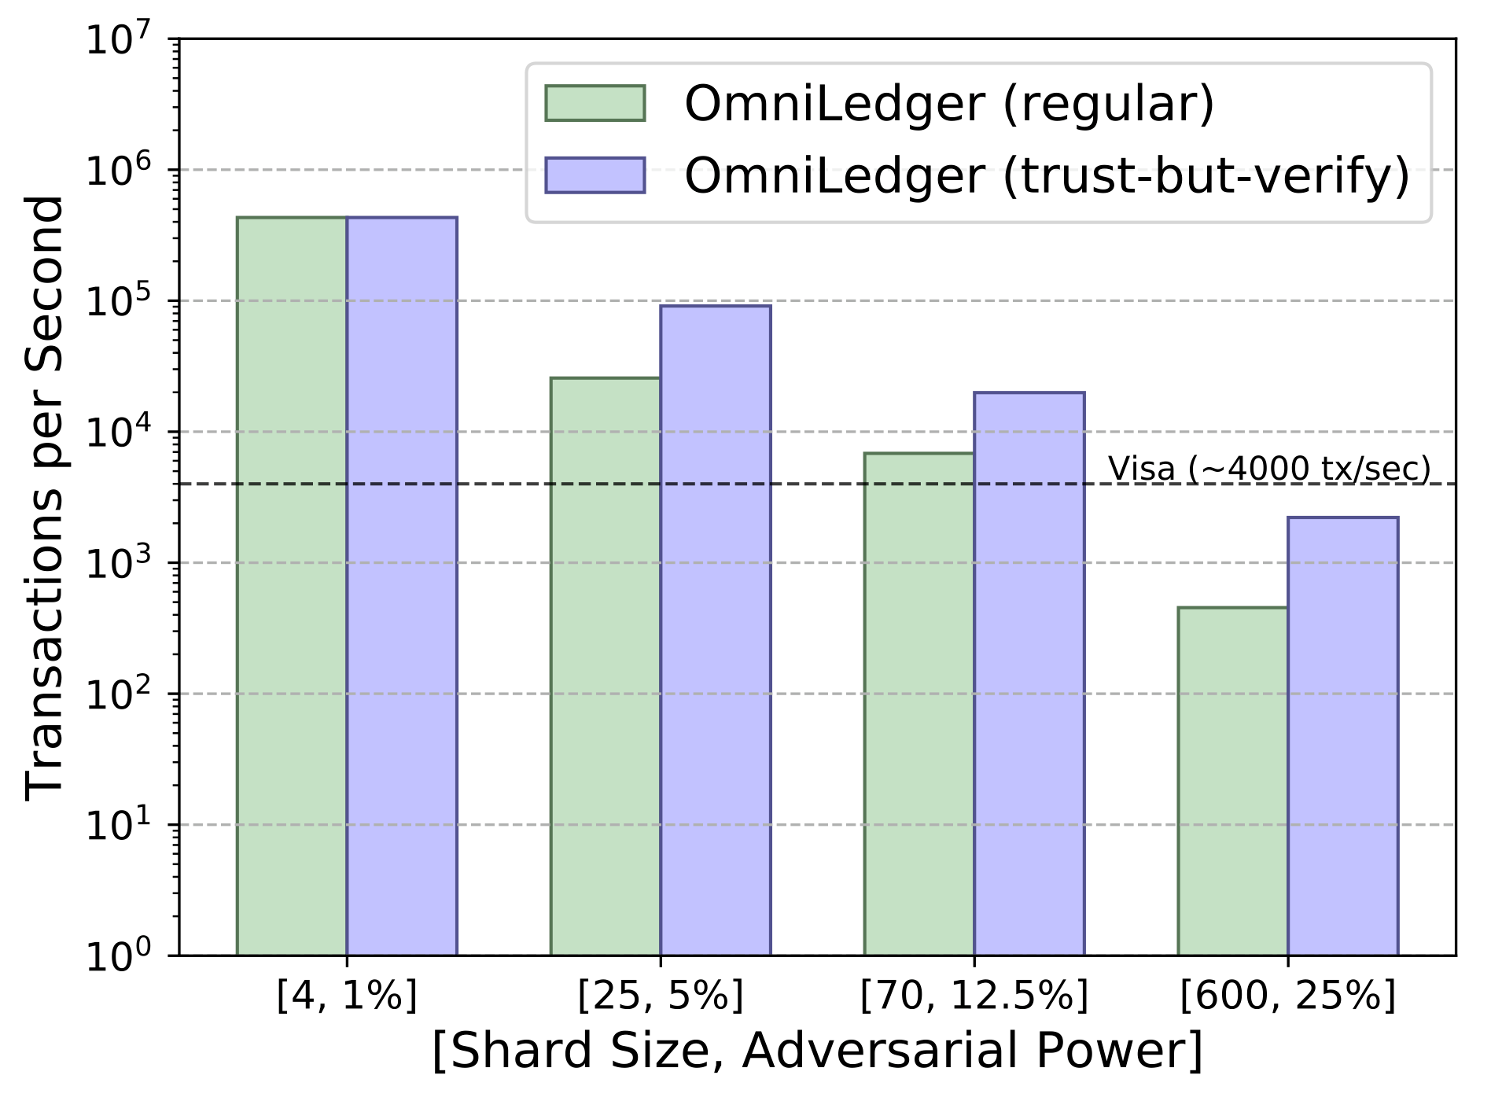
Evaluation: Throughput
Results for 1800 validators

Slide 26

Evaluation: Latency
Transaction confirmation latency in seconds for regular and mutli-level validation
#shards, adversary | 4, 1% | 25, 5% | 70, 12.5% | 600, 25%
regular validation | 1.38 | 5.99 | 8.04 | 14.52
1st lvl. validation | 1.38 | 1.38 | 1.38 | 4.48
2nd lvl. validation | 1.38 | 55.89 | 41.89 | 62.96
Bitcoin | 600 | 600 | 600 | 600
1 MB blocks
500 KB blocks
16 MB blocks
latency increase since optimistically validated blocks are batched into larger blocks for final validation to get better throughput
Notes:
二层验证模型 第一层降低小额延迟；第二层由于整合成大块 寻求系统最大吞吐量 而牺牲延迟

