Slide 1
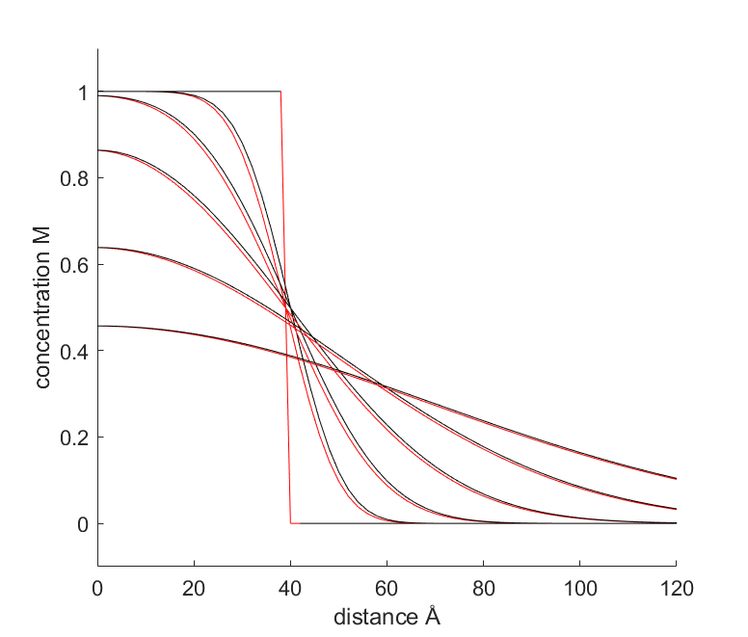
t = 0
t = 0.3 ns
——— numerical
——— analytical
t = 1 ns
t = 3 ns
D = 1.2E-5 cm2·s-1
Initial condition:
c(t = 0, 0 < x < 40 Å) = c₀ = 1 M
c(t = 0, x > 40 Å) = 0.
Boundary condition:
x > 0 (Impermeable boundary at x = 0, semi-infinite)
t = 8 ns
t = 18 ns

