Slide 1
JRS
Job Recruitment System
Applicant Side Design
and Implementation
Use case revision, wireframe improvement, and first HTML webpage
Sihuanjia C3543525
Notes:
Hello, my name is Sihuanjia, student ID C3543525. In this video, I will present my applicant-side contribution to the Job Recruitment System.
[Sources]
User-created project files in this workspace: updated use case report, Figma SVG wireframes, and HTML implementation.

Slide 2
My work focused on the applicant journey
I narrowed the design to what a job applicant really needs on one company recruitment website.
Use Case
Wireframes
HTML Page
Reflection
Updated the applicant use cases to match a single-company recruitment website.
Designed five clearer applicant pages with larger text and more focused layout.
Built the first working page for searching company job postings.
Used supervisor feedback to remove broad or unnecessary functions.
Notes:
My main responsibility was the applicant side. I worked on the use case design, wireframes, and the first HTML webpage. I also revised my design after supervisor feedback.
[Sources]
User-created project files in this workspace: updated use case report, Figma SVG wireframes, and HTML implementation.

Slide 3
Supervisor feedback helped me reduce the scope
The revised design is simpler, more realistic, and easier to implement.
Before
After
• Browse Job Market was too broad
• Applicant dashboard was not necessary
• Fit percentage was difficult and unrealistic
• Application form did not highlight work experience
• Company job listings only
• No applicant dashboard
• Manual requirement check
• Larger work experience area
• Resume visibility control added
Notes:
At first, some functions were too broad. Based on feedback, I changed the design from a job market to a company career website and removed parts that were not useful for applicants.
[Sources]
User-created project files in this workspace: updated use case report, Figma SVG wireframes, and HTML implementation.

Slide 4
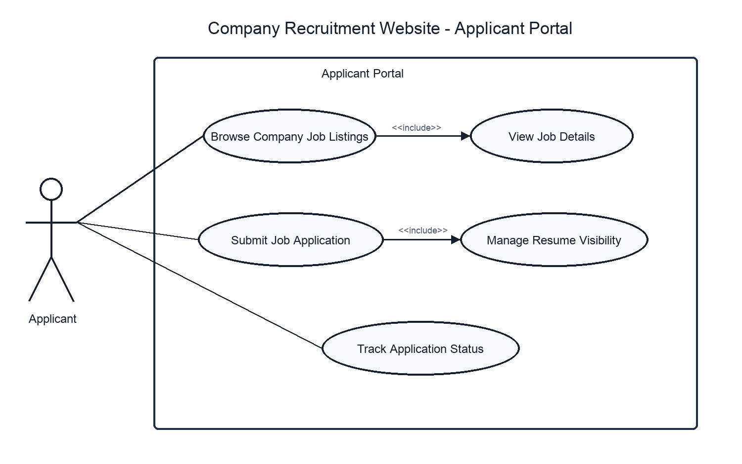
The updated use case follows one applicant path
The diagram now works like a directory for the later wireframes and implementation.
Main use cases
1. Browse company jobs
2. View role details
3. Submit application
4. Manage resume visibility
5. Track application status
Notes:
This is the updated use case diagram. It is less dense and each use case has a clear connection to one or more wireframe pages.
[Sources]
User-created project files in this workspace: updated use case report, Figma SVG wireframes, and HTML implementation.

Slide 5
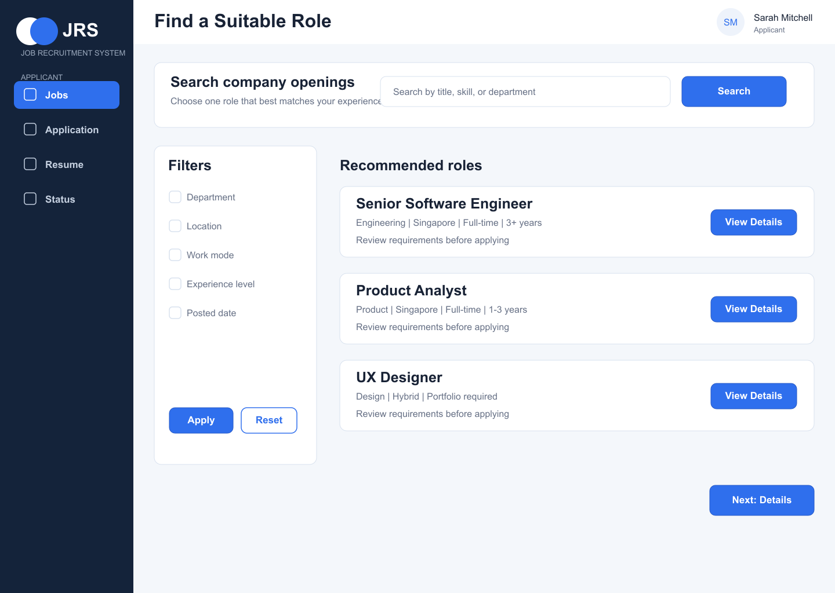
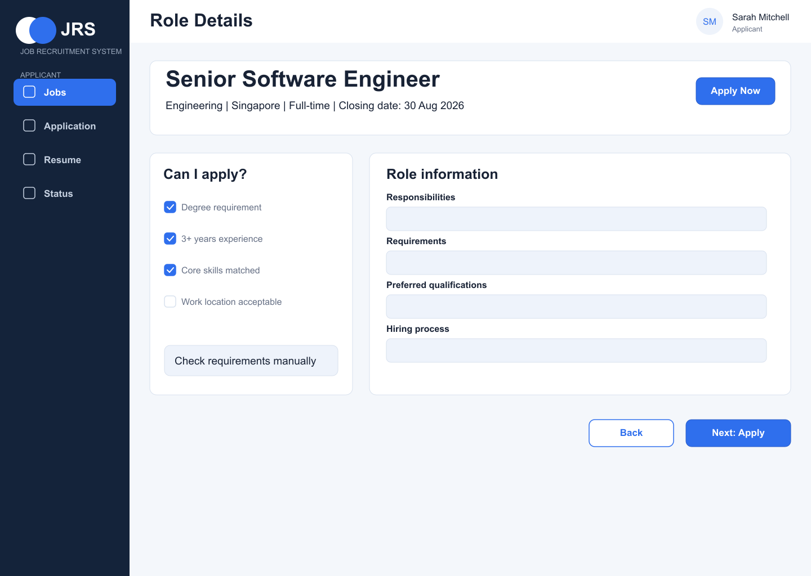
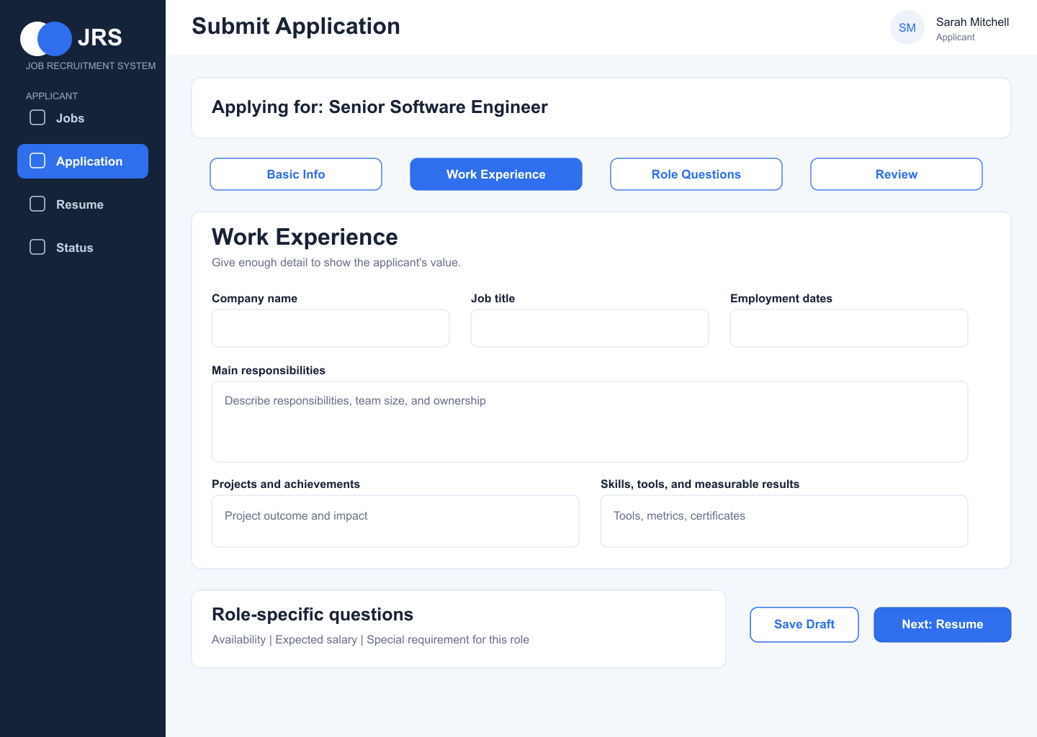
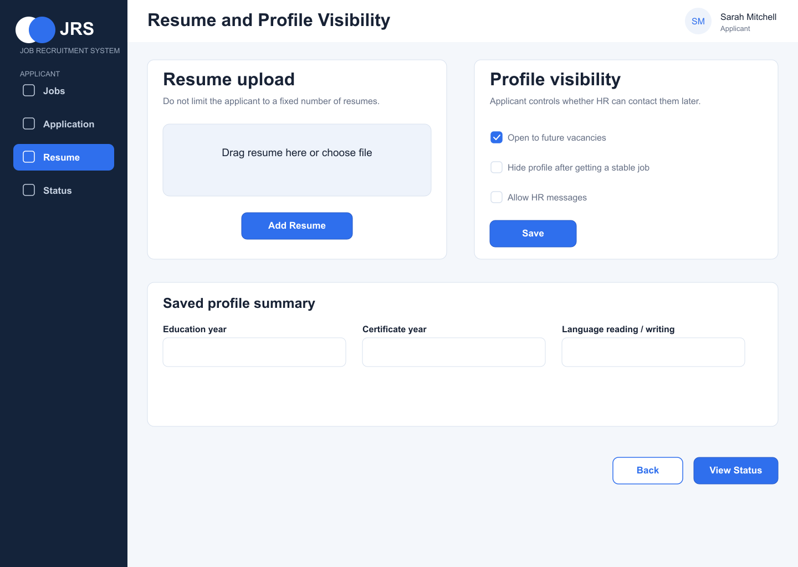
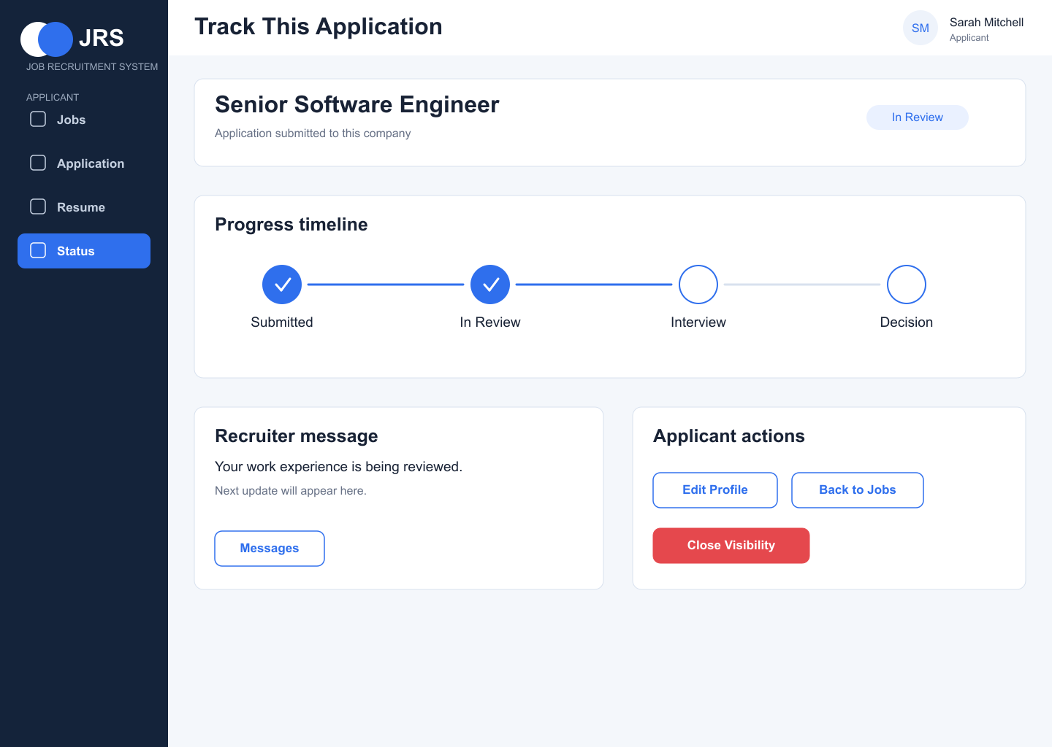
The wireframes connect as one applicant flow
Each page supports the next decision instead of showing unrelated information.
→
→
→
→
Find role
Read details
Apply
Resume setting
Track status
The flow supports one serious application for a suitable role, not many random applications.
Notes:
The five wireframes are connected. The applicant searches for a role, checks the details, submits one focused application, controls resume visibility, and tracks the application.
[Sources]
User-created project files in this workspace: updated use case report, Figma SVG wireframes, and HTML implementation.

Slide 6
The application form gives more space to experience
This change matches the feedback that work experience is the applicant's main value.
Design changes
• Larger work experience section
• Separate role-specific questions
• Clear save draft and submit actions
• Fewer unrelated fields
Notes:
For the application page, I gave more space to work experience because this is where the applicant can show value. I also separated special requirements because each job may ask different questions.
[Sources]
User-created project files in this workspace: updated use case report, Figma SVG wireframes, and HTML implementation.

Slide 7
The first page was implemented with HTML, CSS, and JavaScript
The prototype demonstrates search and filtering for company job postings.
<input id="searchInput">
<button onclick="filterJobs()">Search</button>
function filterJobs() {
// Filter company job cards
}
Implemented features
• Company job search
• Filter-friendly job cards
• View Details / Apply buttons
• Responsive visual layout
File: web/01_jobs_search/index.html
Notes:
In the implementation part, I practised HTML structure, CSS layout, and simple JavaScript filtering. This is the first working page and it connects to the job search wireframe.
[Sources]
User-created project files in this workspace: updated use case report, Figma SVG wireframes, and HTML implementation.

Slide 8
This revision made the applicant side more realistic
The next stage is to continue turning the wireframes into working webpages.
What I learned
What improved
Next step
Use cases should match the real user and project scope.
The pages are clearer, less crowded, and easier to implement.
Build the remaining applicant pages and connect them in the prototype.
Notes:
To conclude, this revision made my applicant-side design more realistic. Next, I will continue building the remaining pages and connect them into a more complete prototype.
[Sources]
User-created project files in this workspace: updated use case report, Figma SVG wireframes, and HTML implementation.

