Slide 1
HTTP 5201
Security & Quality Assurance
Sean Doyle

Slide 2
User testing
Lesson 4

Slide 3
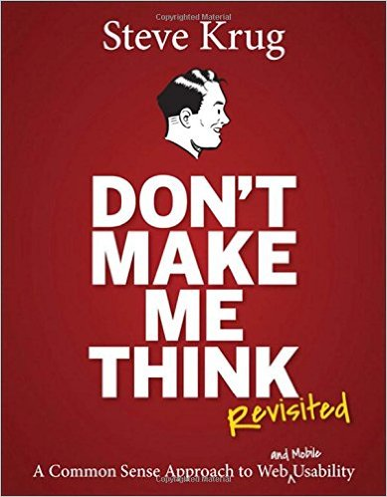

STEVE KRUG

Slide 4
DEFINITION
Usability Testing:
"Watching people try to use what you're creating/designing/building…with the intention of (a) making it easier for people to use or (b) proving that it is easy to use."
Krug, Steve. Rocket Surgery.

Slide 5
Types of Usability Testing
Quantitative
Qualitative
Minimize interaction with participants
Strict adherence to testing protocol
10 + participants
Seeks to prove something with data
Frequent interaction with participants
Allows for changes to protocol mid-test
3 participants
Seeks to gain insight

Slide 6
Test "participants"
"In usability testing, we call the people we're observing "test participants", not "test subjects" to remind ourselves that we really aren't testing them – we're testing the thing they're using."

Slide 7
Reasons for Informal "Do-it-yourself" Usability Testing
Can't afford full testing
Higher Ups don't believe in it
Take matters into your own hands
Catching issues sooner saves time & money

Slide 8
The point
"…identify major problems and make the thing better by fixing them."

Slide 9
The hope
To be surprised.
The most exciting phrase to hear in science, the one that heralds new discoveries, is not “Eureka!”but “That's funny...”
- Isaac Asimov

Slide 10
Why bother with getting users?
Developers make bad testers because we know how things are supposed to work.
The client and the team are often too close to see the obvious.
"Testing with five users will find 85% of problems." (Krug, Steve. Rocket Surgery.)

Slide 11
When do I start testing?
"Start earlier than it make sense."(Krug, Steve. Rocket Surgery.)
Common Objections
"We don't have enough done yet."
"It's too rough."
"Why waste people's time looking at something we know we're going to change?"

Slide 12
Testing Early
Before a re-design
  test on the old site
  Test on a competitors site
  Learn from others what works and what doesn't
Card sorting
Wireframes
Mock-ups
Paper Prototypes
"Can you tell me what you make of this? What do you think this is supposed to be?" (Krug, Steve. Rocket Surgery)
Not, "Do you like it?", or "What do you think of this?"
Not seeking their opinion, but their understanding.

Slide 13
Creating your Test
Select tasks to test (5-10 most important user goals)
Turn tasks into scenarios
  "You are…" "You need to…"
  Provide any additional required info (user/password etc)
Beware of TMI! Don't give your test participants clues that will help them: "Search 'waffles blueberry'"
Instruct them not to use the search bar
Do pilot test first
Refine based on pilot test and print off new test for test participant to use
Print out the scenarios

Slide 14
CREATING A test
Google Search

Slide 15
Running the Test
Welcome & introduction (Krug script)
Review home page first
Proceed with scenarios

Slide 16
Observing the Test
Recording the test.
Clarify their comments.
Be careful not to give clues
Remain neutral? "Don't express your opinion- or even agree with theirs."
"What are you thinking right now?"
Timing the test and activities.

Slide 17
observing A test
Google Search

Slide 18
When to Move On
"As soon as you lose the feeling that you're certain what they're thinking, it's time to ask."
"…when it starts to feel like you're not likely to learn anything more continuing, let them continue a little bit longer and the move on. About half the time something useful will happen in this 'overtime'".
Breaking eye contact

Slide 19
After the Test
Post-test survey or "Do you have any questions for me?"
Complete notes and create report while fresh in your mind
Discuss with observers/stake-holders while fresh in your mind
Create a report while fresh in your mind

Slide 20
Between Tests
Before the next user…
Finish your notes
Clear cache & browsing history

Slide 21
Running A test
Humber Student Work Placement Services

Slide 22
Reporting on your Tests
Testing Information
The Report
Name of site
Relevant urls
Name of tester
Date tested
Description of test (or add as appendix)
Observations(by participant)
Issues Discovered
"What's the smallest, simplest change we can make that's likely to keep people from having the problem we observed?"
"Tweak, don’t redesign"
"Take something away"
Humber Coop Website
coop.humber.ca
Sean Doyle Feb 4, 2016
Tests Run (see appendix A)
Ravi
(observations)
Sheila
(observations)
Marie
(observations)
Usability Issues Discovered
Issue 1
Issue 2

Slide 23
For more info…
Website: http://www.sensible.com/rsme.html
Demo Test: https://www.youtube.com/watch?v=QckIzHC99Xc&feature=player_embedded

Slide 24
User testing
Lesson 4

