Slide 1

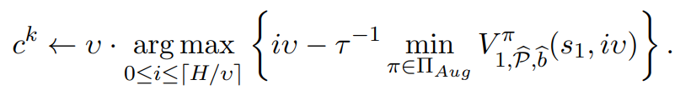
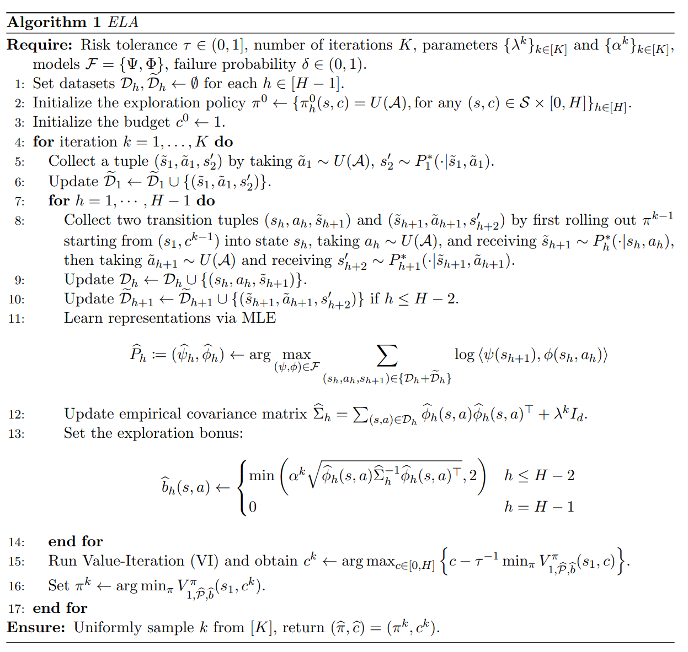
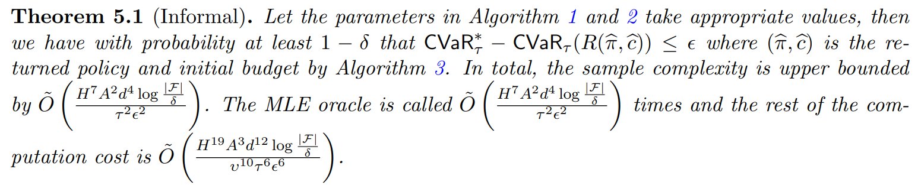
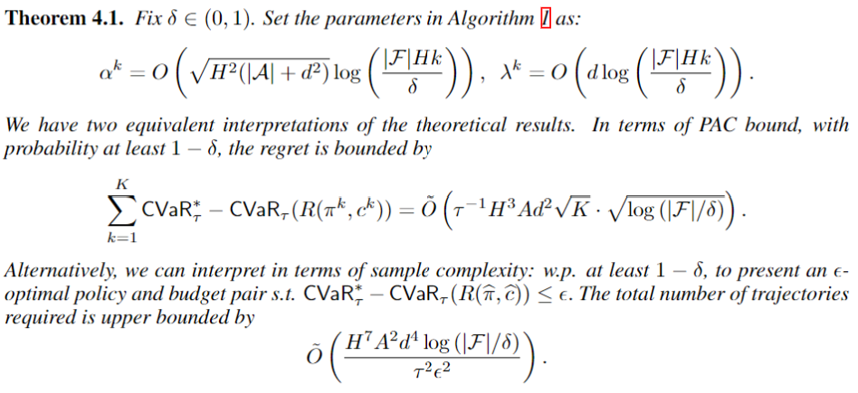
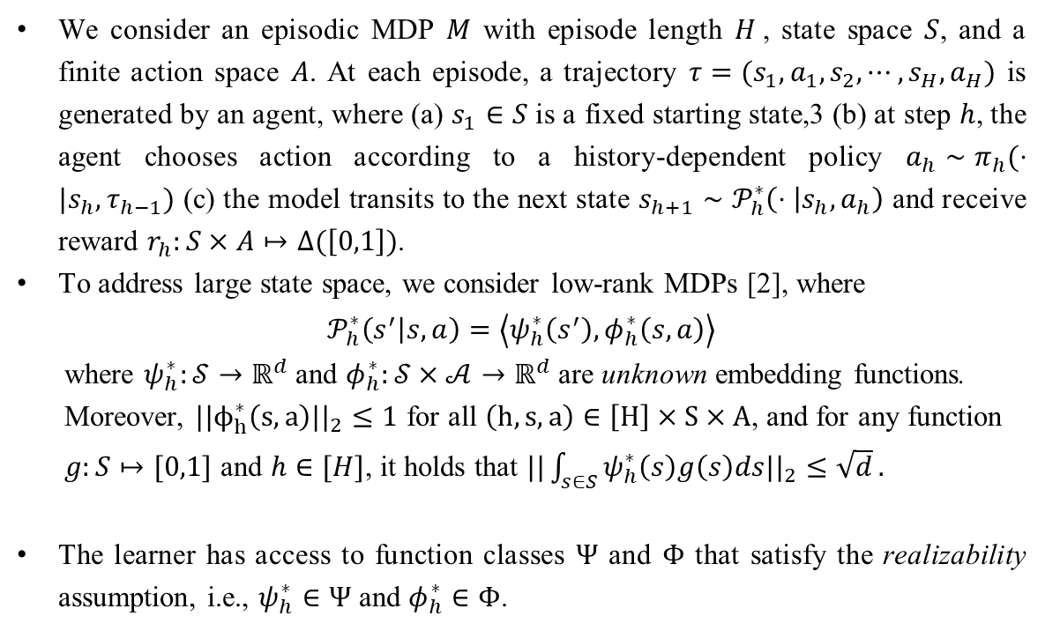
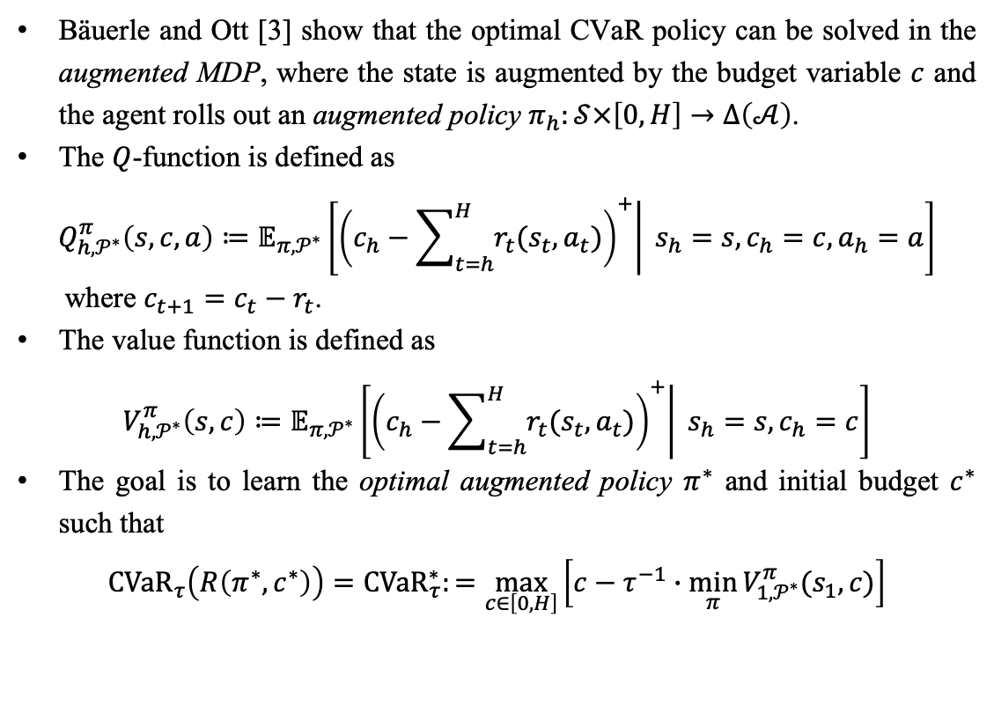
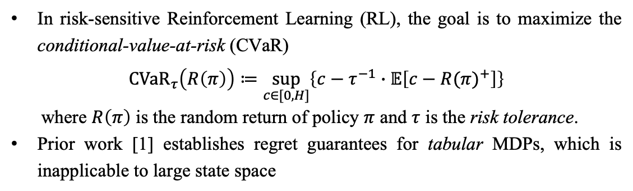


Provably Efficient CVaR RL in Low-rank MDPs
Yulai Zhao*, Wenhao Zhan*, Xiaoyan Hu*,
Ho-fung Leung, Farzan Farnia, Wen Sun, Jason D. Lee
Motivation
Main Results
In risk-sensitive Reinforcement Learning (RL), the goal is to maximize the conditional-value-at-risk (CVaR)
$${CVaR}_{τ}\left(R\left(π\right)\right)≔\sup_{c∈[0,H]}\left\{c−τ^{−1}∙𝔼\left[{c−R(π)}^{+}\right]\right\}$$
where $R\left(π\right)$ is the random return of policy $π$ and $τ$ is the risk tolerance.
Prior work [1] establishes regret guarantees for tabular MDPs, which is inapplicable to large state space
1. ELA (REprensentation Learning for CVAR)
2. ELLA (REprensentation Learning with LSVI for CVAR)
This algorithm has the following key components.
Data Collection (Lines 8-10). We collect two (disjoint) sets of transition tuples to compute the bonus terms and estimate the transition kernels. These two datasets are different in their (marginalized) distributions and facilitate the regret analysis.
MLE oracle (Line 11). Model transitions are estimated through the MLE oracle.
Value Iteration (Line 15). Based on the learned model, the algorithm runs Value-Iteration (VI) with the exploration bonus term. Such a value function is used to perform VI and update policy on the learned model $\hat{P}$, since the learner has no prior knowledge of the real model transitions. Therefore, obtaining an accurate estimation of the model determines the quality of the output policy.
We remark that the exact VI in Line 15 is not computationally efficient due to the continuity of $c$ and potentially large state space $S$. To overcome such a computational barrier, in the next algorithm, we provide a computationally efficient planning oracle that performs LSVI with discretized reward function (with sufficiently high precision).
In Algorithm 1, the VI in line 15 is not computational efficient since objective $c− τ^{−1}\underset{ }{\min_{π} V_{1,\hat{P}, \hat{b}}^{π}(s_{1},c)}$ is not concave, which brings significant computational overhead.
We introduce a feasible planning oracle for this step and provide the corresponding theoretical guarantees.
For simplicity, we assume the reward distribution $r$ is discrete and $r_{h}(s,a)$ only takes value in $i υ$ where $υ>0$ and $0≤i≤⌈\frac{1}{υ}⌉$. Under the discreteness, when the reward $r_{h}$ is discrete, we can only search $c^{k}$ within the grid in Line 15 of Algorithm 1:
For this objective we introduce a novel LSVI-UCB, stated in Algorithm 2.
For a continuous $r$, we can discretize it with sufficiently high precision so that all the analysis still applies. Combining Algorithm 1 and 2, we can derive a computationally efficient algorithm, called ELLA, for CVaR objective in low-rank MDPs, which is shown in ELLA Algorithm.
Theoretical guarantees. Particularly, the following theorem characterizes the computational cost for finding an ϵ-optimal policy
Contributions
We study CVaR RL in low-rank MDPs [2], where the transition kernel admits unknown low-rank decomposition and the state space can be arbitrarily large
We propose REpresentation Learning for CVaR (ELA), an online algorithm that learns a near-optimal policy with polynomial sample complexity
Computational-wise, we propose REpresentation Learning with LSVI for CVaR (ELLA) as an efficient oracle to compute a near-optimal policy in the learned model, i.e., linear MDPs
To our knowledge, this is the first provably sample-efficient and computation-efficient CVaR RL algorithm in low-rank MDPs.
Problem Setup
1. Risk-Sensitive RL and Augmented MDP
Bäuerle and Ott [3] show that the optimal CVaR policy can be solved in the augmented MDP, where the state is augmented by the budget variable $c$ and the agent rolls out an augmented policy $π_{h}:𝒮×\left[0,H\right]→Δ\left(𝒜\right)$.
The $Q$-function is defined as
$$Q_{h,𝒫^{∗}}^{π}\left(s,c,a\right)≔𝔼_{π,𝒫^{∗}}\left[\left.{\left(c_{h}−\sum_{t=h}^{H}{r_{t}(s_{t},a_{t})}\right)}^{+}\right| s_{h}=s,c_{h}=c, a_{h}=a\right]$$
where $c_{t+1}=c_{t}−r_{t}$.
The value function is defined as
$$V_{h,𝒫^{∗}}^{π}\left(s,c\right)≔𝔼_{π,𝒫^{∗}}\left[\left.{\left(c_{h}−\sum_{t=h}^{H}{r_{t}(s_{t},a_{t})}\right)}^{+}\right| s_{h}=s,c_{h}=c\right]$$
The goal is to learn the optimal augmented policy $π^{∗}$ and initial budget $c^{∗}$ such that
$${CVaR}_{τ}\left(R\left(π^{∗},c^{∗}\right)\right)={CVaR}_{τ}^{∗}:=\max_{c∈\left[0,H\right]}\left[c−τ^{−1}∙\min_{π}{V_{1,𝒫^{∗}}^{π}(s_{1},c)}\right]$$
Acknowledgements
The work presented in this paper is partially supported by a research grant from the Research Grants Council, Hong Kong, China (RGC Ref. No. CUHK 14206820).
References
[1] Wang, Kaiwen, Nathan Kallus, and Wen Sun. "Near-Minimax-Optimal Risk-Sensitive Reinforcement Learning with CVaR." arXiv preprint arXiv:2302.03201 (2023).
[2] Agarwal, Alekh, et al. "Flambe: Structural complexity and representation learning of low rank mdps." Advances in neural information processing systems 33 (2020): 20095-20107.
[3] Bäuerle, Nicole, and Jonathan Ott. "Markov decision processes with average-value-at-risk criteria." Mathematical Methods of Operations Research 74 (2011): 361-379.
[4] Jin, C., Yang, Z., Wang, Z., and Jordan, M. I. (2020). Provably efficient reinforcement learning with linear function approximation. In Conference on Learning Theory, pages 2137–2143. PMLR.
[5] Uehara, M., Zhang, X., and Sun, W. (2022). Representation learning for online and offline RL in low-rank MDPs. In International Conference on Learning Representations.
[6] Chow, Y. and Ghavamzadeh, M. (2014). Algorithms for CVaR optimization in MDPs. Advances in neural information processing systems, 27.
[7] Osbert Bastani, Jason Yecheng Ma, Estelle Shen, and Wanqiao Xu. Regret bounds for risk-sensitive reinforcement learning. Advances in Neural Information Processing Systems, 35:36259–36269, 2022.
Audrey Huang, Jinglin Chen, and Nan Jiang. Reinforcement learning in low-rank MDPs with density features. arXiv preprint arXiv:2302.02252, 2023.
[8] Y. Du, S. Wang, and L. Huang. Provably efficient risk-sensitive reinforcement learning: Iterated cvar and worst path. In The Eleventh International Conference on Learning Representations, 2022.
[9] Y. Chen, Y. Du, P. Hu, S. Wang, D. Wu, and L. Huang. Provably efficient iterated cvar reinforcement learning with function approximation. arXiv preprint arXiv:2307.02842, 2023.
2. Low-rank MDPs
Theoretical guarantees. This presents the first regret/sample complexity bounds for CVaR RL with function approximation, in which exploring the unknown action/space spaces posits extra difficulty.
We consider an episodic MDP $M$ with episode length $H$, state space $S$, and a finite action space $A$. At each episode, a trajectory $τ=(s_{1},a_{1},s_{2},⋯, s_{H},a_{H})$ is generated by an agent, where (a) $s_{1}∈S$ is a fixed starting state,3 (b) at step $h$, the agent chooses action according to a history-dependent policy $a_{h}∼π_{h}(⋅|s_{h}, τ_{h−1})$ (c) the model transits to the next state $s_{h+1}∼𝒫_{h}^{∗}\left(⋅ | s_{h},a_{h}\right)$ and receive reward $r_{h}:S×A↦Δ(\left[0,1\right])$.
To address large state space, we consider low-rank MDPs [2], where
$$𝒫_{h}^{∗}\left(s^{′} | s,a\right)=\left\langle ψ_{h}^{∗}\left(s^{′}\right),φ_{h}^{∗}\left(s,a\right)\right\rangle$$
where $ψ_{h}^{∗}:𝒮→ℝ^{d}$ and $φ_{h}^{∗}:𝒮×𝒜→ℝ^{d}$ are unknown embedding functions.
Moreover, $||ϕ_{h}^{∗}\left(s,a\right)||_{2}≤1$ for all $\left(h,s,a\right)∈\left[H\right]×S×A$, and for any function
$g:S↦[0,1]$ and $h∈[H]$, it holds that $||\int_{s∈S}{ψ_{h}^{∗}\left(s\right)g\left(s\right)ds||_{2}≤\sqrt{d}}.$
The learner has access to function classes $Ψ$ and $Φ$ that satisfy the realizability assumption, i.e., $ψ_{h}^{∗}∈Ψ$ and $φ_{h}^{∗}∈Φ$.

